Slide 1
Audiovision
Team Codescapes
Miguel Vazquez and Luc Tang

Slide 2
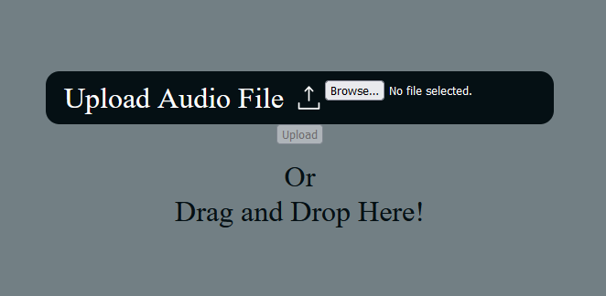
Back-end updates:
Blocks:
Learning React + css
Front-end not formatted
No Drag and drop yet
Accomplished:
Links now public
Audio objects → MongoDB
Can upload from front-end

Slide 3
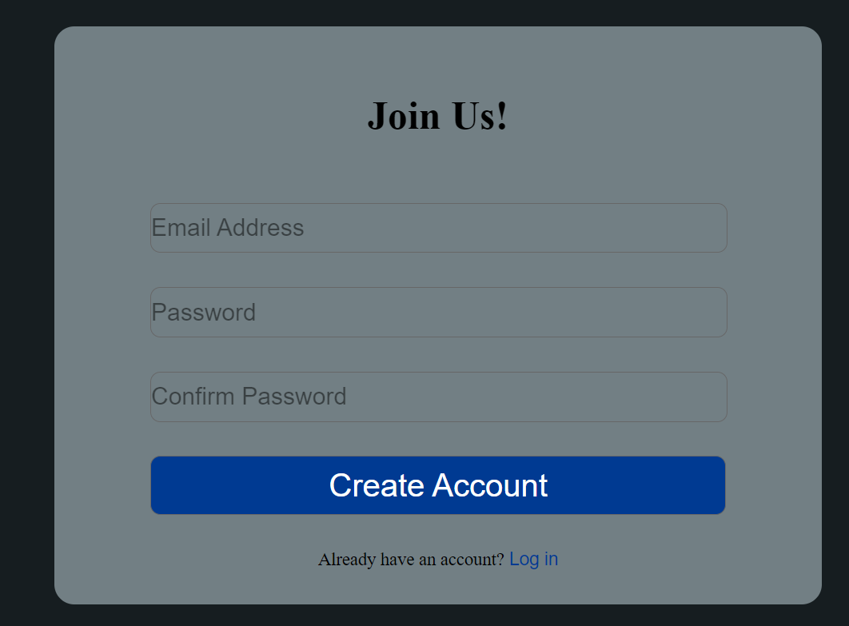
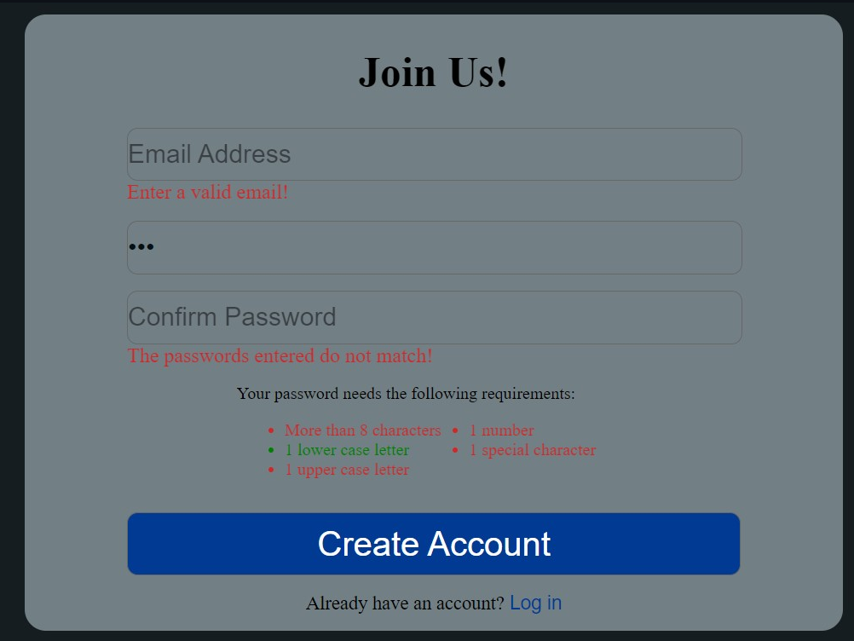
Front-end updates:
Accomplished:
Connected the signup page to the server.
Fixed user-input validation.
Handled when a user tries to create an account with an email already in use.

Slide 4
Milestones:
1
2
3
4
Finish back-end
Build front-end
Audio Visualizers
Integrate front-back
Test s3 connection
Sync s3 and mongoDB
Refine UI sketches
Implement main page
Implement login page
Sign up functionality
Audio upload
Create 2 sketches
Implement customizability

Slide 5
Testing plan
Account creation / login
Uploading and retrieving audio
Downloading Output Video

Slide 6
Deepcourse’s Feedback
Red and green text on sign up page is hard to read
No need to show passing requirements
Framework looks good

Slide 7
Response to Deepcourse
Font colors and UI will be adjusted as suggested

