Slide 1
Audiovision
Team Codescapes
Miguel Vazquez and Luc Tang

Slide 2
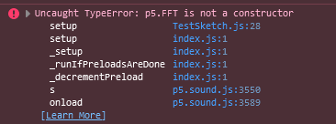
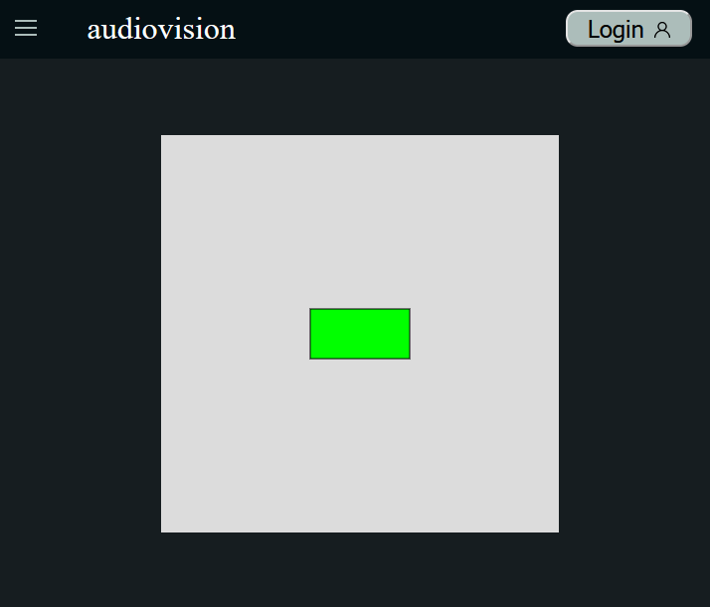
Back-end updates:
Blocks:
Trying to use uploaded audio in sketch
Accomplished:
Audio playback
Click to play/pause

Slide 3
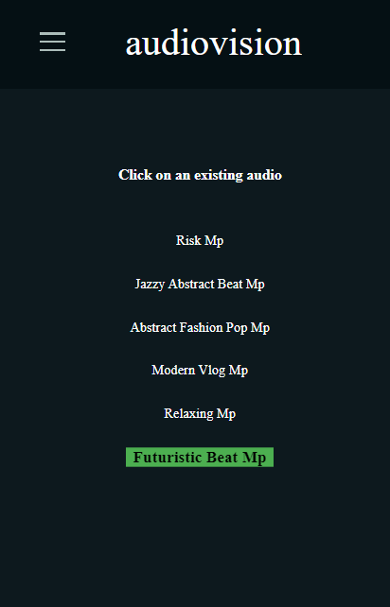
Front-end updates:
Accomplished:
Added audios to the database to be used by guest users
Created the API to get those audios in the client
The client can see the audios and select them
Added animations
Blockers:
Need to send to the visualization page

Slide 4
Milestones:
1
2
3
Finishing touches
Finalize prototype
Non-essential features
Working audio-reactive sketch
Dynamic parameters
Test for and fix bugs
Present working prototype
Exporting audio visual
Redesigning colors

Slide 5
Hosting methods
Several web hosting services offer free plans for students
InfinityFree
AwardSpace
000webhost

Slide 6
Feedback from Two Seniors
Add instructions on how to install prerequisites
Logging in needs some feedback on what the status of the account creation/log in is
More status messages throughout website
Cookies and upload audio working
Easy setup
Response:
Bugs will be fixed throughout the next weeks
More messages will be displayed for users

Slide 7
Demo!

Slide 8
Feedback from Team Treehouse
Setup feedback:
Clear and concise documentation. Setup was easy and straightforward.
App feedback:
Organized layout and clean UI.
Login functionality works as expected.
Looking forward to the completion of the visualization feature!

