Slide 1
Audiovision
Team Codescapes
Miguel Vazquez and Luc Tang

Slide 2
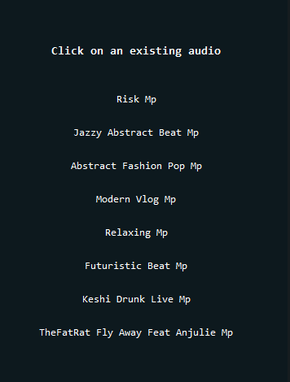
Back-end updates:
Accomplished:
Fixed guest page visualization not working
Created user audio libraries

Slide 3
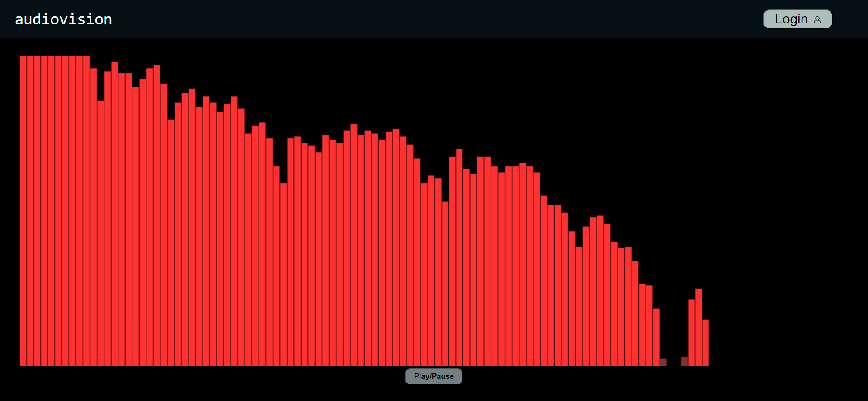
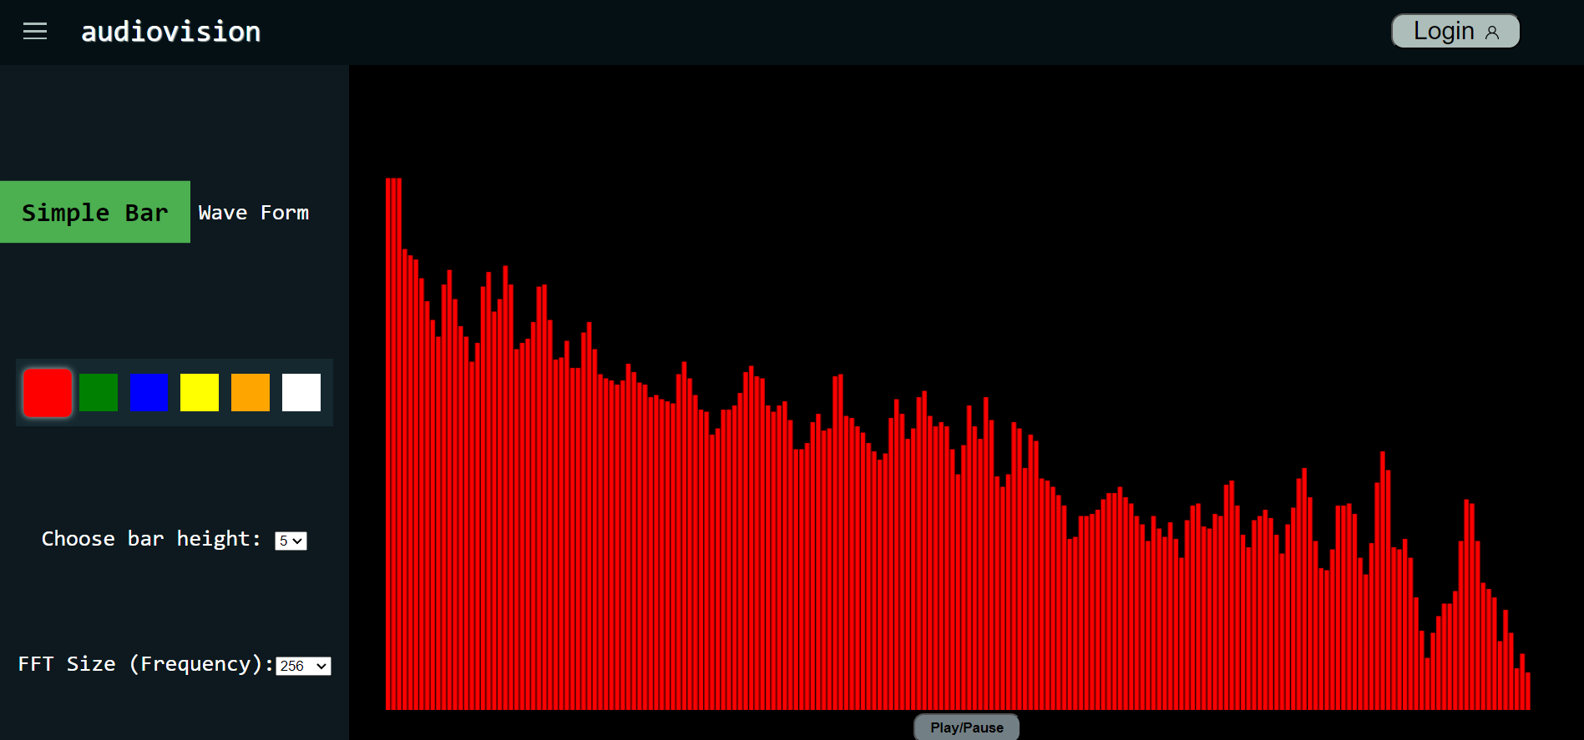
Front-end updates:
Accomplished:
Fixed bugs in visualization page
Started implementing a waveform visualization
Created SketchMenu
Started adding customization to sketches

Slide 4
Feature Status
Completed:
User Registration/Login
Select/Upload audio
Create visualization from audio
Uncompleted:
Visual customization menu
Download visualization
May not implement
Drag and drop a file

Slide 5
Hosting methods
Amazon EC2 for frontend
Amazon DocumentDB/AWS for mongoDB hosting

Slide 6
Demo!

Slide 7
Feedback from Team Thrive Today
- Great looking website, home page is very unique
- Color picker wasn't working

