Slide 1
Web Audio Visualizer
Team Codescapes
Miguel Vazquez and Luc Tang

Slide 2
Project Description
A Website where the users can upload or select an audio file to generate reactive visuals.
The website will generate customizable visuals based on properties of the audio file.
The user will be able to select from a variety of different styles and color pallets for the visuals being displayed.

Slide 3

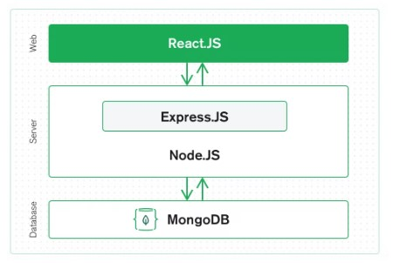
Technology tools
We’ll make use of the MERN stack.
M - MongoDB
E - Express
R - React (p5.js)
N - Node.js
(Audio analysis)

Slide 4
Milestones:
1
2
3
Set up Github
UI sketches
Create 14 Week plan
Prototype done by April 3rd
Login page
Main page
4
5
6
Set up IDE
Build back-end
Start front-end
✅Database connected
Build REST API
Refine UI sketches
Implement main page

Slide 5
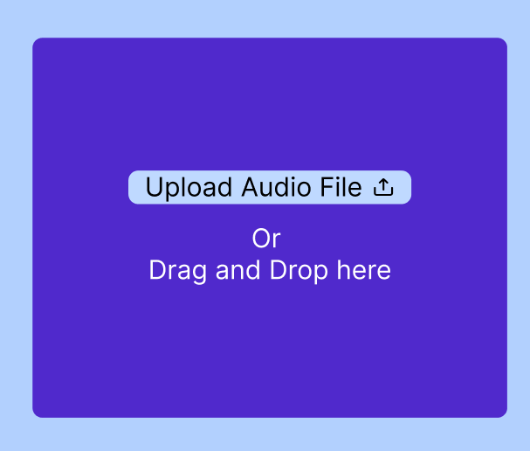
Use cases
The user can upload an audio file by clicking on the button that says “Upload Audio File”.
The user can also drag and drop the audio file into a drag and drop area.

Slide 6
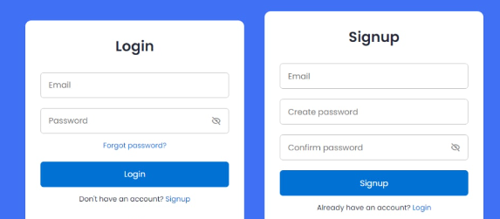
Login and sign up
The users will be able to create an account to access more features like downloading a video of the visualizations.

Slide 7
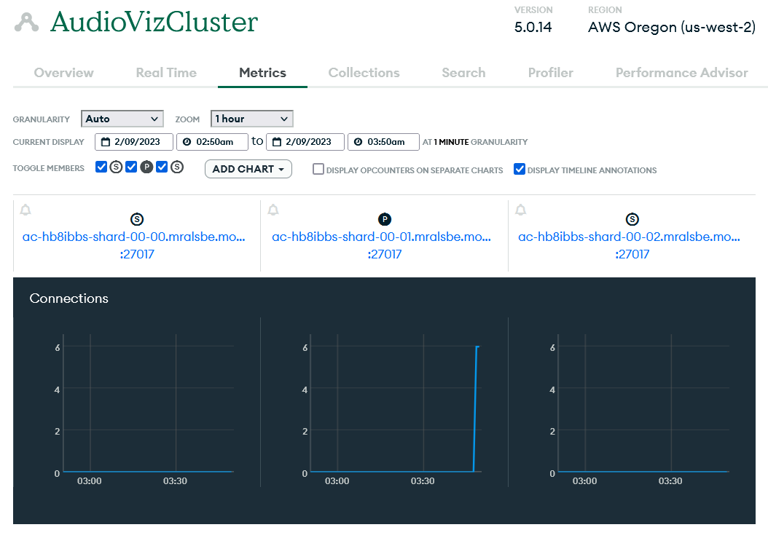
MongoDB

Slide 8
Feedback
Ideas that inspired our team
We liked how the Codescapes team created a timeline for the entire project
Technologies used in both teams
Both of our teams are using MERN stack, so we can collaborate with each other here
Suggestions for team Codescapes
Map out the different components in your website before jumping into code

