Slide 1
Audiovision
Team Codescapes
Miguel Vazquez and Luc Tang

Slide 2
Back-end updates:
Blocks:
Not much REST documentation
Accomplished:
Implemented posting audio to s3 and mongoDB (aws-connection)

Slide 3
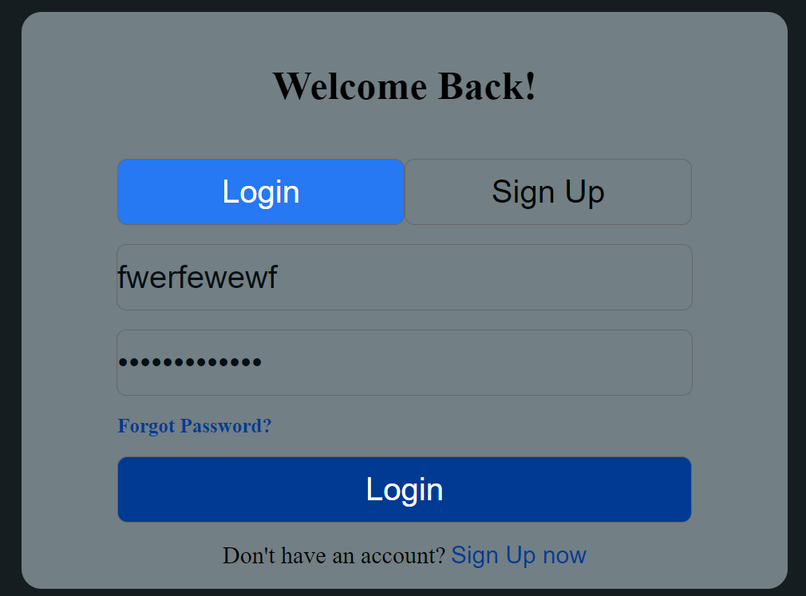
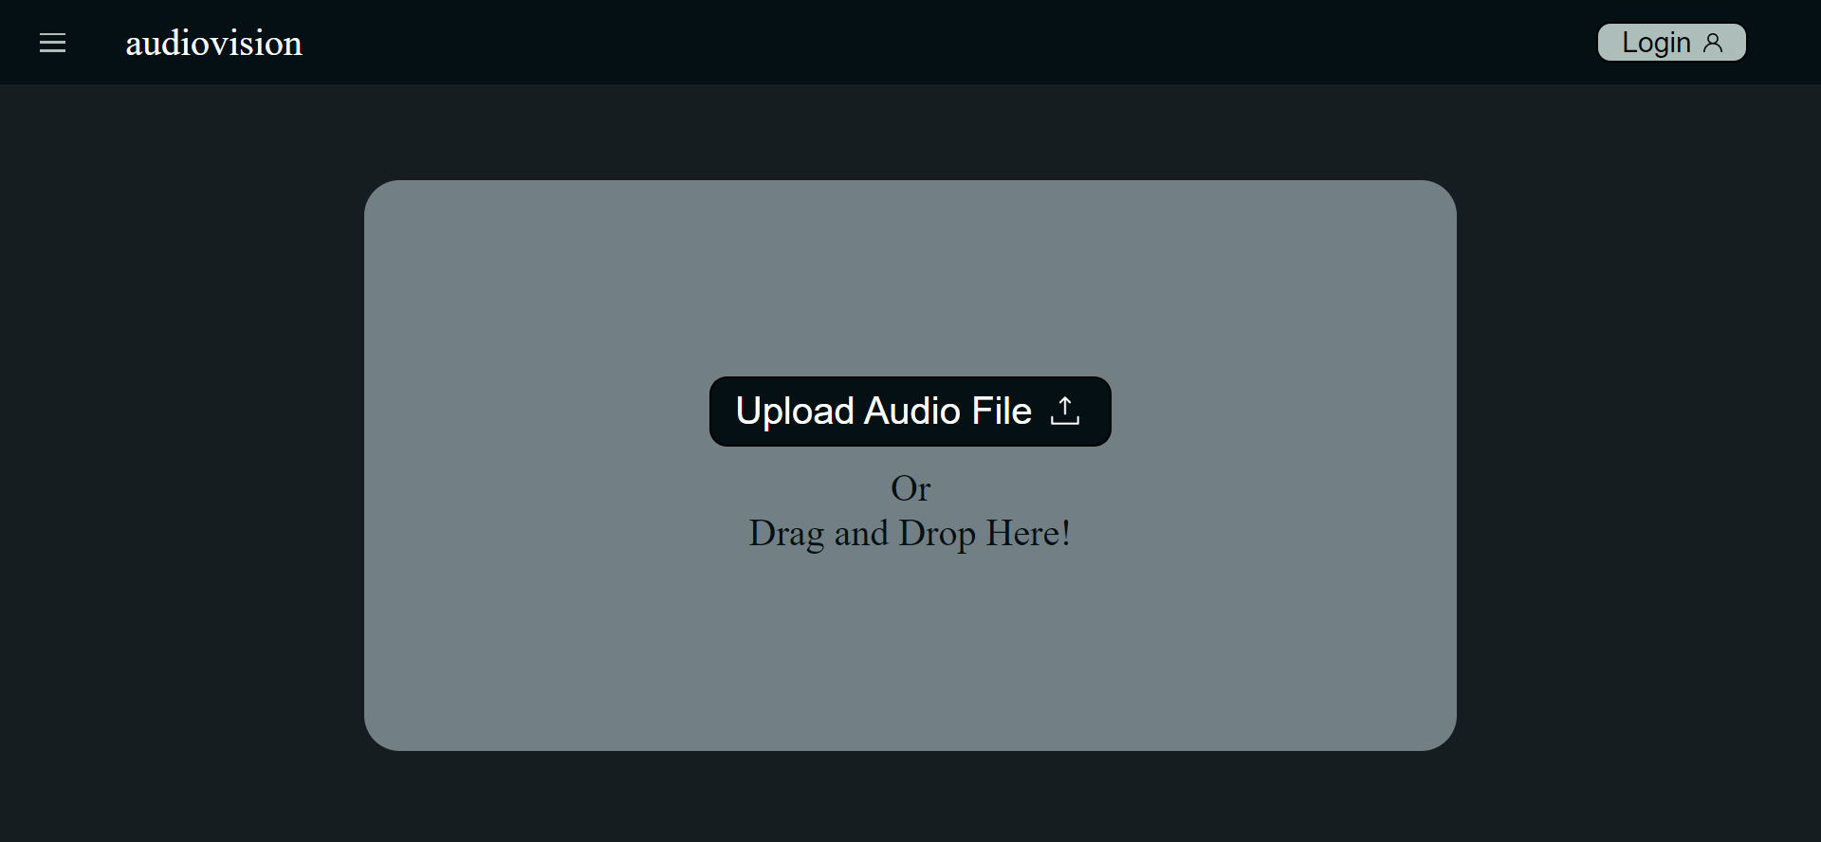
Front-end updates:
Accomplished:
Implemented the initial design of the upload page
Implemented the login/sign up page.
Utilized React Router to connect the pages

Slide 4
Milestones:
1
2
3
4
Improve back-end
Build front-end
Complete back-end
Integrate front-back
Connect to s3
Separate API calls by page
Test s3 connection
Sync s3 and mongoDB
Refine UI sketches
Implement main page
Implement login page
Login functionality
Audio upload
Start p5.js sketches

Slide 5
Documentation
Installation
Clone the repository using the following command:
git clone https://github.com/poke8014/CS161.git
Move to the dev folder
Change your working directory to config
Create a config.json file using the template config.example.json file.
Fill in the required API keys in the config.json file.
Return to the dev folder
Install dependencies by running the following command:
“npm install”
Start the app with the following command:
“npm run start”
The server should now be running on http://localhost:8000 and the front-end will be running on http://localhost:3000.

Slide 6
ThriveToday’s Feedback
Project very easy to set up
One command to set up server and front-end is convenient
Not necessary if server is deployed

Slide 7
Response to ThriveToday
Hosting is ideal
Deployment will be high priority if we have time
Not ideal long term without a free option, but the experience is necessary

