Slide 1
Audiovision
Team Codescapes
Miguel Vazquez and Luc Tang

Slide 2
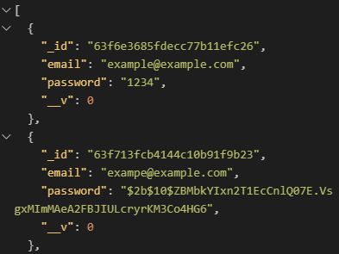

Back-end updates:
Blocks:
Merge conflict!!
Accomplished:
Tested CRUD
Passwords hashed
Unique emails in database

Slide 3
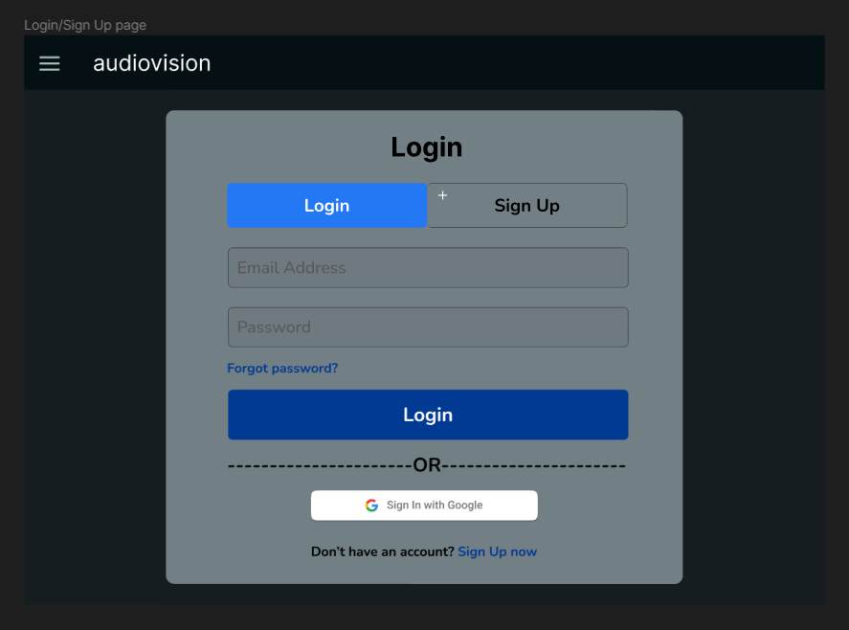
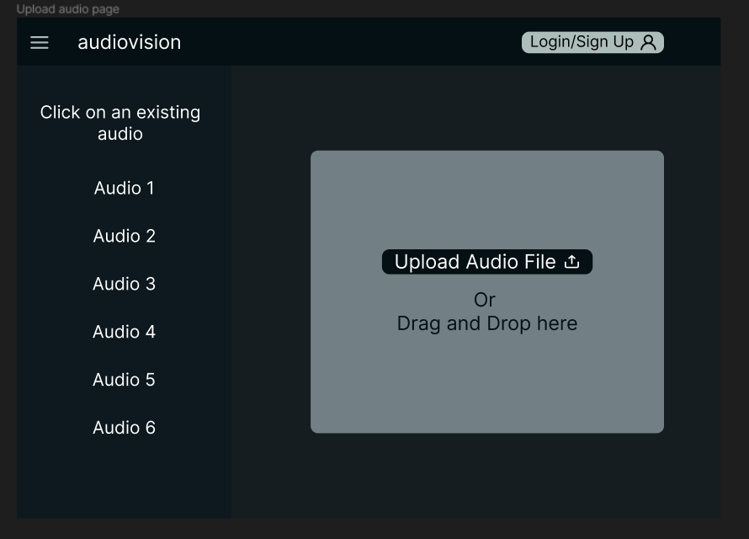
Front-end updates:
Accomplished:
Implemented the initial design of the upload page
Created the components:
Menu
NavBar
Refined the UI/UX designs

Slide 4
Milestones:
1
2
3
4
Build back-end
Improve back-end
Build front-end
Integrate front-back
Database connected
REST API
Test API calls
Connect to s3
Separate API calls by page
Refine UI sketches
Implement main page
Login page
Start p5.js sketches

Slide 5
Front-end Documentation
Installation
Clone the repository using the following command:
git clone https://github.com/poke8014/CS161.git
Move to the client folder inside of dev
Run the following command:
npm install <<<<< this command will install the required dependencies
Running the React Project
Use the following command to run the React Project:
npm start
The React project should be running on http://localhost:3000/

Slide 6
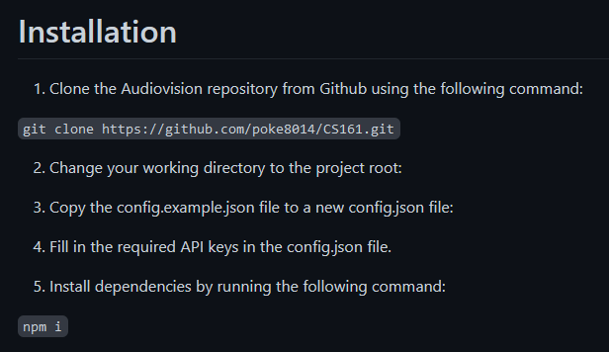
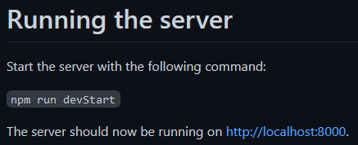
Back-end Documentation*
*Documentation will also merge after PR approved!!

Slide 7
Feedback from Team Treehouse
User Experience
Not much developed at the moment
Server updates instantly
Database connectivity verified
Use Cases/Manual
Straightforward application
Simple to use

