Slide 1
Audiovision
Team Codescapes
Miguel Vazquez and Luc Tang

Slide 2
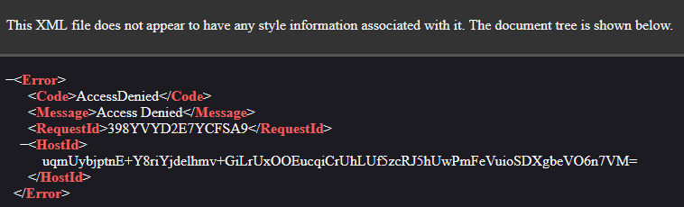
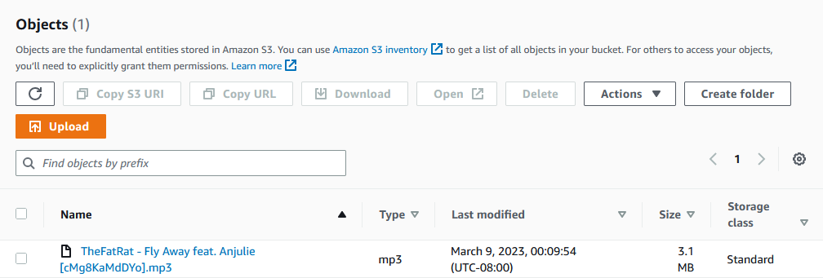
Back-end updates:
Blocks:
Cannot access audio file via link
Accomplished:
De-bugged s3 API
Posted first audio file to database!

Slide 3
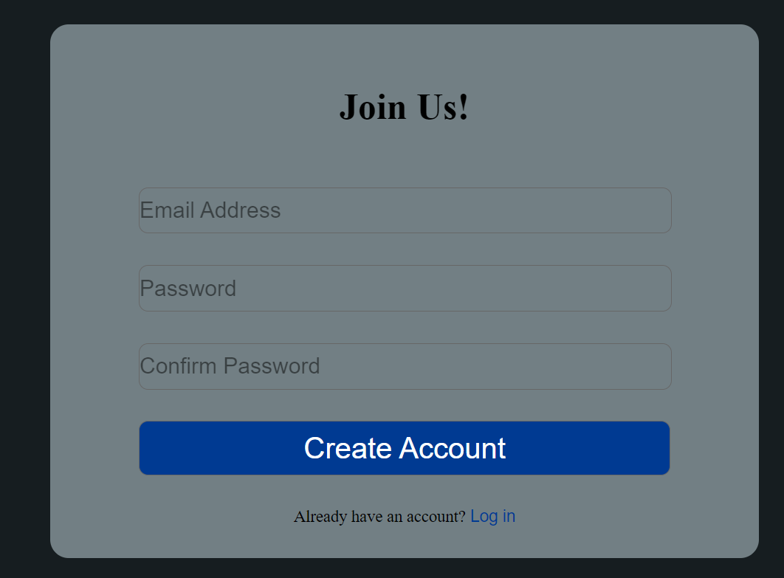
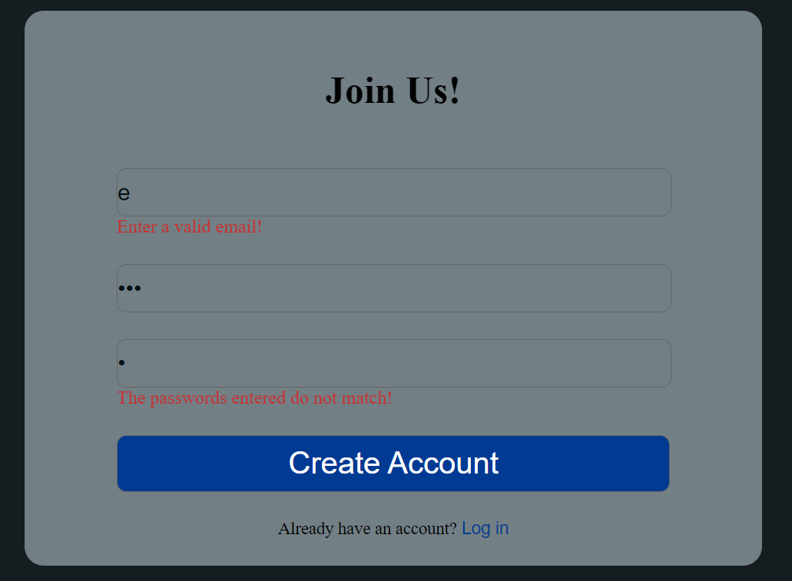
Front-end updates:
Accomplished:
Connected the signup page to the server.
Added user-input validation
Updated the Menu component to make it reusable in other pages.

Slide 4
Milestones:
1
2
3
Finish back-end
Build front-end
Integrate front-back
Test s3 connection
Sync s3 and mongoDB
Refine UI sketches
Implement main page
Implement login page
Sign up functionality
Audio upload
Start p5.js sketches

Slide 5
Documentation
Installation
Clone the repository using the following command:
git clone https://github.com/poke8014/CS161.git
Move to the dev folder
Change your working directory to config
Create a config.json file using the template config.example.json file.
Fill in the required API keys in the config.json file.
Return to the dev folder
Install dependencies by running the following command:
“npm install”
Start the app with the following command:
“npm run start”
The server should now be running on http://localhost:8000 and the front-end will be running on http://localhost:3000.

Slide 6
Luna R’s Feedback
- Easy setup - documentation was easy to follow, except for expert_users installation instruction can add more explanations for “Fill in the required API keys in the config.json file.”
Clean UI

Slide 7
Response to Luna R
We need to work on making the setup simpler.

Slide 8
Feature wanted: Superuser account
Won’t take too much time
Lower priority feature
No users to manage
Useful features for our product:
Reset user passwords
Remove user accounts
Delete inappropriate files
Resetting and Removing should be automated
Copyright issues may cause user uploaded files to be local
Notes:
ideally users should be able to reset their own passwords using email and inactive accounts would be removed automatically after a certain amount of time

