Slide 1
Audiovision
Team Codescapes
Miguel Vazquez and Luc Tang

Slide 2
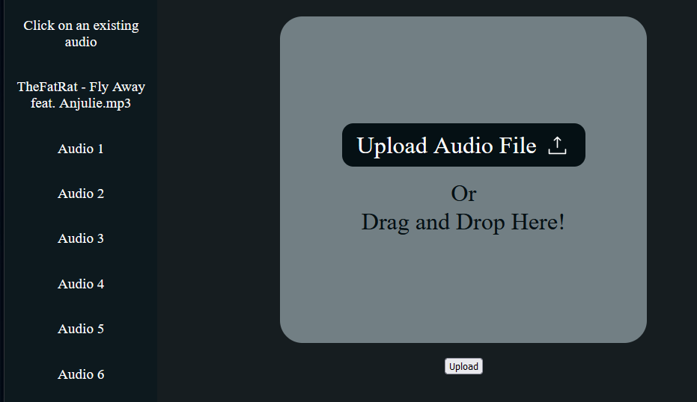
Back-end updates:
Blocks:
No Drag and drop yet
Trying to use uploaded audio in sketch
Accomplished:
Audio file state usable on all pages
Menu displays selected file

Slide 3
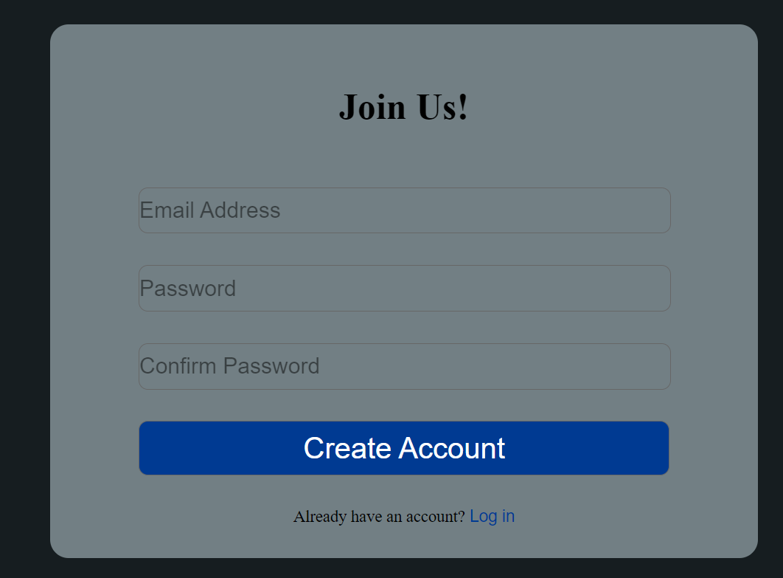
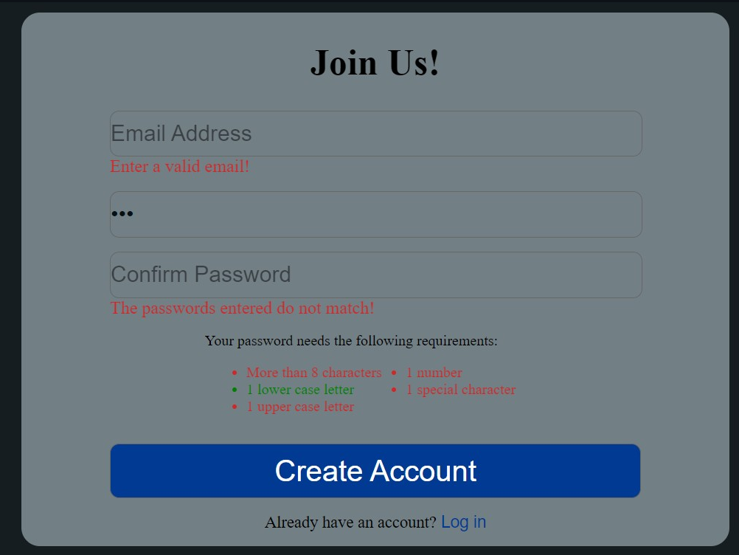
Front-end updates:
Blockers:
Need to handle routing
Accomplished:
Added API calls to the server to login and logout.
Added a temporary style for the requirements when signing up
Finished the initial. implementation of the login functionality.
Added persistent login to the website

Slide 4
Milestones:
1
2
3
Build front-end
Audio Visualizers
Integrate front-back
Refine UI sketches
Implement main page
Implement login page
Sign up functionality
Audio upload
Sign in functionality
Create 2 sketches
Implement customizability
Fetch Audio from database

Slide 5
Hosting methods
Several web hosting services offer free plans for students. Some popular options include InfinityFree, AwardSpace, and 000webhost. These services provide free server space, bandwidth, and other features to host your website.

Slide 6
Feedback from Two Seniors
Add instructions on how to install prerequisites
Logging in needs some feedback on what the status of the account creation/log in is
More status messages throughout website
Cookies and upload audio working
Easy setup
Response:
Bugs will be fixed throughout the next weeks
More messages will be displayed for users

