Slide 1
Audiovision
Team Codescapes
Miguel Vazquez and Luc Tang

Slide 2

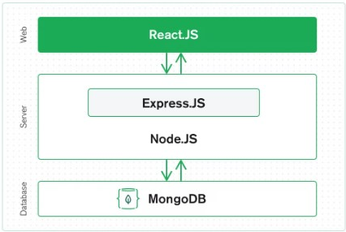
Update to Technology tools
We’ll make use of the MERN stack.
M - MongoDB
E - Express
R - React (p5.js)
N - Node.js
Role update:
Luc: backend lead
Miguel: frontend lead
Amazon s3 for storage
(Audio analysis)

Slide 3
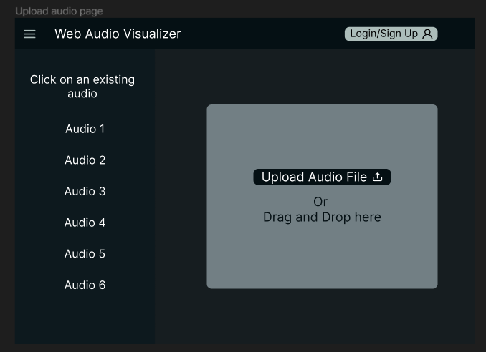
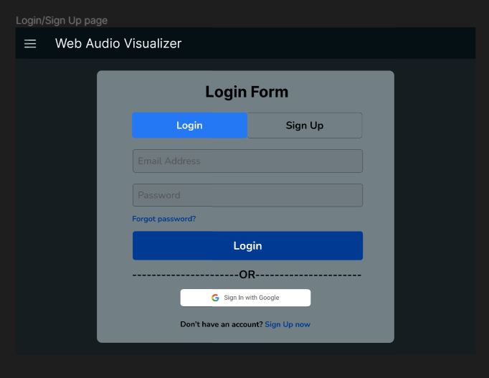
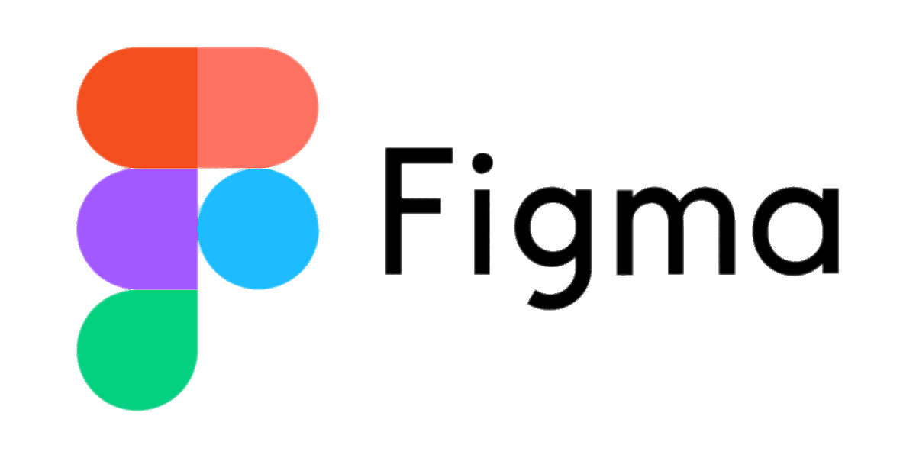

Refined the initial designs of the website using Figma and started implementing the main page in React

Slide 4
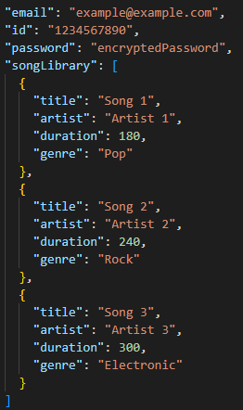
Back-end:
Blocks:
Learning how backend components connect
Data files too large for MongoDB
Accomplished:
CRUD for user information

Slide 5
Milestones:
1
2
3
Set up IDE
Build back-end
Start front-end
Database connected
REST API boilerplate
Test API calls
Connect to s3
Refine UI sketches
Implement main page

Slide 6
Feedback
Suggestions for team Codescapes
Map out the different components in your website before jumping into code
Authenticated users have extra features
Login to download visualizers + audio
Access to more visualizers

