Slide 1
Audiovision
Team Codescapes
Miguel Vazquez and Luc Tang

Slide 2
Back-end updates:
Blocks:
userID not passing properly to store
Accomplished:
Changed audiofile schema

Slide 3
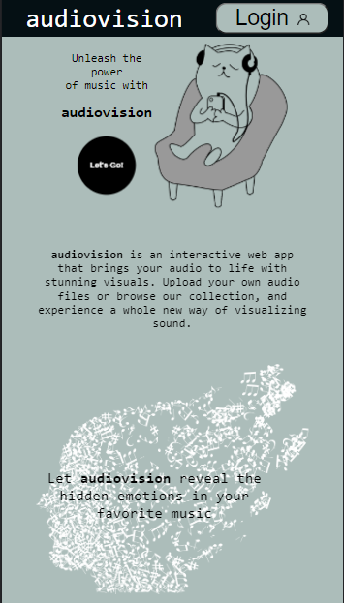
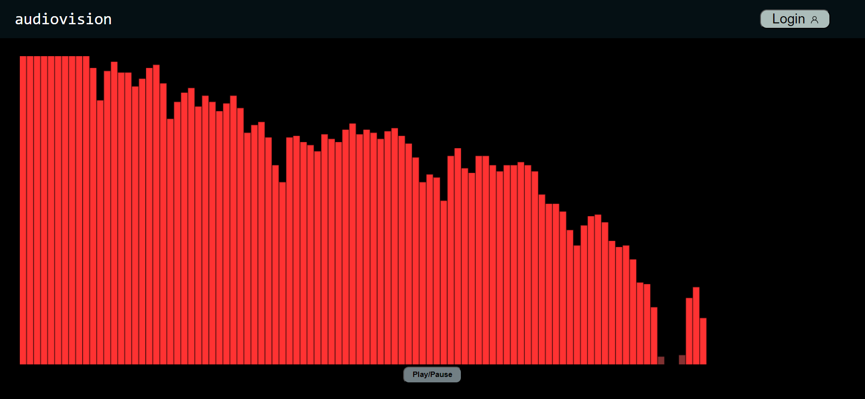
Front-end updates:
Accomplished:
Implemented a home page and updated the routes
Fixed bugs in visualization page
Implemented a simple sketch using just Javascript
Blockers:
Couldn’t use p5 library so, decided to use Javascript instead

Slide 4
Milestones:
1
2
3
Finishing touches
Finalize prototype
Non-essential features
Working audio-reactive sketch
Dynamic parameters
Test for and fix bugs
Present working prototype
Exporting audio visual
Redesigning colors

Slide 5
Hosting methods
Several web hosting services offer free plans for students
  InfinityFree
  AwardSpace
  000webhost

Slide 6
Demo!

Slide 7
Feedback from Team Deepcourse
Was able to build project based on expert user documentation
UI looked really clean
Was able to view audio visual for sample audio files
No bugs found for the completed features
Team Deepcourse didn’t need any help.
  We discussed the grading criteria and ran each others projects

