Slide 1
Abebooks.com Log In Use Case GUI Prototype
Aidan Fischer

Slide 2
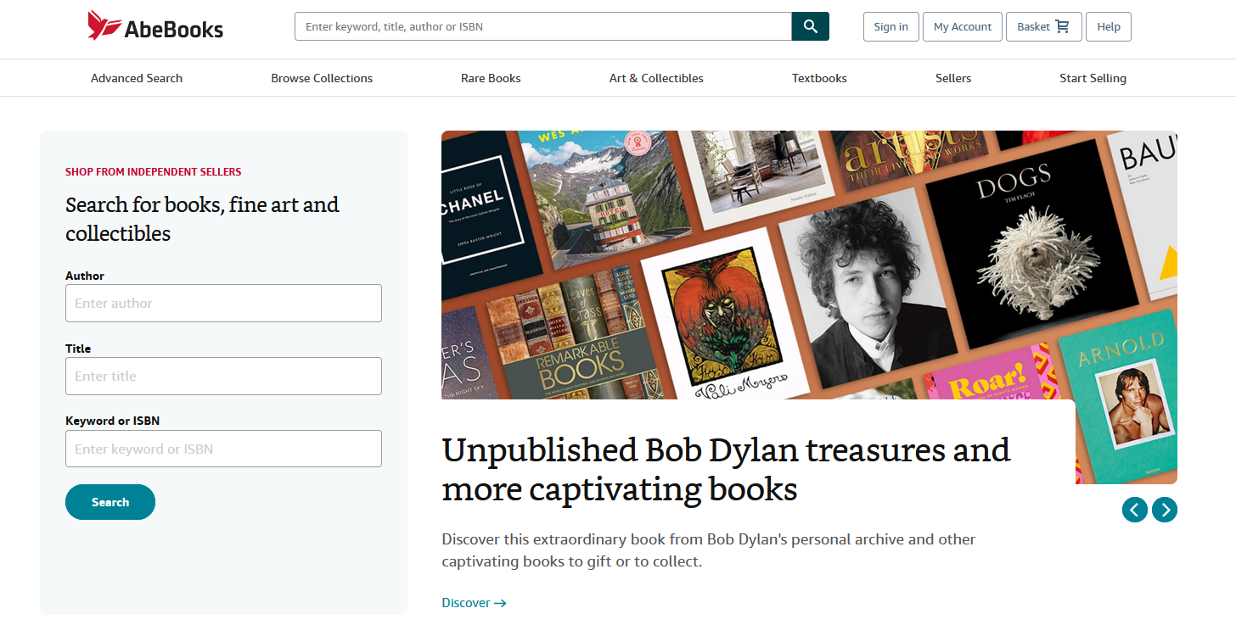
Log In Use Case
Basic Course: The user clicks on Sign On
on AbeBooks.com’s home page

Slide 3
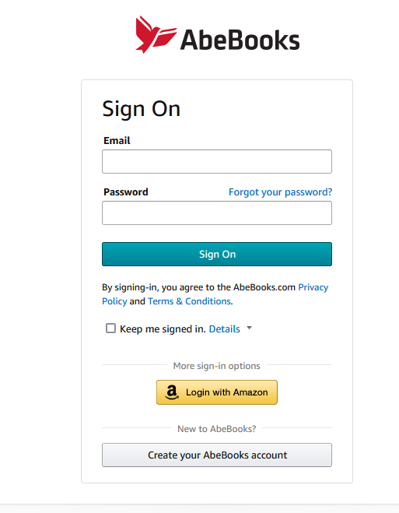
The user enters their account details
(Email and Password)
The User clicks sign on
The page returns to the home page with
the user account loaded

Slide 4
Alternate course:
The user clicks on forgot password
The system delegates control to the
“forgot password” use case

Slide 5
Alternate course:
The user enters incorrect account details
(Unregistered email, incorrect password)
The user clicks sign on
The system displays an error informing the
user to double check the entered details
and try again.

Slide 6
If the user clicks on Privacy Policy, redirect
the page to AbeBooks.com’s Privacy Policy page

Slide 7
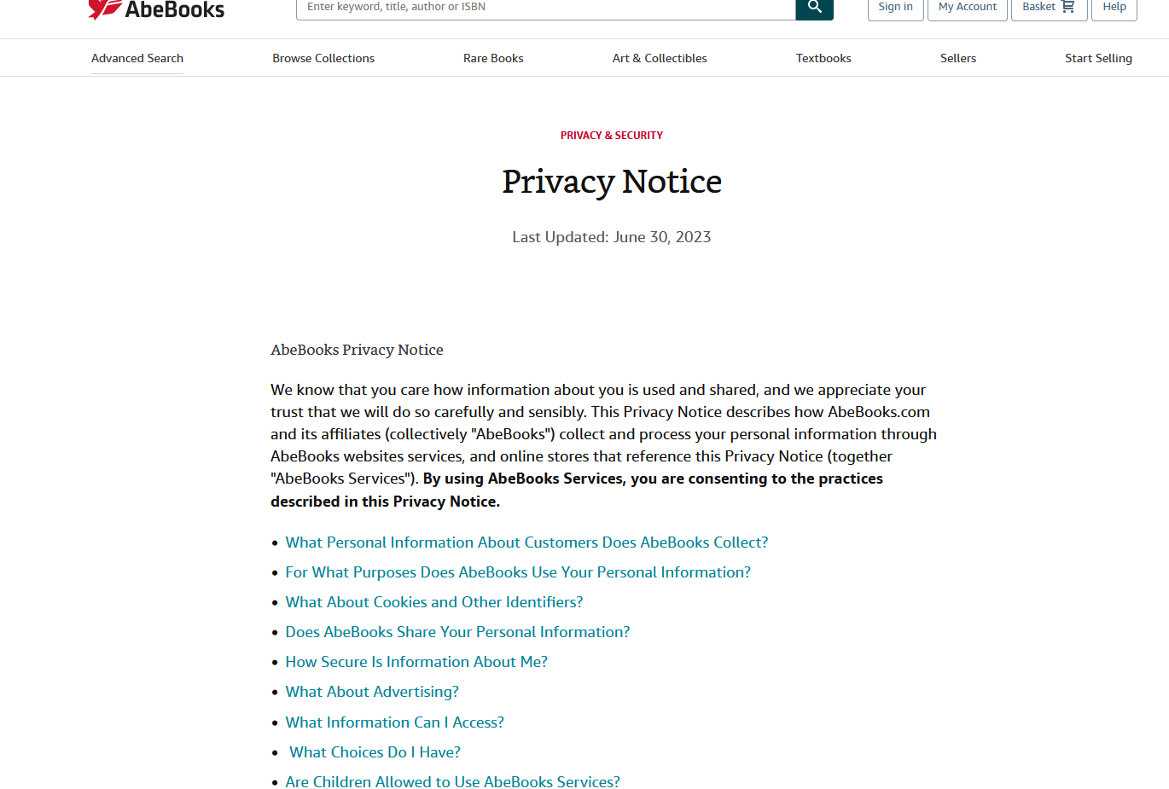

Slide 8
If the user clicks on Terms & Conditions, redirect
the page to AbeBooks.com’s Terms & Conditions
page

Slide 9
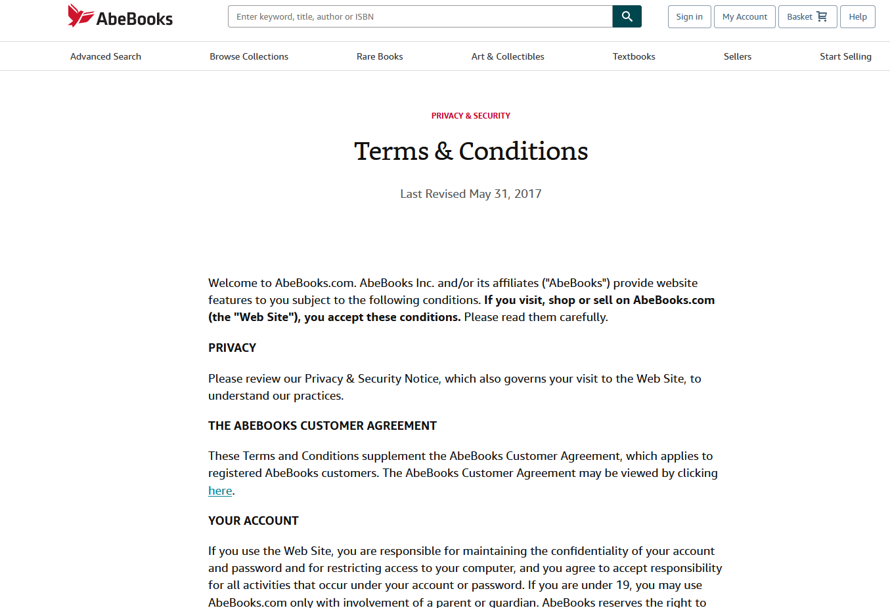

Slide 10
If the user toggles the “Keep me signed in”
checkbox on prior to a successful login,
prevent the system from logging the user
out when the tab is closed.
If the user clicks on Details, display a small
box describing what “Keep me signed in” does.

Slide 11
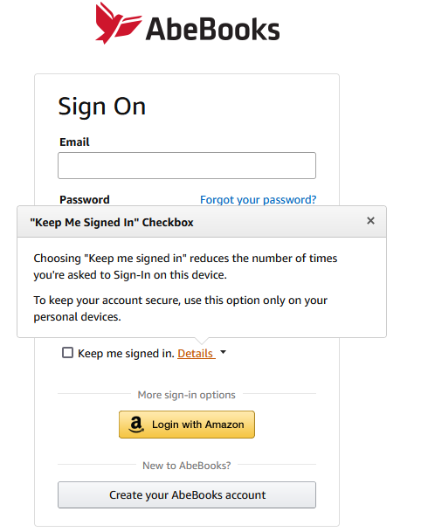

Slide 12
Alternate course:
If the user selects Login with Amazon,
redirect to Amazon’s external sign in
page with details for Amazon to return
proper authentication information.

Slide 13
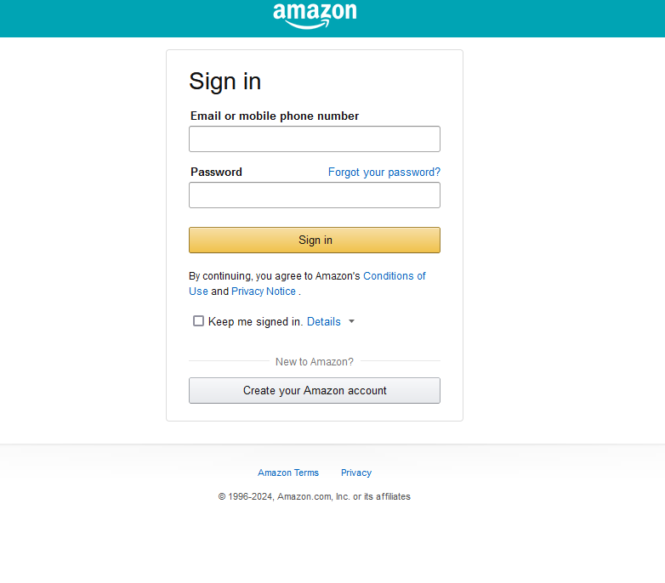

Slide 14
Alternate Course:
If the user selects Create your AbeBooks account,
redirect to the “Create an account” use case.

