Slide 1
PageRank-inspired Natural Language Generation
Hongpo Chen
U2022097E

Slide 2

Why Summaries?
too much information
unsure what is important or relevant

Slide 3
PageRank
Google’s algorithm for ranking importance of pages
Assigns a score to each page
Based on how many other pages point to it
Creates a graph with the pages as nodes

Slide 4
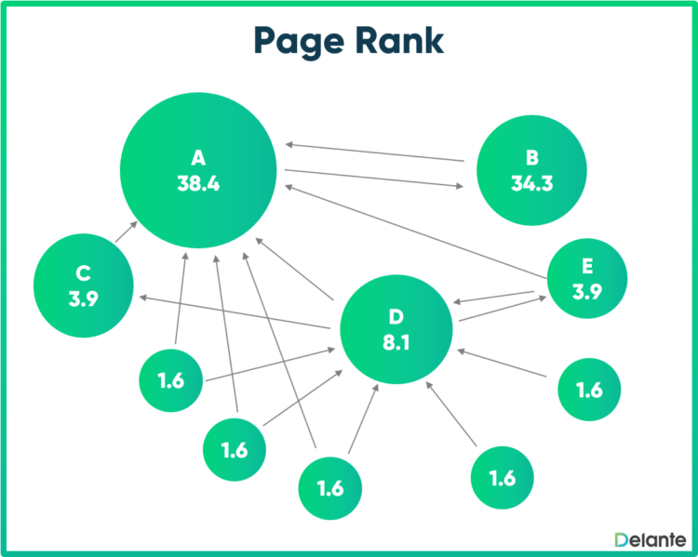

Slide 5
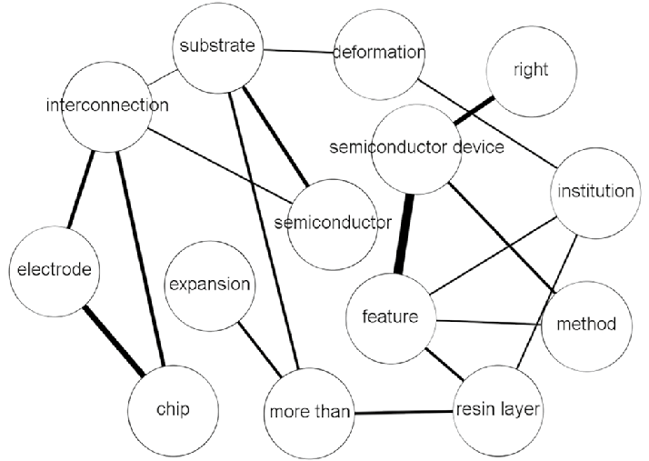
How this can work with text
The nodes of the graph would be replaced with sentences/words
Rank each of them in importance

Slide 6
Implementation - Preprocessing
Tokenization
Remove stopwords (‘the’, ‘and’, etc)
Vectorization by TF-IDF
Term-Frequency Inverse Document Frequency

Slide 7
Implementation - Graph
Vectors multiplied to form similarity matrix
Matrix turns into graph
Score is assigned to each
We get list of sentences ranked by importance

Slide 8
Implementation – Parameter Exploration
Size of summary compared to original text – N
PageRank damping factor – Alpha
Number of iterations for convergence – Max iterations
Each of these can be tuned for different use cases

Slide 9
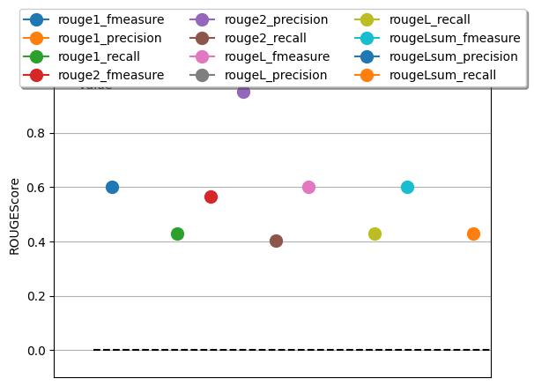
Implementation – Performance Evaluation
ROUGE - Recall-Oriented Understudy for Gisting Evaluation
Evaluates reference summaries versus machine done ones
Measures overlap of n-grams
similarity between 2 texts
Visualizes it in a graph

Slide 10
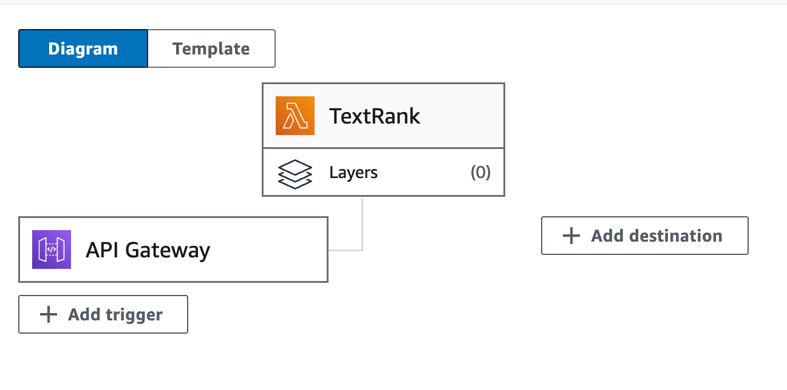
Implementation – Integration with Cloud
enhance scalability with larger text
SaaS business model
Leverage computing power from the cloud
AWS

Slide 11
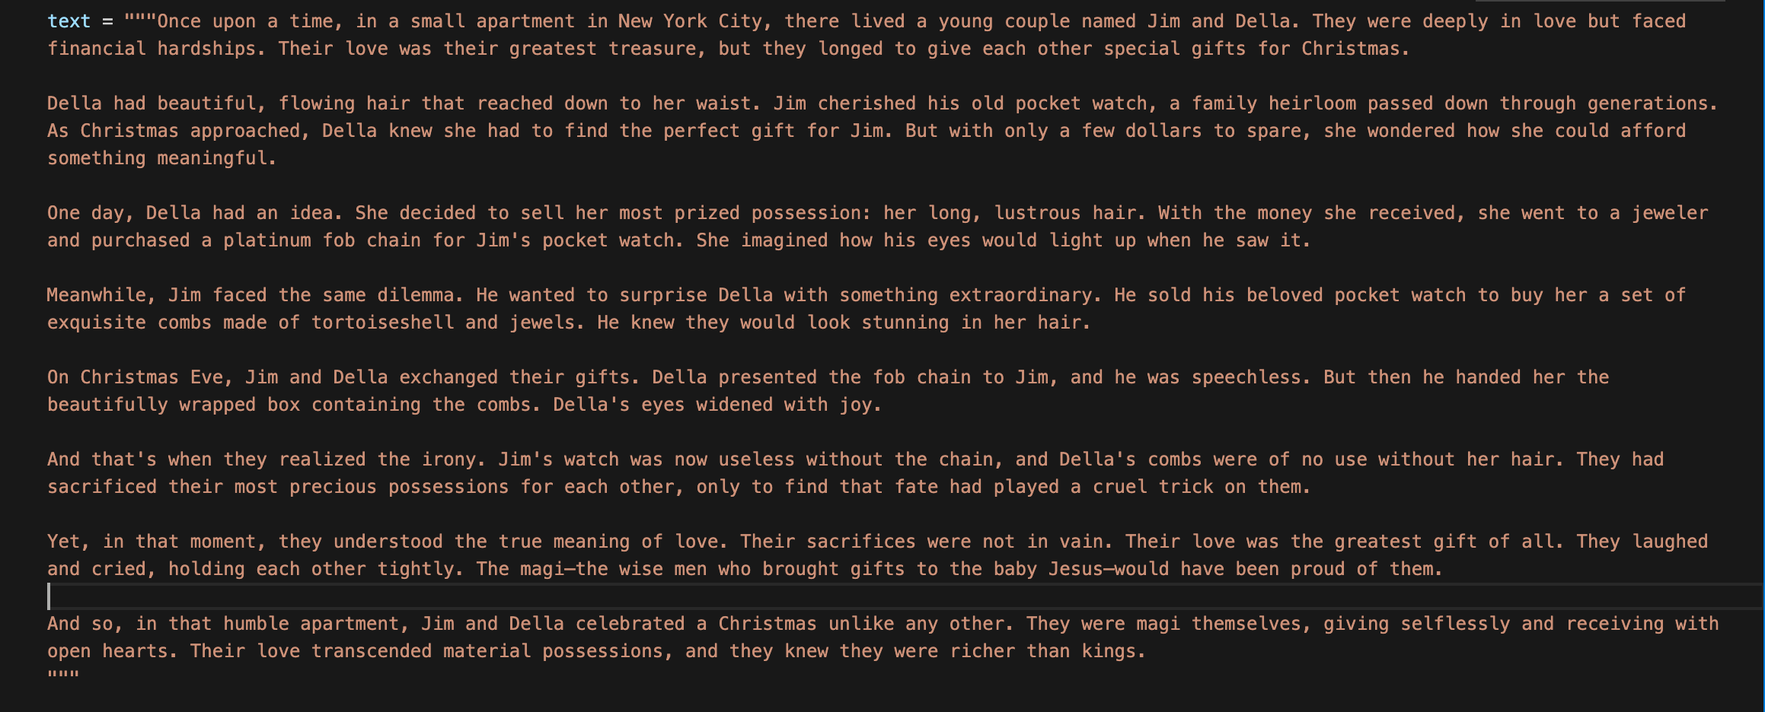
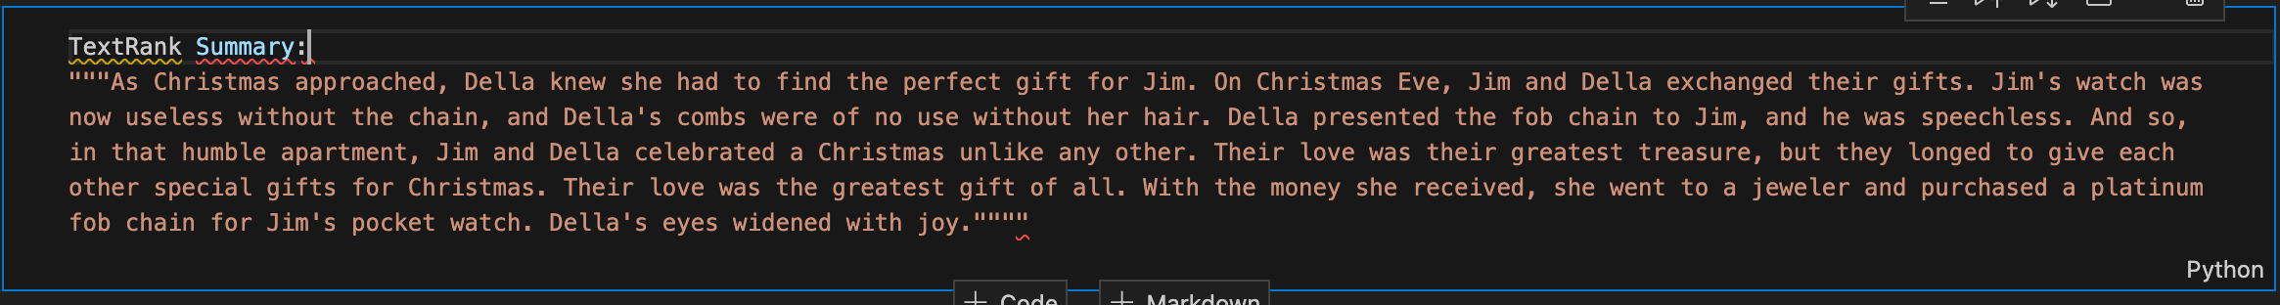
Example

Slide 12
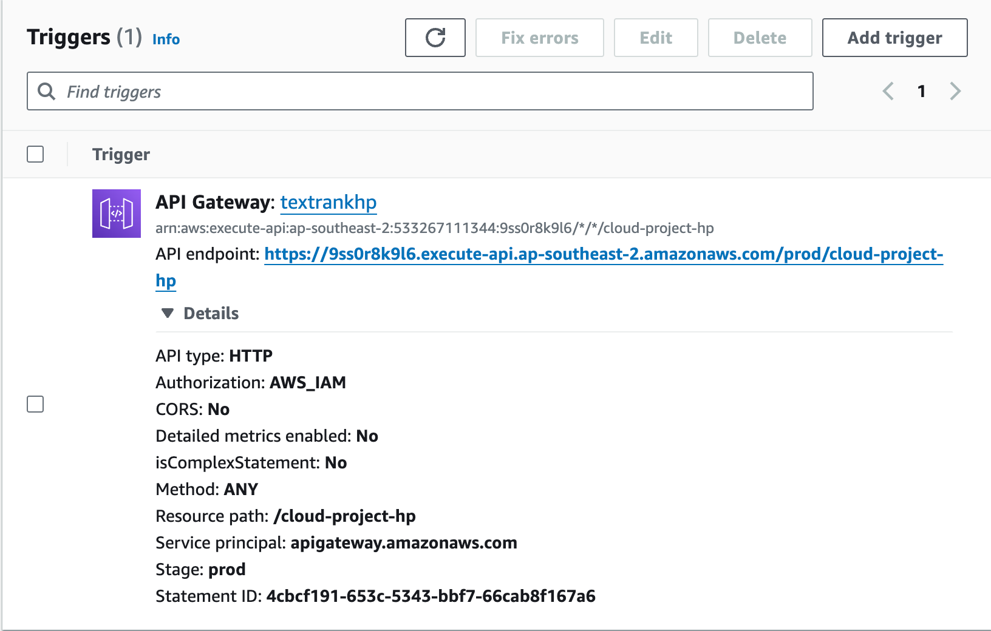
AWS – Lambda Trigger

Slide 13

AWS - API Integration

Slide 14
Conclusion
This algorithm can quickly summarise an article
Saves time and effort for readers
Integration with AWS enables it to be SaaS

Slide 15
Thank you!
any questions?

