Slide 2
Minor Project – I Optimizing real road networks by applying time efficient shortest path algorithms
MEMBER’S NAME | ROLL NUMBER | SAP ID | BRANCH
DIVYAM VERMA | R103218043 | 500067103 | CSE-BAO
DEVANSH MESSON | R103218037 | 500067983 | CSE-BAO
MAYANK RASTOGI | R103218081 | 500069069 | CSE-BAO
Under the guidance of
Mr.Amit Singh

Slide 3
CONTENTS
Introduction
Motivation
Literature Review
Problem Statement
Objective
Methodology
Flow Chart, Algorithm & Implementation
Progress (results if any)
References

Slide 4
Introduction
Two algorithms are applied to compute the shortest path from a particular source to one or more destinations:
Dijkstra algorithm:
Computes shortest path from a particular source to a particular destination.
Solution: Greedy method
Single source shortest path
Travelling Salesman Problem:
Given a set of cities and distance between every pair of cities, the problem is to find the shortest possible route that visits every city exactly once and returns to the starting point.
Solution: Dynamic programming and approximation methods.

Slide 5
Motivation
For large number of nodes and edges,standard implementation of dijkstra and TSP are not efficient in terms of execution time.
To improve the running time of the algorithm,following can be used:
Advanced data structures (Eg.binary heaps)
Nature-inspired methods (Eg.Genetic algorithm)
Heuristic/mathematical techniques (Eg. A-star algorithm)

Slide 6
Literature Review
Dijkstra algorithm-
1. Brute force- It is a naïve method in which no data structure is used to implement [2]
1. Bidirectional dijkstra- It runs two times faster than ordinary dijkstra[1][2]
2. Binary heap implementation – It is used to implement priority queue to optimize dijkstra.[3]
3. Fibonacci heap implementation - It is used to implement priority queue to optimize dijkstra [3][2]
Travelling Salesman Problem-
1.Backtracking/brute force – checking all the possibilities through generating (n-1)! Permutations of the nodes [3][1]
2.Dynamic programming method - Divide the problems into sub- problems by a recurrence relation[2]

Slide 7
Problem Statement
In this pandemic, many people encountered various lethal health problems, therefore it becomes an emergency case and such situation expects an ambulance to reach the patient’s place as soon as possible. Obviously, ambulance must take the shortest possible path from the hospital to patient’s place in the real road network given in the form of a graph to reach the destination faster to save a life.

Slide 8
Objective
Our objective is to suggest the ambulance a shortest possible path as soon as possible in the real road network by applying time efficient shortest path algorithms.
For single destination: determine the shortest possible path from source to destination.
For multiple destinations: determine a route such that the vehicle visits all the destinations and comes back to the source location in the least possible time.

Slide 9
Methodology
For Dijkstra algorithm:
4 solving optimizations are being proposed:
Bruteforce method
Fibonacci heap implementation
Binary heap implementation
Bi-directional Dijkstra algorithm
For solving Travelling Salesman Problem:
2 solving optimization is being proposed:
Bruteforce/backtracking method
Dynamic programming method

Slide 10
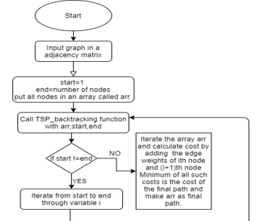
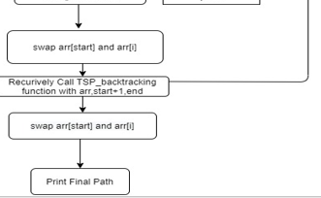
Flowchart for TSP Bruteforce

Slide 11
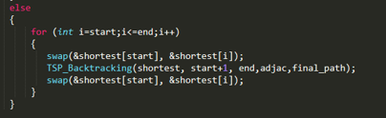
Solution to Travelling Salesman Problem:
Backtracking/Bruteforce Method:
1.Root node or source node(1) is the starting point and ending point of the final path.
2.Generate all (n-1)! permutations of the nodes as:
-Traverse the array of nodes by variable i.
-Swap starting node and ith node.
-Recursively call the function with starting node=starting node+1.
-Swap starting node and ith node.
3.when starting node==ending node,Calculate cost of the path.
4.Return the permutation having the minimum cost.

Slide 12
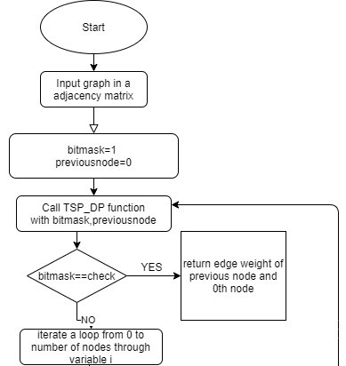
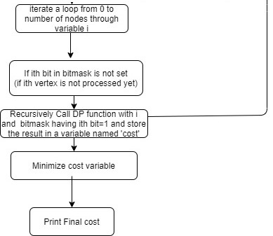
Flowchart for DP method

Slide 13
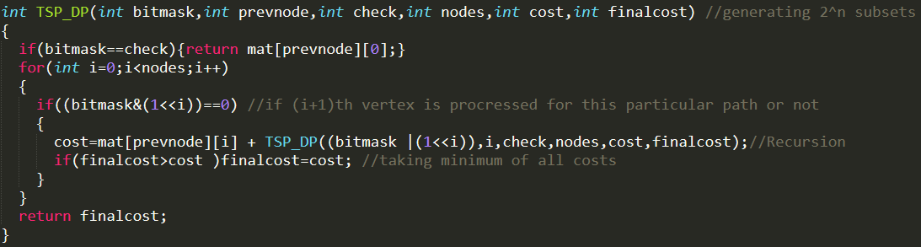
Dynamic programming method:
1.Considering Starting vertex and ending vertex as 1.
2.Find ith vertex which must be second last vertex in the path.
3.For point 2,Generate all 2^n subsets of the nodes through bit manipulation.
4.Bit manipulation works as visited arr,bits of the bitmask will represent nodes.
5.1 means visited and 0 means not visited.
6.Recurrence relation for point 2:
cost(S,i)=dist[i][j]= + cost( {S-i-1} , j ) , where S represents set of all vertices and
j belongs to S.
Time complexity for computing minimum cost is: O(n*(2^n)).

Slide 14
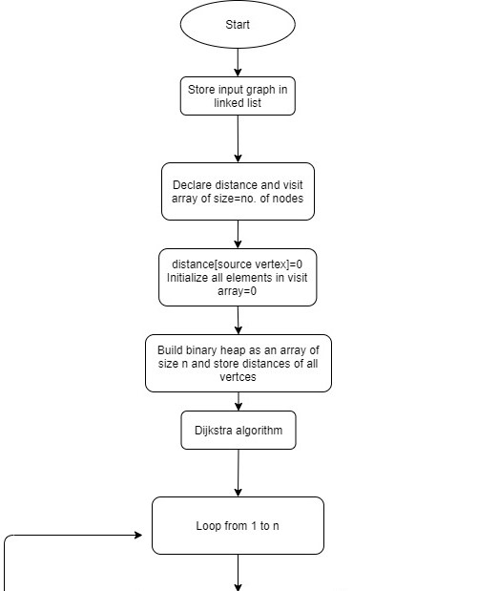
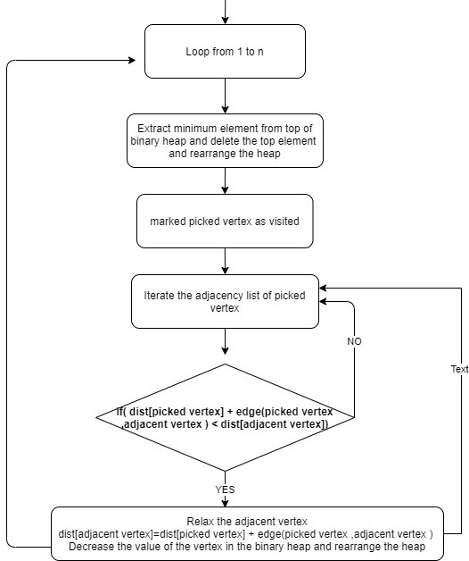
Flowchart of binary heap implementation

Slide 15
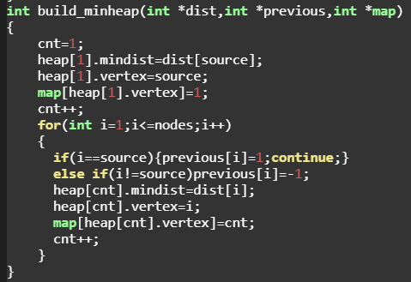
Binary Heap Implementation
Binary Heap is used to implement minimum priority queue which is used to find node with the minimum distance from source in O(LogN) time , where N is the number of vertices.
Binary Heap is stored in the form of an array.
Top element of Binary heap is the minimum element.
If parent node is stored in ith index,then its two children are stored at indexes: (2*i)+1 , : (2*i)+2.
Maximum Height of binary heap is Log N.
1.Building Minimum Heap:
Distance of nodes from source node is infinity except source node.
Put distance[source node]=0 as root of the heap.
Traverse the heap array from 2nd index and put distance of all other
nodes.

Slide 16
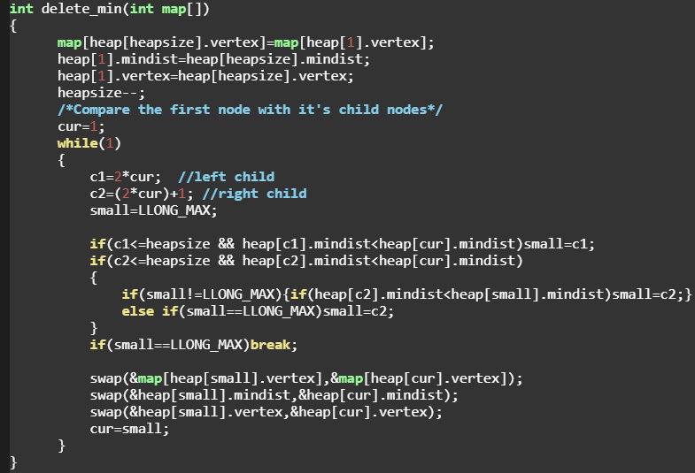
2.Deleting Minimum Node from binary heap
Move the last element of heap to 1st index of heap array.
Rearrange the heap such that min. element
is on top.
Start from top element:
Child1=2*(parent’s index)+1
Child2=2*(parent’s index)+2
If distances[children] < distance[parent]:
-Take min. of distances of Child1 , Child2
and swap the minimum one with the
parent node.
-Make the minimum element as parent and
repeat the above steps.
Else:
Do nothing
Time-Complexity-O(LogN)

Slide 17
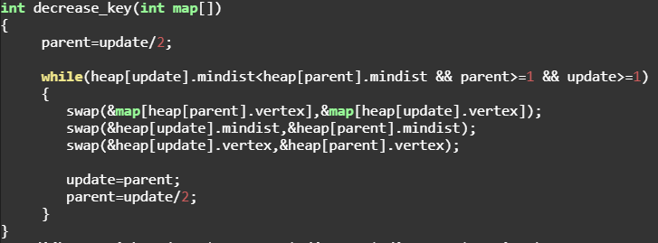
3.Decrease a value of ith element in heap.
Map array is used to get the position of a particular element in heap.
Assign:
value of ith element=Decreased value
Heap might get disturbed so rearrange it.
Start from the ith element and go upwards
In heap.Compare it’s value with parent.
Parent’s index in heap=i / 2;
while Parent’s value>ith element’s value:
-swap(parent,ith element)
-update the map array
-ith element=parent(going upwards).
Time-Complexity-O(LogN)

Slide 18
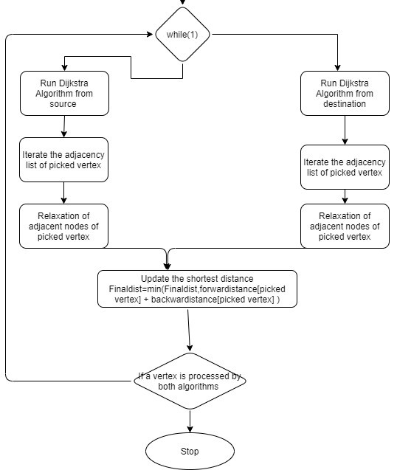
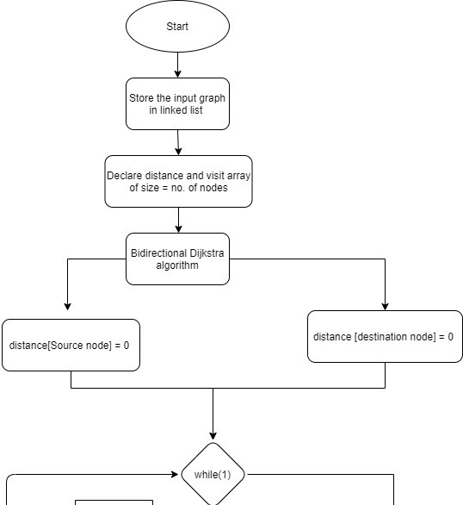
Flowchart of Bi-directional Dijkstra algorithm

Slide 19
Bi-Directional Dijkstra Algorithm
In Bi-directional dijkstra algorithm, Dijkstra algorithm runs from both source(forward) and destination(backward) simultaneously.When a node is being processed by both sides then this algorithm is terminated.
A common point is found to link both forward and backward Dijkstra algorithm which gives the shortest path.
This signifies that if path goes through this common point,then distance is minimum.
Bi-directional algorithm runs 2 times faster than ordinary dijkstra algorithm.
Two priority queues are required in this algorithm.
1.Forward priority queue
2.Backward priority queue
Binary heaps are used to implement priority queue in this algorithm.

Slide 20
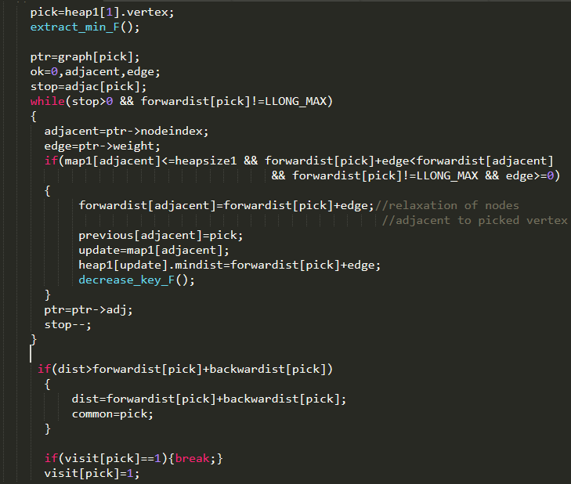
Algorithm
Forward Dijkstra
1.Build forward binary heap [source=original source of the input graph]
2.Build backward binary heap [source=destination of input graph.]
3.while(1)
{
Run Dijkstra algorithm from source(forward dijkstra)
find the linking point i=top node
final_distance=min(final_distance , forwardist[i] + backwardist[i])
if(visit[top node]==1)break; //Termination Condition
else visit[i]=1;
Run Dijkstra algorithm from destination(backward dijkstra)
find the linking point i=top node
final_distance=min(final_distance , forwardist[i] + backwardist[i])
if(visit[top node]==1)break; //Termination Condition
else visit[i]=1;
if(forward heap is empty || backward heap is empty)break;
}

Slide 21
Future Objective
1. Genetics algorithm to optimize TSP

Slide 22
References
[1] https://www.youtube.com/
[2]https://www.geeksforgeeks.org
[3] CLRS Book

