Slide 1

Paper ID - 67 Comparative Study Of Various Approaches Of Dijkstra Algorithm
1st Divyam Verma, 2nd Devansh Messon, 3rd Mayank Rastogi, 4th Dr.Amit Singh
School of Computer Science, University of Petroleum and Energy Studies
Dehradun, Uttarakhand, India
divyam0216@gmail.com, devansh.messon28@gmail.com, Mayikmj@gmail.com, amit.singh1@ddn.upes.ac.in

Slide 2
Contents
Abstract
Introduction
Motivation
Results
Analysis
Conclusion
Future Scope

Slide 3
Abstract
Dijkstra algorithm was implemented by 4 approaches. 18 test cases representing dense and sparse graphs were prepared and were used to generate results in the form of execution time. These results were thoroughly analyzed and visualized by plotting performance curves and bar graphs. The largest test case is of the order 1 lakh nodes and 1 million edges.
Improved
37 seconds
3 milliseconds

Slide 4
Introduction
Dijkstra algorithm:
Computes shortest path from a particular source to a particular destination.
Solution: Greedy method
Single source shortest path
For Dijkstra algorithm-
4 solving optimizations are being proposed:
Brute-force method
Fibonacci heap implementation
Binary heap implementation
Bi-directional Dijkstra algorithm (Giving Least execution time)

Slide 5
A Big Issue!
In this pandemic, many people encountered various lethal health problems, therefore it becomes an emergency case and such situation expects an ambulance to reach the patient’s place as soon as possible. Obviously, ambulance must take the shortest possible path from the hospital to patient’s place in the real road network given in the form of a graph to reach the destination faster to save a life.

Slide 6
Motivation
Motivation to efficiently implement Dijkstra algorithm comes from the fact that for large number of nodes and edges, naive approaches are not efficient in terms of execution time and space.
For example , V=10¹⁸
Time complexity of Naive approach for Dijkstra – O(V²)
Total iterations – 10³⁶ [~10²⁸ seconds]
To improve the running time of the algorithm, following techniques can be used:
Advanced data structures (Eg. binary heap)
Mathematical techniques

Slide 7
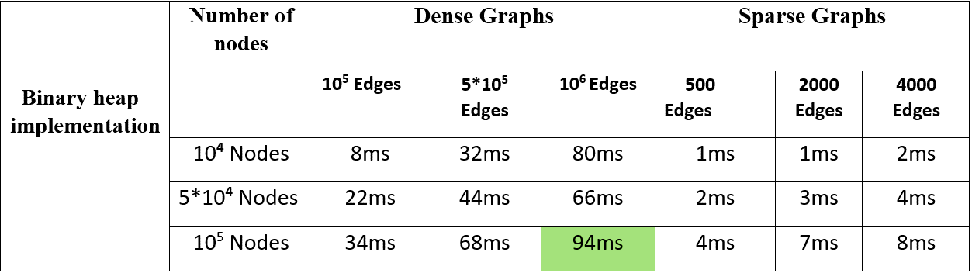
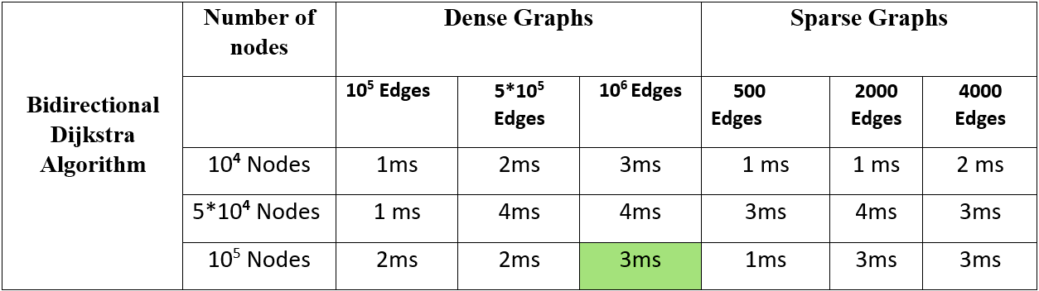
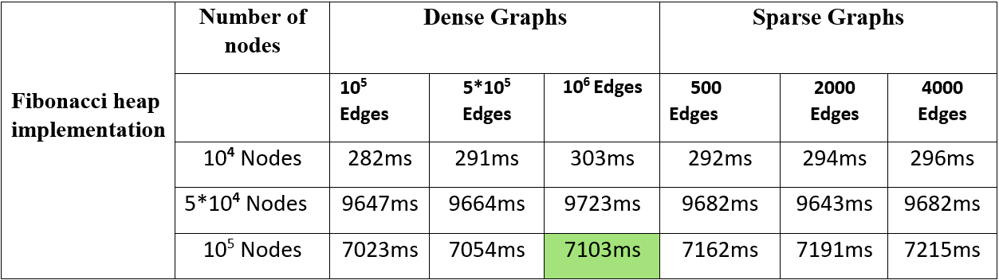
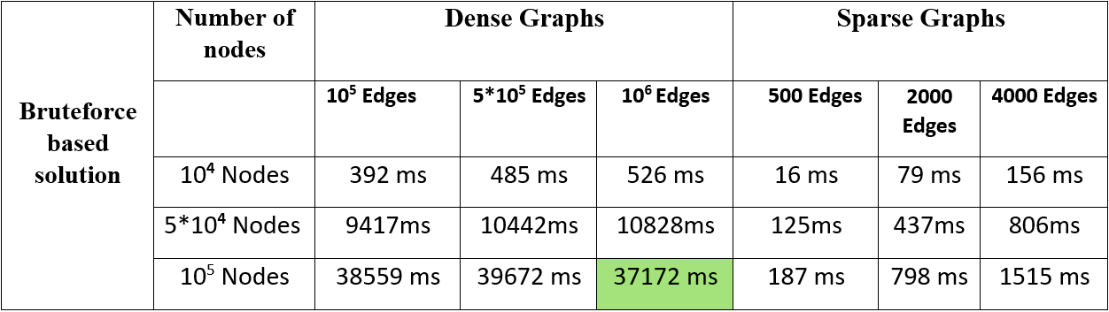
Results

Slide 8
Different cases of analysis
Brute-force approach
vs
Fibonacci heap implementation
Dense Graph
Sparse Graph
Binary heap implementation
vs
Bi-directional Dijkstra
ABBREVATIONS IN ANALYSIS GRAPHS
BFB - Brute-force approach
FHI - Fibonacci Heap Implementation
BHI - Binary Heap Implementation
BDD - Bi-directional Dijkstra

Slide 9
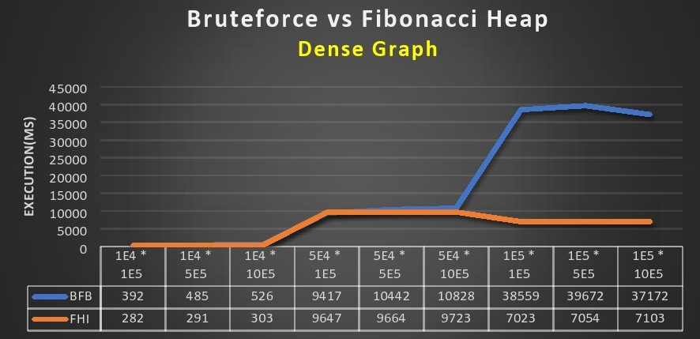
Analysis
Performance curves between the different approaches
Increasing density of graph

Slide 10
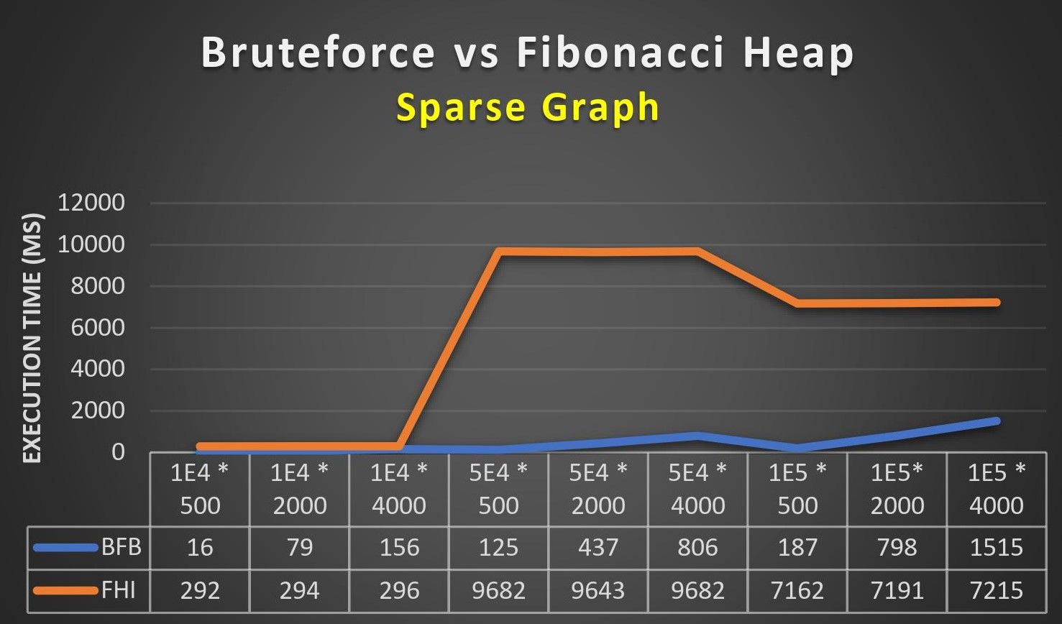
Increasing sparsity of graph

Slide 11
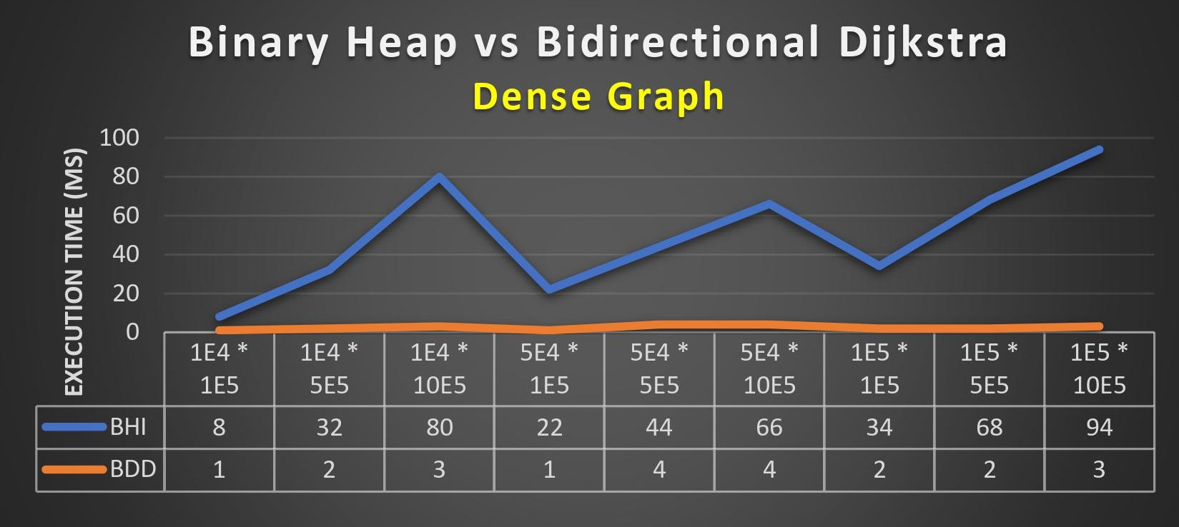
Increasing density of graph

Slide 12
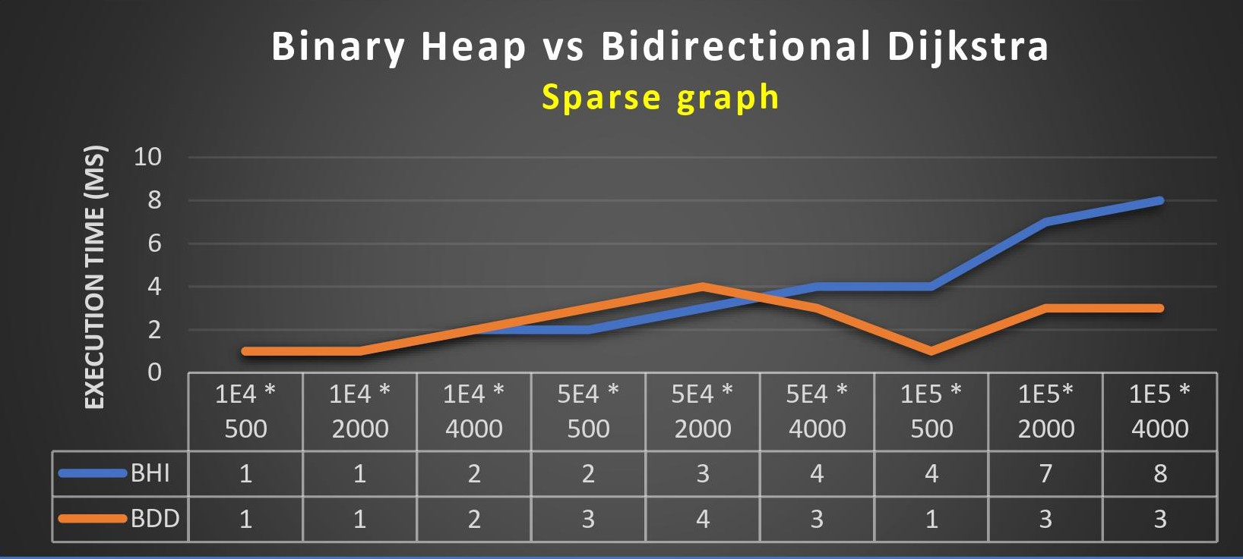
Increasing density of graph

Slide 13
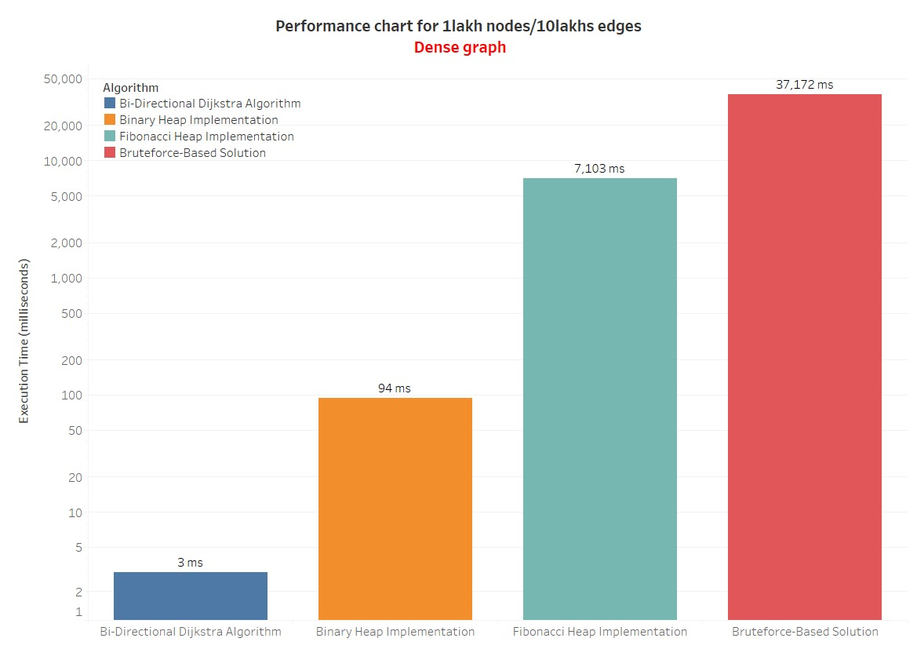

Slide 14
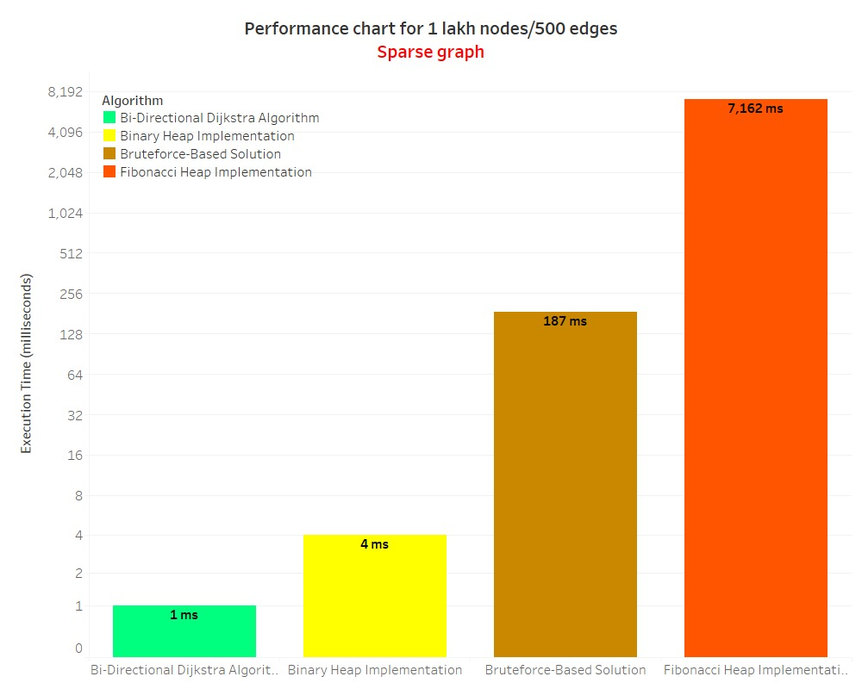

Slide 15
Conclusion
Bidirectional Dijkstra algorithm comes out to be the most time-efficient algorithm out of the four algorithms on the basis of execution time on almost every test case. Therefore, it is proved that this algorithm can process huge real-world graphs in a very small amount of time.

Slide 16
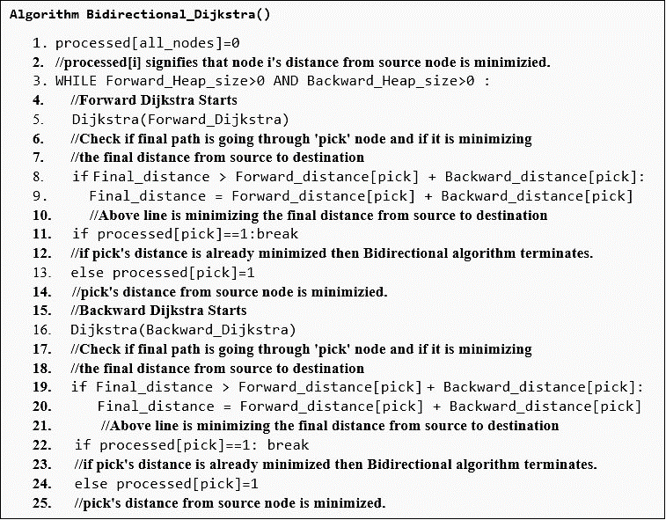
Optimizing
Dijkstra algorithm
Algorithm
Of
Bidirectional Dijkstra algorithm

Slide 17
Future Scope
Artificial intelligence can be used to optimize Dijkstra algorithm. A* algorithm is an AI algorithm which optimizes Dijkstra algorithm by generating heuristics. These heuristics are the estimates which helps in choosing the optimal path from source to destination.
Contraction hierarchies is another smart technique to optimize Dijkstra algorithm. The speed-up is achieved by creating shortcuts in a preprocessing phase which are then used during a shortest-path query to skip over "unimportant" vertices. This is based on the observation that road networks are highly hierarchical.

Slide 18


