Slide 1
Bioinformatics
Slides adapted from CMU

Slide 2
What does biology have to do with computers?
Huge amount of data: too much to analyze by hand, lots of mystery left about how life works.
•
Requires clever algorithms to:
find interesting patterns store / search / compare
visualize vast collections of data
predict missing or hard-to-observe features (like protein structure or evolutionary relationships)
•
•
•
•
Nearly all molecular biology is now “computational biology”: biologists depend on computer scientists every day.

Slide 3
Computational Successes:
Genome assembly
Gene discovery
Understanding the origin of swine flu
Predicting protein structure

Slide 4
Genome assembly

Slide 5
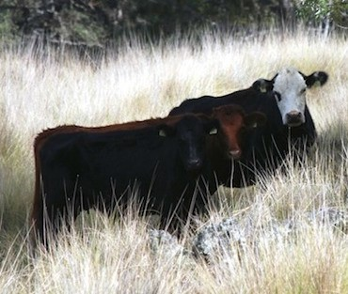
Genome of the Cow
a sequence of 2.86 billion letters
enough letters to fill a million pages of a typical book.
TATGGAGCCAGGTGCCTGGGGCAACAAGACTGTGGTCACTGAATTCATCCTTCTTGGTCTAACAGAGAACATAG AACTGCAATCCATCCTTTTTGCCATCTTCCTCTTTGCCTATGTGATCACAGTCGGGGGCAACTTGAGTATCCTG GCCGCCATCTTTGTGGAGCCCAAACTCCACACCCCCATGTACTACTTCCTGGGGAACCTTTCTCTGCTGGACAT TGGGTGCATCACTGTCACCATTCCTCCCATGCTGGCCTGTCTCCTGACCCACCAATGCCGGGTTCCCTATGCAG CCTGCATCTCACAGCTCTTCTTTTTCCACCTCCTGGCTGGAGTGGACTGTCACCTCCTGACAGCCATGGCCTAC GACCGCTACCTGGCCATTTGCCAGCCCCTCACCTATAGCATCCGCATGAGCCGTGACGTCCAGGGAGCCCTGGT GGCCGTCTGCTGCTCCATCTCCTTCATCAATGCTCTGACCCACACAGTGGCTGTGTCTGTGCTGGACTTCTGCG GCCCTAACGTGGTCAACCACTTCTACTGTGACCTCCCGCCCCTTTTCCAGCTCTCCTGCTCCAGCATCCACCTC AACGGGCAGCTACTTTTCGTGGGGGCCACCTTCATGGGGGTGGTCCCCATGGTCTTCATCTCGGTATCCTATGC CCACGTGGCAGCCGCAGTCCTGCGGATCCGCTCGGCAGAGGGCAGGAAGAAAGCCTTCTCCACGTGTGGCTCCC ACCTCACCGTGGTCTGCATCTTTTATGGAACCGGCTTCTTCAGCTACATGCGCCTGGGCTCCGTGTCCGCCTCA GACAAGGACAAGGGCATTGGCATCCTCAACACTGTCATCAGCCCCATGCTGAACCCACTCATCTACAGCCTCCG GAACCCTGATGTGCAGGGCGCCCTGAAGAGGTTGCTGACAGGGAAGCGGCCCCCGGAGTG ...

Slide 6


We can only read ~ 1000 characters at a time from a random place:
good-natured, she thought: still
when it saw Alice. It looked
ought to be treated
good-natured, she thought, still
Cat only
a greet many
It looked good- The Cat only grinned when it saw Alice.
be
treated with respect.
sti1l it had very long claws
claws and a great many teeth, so she
so she felt that it ought
Algorithms are needed to piece the story together.

Slide 7
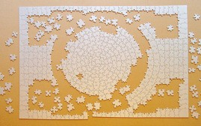
The Cat only grinned when it saw Alice. Cat only when it saw Alice.
It looked
It looked good-
good-natured, good-natured,
she thought: she thought,
still still
sti1l
it had very long claws
claws | and | a | great | many | teeth, | so | she
 |  | a | greet | many |  | so | she | felt | that | it | ought
ought | to | be | treated
 |  | be | treated | with | respect.
It’s a jigsaw puzzle ...
...except with 35 million pieces

Slide 8
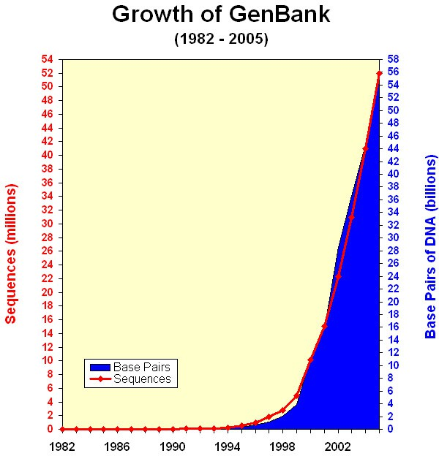
Recent Genomics (DNA)
•
First genome sequenced in 1995 (the bacteria H. influenzae with a genome of 1,830,140 letters).
1st draft of human genome finished in 2001 (~ 3 billion letters)
Now: Over 1100 bacterial genomes
Hundreds of higher-order genomes done or in progress.
Several complete human genomes finished.
•
•
•
•

Slide 9
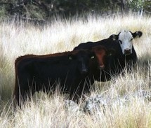
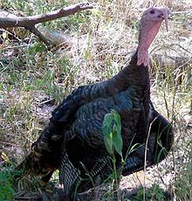
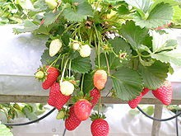
Researchers at many institutions are putting together the genomes of many animals.
Help understand how to make animals and plants more hardy, resistant to disease, and understand their biology.
New technologies and larger genomes require new algorithms and faster computers.

Slide 10
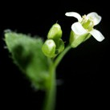
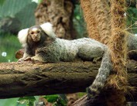
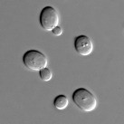
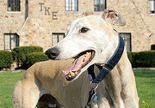

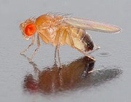

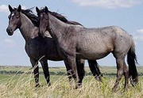
Other Sequenced Genomes
Arabidopsis thailiana
Callithrix jacchus
(marmoset)
Saccharomyces cerevisiae (baker’s yeast)
Canis lupus familiaris (dog)
Apis mellifera (honey bee)
Drosophila melanogaster (fruit fly)
Bos torus (cow)
Equus caballus (horse)
Sequenced Eukaryotic Chromosomes
and many more...

Slide 11
Gene discovery

Slide 12
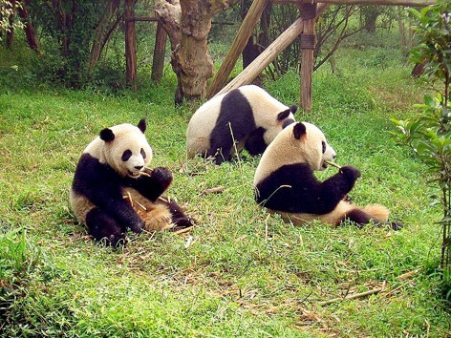
1 atactataaa tccacctctc attttattca cttcatacat gctattacac actctgtgcc
61 atcatagtat gttttcatac atcctccctt ctttcacacc ctatgtatat cgtacattaa
121 tggtgtaccc cccctccccc tatgtatatc gtgcattaat ggcgtgcccc atgcatataa
181 gcatgtacat actgtgcttg gctttacatg aggatactca ttacaagaac ttatttcaag
241 cgatagtcta tgagcatgta tttcacttag tccaagagct tgatcaccaa gcctcgagaa
301 accagcaatc cttgcgagta cgtgtacctc ttctcgctcc gggcccataa tttgtggggg
361 tttctatact gaaactatac ctggcatctg gttcttacct cagggccatg ttagcgtcaa
421 ctcaatccta ctaacccttc aaatgggaca tctcgatgga ctaatgacta atcagcccat
481 gatcacacat aactgtggtg tcatgcattt ggtatttttt aattttaggg ggggaacttg
541 ctatgactca gctatgaccg taaaggtctc gtcgcagtca aatcagctgt agctgggctt 601 attcatcttt cgaggctcct catggacacc cataaggtgc aattcagtca atggtcacag 661 gacataacac tatagatcac ccggactggc gttacgtgta cgtacgtgta cgtacgtgta 721 cgcacgtgta cgtacgtgta cgcacgtgta cgtacgtgta cgcacgtgta cgcacgtgta 781 cgtacgtgta cgcacgtgta cgtacgtgta cgtacgtgta cgcacgtgta cgcacgtgta 841 cgtacgtgta cgcacgtgta cgtacgtgta cgcacgtgta cgcacgtgta cgcacgtgta 901 cgtacgtgta cgcacgtgta cgtacgtgta cgcacgtgta cgcacgtgta cgtacgtgta 961 cgcacgtgta cgcacgtgta cgcacgtgta cgcacgtgta cgcacgtgta cgtacgtgta 1021 cgcgtacgta ttttagatac taagttagct tagacaaacc ccccttaccc cccgtaactt 1081 caagaagctt acatatactt atggatgtcc tgccaaaccc caaaaacaag actaaatata 1141 tgcgcaaaca tgaagtcact tacacctaaa cccatataat taagctaacc ccccagccaa 1201 tgttgcaaca actacggaca tgggactcta aattttaatt tatctataga tatttttctt 1261 ttactgtgtc tccccagcat tgatttttta attatcatta ttccacacca ccaatttcca 1321 ttgagctatt tcacatgagt tccaaatcaa ttatgttcat gtagcttaac gaataaagca 1381 aggtactgaa aatgcctaga tgggtcacgc taccccatag acataaaggt ttggtcctag 1441 ccttcctatt agccattaac aagattacac atgtaagtct ccacgctcca gtgaaaatgc 1501 cccttaagtc ctcttagacg acctaaagga gcgggtatca agcacacctt atggtagctc 1561 acaacgcctt gcttagccac acccccacgg gaaacagcag tgataaaaat taagctatga 1621 acgaaagttc gactaagcta tgttaatact agggttggta aatctcgtgc cagccaccgc 1681 ggtcatacga ttaactcgag ttaataggcc tacggcgtaa agcgtgtaaa agaaaaaatc 1741 tcctctacta aagttaaagt atgattaagc tgtaaaaagc taccattaat actaaaataa 1801 actacgaaag tgactttaaa atttctgatt acacgatagc tagggcccaa actgggatta 1861 gataccccac tatgcctagc tctaaacata gatattttac taaacaaaac tattcgccag 1921 agaactacta gcaacagctt aaaactcaaa ggacttggcg gtgctttata tccccctaga 1981 ggagcctgtt ctgtaatcga taaaccccga tagacctcac catcccttgc taattcagtt 2041 tatataccgc catcttcagc aaacccttaa aaggaaaaaa agtaagcata actaccctac 2101 ataaaaaagt taggtcaagg tgtaacctat gggctgggaa gaaatgggct acattttcta 2161 ttcaagaaca acttctacga aaacttttat gaaactaaaa gctaaaggcg gatttagtag 2221 taaattaaga atagagagct taattgaaca gggcaatgaa gcacgcacac accgcccgtc 2281 accctcctcg agtgatataa tttaattata acctatttaa actaagcaaa gcataagagg 2341 agacaagtcg taacaaggta agcatactgg aaagtgtgct tggatgagcc aaagtgtagc 2401 ttaaacaaag cgtctggctt acatccagaa gatttcatta atatatgact actttgaacc 2461 caaagctagc ccaagcaaca atgactagta aaaccattat gaaacattca aacaaaacat 2521 ttagtagcat gactagagta taggagatag aaatttttaa ctggagctat agagagagta 2581 ccgcaaggga atgatgaaag attacctaaa gtgataaaca gcaaagattg ccccttctac 2641 cttttgtata atgagttagc tagaaataac ttaacaaaga gaacttaagc taagtccccc 2701 gaaaccagac gagctaccta tgaacaatcc actgggatga actcatctat gttgcaaaat 2761 agtgagaaga tccataggta gaggtgaaag gcctaacgag cctggtgata gctggttgcc 2821 cagaatagaa ttttagttcg actttaaacc tgcctacaaa actaataatt ctaatgcaga 2881 tttaaaatat attctaaaaa ggtacagctt tttagagtta aggatacagc cttacttaga 2941 gagtaaatat ttatataagc catagtaggc ctagaggcag ccatcaatta agaaagcgtt 3001 aaagctcaac atctctatta acttaatacc aagaatattt aatcaactcc taatgtatta 3061 ctgggtcaat ctatttaaat atagaagtga taatgctaat atgagtaaca agaaatattt 3121 ctcccatgca taagcttata acagcaacgg ataaccactg atagttaaca acaacataga 3181 aataacctaa tgataaaaca cctattaaat caattgttag tccaacacag gcatgcaatc 3241 agggaaagat taaaagaagt gaaaggaact cggcaaatac aaaccccgcc tgtttaccaa 3301 aaacatcacc tccagcattt ccagtattgg aggcactgcc tgcccggtga catcagttaa 3361 acggccgcgg tattctgacc gtgcaaaggt agcataatca tttgttctct aaataaggac 3421 ttgtatgaat ggccacacga gggtttaact gtctcttact tccaatcagt gaaattgacc 3481 tccccgtgaa gaggcgggga taagacaata agacgagaag accctatgga gctttaatta 3541 actaattcaa aaagaaacta ctaacgaccc aacaggaata atatatctct tttatgaatt 3601 agcaatttag gttggggcga cctcggagga caaaatagcc tccgagtgat tataaatcta 3661 gacttaccag tcaaaatgct taatcactta ttgatccaaa aattcttttg atcaacggaa 3721 caagttaccc tagggataac agcgcaatcc tatccgagag tccatatcga caatagggtt 3781 tacgacctcg atgttggatc aggacatcct aatggtgcag cagctattaa aggttcgttt 3841 gttcaacgat taaagtccta cgtgatctga gttcagaccg gagcaatcca ggtcggtttc 3901 tatctattca aataatttct cccagtacga aaggacaaga gaaataaggc ctacttctct 3961 gaagcgcctt aagaccaata gatgaattta tctaaatcta gtaaatctaa ctccaatatt 4021 gcccaagaga cagggctttg ttagggtggc agagcccggt aattgtgcaa aacttaaact 4081 cttgtgtcca gaggttcaat tcctctccct agcatatgtt tataattaac atcttctcac 4141 taattgtacc tattcttctt gctgtagcct ttctgactct agtagaacga aaagtactag
Example Genomic Sequence
⇐ Giant Panda (Ailuropoda melanoleuca) mitochondrion sequence [Peng et al, Gene 397:76-83 (2007)]
Obviously, computers are needed to understand what this means.
Where are the genes encoded in this sequence? What causes each gene to be turned on or off? How does the genome produce observed traits?

Slide 13
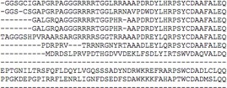
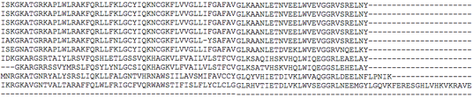
Two ways to find genes .
1. Search for sequence of DNA similar to known gene:
Human version of gene
{
Similar sequences in other organisms
⇒ need to search for strings really fast (allowing for errors)
2. Search the genome sequence for patterns of letters that “look like genes”.

Slide 14
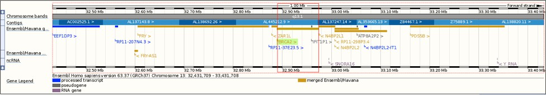
Some Human Genes
http://useast.ensembl.org/Homo_sapiens/Location/View?db=core;g=ENSG00000139618;r=13:32889611-32973805

Slide 15
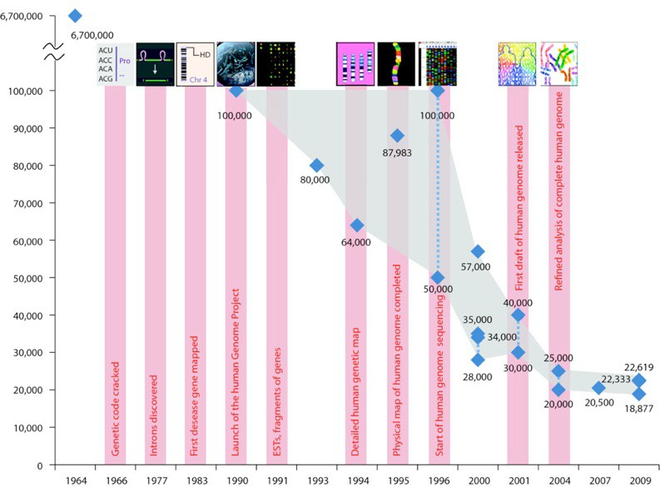
Estimates for the # of Human Genes
Before human genome sequence was available, many
(but not all) estimates for # of genes were high (> 80,000).
Now estimates are < 23,000.
Pertea and Salzberg Genome Biology 2010 11:206

Slide 16
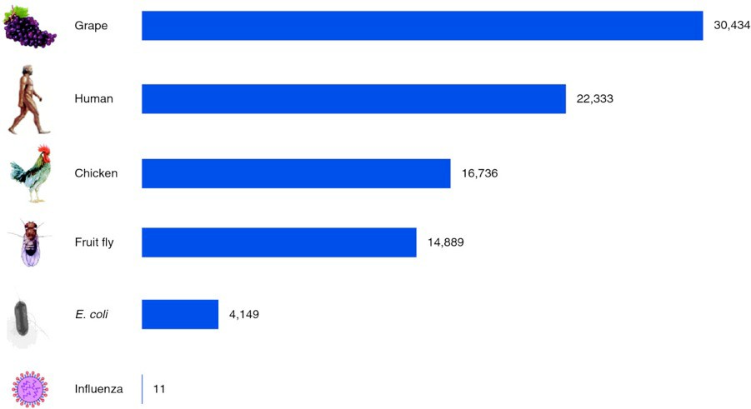
# of Genes in Various Organisms
•
•
Subsequences of DNA are “genes” that encode (mostly) for proteins.
# of genes in various organisms still not definitely know (because finding genes in the sequence is a hard problem that we will talk about).
Pertea and Salzberg
Genome Biology 2010
11:206
•
But there are reasonably good estimates.

Slide 17
Tracking the evolution of influenza

Slide 18

Influenza Virus
Rapidly evolving (it’s genome is mutating):
that’s why you have to get a different flu shot every year
3 strains must be selected each year to include in the vaccine.
(Toda et al., 2006)
So, the evolution of the virus is must be predicted.

Slide 19
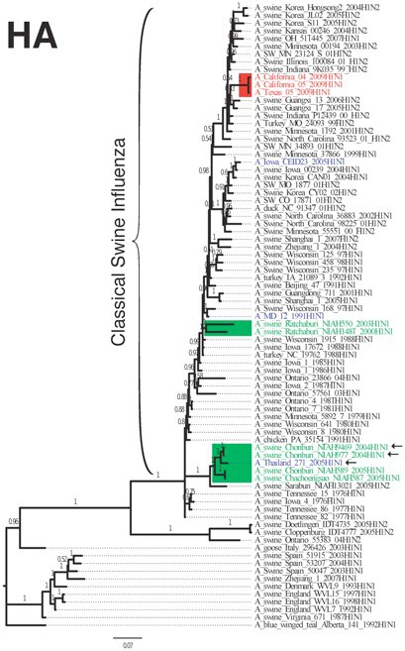
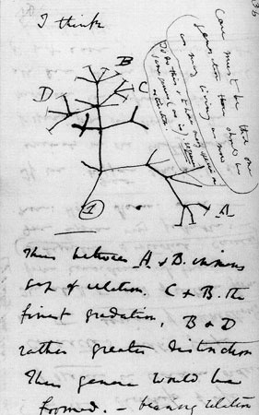
Evolutionary Trees
http://www.amnh.org/exhibitions/darwin/idea/treelg.php

Slide 20
Protein structure prediction

Slide 21
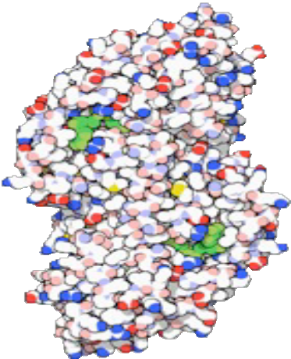
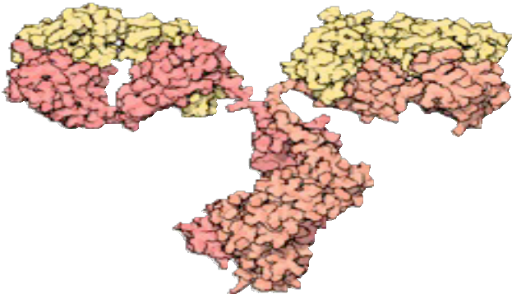
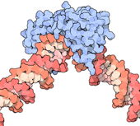

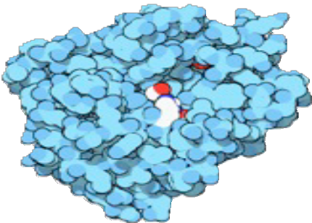
Examples of Proteins
Alcohol dehydrogenase
Antibodies
TATA DNA
binding protein
Collagen: forms tendons, bones, etc.
Trypsin: breaks down other proteins
Examples of “Molecules of the Month” from the Protein Data Bank
http://www.rcsb.org/pdb/

Slide 22
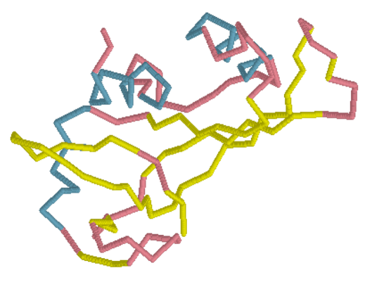
Predicting Structure
Given: ATGAAGATGATAGATGGGGCCCGACAG…
Determine:

Slide 23
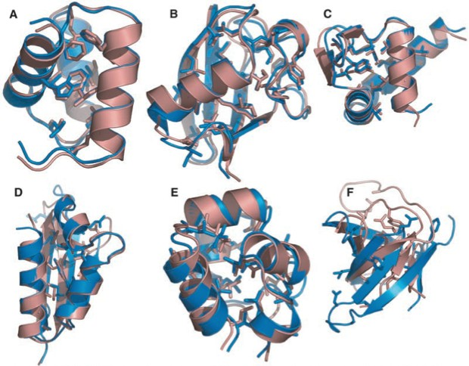
blue = computational prediction red = experimentally determined
Bradley, P., Misura K. M. S., & Baker D. (2005). Toward high-resolution de novo structure prediction for small proteins. Science. 309(5742), 1868-71.

Slide 24


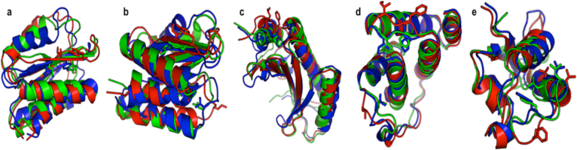
http://boinc.bakerlab.org/rosetta/
http://fold.it/portal/
Cooper, Khatib et al, Nature, 466, 756-60. (2010)

Slide 25
Links
DNA Microarray

