Slide 1

Scientific Method

Slide 2
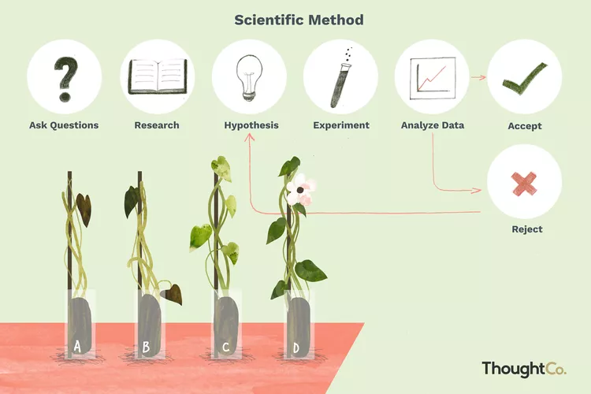

Slide 3
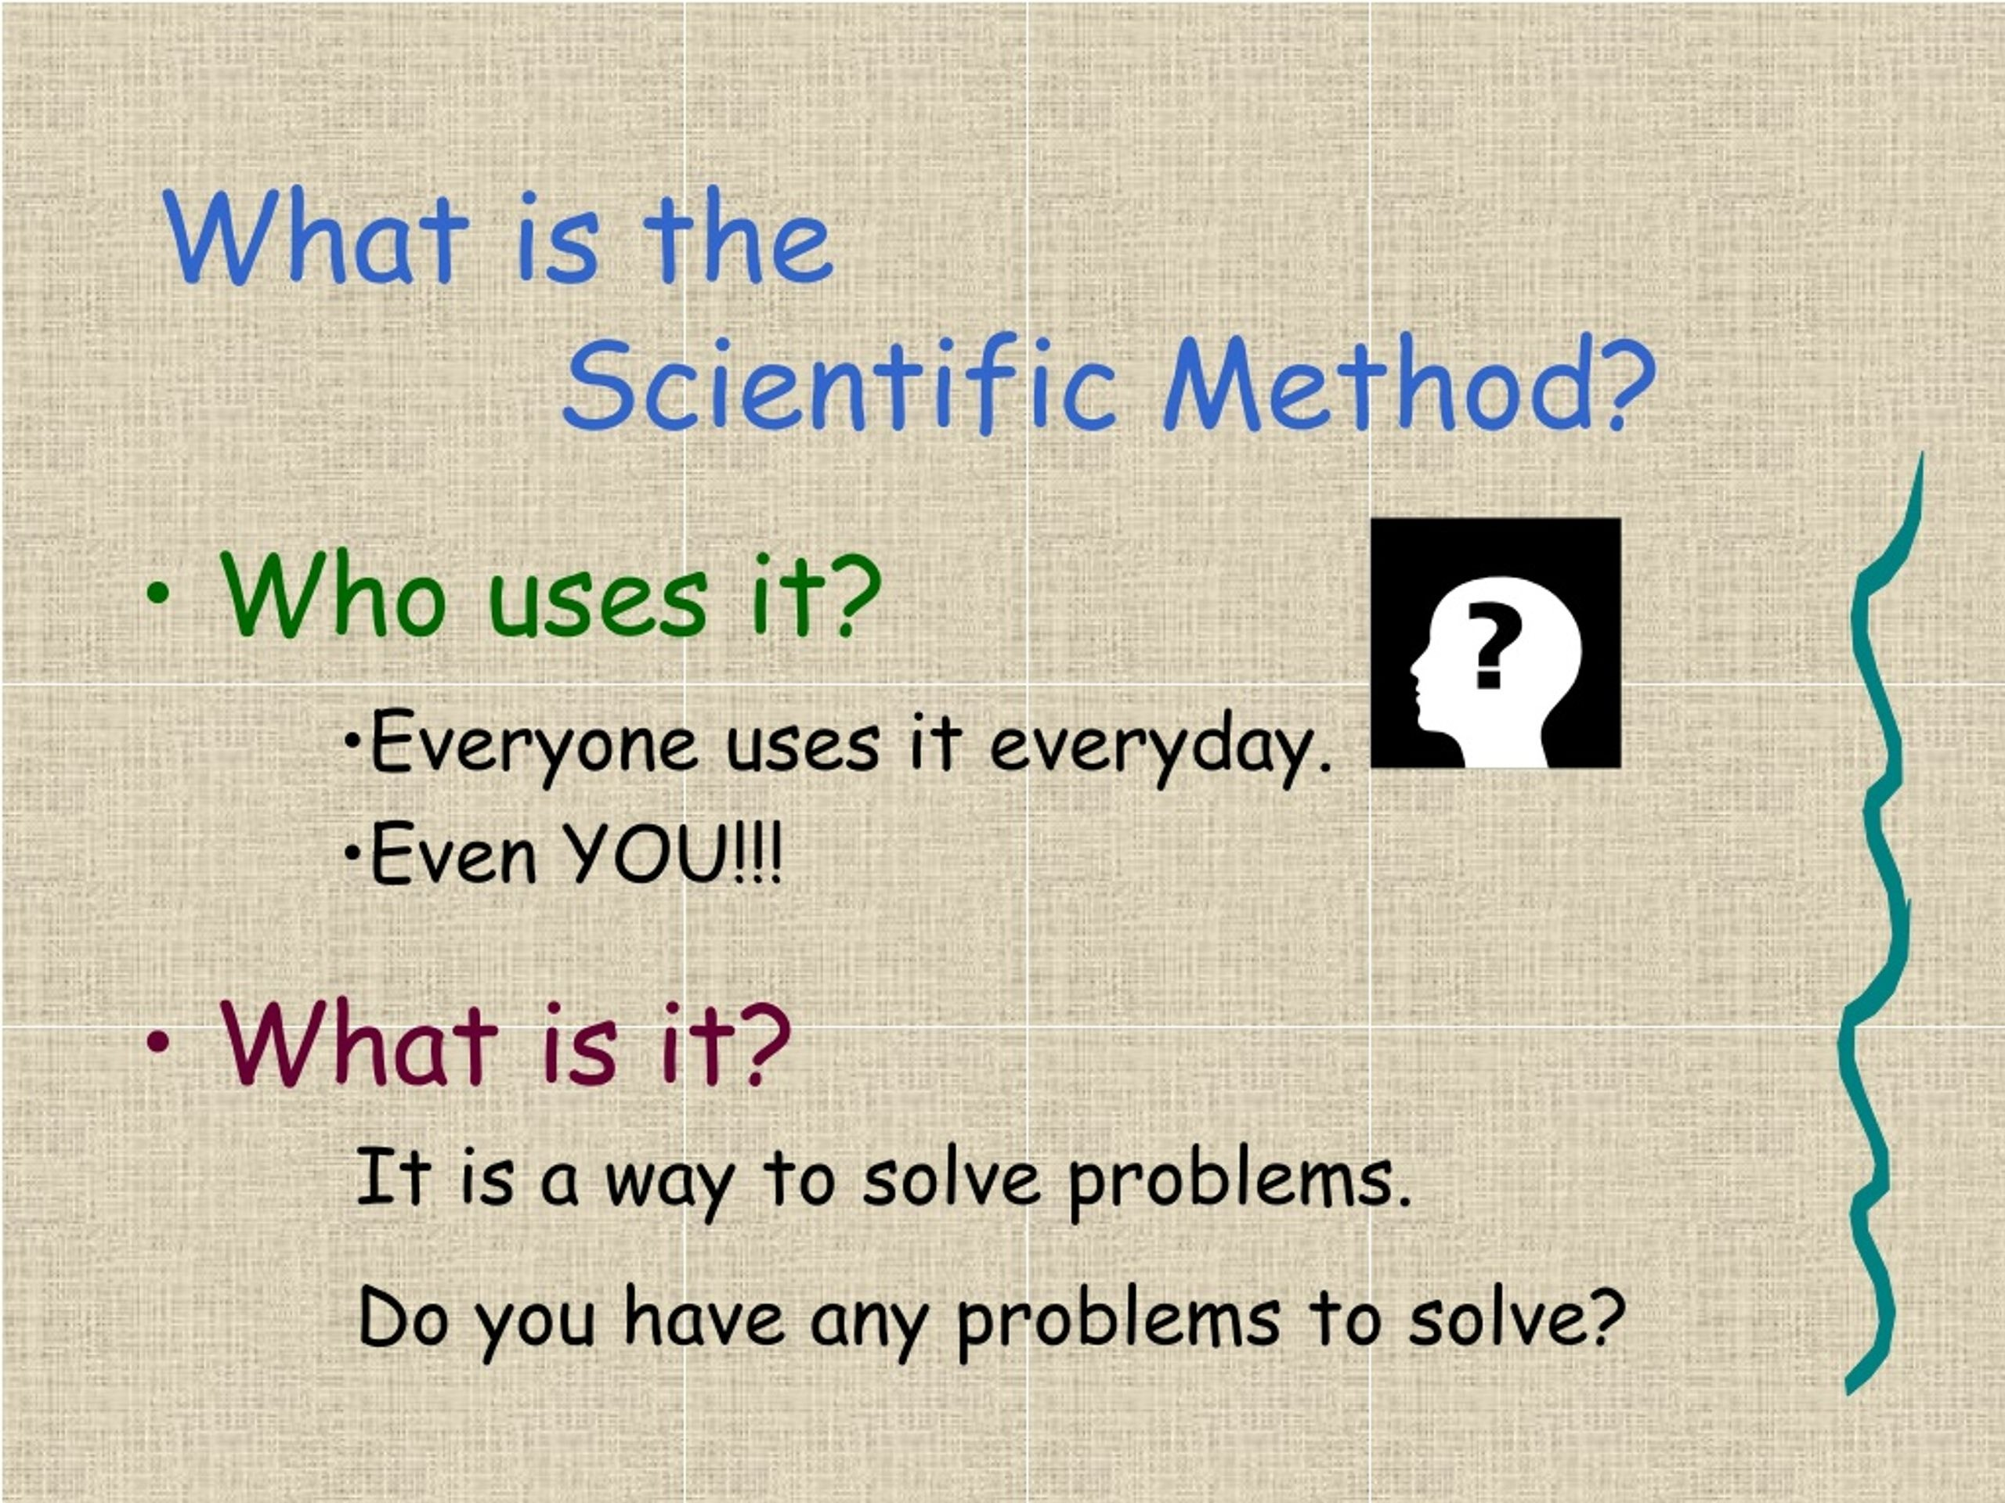

Slide 4
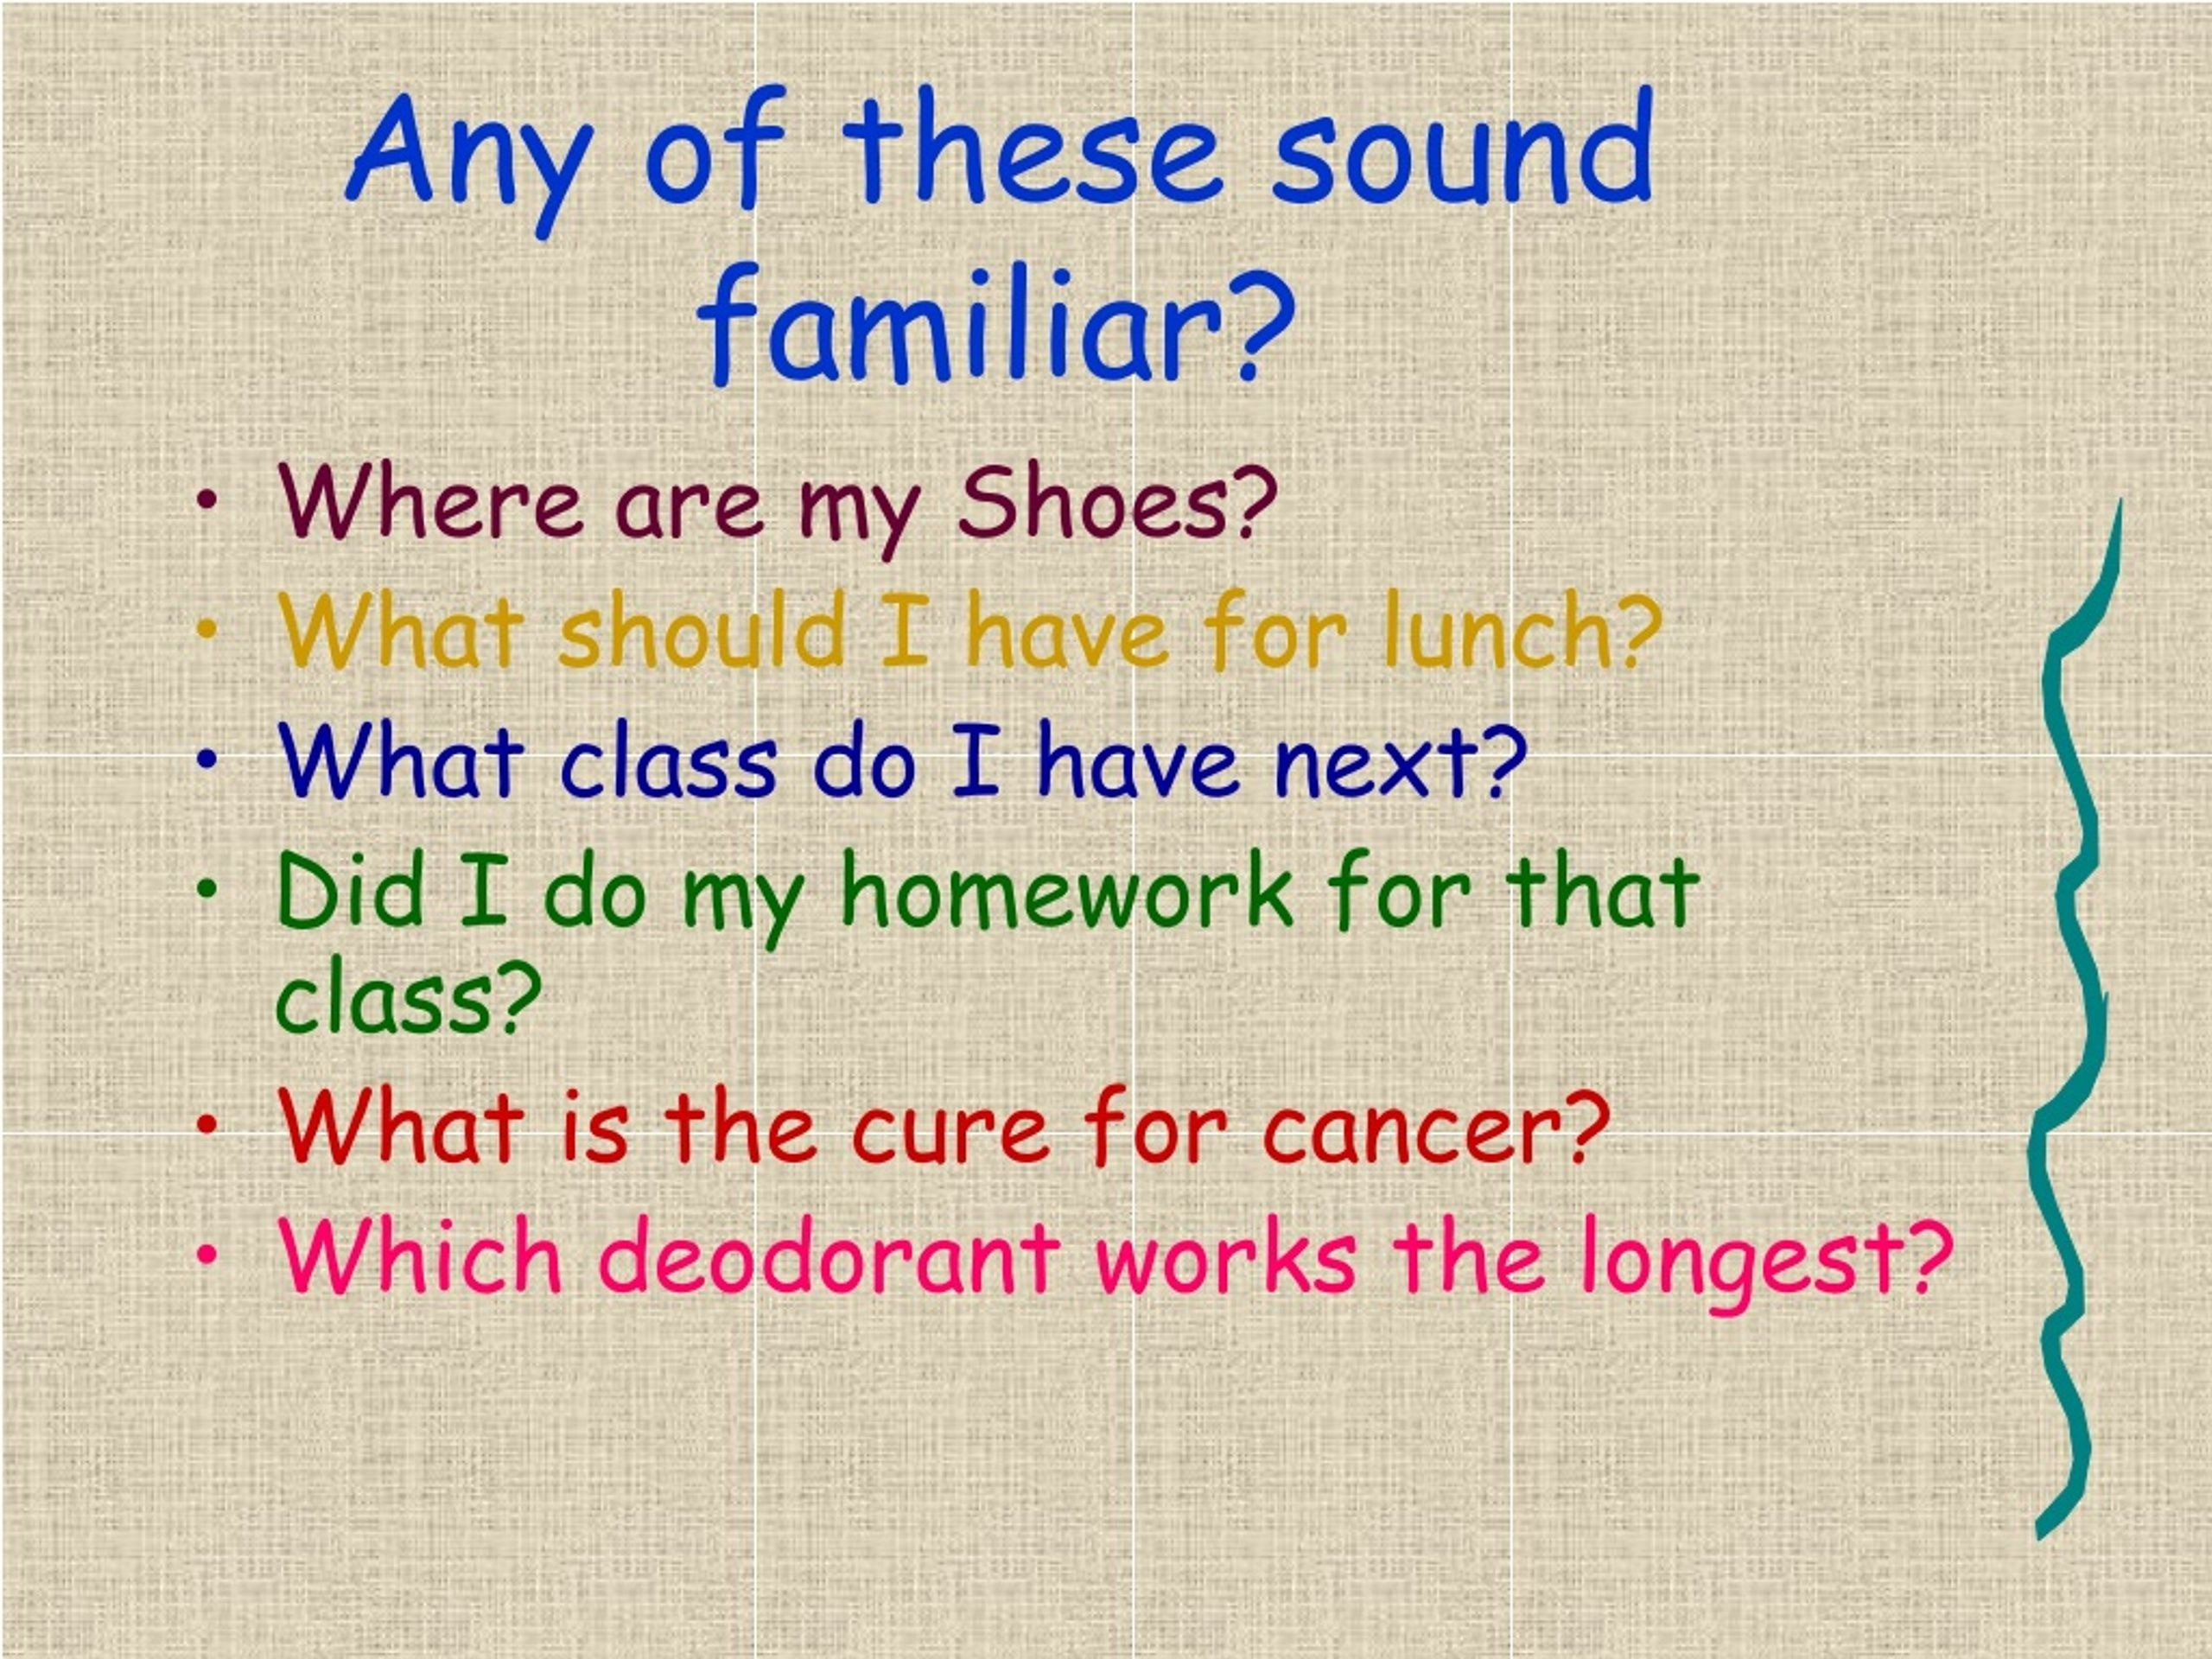

Slide 5
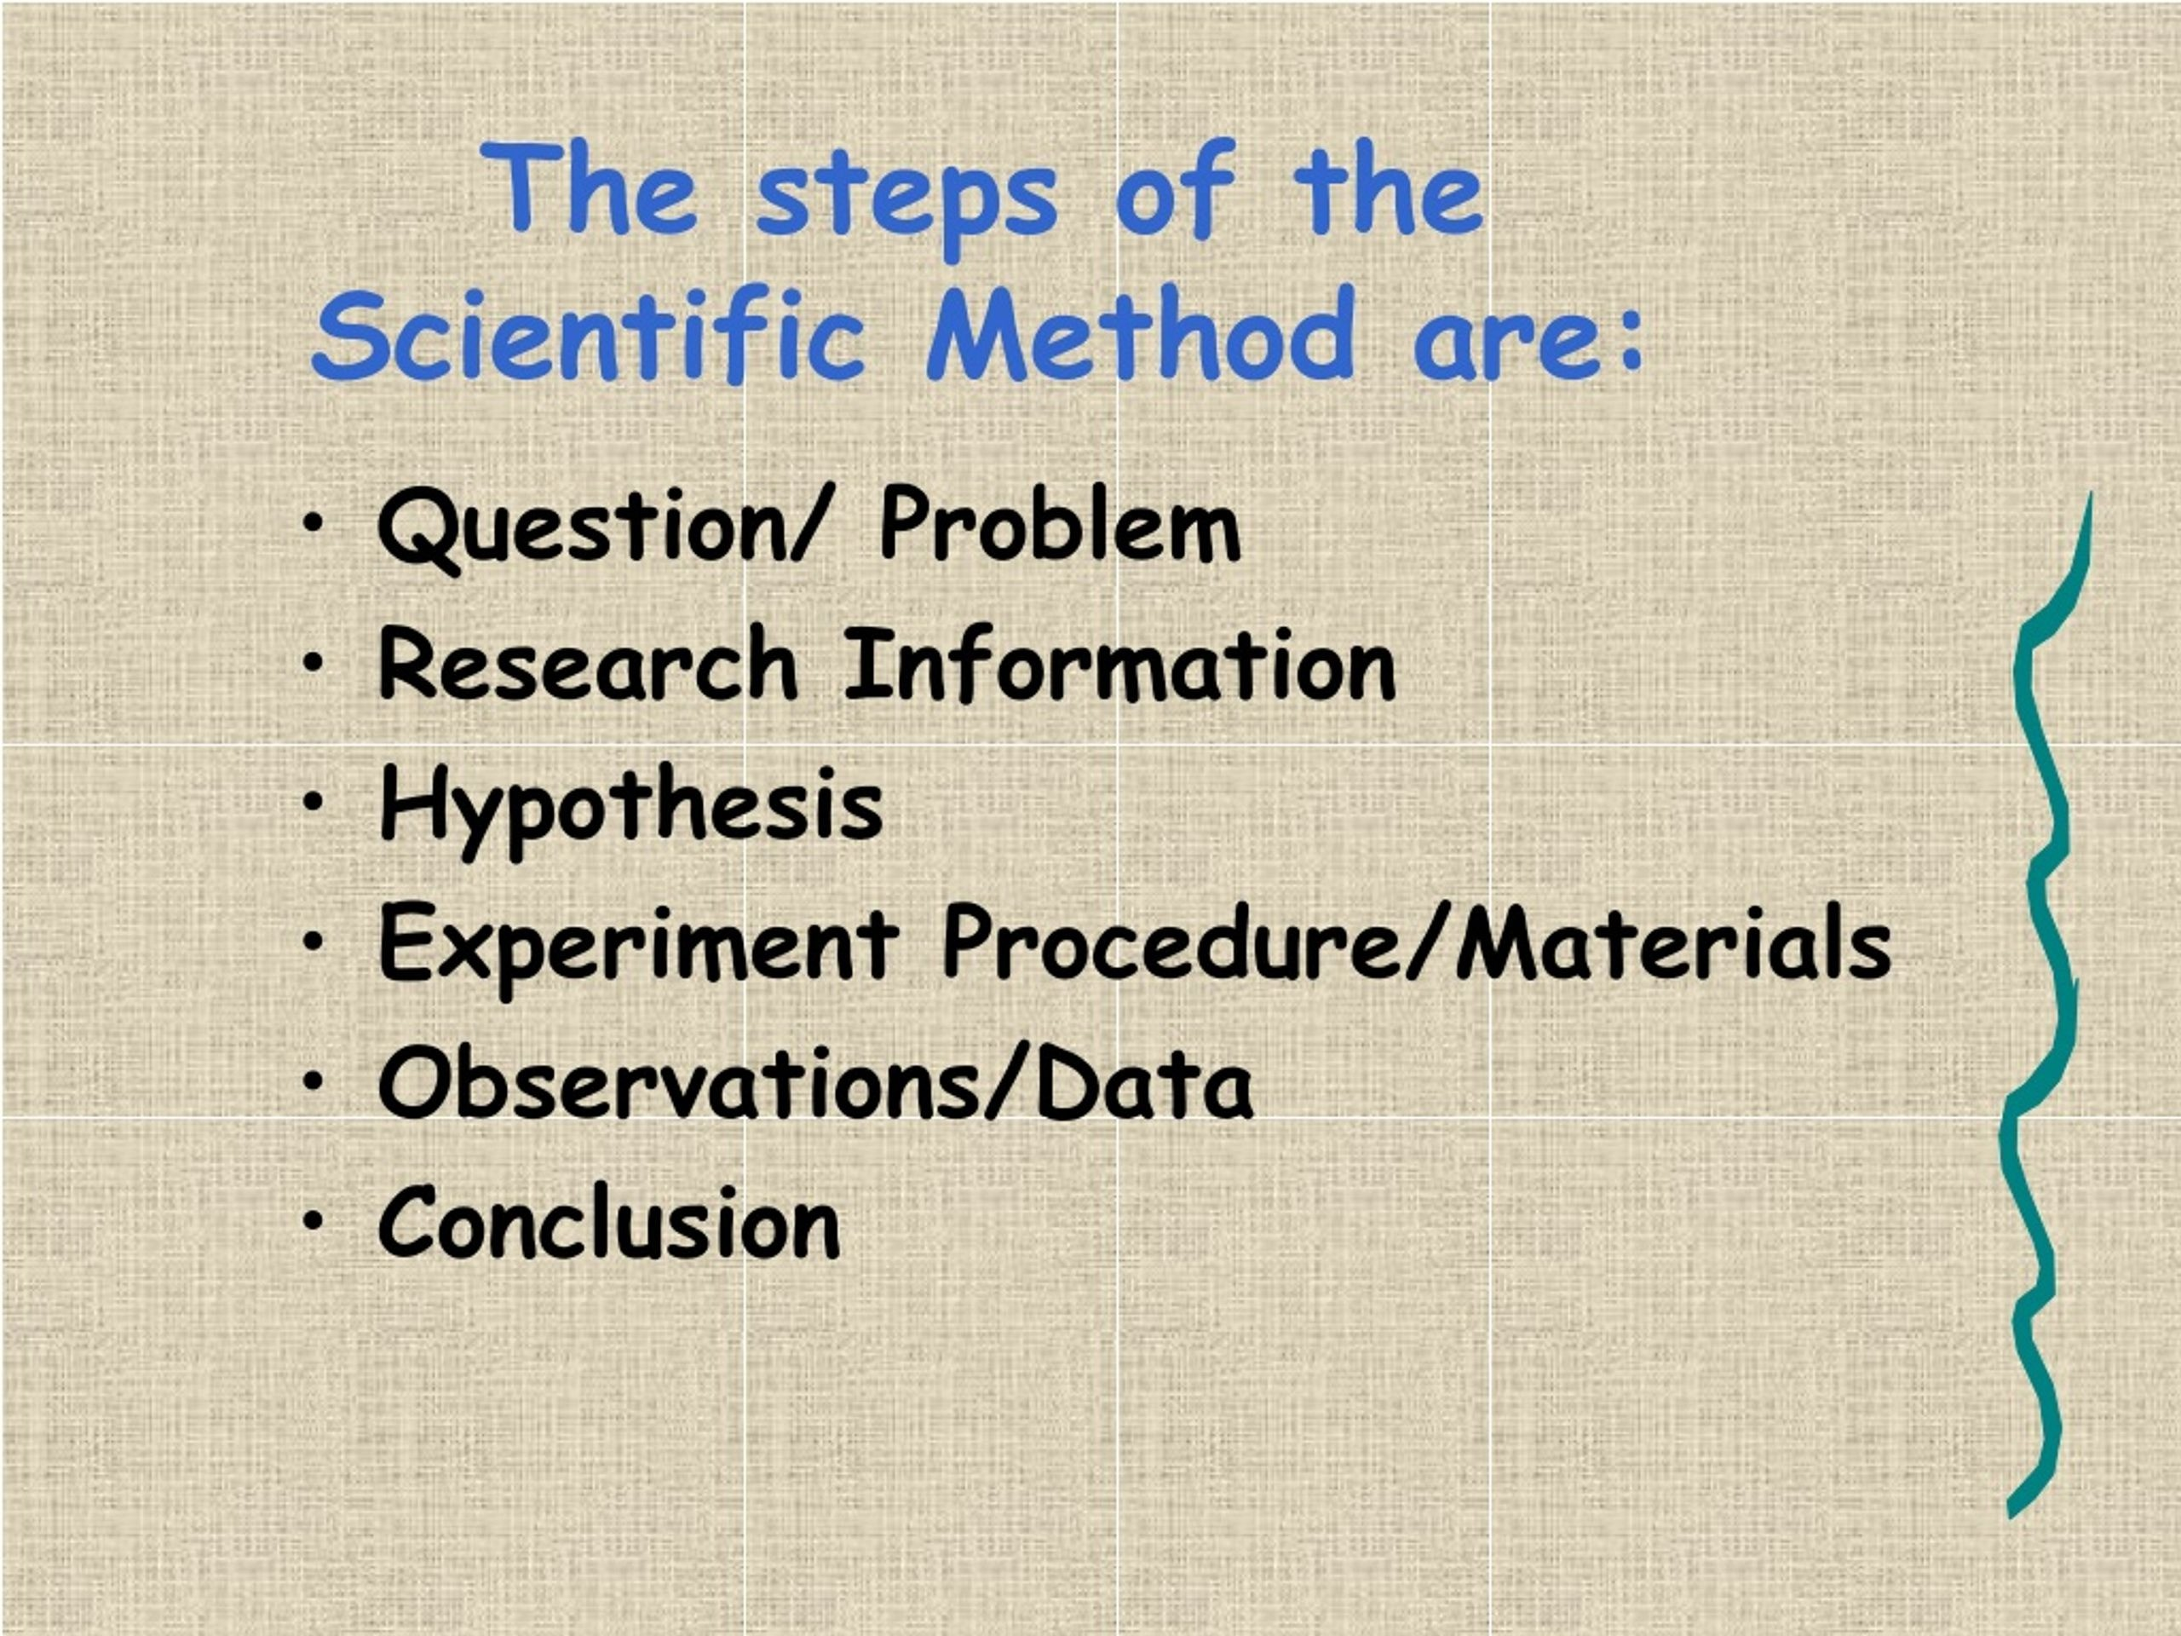

Slide 6


Slide 7


Slide 8
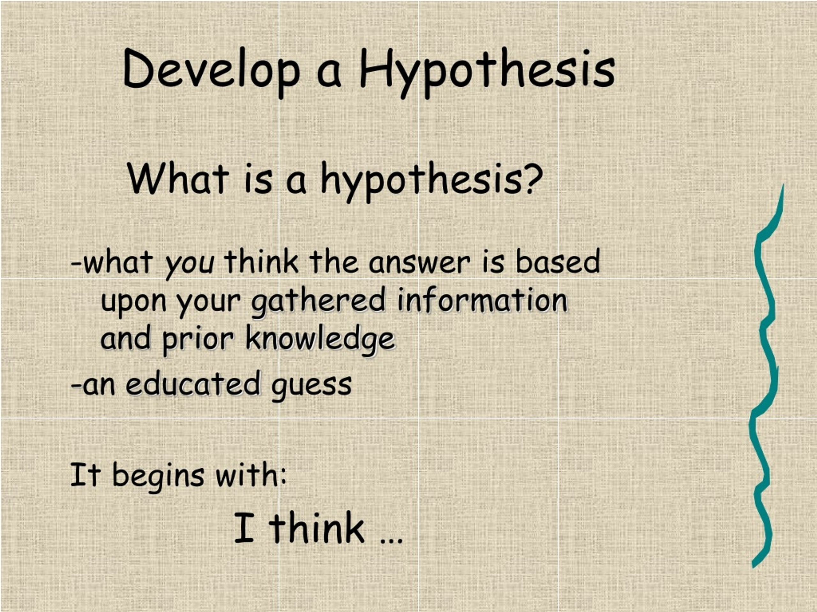

Slide 9
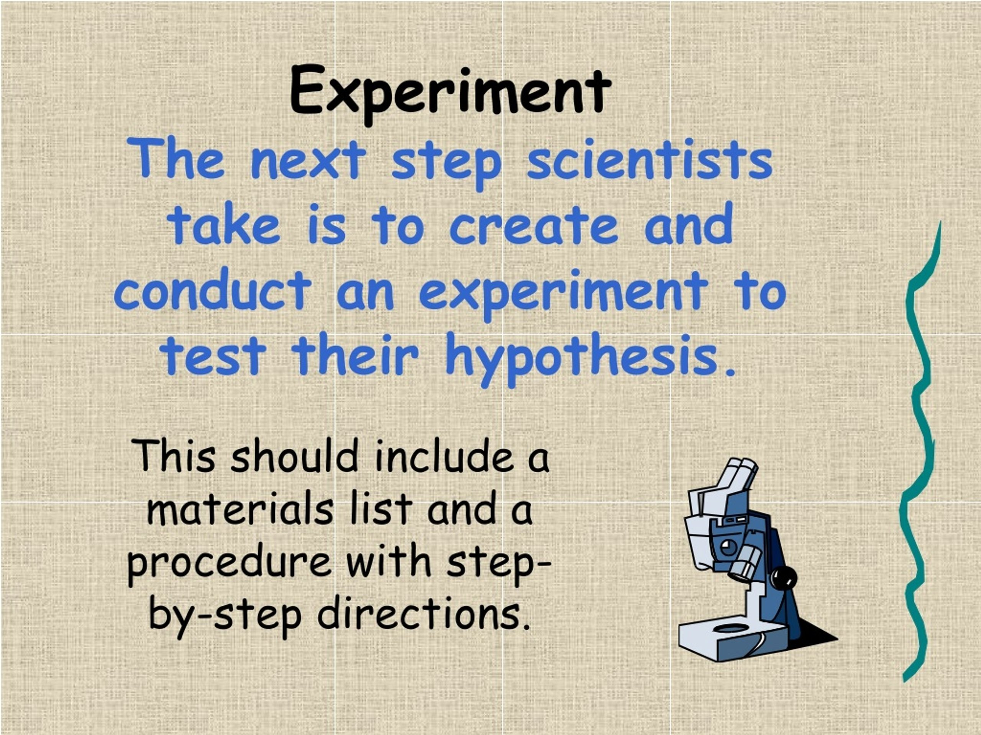

Slide 10
HYPOTHESIS
Prediction based on prior knowledge
FORMAT: If x happens, then y happens, because ________________.
Example:
Question: Will fertilizer affect how tall a plant will grow?
Hypothesis: IF fertilizer is added to a plant, THEN, it will grow taller BECAUSE the plant will gain more energy and nutrients to grow.

Slide 11
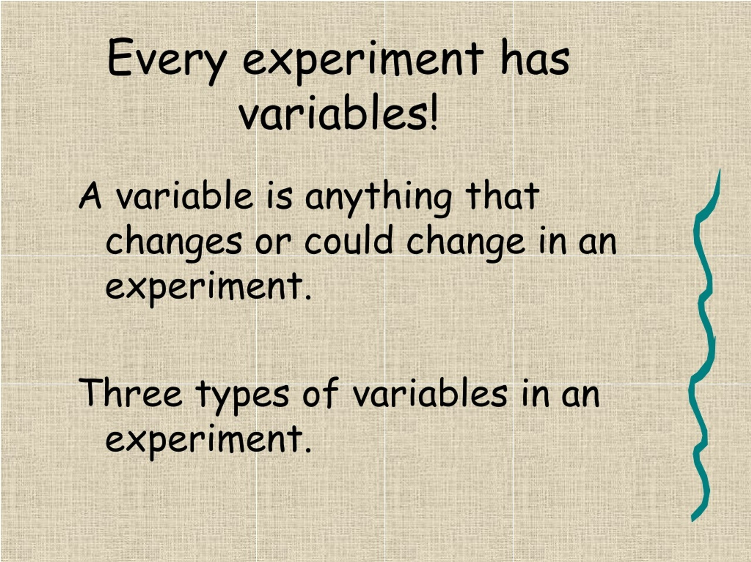

Slide 12
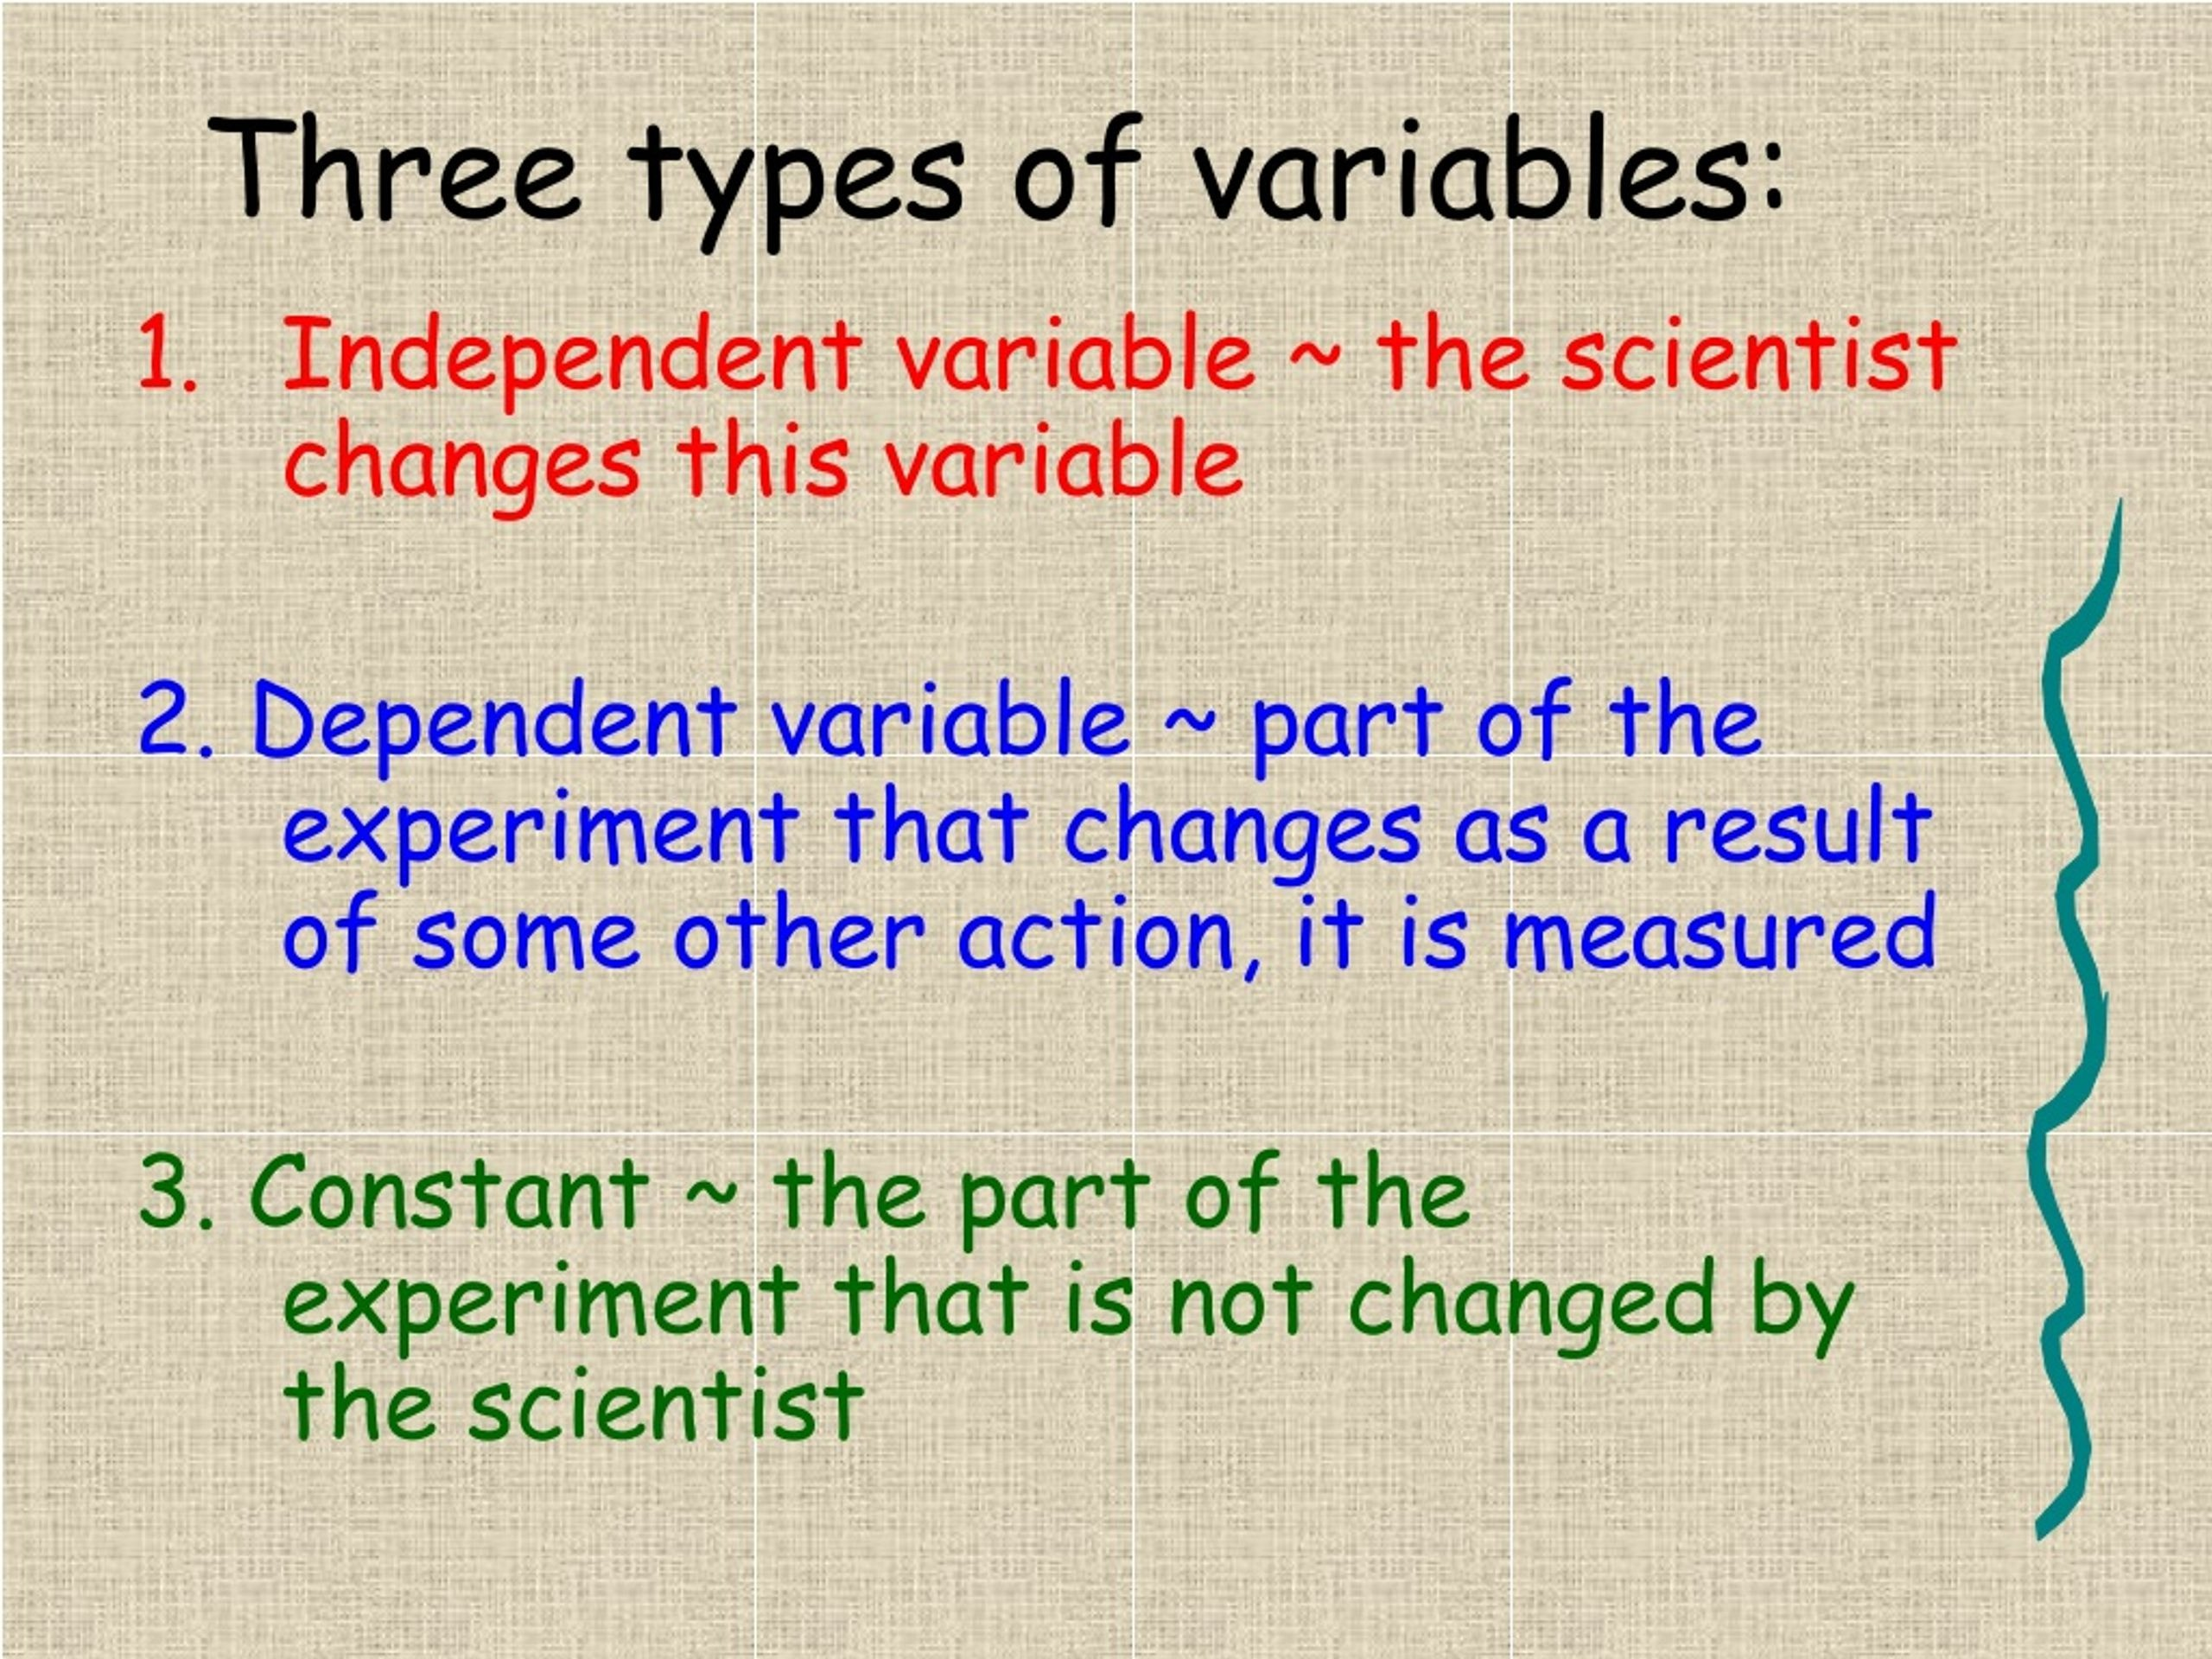

Slide 13
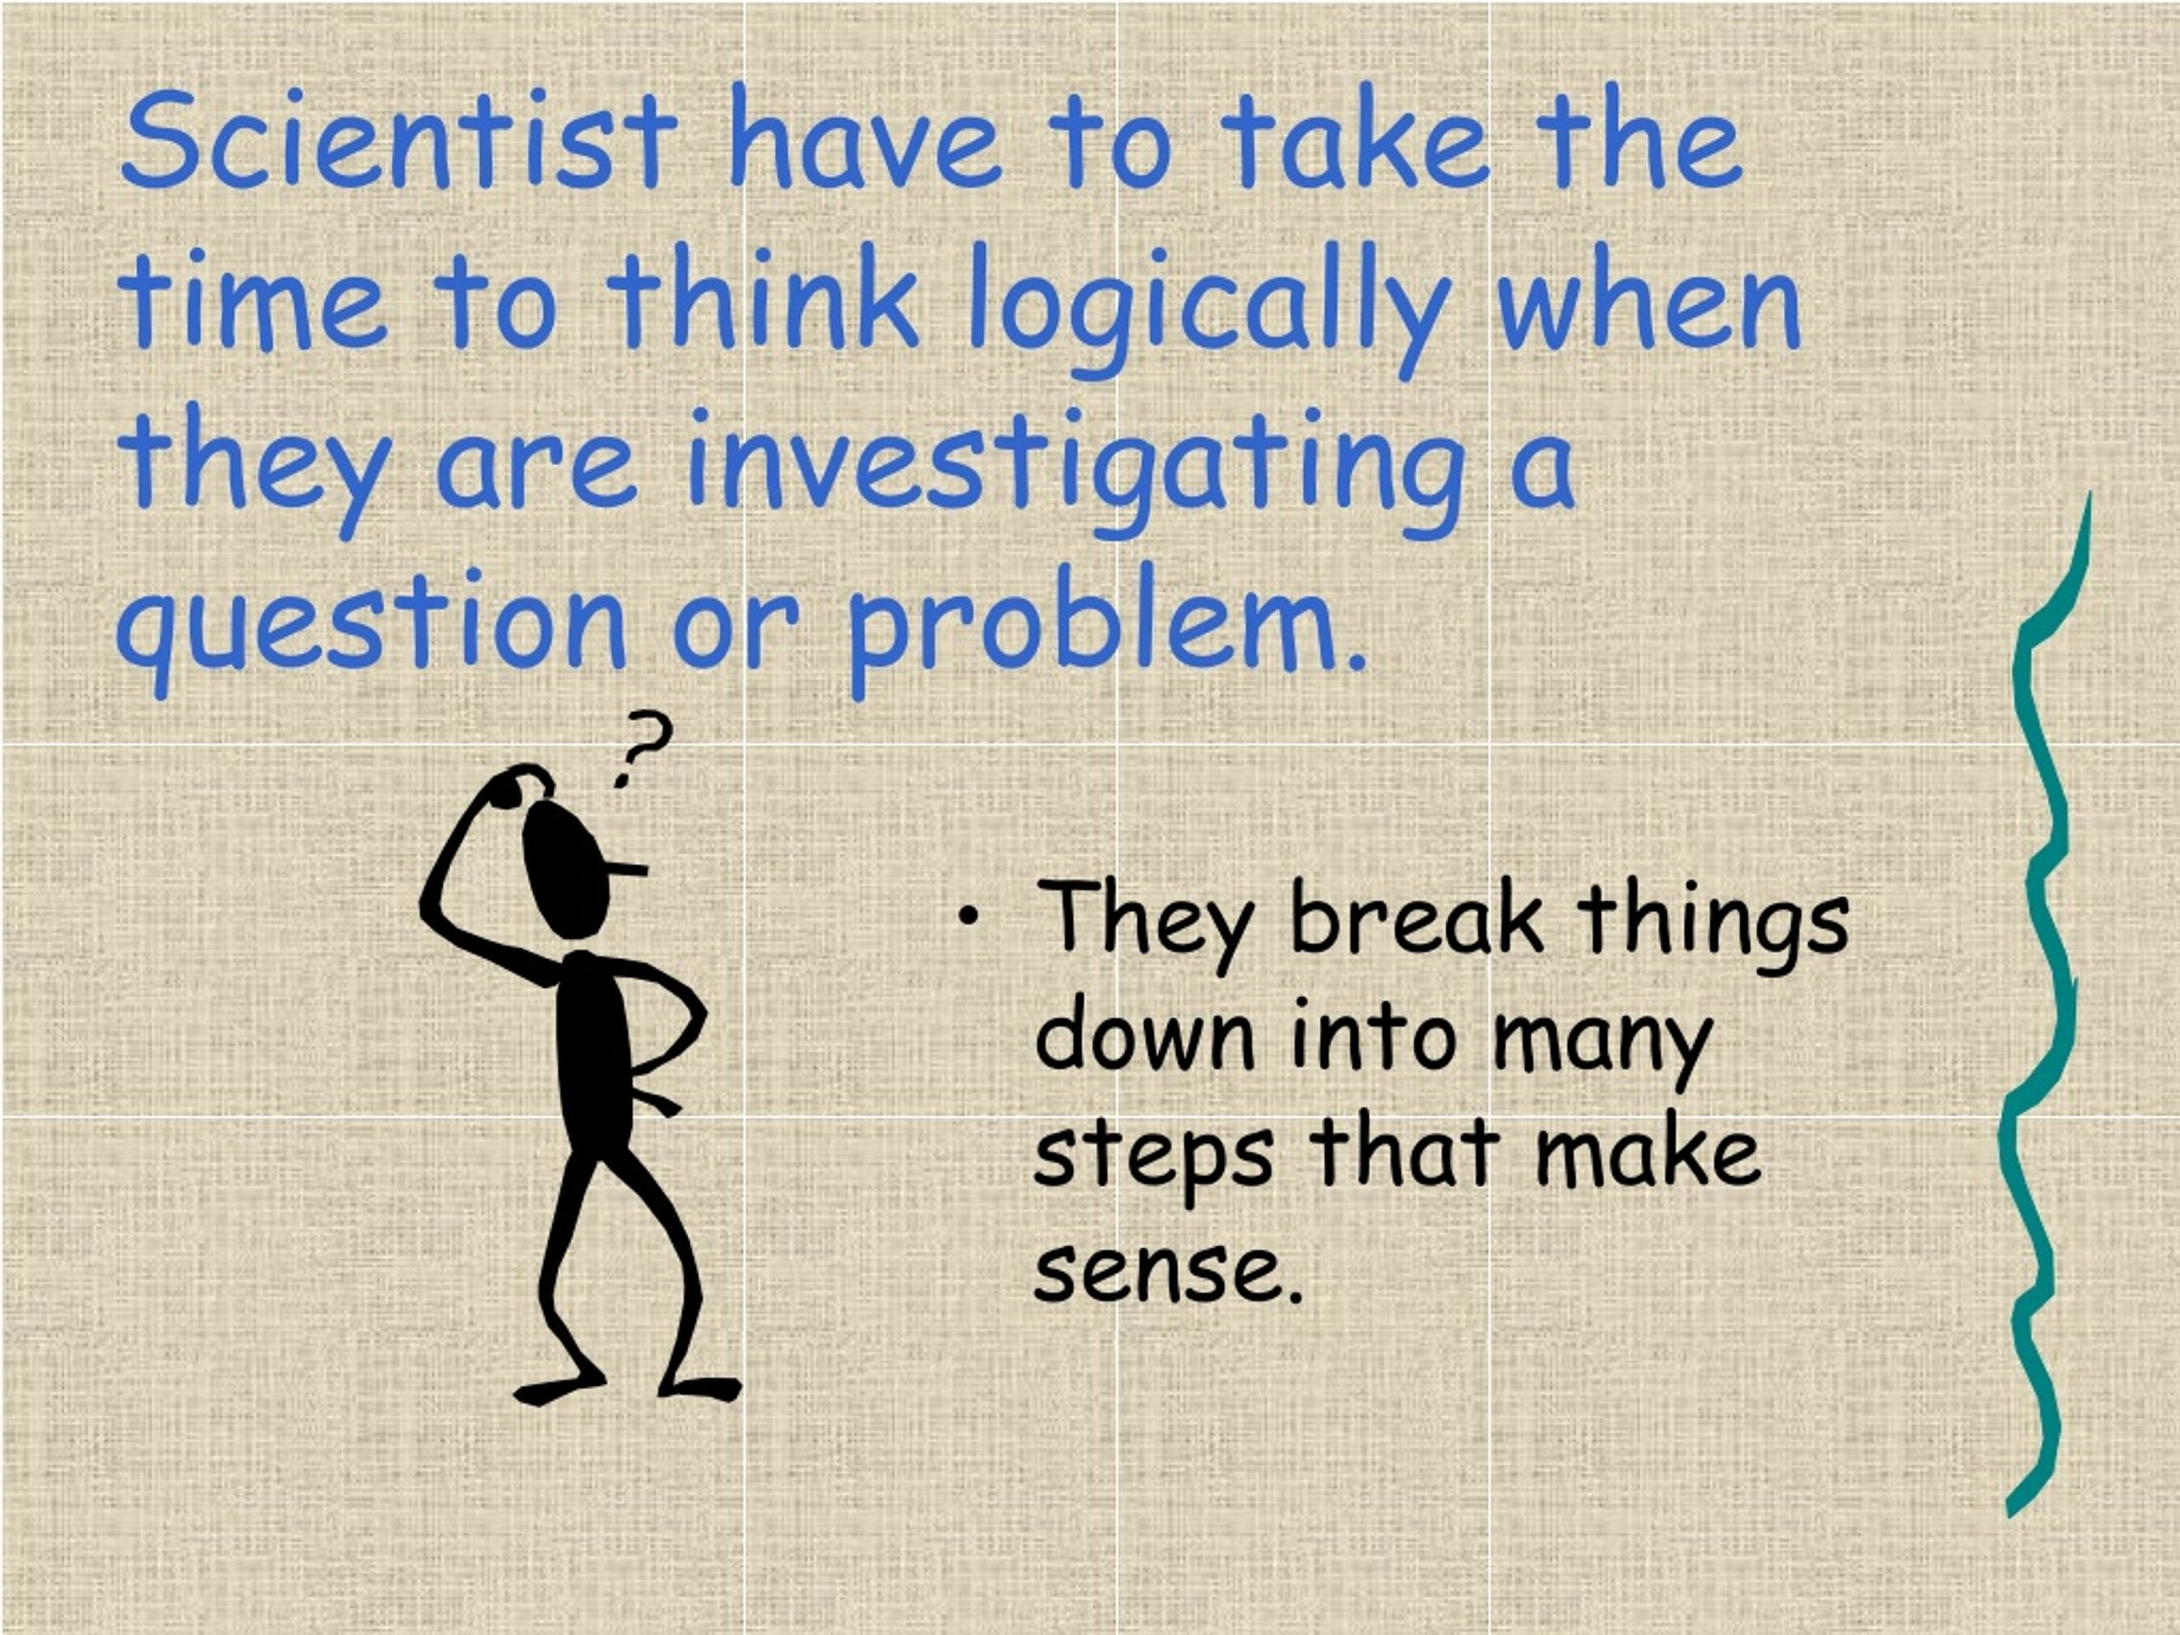

Slide 14
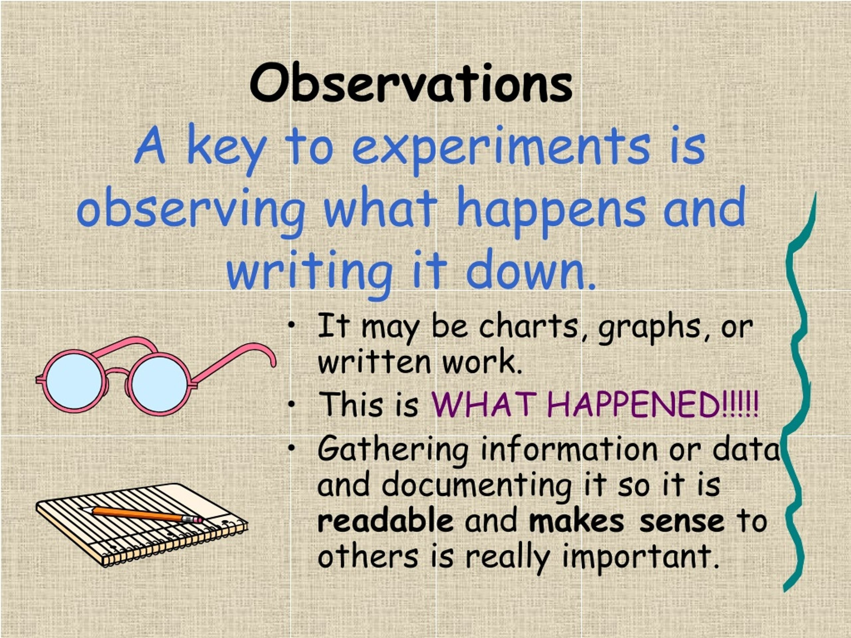

Slide 15
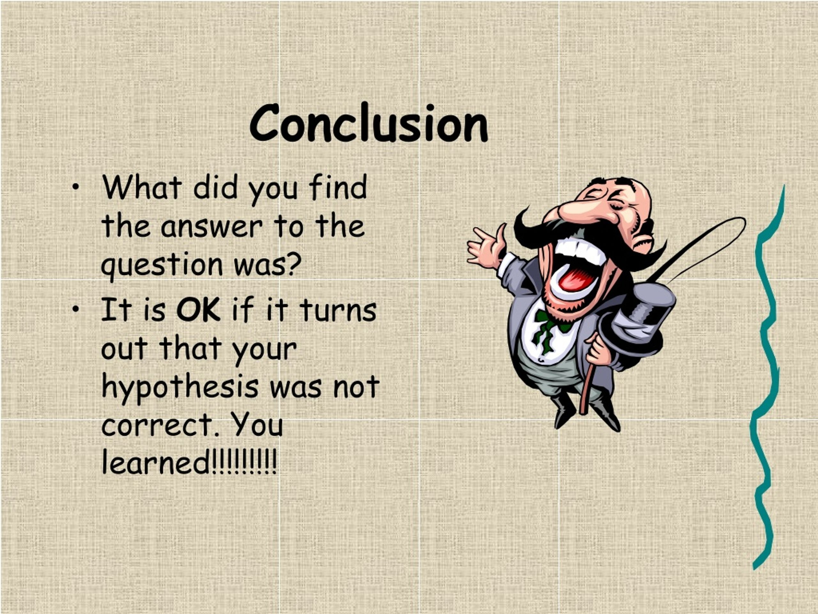

Slide 16
experimen†, †hey of†en repeQ† i†

Slide 17
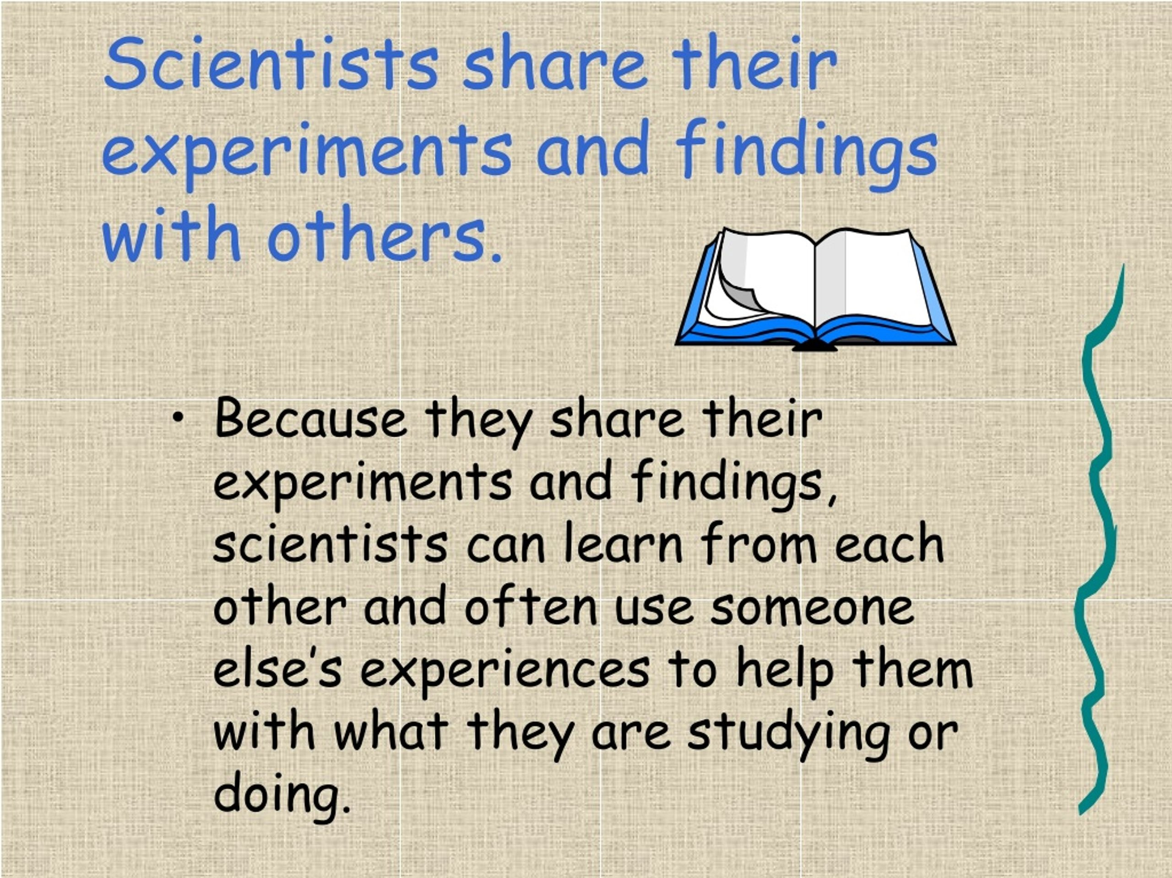

Slide 18
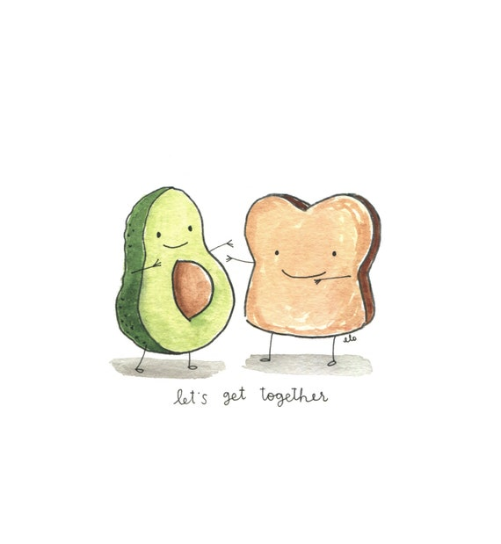
Avacado & Toast

Slide 19
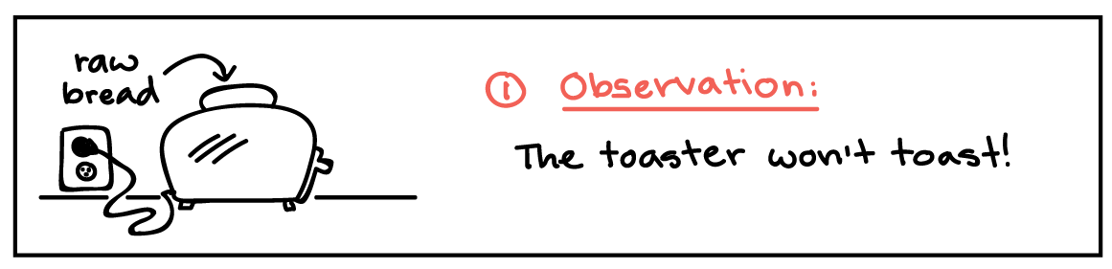

Slide 20


Slide 21


Slide 22
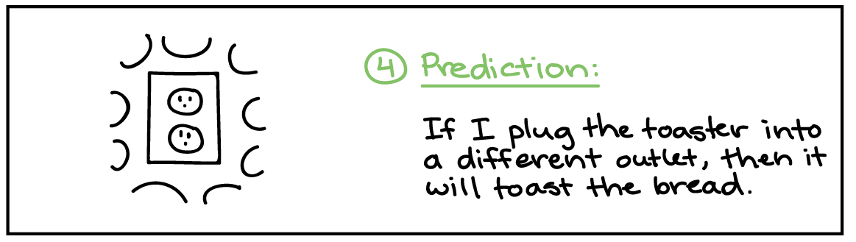

Slide 23
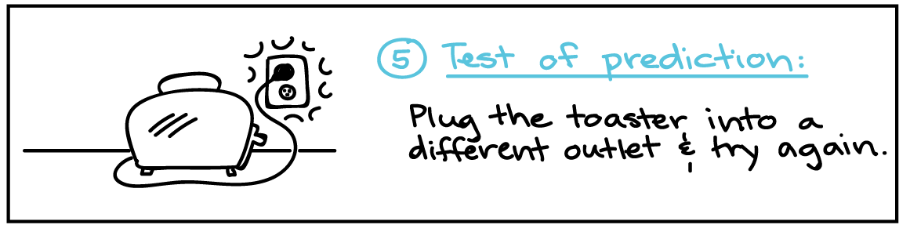

Slide 24
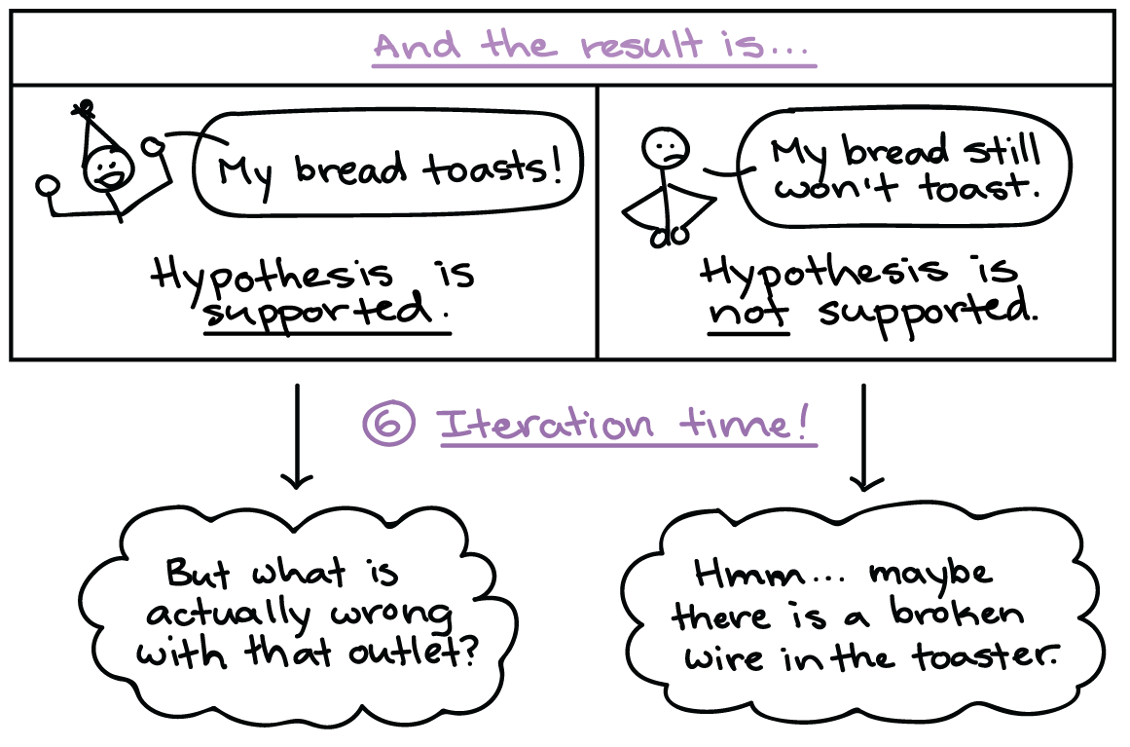

Slide 25
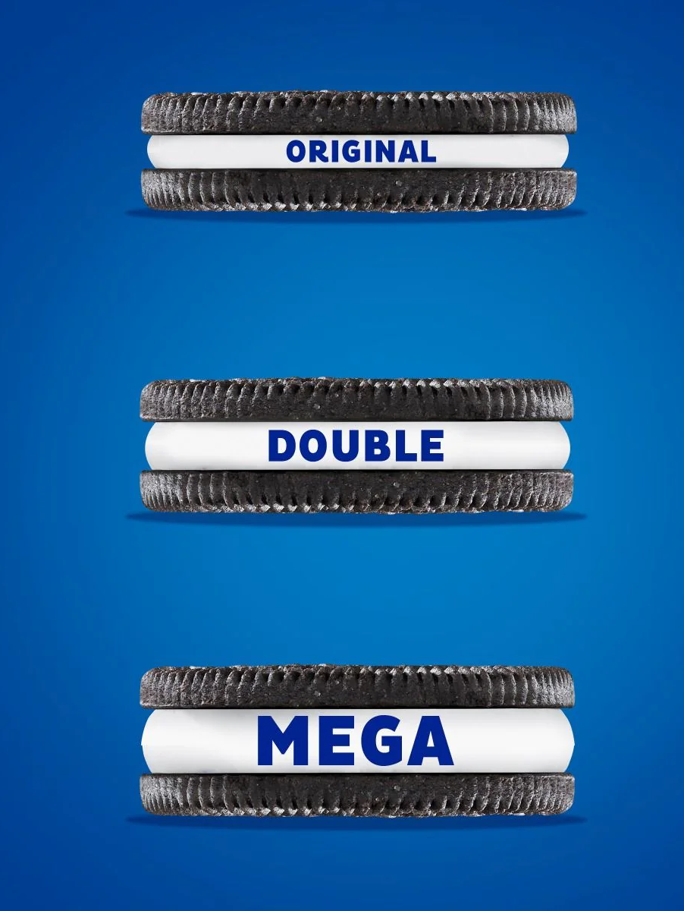
Are Double Stuf Oreos actually double stuffed?

Slide 26
Dan Anderson, a math teacher in New York, had his class put the double-stuffed claims to the test in 2013. Read More:
Instead of double the amount of creme filling, according to the class's findings, the Double Stuf cookies had only 1.86 times the creme as the original. That's 7% less creme than expected per cookie.Read More: https://www.tastingtable.com/1070092/are-double-stuf-oreos-actually-double-stuffed/
Insider duplicated the study with similar findings. In their own experiment, reporters found Double Stuf Oreos to contain 1.91 times as much creme filling as the original.Read More: https://www.tastingtable.com/1070092/are-double-stuf-oreos-actually-double-stuffed/
Are Double Stuf Oreos actually double stuffed?

