Slide 1

Welcome to Drone Design

Slide 2

Safety

Slide 3
Agenda
FAA Safety Regulation

Slide 4
FAA Safety regulation
Safe operation among aircrafts (both unmanned and manned)
Protect people and properties on the ground
Enhance National Safety

Slide 5
Regulation
All drone weighing between 0.55lbs (250 grams) and 55lbs (25kg) must be registered with FAA
Like how vehicles must have a license plate

Slide 6
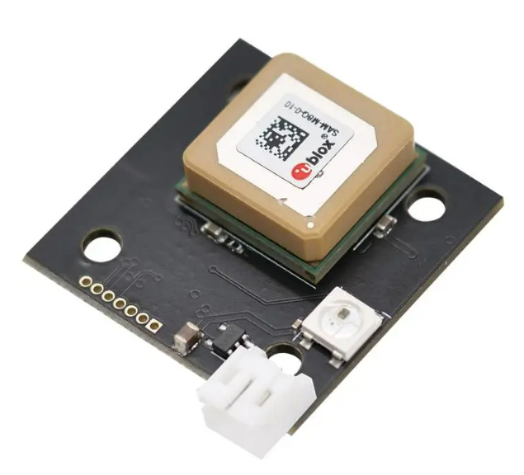
Regulation
Drones must have Remote ID capability which allows identification of the drone and its control station location in real time
Only allowed to operate in nighttime under certain conditions if drones are equipped with appropriate anti-collision light

Slide 7
Regulation
Operations over people (Category 1)
Drone must weight 0.55lbs or less
No open rotating parts that could cause injury
No operation over Open-Air Assemblies (unless the drone is compliant with the requirements for remote ID)

Slide 8
Regulation
Operations over people (Category 2)
No open rotating parts that could cause injury
No operation over Open-Air Assemblies without remote ID
Must not cause injury equivalent to or greater than the severity of injury caused by a transfer of 11 foot-pounds of kinetic energy upon impact from a rigid object.
Must meet specific FAA-accepted means of compliance and be listed on an FAA-accepted Declaration of Compliance

Slide 9
Regulation
Operations over people (Category 3)
No open rotating parts that could cause injury
No operation over Open-Air Assemblies without remote ID
Must not cause injury equivalent to or greater than the severity of injury caused by a transfer of 25 foot-pounds of kinetic energy upon impact from a rigid object.
Must meet specific FAA-accepted means of compliance and be listed on an FAA-accepted Declaration of Compliance
Operation over people are allowed if:
It’s within closed or restricted area where everyone knows about drone flying over them
Everyone under structures that provide protections from drone falling

Slide 10
Regulation
Operations over people (Category 4)
Drone must be a certified aircraft
The drone must be operated in accordance with the operating limitations specified in the approved Flight Manual or as otherwise specified by the Administrator.
The drone must be maintained in accordance with the maintenance and inspection requirements in the approved Flight Manual or the maintenance program for the aircraft.
Operations over people are allowed if the drone is compliant with the relevant remote identification requirements.

Slide 11
Regulation
Operations over people (Special Operations)
Operators can apply for waivers for specific regulations that are not covered by these categories if they can demonstrate that their proposed operation can be conducted safely.

Slide 12
FAA Operation Rules (Commercial Operator)
Fly only during daylight hours or civil twilight (30 minutes before sunrise to 30 minutes after sunset) with appropriate lighting.
Always keep the drone within visual line-of-sight.
Maximum altitude of 400 feet above ground level or, if higher, within 400 feet of a structure.
Maximum groundspeed of 100 mph (87 knots).
No flights over people not directly involved in the operation.
No flights from a moving vehicle unless in a sparsely populated area.
No careless or reckless operations.
Certification: Operators must obtain a Remote Pilot Certificate from the FAA by passing an aeronautical knowledge test at an FAA-approved knowledge testing center.
Registration: Drones used for commercial purposes must be registered with the FAA.

Slide 13
FAA Guidelines
Fly for hobby or recreation only.
Follow the safety guidelines of a community-based organization.
Fly within visual line-of-sight.
Give way to manned aircraft.
Fly at or below 400 feet in uncontrolled airspace (Class G).
Obtain authorization before flying in controlled airspace (Classes B, C, D, and E).
Do not fly near other aircraft or over groups of people, public events, or stadiums full of people.
Do not fly near emergency response activities.
Never fly under the influence of drugs or alcohol.

Slide 14
Types of airspace
No Authorization needed
Green coded
Class G
If drones fly withing 400ft height
Require authorization
Caution advised
Warning Areas and Military Operations Areas
Blue coded
Class B and D
Magenta coded
Class C and E
Restricted, No operations
Red Coded
Restricted Areas
Prohibited Areas
Temporary Flight Restrictions (TFRs)
Special Flight Rule Areas (SFRAs)

