Slide 1


Vaccine Development, Drug Discovery, CRISPR, Genomics

Slide 2
Genetic disorder
What are some common genetic disorders that you have heard of?

Slide 3
Genetic disoders

Slide 4








Why Medical Datasets Matter
Evidence-Based Decisions
Improves clinical care through data-driven approaches.
Research Acceleration
Speeds discovery of new treatments and interventions.
Population Health
Identifies trends and risk factors across communities.
Policy Development
Guides resource allocation and healthcare planning.

Slide 5
Example Datasets
15 Open Healthcare Datasets - 2024 Update
HealthData.gov
MIMIC-III
NIH Chest X-ray
3,000+ datasets on healthcare services, costs, and quality metrics.
de-identified health-related data from intensive care unit (ICU) patients
100 k chest X-ray images
for advancing medical imaging and diagnostics
CDC
WHO Dataset
Kaggle
Almost 700 datasets from the CDC as well as from other Federal agencies
Global health indicators across 194 member states.
Global Collection of Datasets in various fields

Slide 6
Sources
Universities
Research Labs
Governmental
Agencies
Private Firms &
Organizations
Hospitals
International Sources

Slide 7
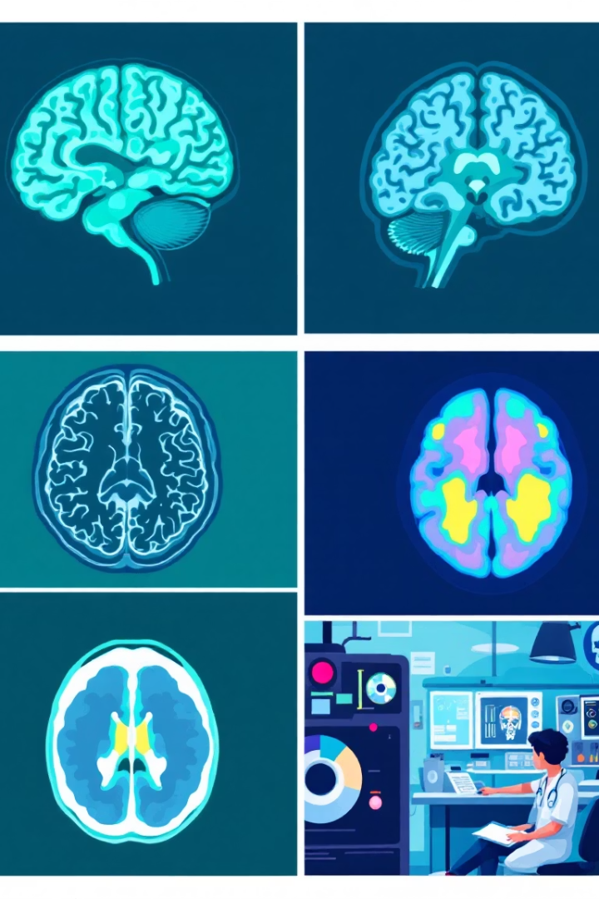
Specialized Datasets
Human Mortality Database
Population and mortality rates from countries worldwide
ADNI
Alzheimer's data including MRI, PET, genetics, biomarkers
OpenNeuro
716 datasets from 27,482 participants (MRI, PET, EEG)
Deep Lesion
32,000+ CT images from NIH Clinical Center
Footwear, handwriting, bloodstain Pattern, firearms
CSAFE

Slide 8


Medical Journals

Slide 9
Do you know any medical journals? Have you read a research paper before?

Slide 10
Title
Peer reviewed research articles related to health, medicine, and public health
Written by doctors, researchers, health professionals to share new findings, clinical trials, and case studies
Journals are owned by medical societies and other health-focused organizations.
Access is commonly Open Access, and sometimes Subscription based

Slide 11
Common Medical Journals
The Lancet
New England Journal of Medicine (NEJM)
Journal of the American Medical Association (JAMA)
British Medical Journal (BMJ)
World Medical Journal (WMJ)
And so much more……

Slide 12

PubMed
PubMed® comprises more than 38 million citations for biomedical literature from MEDLINE, life science journals, and online books.
Citations may include links to full text content from PubMed Central and publisher web site

Slide 13



Slide 14
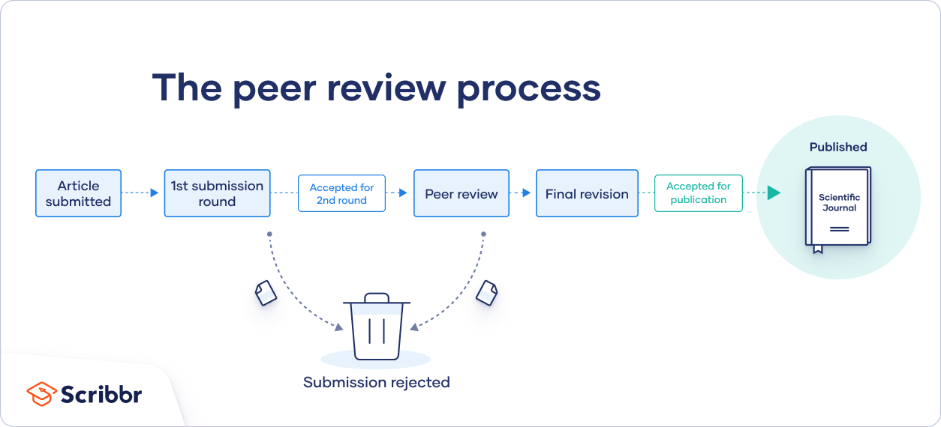
What Is Peer Review? | Types & Examples

Slide 15
Peer Review
Using strict criteria, a panel of reviewers in the same subject area decides whether to accept each submission for publication.
Peer-reviewed articles are considered a highly credible source
Journals are owned by medical societies and other health-focused organizations.
Access is commonly Open Access, and sometimes Subscription based

Slide 16


Slide 17
Zeno has a theory: “Lambchop is the most fun toy of all”
He writes a paper “The Squeak Effect: Why Lambchop Is The Best”
He submits his paper to the Journal of Canine Fun

Slide 18

Three other peer reviewers read his paper:
🐕 Mochi: “You didn’t explain how you measured tail wags. Can you add that?”
🐩 Simba: “Did you try toys in different orders? Maybe the first toy always gets more attention.”
🐕‍🦺 Chevy: “You only tested bigger plush toys. What about smaller ones?”

Slide 19

Parts of research paper

Slide 20
Title
Paper Identity
The name of your paper and a "running head" appear here.
Authorship
Lists all authors and their institutional affiliations.

Slide 21




Abstract
Concise Overview
Brief Length
One-paragraph summary of the entire study.
Typically no more than 250 words.
Complete Picture
Provides a snapshot of the research
purpose and findings.

Slide 22





Introduction
Topic Presentation
Describes the subject under investigation.
Literature Review
Summarizes relevant prior research.
Research Gap
Identifies unresolved issues to address.
Study Overview
Previews the research to be described in detail.

Slide 23








Methods
Participants
Study Design
Description of subjects involved in the study.
Structure and approach of the research.
Procedure
Materials
Step-by-step process of conducting the study.
Tools and resources used in the research.

Slide 24





Results
Analysis Procedure
Description of statistical methods used.
Data Collection
Presentation of the gathered information.
Statistical Tests
Results of analyses performed on the data.
Key Findings
Highlight of significant results discovered.

Slide 25






Discussion
Implications
Broader meaning of the findings
Context
How results address research questions
Results Summary
Overview of what was found
Limitations and Future Work.

Slide 26
Conclusion
Restates the main findings.
Emphasizes the impact or importance.
🧠 Think: What should we remember from this paper?

Slide 27
References & Supporting Elements
References
Tables & Figures
Appendix
Alphabetized list of all sources cited. Includes author names, dates, titles, and publication information.
Visual presentations of data. In APA style, each appears on a separate page after references, though some formats allow embedding in text.
Optional supplementary information not critical to understanding the paper.

Slide 28

Putting It All Together
Begin With Framework
Start with title page, abstract, and introduction to establish purpose.
Detail Your Process
Methods and results sections explain what you did and found.
Provide Context
Discussion and references place your work in the broader field.
Add Supporting Materials
Tables, figures, and appendices offer additional clarity.

Slide 29
Health and Medicine Archives - Science Journal for Kids and Teens

