Slide 1
W09D1 – NLP I
Instructor: Jeremy Eng
Credit: Zain Hasan

Slide 2

Introduction
Instructor: Dr. Jeremy Eng (engj@saskpolytech.ca)
Lead Cloud Applications and Data Instructor at Sask Polytech
Born and raised in Saskatoon, Saskatchewan
PhD in Statistics
Research Areas:
Big data simulations involving Monte Carlo techniques
Developing and applying machine learning techniques to model COVID-19 spread in Saskatchewan and Canada (PMCMC)
Microsoft Certified Trainer
LinkedIn: https://www.linkedin.com/in/jeremy-eng-sk/

Slide 3
Outline
Introduction to NLP
Data Prep in NLP
Simplifying text
Punctuation removal, tokenization, stop words, stemming, lemmatization
Representing Text with Numbers
Bag of Words (BoW), term frequency-inverse document frequency (TF-IDF)
Word2Vec
Demo

Slide 4
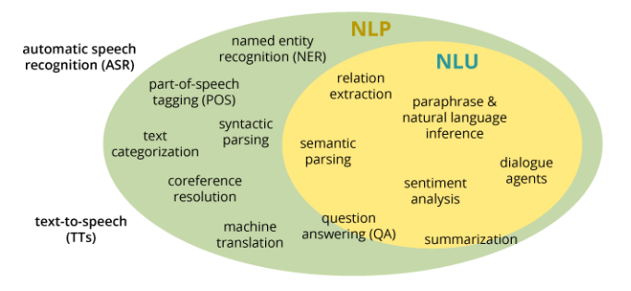
Introduction to Natural Language Processing (NLP)
NLP involves processing and analyzing large amounts of natural language speech/text.
Not solved; very hard problem.
NLU = Natural language understanding
Some well-known applications:
Virtual assistants (Siri, Alexa, Cortana)
Chat bots
Predictive text
Email filters
Sentiment analysis
Topic modeling
NLP has been around for a while, we just now have better tools.
Deep learning, more data, stronger computing power, lower costs.
Notes:
Tomorrow is NLU, today is outside of NLU

Slide 5
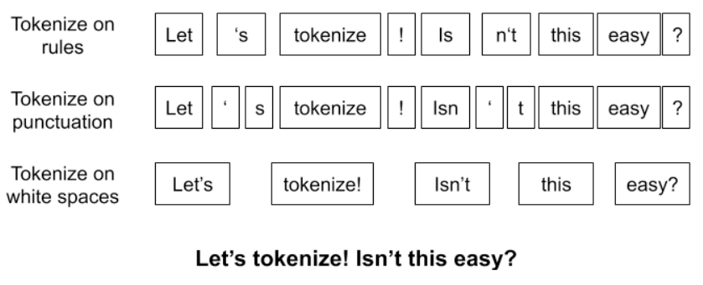
Simplifying Text
Today will just focus on pre-processing text.
Simplifying text
Converting from text into numerical values
Text simplification examples:
Remove punctuation
Remove common (“glue”) words (the, a, and)
Aka “stop words”
Remove capitalization
Tokenize
Stemming/lemmatization
NLTK package (and others) in Python
Notes:
Capitalization in spam
Tokenization makes it easy for us to iterate over text
Stemming = deletes common suffixes: helping, helped, helpful → help
Lemmatization = running, ran → run

Slide 6
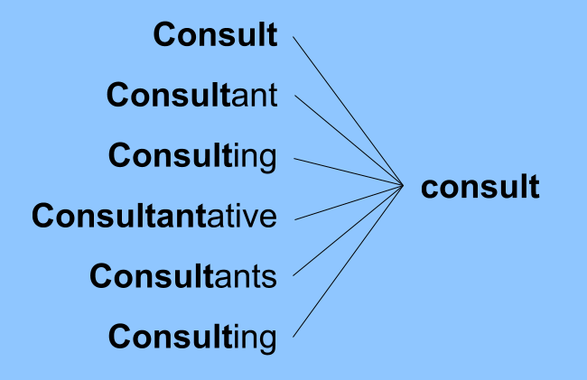
Simplifying Text
Today will just focus on pre-processing text.
Simplifying text
Converting from text into numerical values
Text simplification examples:
Remove punctuation
Remove common (“glue”) words (the, a, and)
Aka “stop words”
Remove capitalization
Tokenize
Stemming/lemmatization
NLTK package (and others) in Python
Notes:
Capitalization in spam
Tokenization makes it easy for us to iterate over text
Stemming = deletes common suffixes: helping, helped, helpful → help
Lemmatization = running, ran → run

Slide 7
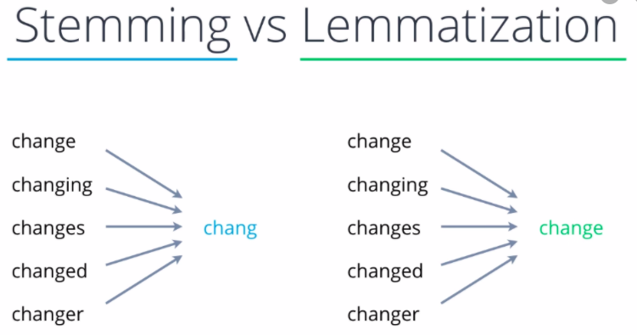
Simplifying Text
Today will just focus on pre-processing text.
Simplifying text
Converting from text into numerical values
Text simplification examples:
Remove punctuation
Remove common (“glue”) words (the, a, and)
Aka “stop words”
Remove capitalization
Tokenize
Stemming/lemmatization
NLTK package (and others) in Python
Notes:
Capitalization in spam
Tokenization makes it easy for us to iterate over text
Stemming = deletes common suffixes: helping, helped, helpful → help
Lemmatization = running, ran → run

Slide 8
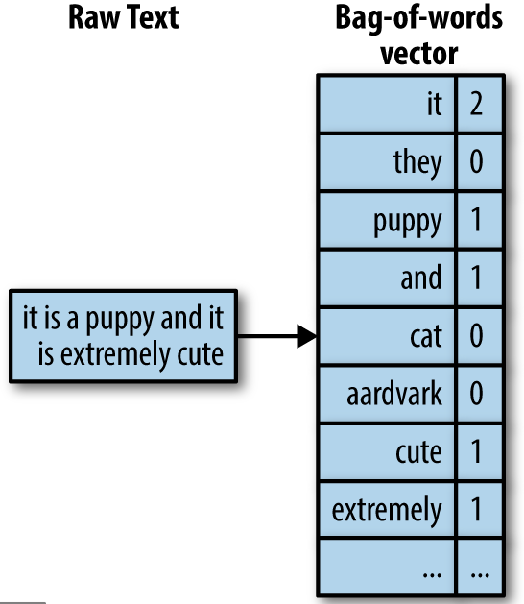
Vectorizing Text
After simplifying our text, we can represent the text using vectors.
Bag of Words
Simply count how often the word appears (problems?).
Text Frequency–Inverse Document Frequency (TF-IDF)
Like BoW, but weighted by how rare the word is across all documents.
Word2Vec: uses a neural network to learn word associations.
Each word is represented by a VECTOR
Similar words are close together. Direction between words can have meaning (add/subtract).
Notes:
BoW problems: size of vectors (features vs observations), ordering/relation (negation, sarcasm)
TF-IDF:
Tf_{x,y} = term frequency = measures how often the word occurs in the document
log term = INVERSE document frequency = how rare the word is across all documents. Rarer term results in a higher IDF score.
Word2Vec: Assigns each word a vector, such that words that share common contexts in the corpus are located close to one another in the space. Can detect synonymous words.
Notice each word is represent by a vector, not a just a number.
Preserves relationships between words
King - man + Woman = Queen

Slide 9
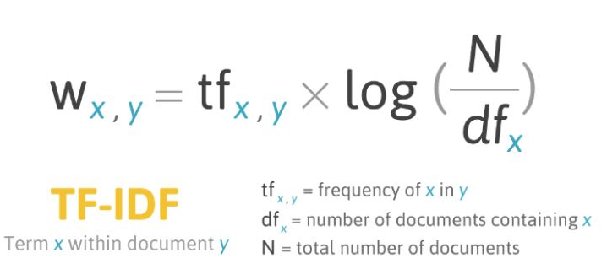
Vectorizing Text
After simplifying our text, we can represent the text using vectors.
Bag of Words
Simply count how often the word appears (problems?).
Text Frequency–Inverse Document Frequency (TF-IDF)
Like BoW, but weighted by how rare the word is across all documents.
Word2Vec: uses a neural network to learn word associations.
Each word is represented by a VECTOR
Similar words are close together. Direction between words can have meaning (add/subtract).
Notes:
BoW problems: size of vectors (features vs observations), ordering/relation (negation, sarcasm)
TF-IDF:
Tf_{x,y} = term frequency = measures how often the word occurs in the document
log term = INVERSE document frequency = how rare the word is across all documents. Rarer term results in a higher IDF score.
Word2Vec: Assigns each word a vector, such that words that share common contexts in the corpus are located close to one another in the space. Can detect synonymous words.
Notice each word is represent by a vector, not a just a number.
Preserves relationships between words
King - man + Woman = Queen

Slide 10
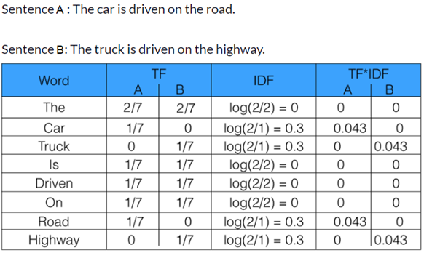
Vectorizing Text
After simplifying our text, we can represent the text using vectors.
Bag of Words
Simply count how often the word appears (problems?).
Text Frequency–Inverse Document Frequency (TF-IDF)
Like BoW, but weighted by how rare the word is across all documents.
Word2Vec: uses a neural network to learn word associations.
Each word is represented by a VECTOR
Similar words are close together. Direction between words can have meaning (add/subtract).
Notes:
BoW problems: size of vectors (features vs observations), ordering/relation (negation, sarcasm)
TF-IDF:
Tf_{x,y} = term frequency = measures how often the word occurs in the document
log term = INVERSE document frequency = how rare the word is across all documents. Rarer term results in a higher IDF score.
Word2Vec: Assigns each word a vector, such that words that share common contexts in the corpus are located close to one another in the space. Can detect synonymous words.
Notice each word is represent by a vector, not a just a number.
Preserves relationships between words
King - man + Woman = Queen

Slide 11
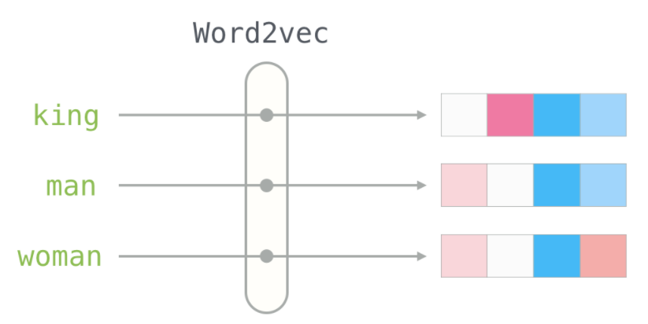
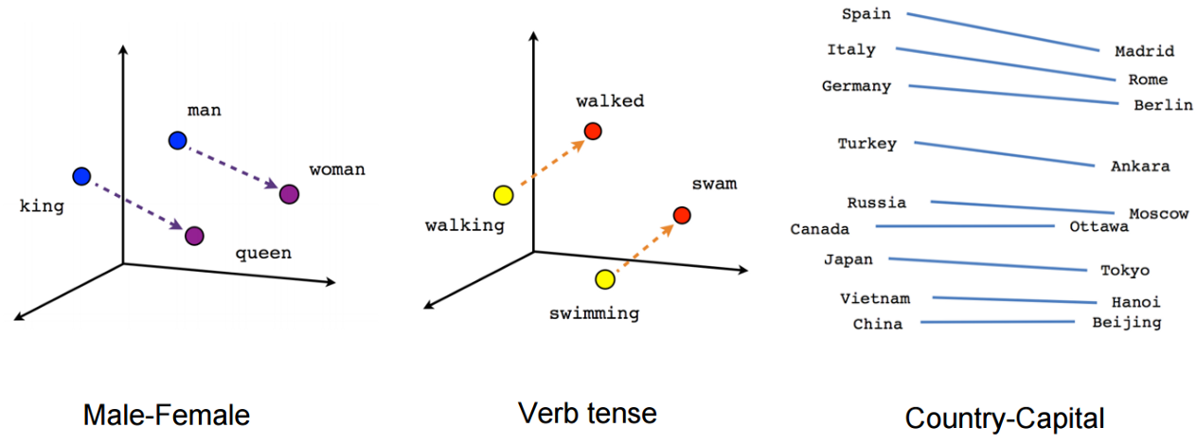
Vectorizing Text
After simplifying our text, we can represent the text using vectors.
Bag of Words
Simply count how often the word appears (problems?).
Text Frequency–Inverse Document Frequency (TF-IDF)
Like BoW, but weighted by how rare the word is across all documents.
Word2Vec: uses a neural network to learn word associations.
Each word is represented by a VECTOR
Similar words are close together. Direction between words can have meaning (add/subtract).
Notes:
BoW problems: size of vectors (features vs observations), ordering/relation (negation, sarcasm)
TF-IDF:
Tf_{x,y} = term frequency = measures how often the word occurs in the document
log term = INVERSE document frequency = how rare the word is across all documents. Rarer term results in a higher IDF score.
Word2Vec: Assigns each word a vector, such that words that share common contexts in the corpus are located close to one another in the space. Can detect synonymous words.
Notice each word is represent by a vector, not a just a number.
Preserves relationships between words
King - man + Woman = Queen

Slide 12
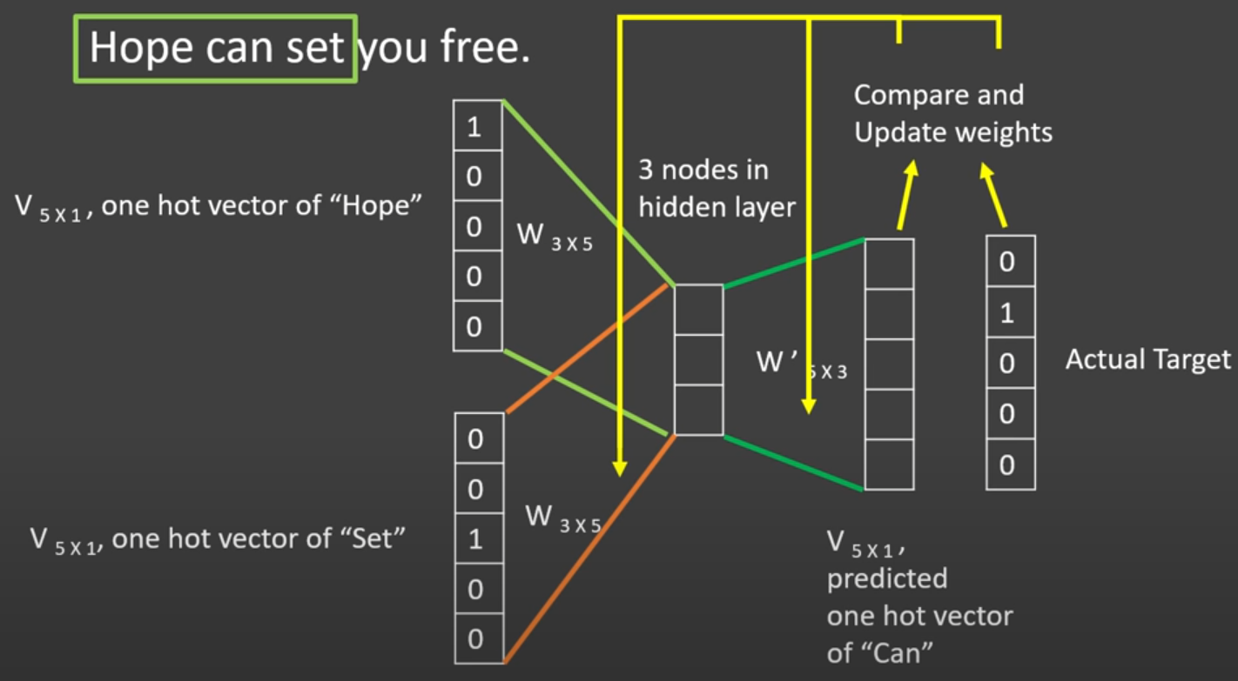
Word2Vec Architectures
Continuous Bag of Words (CBoW)
Tries to predict the target word (center) based on the surrounding words (context).
Notes:
CBoW: several times faster to train than the skip-gram, slightly better accuracy for the frequent words.
Skip-gram: works well with a small amount of the training data, represents well even rare words or phrases.

Slide 13
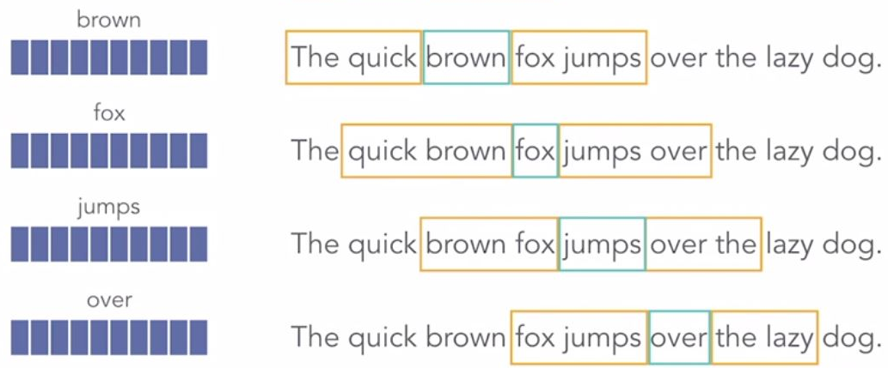
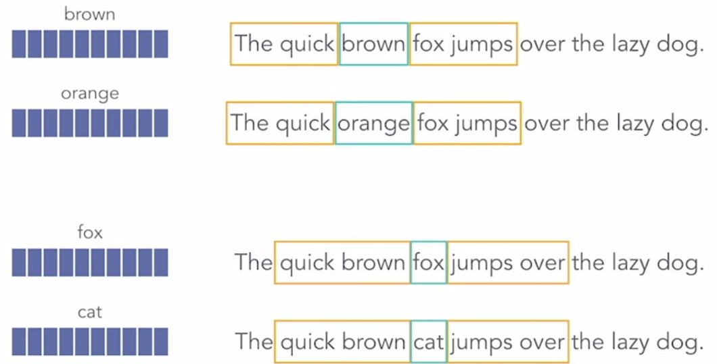
Word2Vec Architectures
Continuous Bag of Words (CBoW)
Tries to predict the target word (center) based on the surrounding words (context).
Notes:
CBoW: several times faster to train than the skip-gram, slightly better accuracy for the frequent words.
Skip-gram: works well with a small amount of the training data, represents well even rare words or phrases.

Slide 14
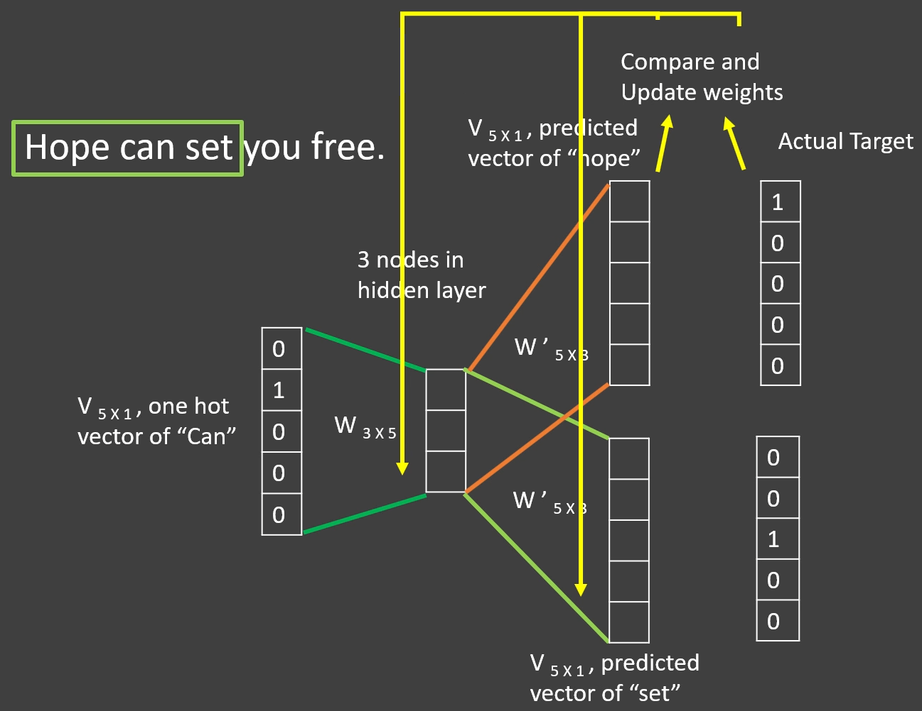
Word2Vec Architectures
Continuous Bag of Words (CBoW)
Tries to predict the target word (center) based on the surrounding words (context).
Skip-gram
Tries to predict the surrounding words (context) based on the target word.
Notes:
CBoW: several times faster to train than the skip-gram, slightly better accuracy for the frequent words.
Skip-gram: works well with a small amount of the training data, represents well even rare words or phrases.

Slide 15
Word2Vec Architectures
Continuous Bag of Words (CBoW)
Tries to predict the target word (center) based on the surrounding words (context).
Skip-gram
Tries to predict the surrounding words (context) based on the target word.
Notes:
CBoW: several times faster to train than the skip-gram, slightly better accuracy for the frequent words.
Skip-gram: works well with a small amount of the training data, represents well even rare words or phrases.

Slide 16
NLP Pre-processing Summary
NLP involves processing and analyzing large amounts of natural language speech/text.
Not solved; very hard problem.
Today we just focused on pre-processing text (simplifying, vectorizing)
Tomorrow: NLP applications (sentiment analysis and topic modeling)
Simplifying:
Punctuation removal, tokenization, stop words, stemming, lemmatization
Vectorizing:
BoW, TF-IDF, Word2Vec
Jupyter notebook demo

