Slide 1

Centre wallon de Recherches agronomiques
AGROMET(+ logo)
Damien Rosillon
Jean Pierre Huart
Thomas Goossens
Unit Farming systems, Territories and Information Technologies (Unit 11)
in collaboration with RMI

Slide 2


Agromet
Context
European directive 2009/128/CE
⇒ rational use of plant protection products
⇒ agricultural warning systems, based on crop monitoring models for the control of pests and diseases
⇒ weather data = model input
⇒ High spatial resolution weather data required

Slide 3
Agromet
Project
Financement
- exemple : SPW, DGO3, DPS
Budget et durée du projet
- x €
- xx mois/an – xx/xx/20xx-xx/xx/20xx)
Collaborations
- Royal Meteorological Institue (RMI)

Slide 4
Projet acronyme
Project
Financement
- exemple : SPW, DGO3, DPS
Budget et durée du projet
- x €
- xx mois/an – xx/xx/20xx-xx/xx/20xx)
Collaborations
- Royal Meteorological Institue (RMI

Slide 5


Agromet
Objectives
Operational tool :
⇒ agro-meteorological data dissemination
(API & website)
⇒ observations et forecasting
⇒ high spatial resolution (1km²)
⇒ high temporal resolution (hourly)

Slide 6
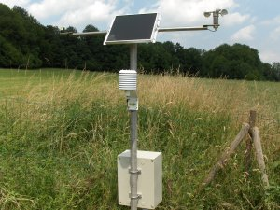




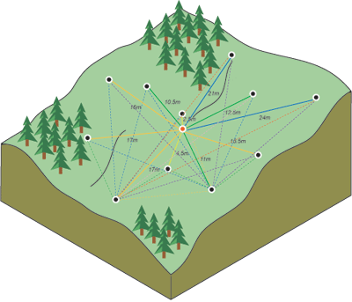
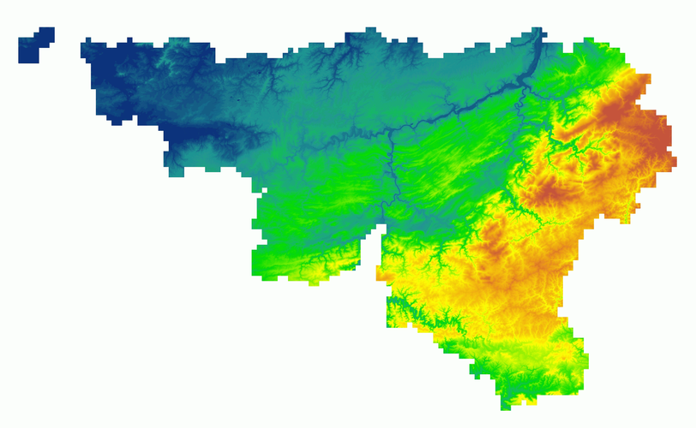
Agromet
Methodology
⇒ acquisition of data from 50 Automatic Weather Stations (AWS) from Pameseb + IRM networks
⇒ spatialisation (kriging, multiple-regression, etc)
⇒ resulting in 16 000 virtual weather stations covering each km² of Wallonia

Slide 7
Agromet
Work Packages
⇒ WP 1 : functional analysis of users needs
⇒ WP2 : spatialisation of weather data
⇒ WP3 : IT infrastructure development
⇒ WP4 : implementation of 2 test crop monitoring
models
⇒ WP5 : in-situ observations vs. test models output
comparison
⇒ WP6 : data use policy definition

Slide 8
Projet acronyme
Résultats attendus/Premiers résultats/Résultats obtenus
Sous-titre
Texte

Slide 9



Agromet
Contact
rue de Liroux 9, 5030 Gembloux
Belgique
www.cra.wallonie.be
Rosillon Damien
Unité 11
d.rosillon@cra.wallonie.be
+32 61 23 10 10

