Slide 1
DASK INSURANCE PRICING
FUNDAMENTAL OF STATISTICS Francesca Ieva
Paolo Ticozzi
Melissa Aoun
Riccardo Affranchi
Gianmaria Carnazzi

Slide 2
SUMMARY
Company profile, DASK products
Variable Analysis
Year Analysis
Clustering Analysis

Slide 3


STAKEHOLDER Allianz
Vulnerability of Turkey stem from its geographical location: the Anatolian plate.
Turkey situated on a number of active fault lines.
Disastrous result of earthquakes → deaths, injuries, extensive property damage region
Implementation of an earthquake insurance for protection, safeguard, fortification and guarantee.
ALLIANZ COMPANY
DASK INSURANCE
Long-established history of 126 years.
Key priority: Sustainability.
Financial strength reflects on company’s stakeholders: - Customers: 7 M - Employees: 2,500 - Net Profit: TL 526 Million
Compulsory Earthquake Insurance.
DASK as of 31st December 09: - Total number of policies: 3,435,861 pieces - Total amount of coverage: TL 201 billion - Average cover per dwelling: TL 59 thousand

Slide 4
Question
How to identify regions for price discrimination for DASK products?

Slide 5
Dataset presentation
Date / Latitude / Longitude / City / Area / ID / Direction / Time of the earthquake
Country -> we considered only "Turkey", and not Aegean Sea
Distance of the above "direction" in Km
Depth of the hypocenter from the surface
Type of magnitude:
Richter Magnitude Scale -> is determined from the logarithm of the amplitude of waves recorded by seismographs
Depending on Time Magnitude (MD) -> estimated from the duration or length of the seismic wave-train
Surface-Wave Magnitude (MS) -> considers only surface waves
Body-Wave Magnitude (MB) -> considers P- and S-waves
Moment Magnitude (MW) -> based on seismic moment, a measure of work done by the earthquake
Biggest Magnitude Value (XM) -> represents the highest magnitude value of the above variables

Slide 6
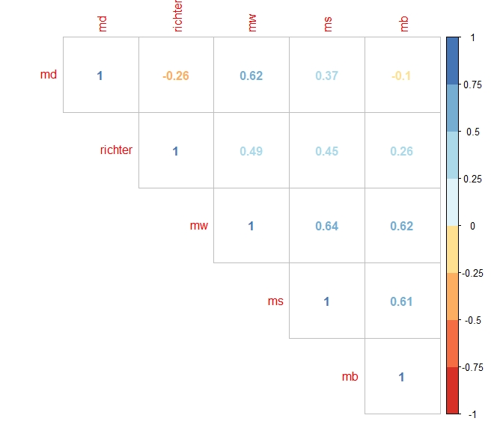
Correlation
The dataset reports all the earthquakes occurred between 1910 and 2017
Descriptive variables: Date Country City Area Direction Time ID
Continuous variables:
Latitude Longitude
Richter Scale Index Biggest Magnitude Value - XM Depending on Time Magnitude - MD Surface-Wave Magnitude - MS Body-Wave Magnitude – MB Moment Magnitude - MW
Distance Depth

Slide 7
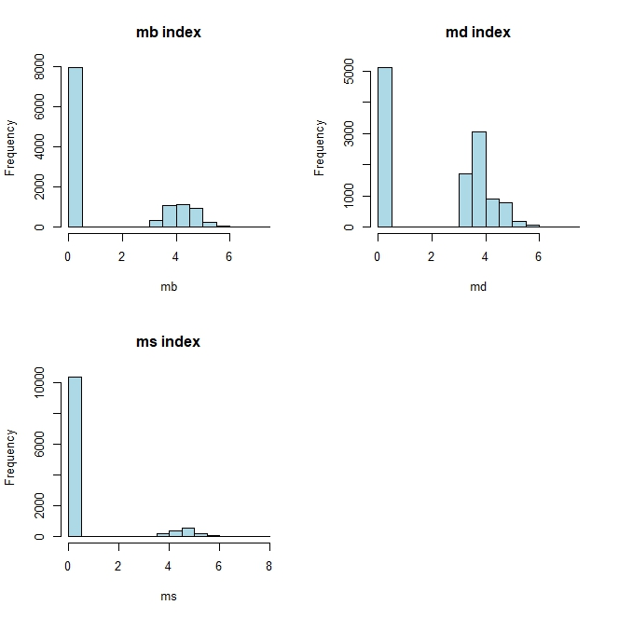
Distribution
*In all the indexes for magnitude there is a high concentration of low intensity earthquakes, which provoke less damages to people and properties/infrastructures

Slide 8
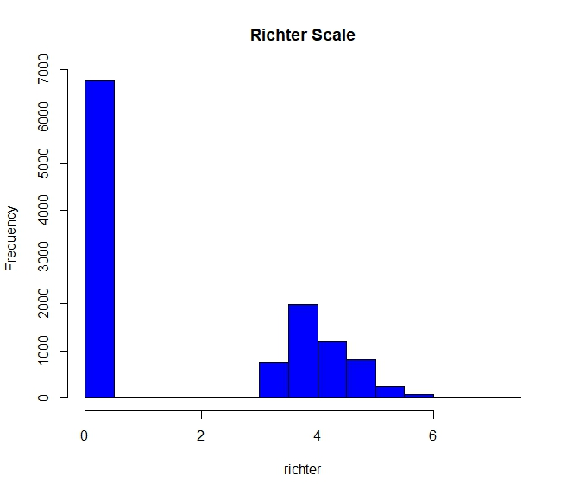
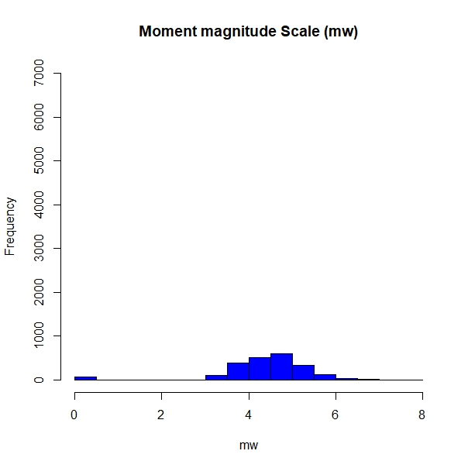
Magnitude Scales
Range: [0, 7000]

Slide 9
Location indexes
 | Mean | Median | Mode
Richter | 1.762 | 0.000 | 0.000
MW* | 4.459* | 4.6* | 5.0*
MD | 2.239 | 3.500 | 0.000
MS | 0.577 | 0.000 | 0.000
MB | 1.397 | 0.000 | 0.000
*MW is the moment magnitude scale, the mostly used nowadays because it directly relates the energy of an earthquake to the ranking systems. Its statements are on average higher than the others because it is hardly calculated for earthquakes of magnitude of 4.0 or less points on Richter scale.

Slide 10
Dispersion indexes
 | Sd | Var | Range
Richter | 2.068 | 4.279 | [0;7,2]
MW* | 1.031* | 1.062* | [0;7.7]*
MD | 1.993 | 3.974 | [0;7,4]
MS | 1.561 | 2.438 | [0;7,9]
MB | 2.034 | 4.138 | [0;7,1]
*MW is the moment magnitude scale, the mostly used nowadays because it directly relates the energy of an earthquake to the ranking systems. Its statements are less spread compared to the other variables because it is hardly calculated for earthquakes of magnitude of 4.0 or less points on Richter scale

Slide 11
Shape indexes
 | Skewness | Kurtosis
Richter | 0.394 | - 1.680
MW* | -2.211* | 8.352*
MD | -0.136 | - 1.754
MS | 2.402 | 4.006
MB | 0.825 | - 1.192
*MW is the moment magnitude scale, the mostly used nowadays because it directly relates the energy of an earthquake to the ranking systems. Its statements are shaped more around the mean with a longer tail on the left

Slide 12
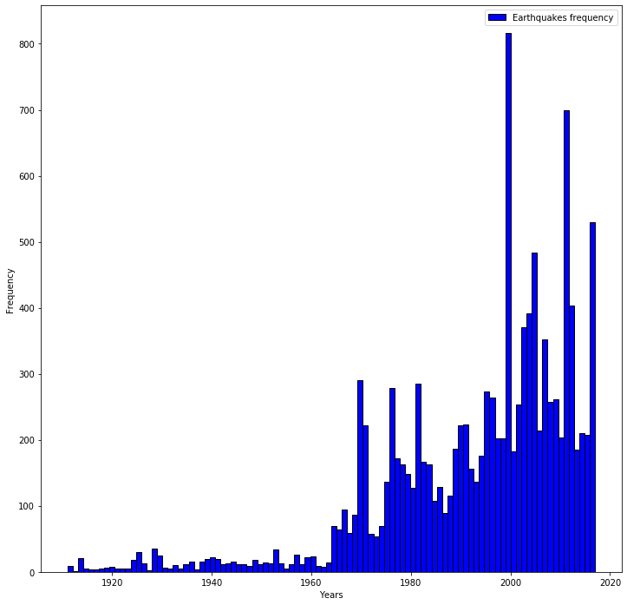
Year frequency
Richter Clusters:
Minor [0.0;3.9]
Moderate [4.0;5.9]
Major [6.0;10.0]

Slide 13
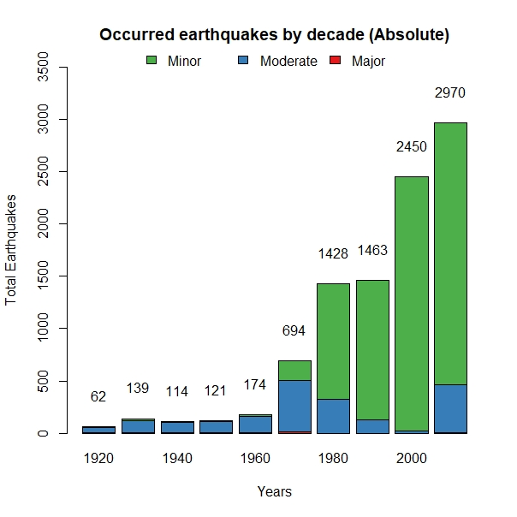
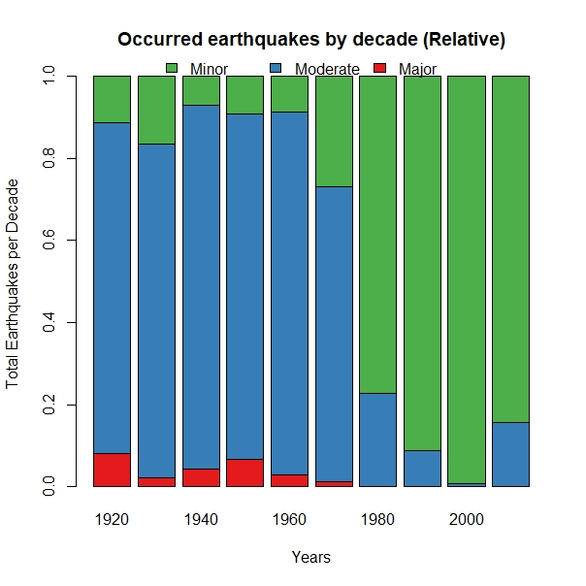
Year frequency by Decade

Slide 14
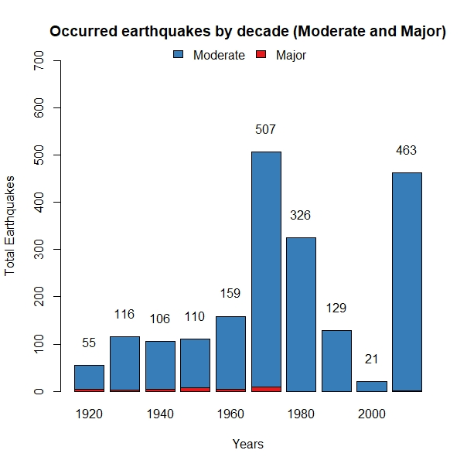
Year frequency on Moderate and Major
The number of earthquakes in Turkey with higher negative impact are quite high, but it is not increasing over time constantly

Slide 15
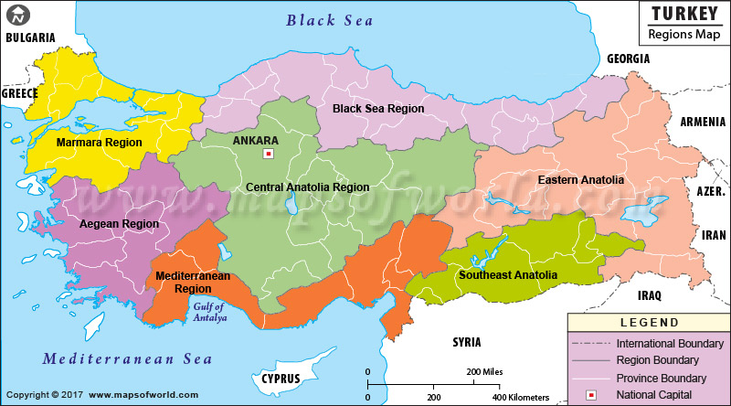
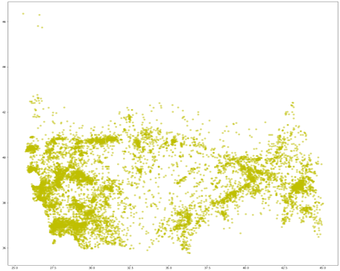
Clustering Analysis Earthquakes map

Slide 16
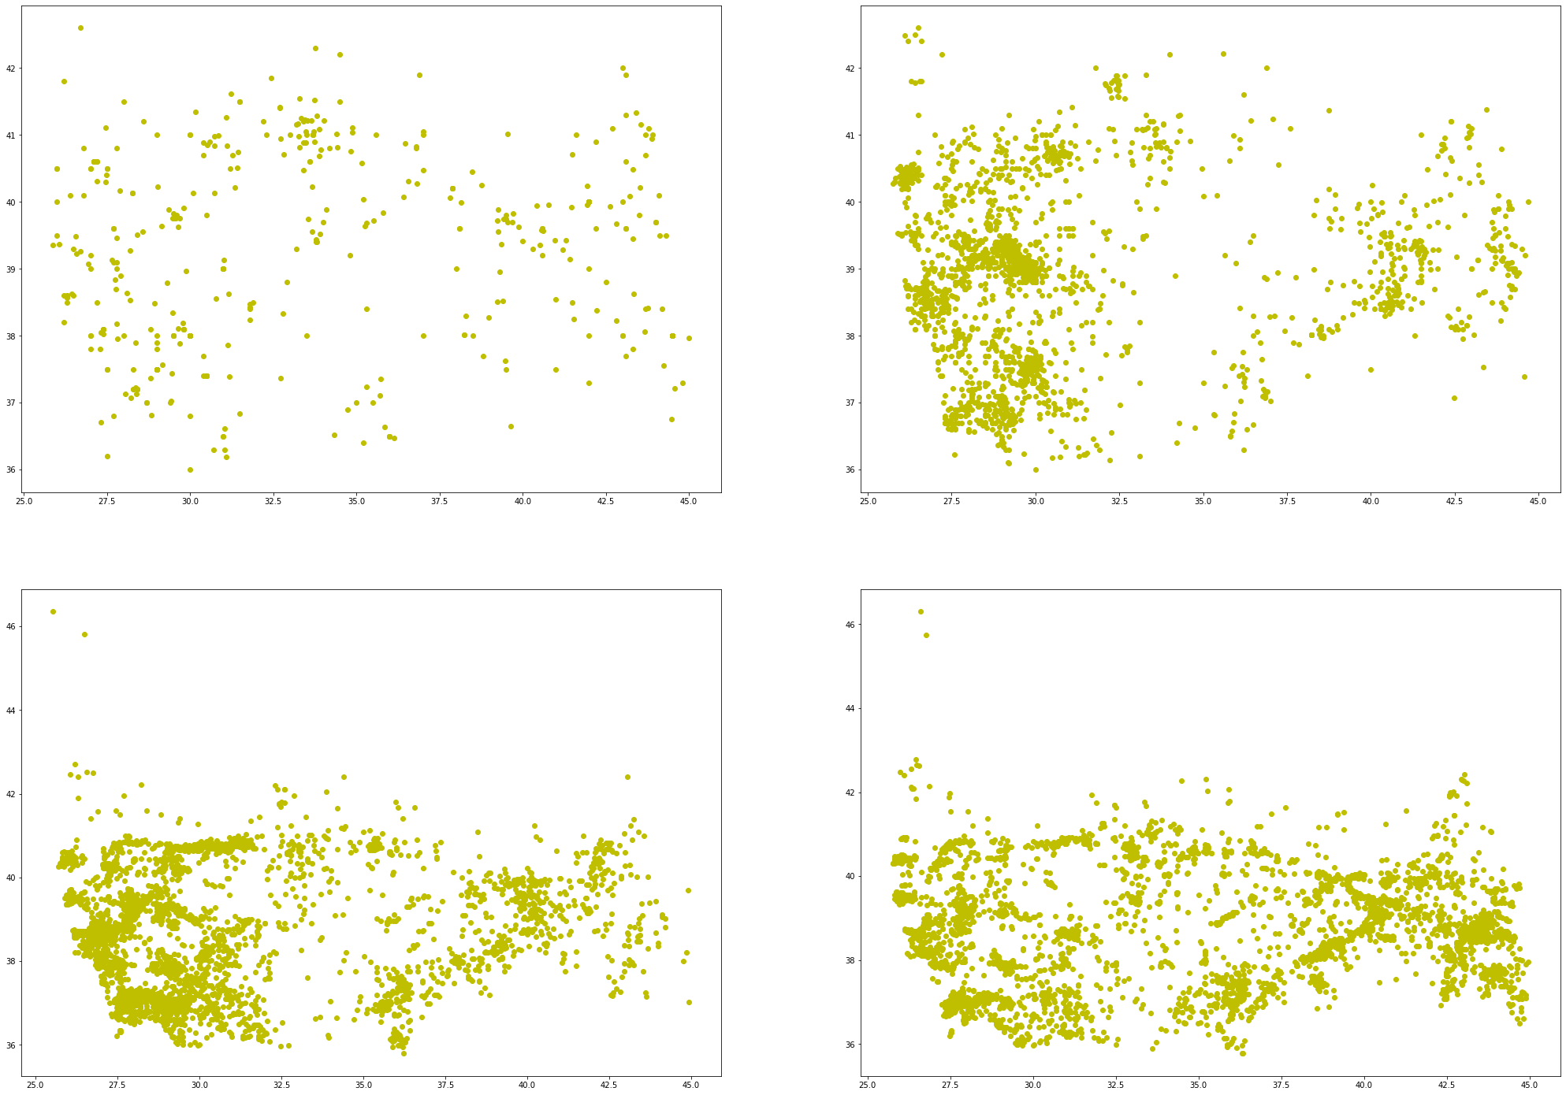

Slide 17
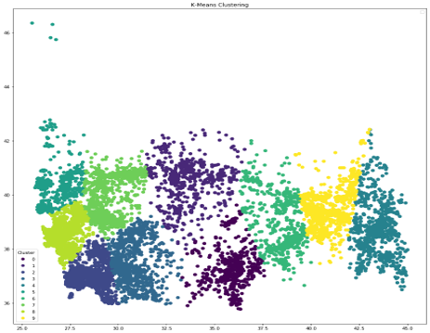
K-Means

Slide 18
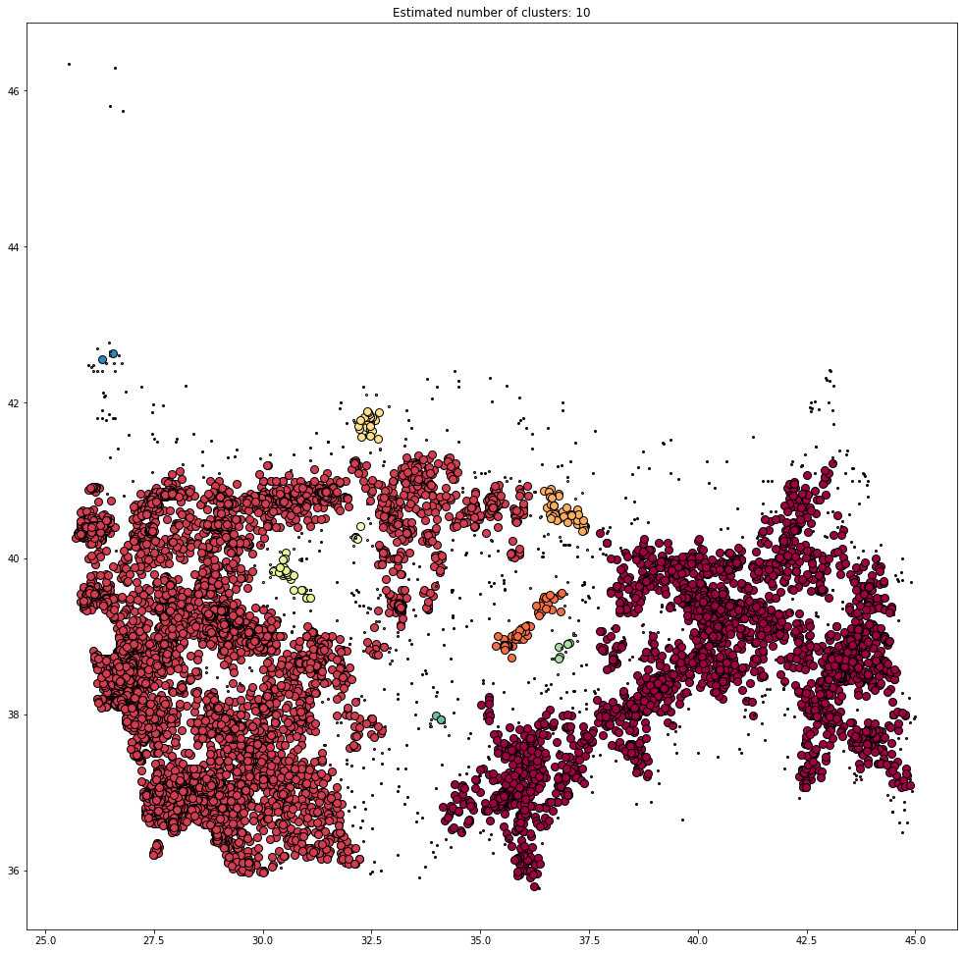
Density clustering

Slide 19
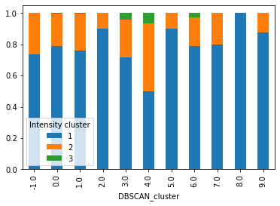
Frequencies

Slide 20
REFERENCES:
https://www.allianz.com/content/dam/onemarketing/azcom/Allianz_com/responsibility/documents/Allianz_SR_Report_Turkey_2016.pdf
http://www.hurriyetdailynews.com/compulsory-earthquake-insurance-sales-increase-100-expert-146963
https://www.kaggle.com/caganseval/earthquake
https://dask.gov.tr/tcip/content/annualReport/2009_Annual_Report_DASK.pdf
https://en.wikipedia.org/wiki/Moment_magnitude_scale

