Slide 1


SMART INDIA HACKATHON 2025
TITLE PAGE
Problem Statement ID - SIH25040
Problem Statement Title - FloatChat - AI-Powered Conversational Interface for ARGO Ocean Data Discovery and Visualization
Theme - Miscellaneous
PS Category- Software
Team ID - AU_ISIH_J4_26
Team Name - Ctrl+Alt+Elite

Slide 2
IDEA TITLE
Ctrl+Alt+Elite
Problem Statement:
ARGO floats collect critical ocean data (temperature, salinity, oxygen) but store it in complex NetCDF files
Only technical experts can access and analyze this data
4000+ floats generate valuable insights locked away from students, policymakers, and researchers
Current tools require programming skills and domain expertise
Proposed Solution: FloatChat transforms complex ocean data into conversational insights using AI and natural language processing.
Our model promises:
Provides instant answers to ocean queries in plain English
Ensures easy visualization through interactive maps and charts
Supports non-technical users with zero coding required
Improves data accessibility from days to seconds
Target Audiences:
Space Agencies
Scientists
Research Organizations
Government
Environmental Organizations

Slide 3
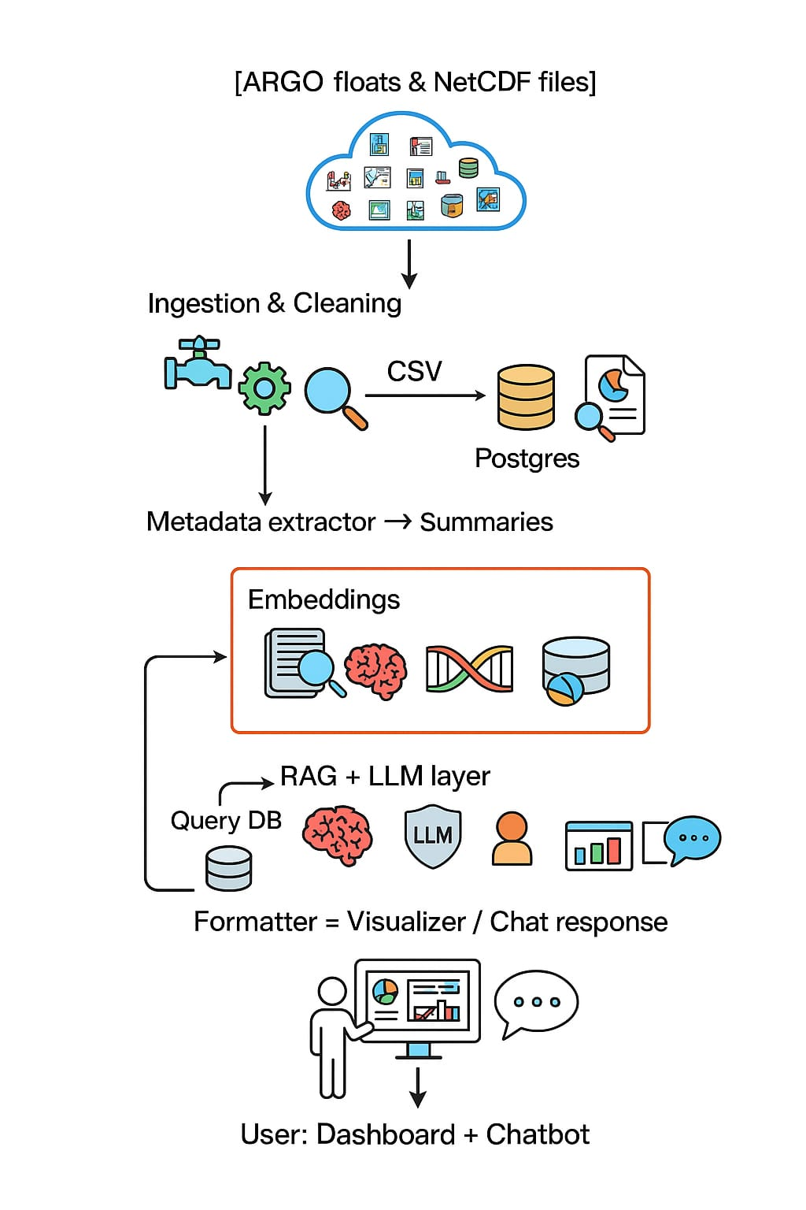
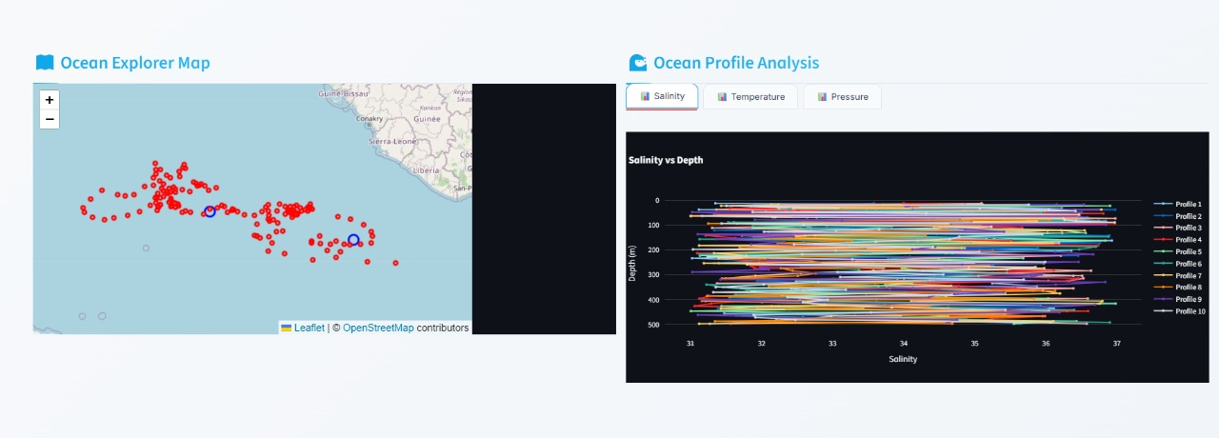
TECHNICAL APPROACH
Ctrl+Alt+Elite
Tech Stack:
Data Processing:
Python (xarray, pandas)
PostgreSQL
Backend:
Express.js
RAG Pipeline
LLMs (GPT/LLaMA/Mistral)
Frontend & Visualization:
React.js
Leaflet, Cesium.js, Plotly
Data Formats:
NetCDF → SQL
JSON
Output :
Product Status: 40% of the app is built with a dashboard and UI added, and further development, testing, and validation are in progress

Slide 4
FEASIBILITY AND VIABILITY
Ctrl+Alt+Elite
Feasibility Analysis:
Python + PostgreSQL convert NetCDF to SQL/JSON, ensuring efficient data access.
Express.js with RAG + LLMs enables intelligent query handling and insights
React.js (Leaflet, Cesium, Plotly) delivers rich interactive visualizations.
Modular, cloud-ready design supports MVP, 4000+ ARGO floats, and easy scaling.
Potential Challenges:
Technical: NetCDF parsing complexity, real-time data synchronization
Accuracy: Ensuring AI responses maintain scientific precision
Scaling: Handling concurrent users and large datasets efficiently
Strategies to Overcome:
Robust Testing: Extensive validation against known oceanographic patterns
Performance Optimization: Caching, database indexing, efficient algorithms
User Feedback: Continuous improvement based on scientist validation

Slide 5
IMPACT AND BENEFITS
Ctrl+Alt+Elite
Impact: Democratizes India's ocean data infrastructure, enabling 10x faster climate research, better monsoon predictions, and informed policy decisions for 1.4 billion citizens affected by ocean-climate interactions.
Benefits:
Efficiency: Ocean insights in seconds vs weeks of technical analysis
Cost-effectiveness: Eliminates need for specialized NetCDF training
Scalability: Handles 4000+ global ARGO floats, expandable to BGC sensors
Long-term value: Foundation for India's Blue Economy and climate resilience
Analogy: Traditional ocean data access is like having a library where all books are locked in safes. FloatChat is the master key that lets everyone read the ocean's story.

Slide 6
RESEARCH AND REFERENCES
Ctrl+Alt+Elite
Research :
https://www.ncei.noaa.gov/access/metadata/landing-page/bin/iso?id=gov.noaa.nodc%3AArgo-Monthly&utm_source=chatgpt.com
https://argo.ucsd.edu/data/acknowledging-argo/
https://www.data.gov.in/resource/indian-ocean-argo-data?utm_source=chatgpt.com
References:
https://www.ncei.noaa.gov/data/oceans/
http://ncei.noaa.gov/data/

