Slide 1
Online Bookstore

Slide 2
Introduction
Our project, the Online Bookstore, is a modern platform designed to meet the growing demand for accessible and diverse reading material. It offers a user-friendly interface where customers can easily browse, purchase, and enjoy a wide range of books.
This project showcases our expertise in developing a full-stack application, integrating front-end design with backend functionality and secure transactions. Our goal is to create a reliable and efficient solution that serves both readers and publishers.

Slide 3
Types of Users
Customers
Description: Individuals who visit the bookstore to browse, purchase, and read books.
Features:
Browse categories and search for specific titles.
Add books to cart and complete purchases.
Access personalized recommendations.
Manage their accounts and view order history.

Slide 4
Types of Users
Administrators
Description: Staff responsible for managing the bookstore's inventory, user accounts, and overall system maintenance.
Features:
Add, update, and remove book listings.
Monitor sales and generate reports.
Manage user accounts and permissions.
Oversee security and system updates.

Slide 5
Types of Users
Publishers/Authors
Description: Individuals or entities that supply books to the store and may want to track the performance of their titles.
Features:
Upload and manage their book listings.
Track sales and analytics for their titles.
Receive payments and manage royalties.

Slide 6
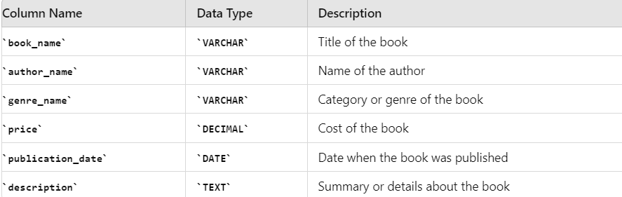
Database Tables
Books
Purpose: Stores information about the books available in the bookstore.
Key Columns:
book_name: Title of the book.
author_name: Name of the author.
genre_name: Category or genre of the book.
price: Cost of the book.
publication_date: Date when the book was published.
description: Summary or details about the book.

Slide 7
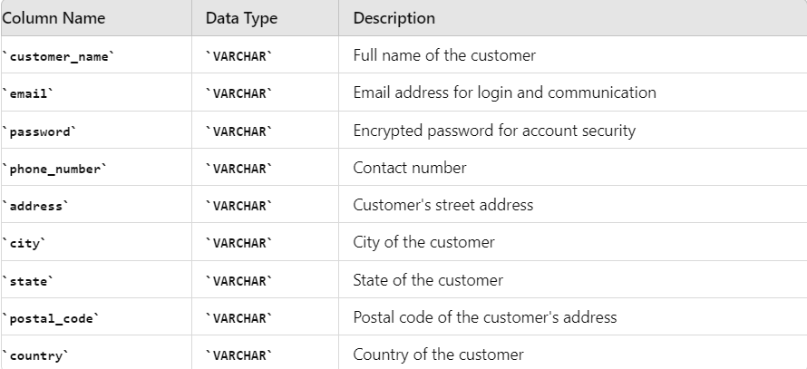
Database Tables
Customers
Purpose: Contains details of the customers registered on the platform.
Key Columns:
customer_name: Full name of the customer.
email: Email address used for account login and communication.
password: Encrypted password for account security.
phone_number: Contact number.
address, city, state, postal_code, country: Customer's shipping address.

Slide 8
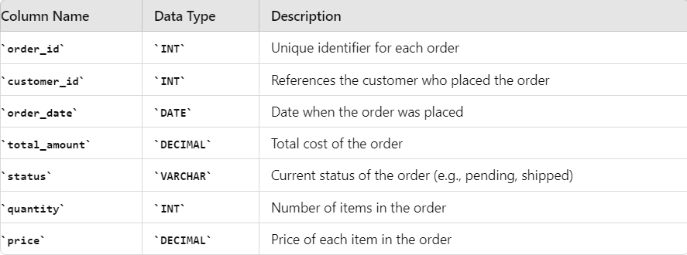
Database Tables
Orders
Purpose: Tracks the orders placed by customers.
Key Columns:
order_id: Unique identifier for each order.
customer_id: References the customer who placed the order.
order_date: Date when the order was placed.
total_amount: Total cost of the order.
status: Current status of the order (e.g., pending, shipped).
quantity: Number of items in the order.
price: Price of each item in the order.

Slide 9
Thank You

