Slide 1
Multi Classification for images

Slide 2
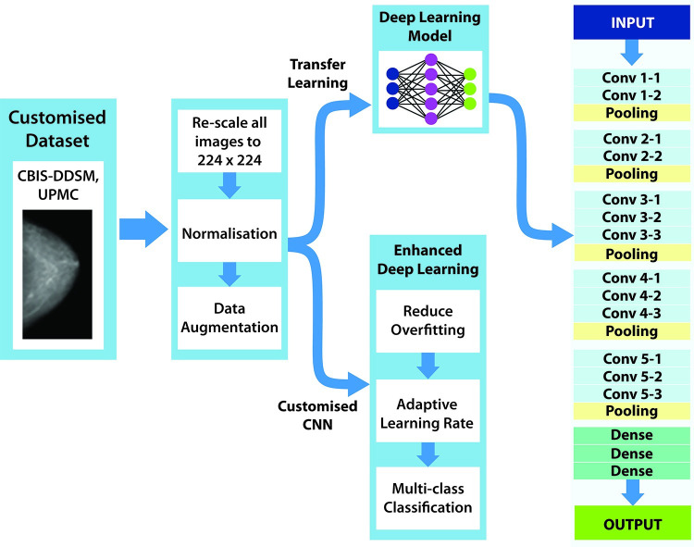
Architecture used in paper

Slide 3
DataSet Details
Data set Name: Multi Classification for images.
It includes 5429 images and includes 5 labels.
Then we split training data to train data and test data we let test data=20%,
And we split test data to test and validation to 50%
Now we have:
Training (4343)
Validation (543)
Testing (543)

Slide 4
Implementation details
Data set upload
Data set pre proccising,then label encoding
Dataset includes 5429 images,
Then we split training data to train data and test data we let test data=20%,
And we split test data to test and validation to 50%
Testing (543)
Data Augmentation
Bulid model cnn
Evalute the model
plot the Trainig and Validation Accuracy , confusion_matrix and roc

Slide 5
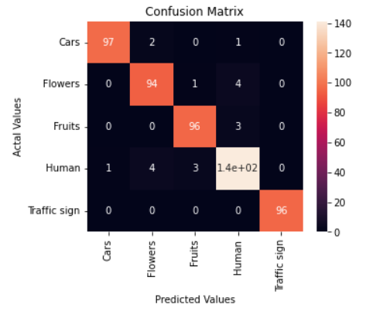
Results and visualizations
ACC train: 0.99
Test ACC: 0.97
Validation ACC : 0.96
Confusion matrix:

Slide 6
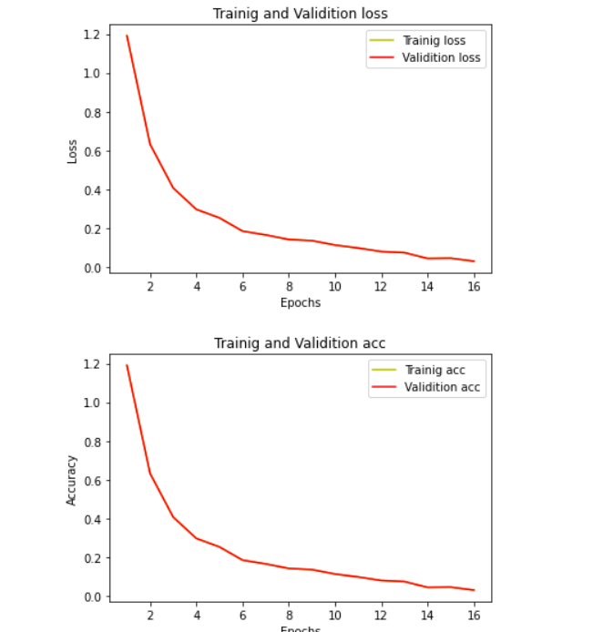
Results and visualizations
Training and validation loss an accuracy :

Slide 7
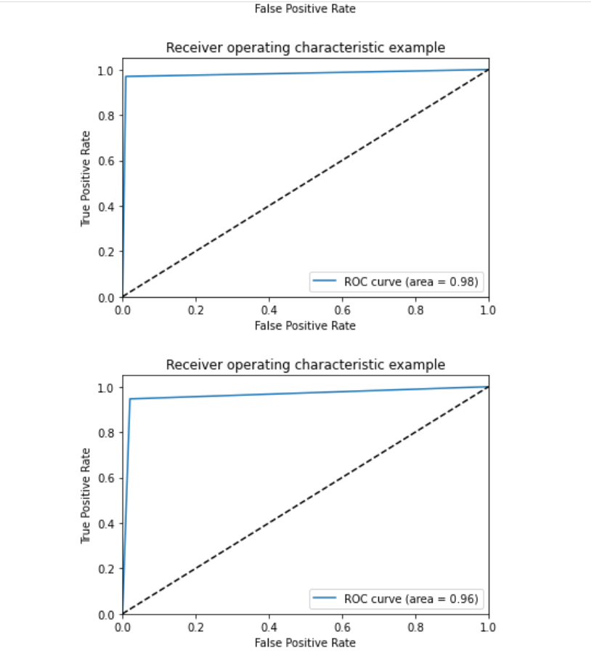
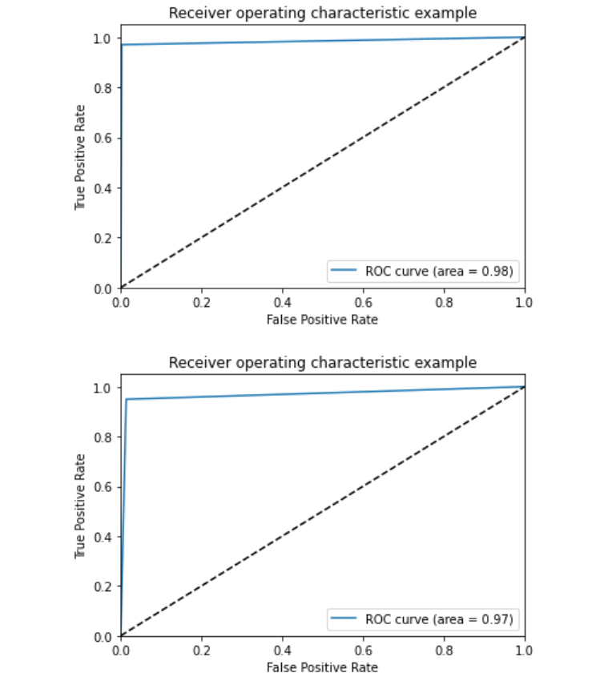
Results and visualizations: roc

