Slide 1
AareML
Predicting River Water Quality in Swiss Catchments
CAS Advanced Machine Learning · University of Bern
github.com/polar-bear-after-lunch/AareML

Slide 2
Agenda
1
Why — Career motivation & the deoxygenation problem
2
Data — CAMELS-CH-Chem, 86 gauges, 40 years
3
Model & Baselines — AR(7) · Ridge · LSTM
4
Transfer Learning — Zero-shot across Swiss gauges
5
EA-LSTM & Temperature — Static catchment attributes
6
Conclusion — Findings, limitations, next steps
2

Slide 3
Swiss rivers are losing oxygen
−0.038
mg/L per decade deoxygenation
Validation: Use LakeBeD-US benchmark to verify results are not nonsense
Dataset: CAMELS-CH-Chem (Nascimento et al. 2025) — one author at Uni Bern
Zhi et al. 2023 — 70% of Central European rivers deoxygenating
40 years · 86 gauges · 4 sensor variables
6 mg/L
fish stress threshold
40 years · 86 gauges · 4 sensor variables · CAMELS-CH-Chem, Nascimento et al. 2025
3

Slide 4
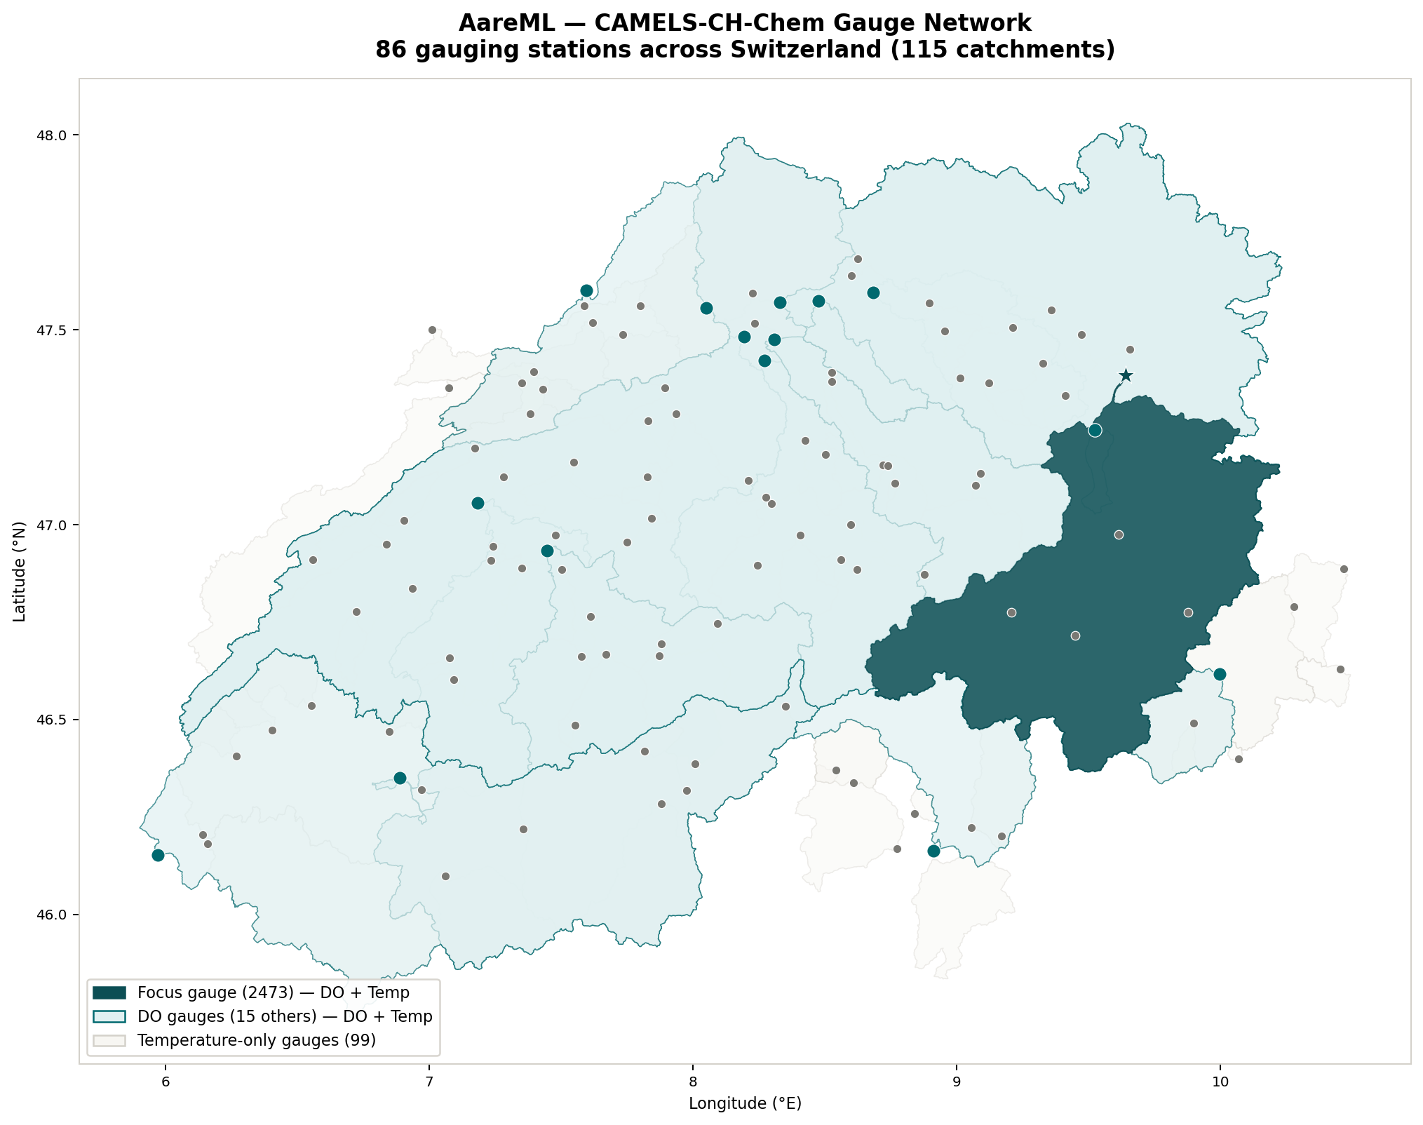
Only 16 of 86 gauges have DO data
16 / 86
gauges with dissolved oxygen data
40 years
1981 – 2020 · daily resolution
4 variables
Temp · pH · Conductivity · DO
This is the problem — and the motivation for transfer learning
Dataset: CAMELS-CH-Chem · Nascimento et al. 2025 · Scientific Data
nb01 | Nascimento et al. 2025
4

Slide 5
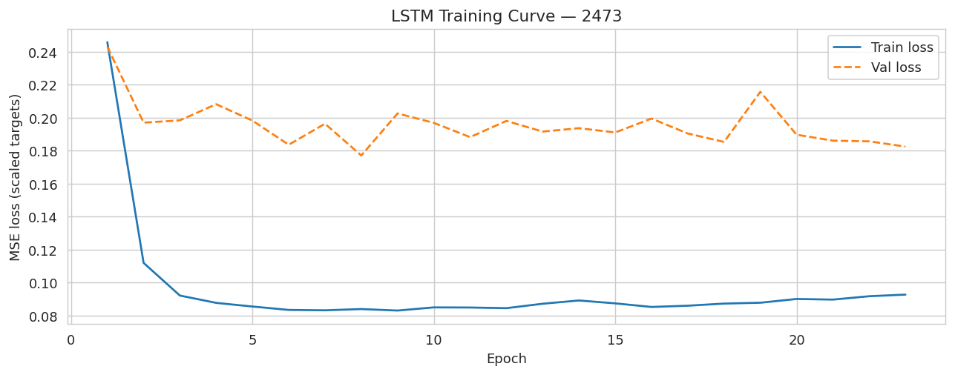
LSTM learns the river's memory
21 days
lookback window
14 days
forecast horizon
75 trials
Optuna hyper-search
Model | RMSE | NSE | KGE
AR(7) — DO only | 0.388 mg/L | 0.765 | 0.904
Ridge regression | 0.303 mg/L | 0.888 | 0.908
LSTM (best) | 0.300 mg/L | 0.891 | 0.936
On one site Ridge keeps up. The difference emerges in transfer.
nb02 · nb03 · nb14 | Zhi et al. 2021
5

Slide 6
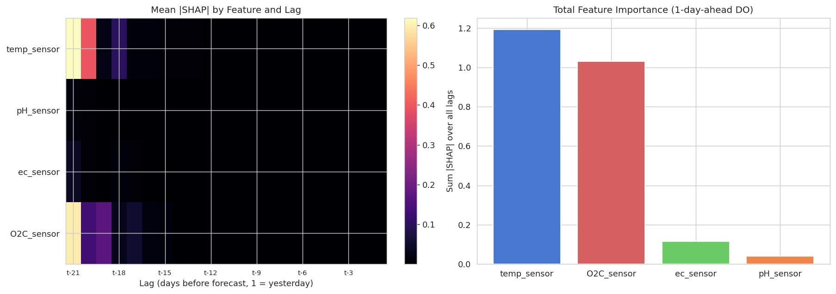
Temperature dominates — correlation, not causation
0.644
mean |SHAP| — temperature lag t−1
Lookback | RMSE
4 days | 0.309 mg/L
5 days | 0.314 mg/L
6 days | 0.308 mg/L
7 days | 0.318 mg/L
21 days | 0.304 mg/L
6-day lookback (0.308) vs. 21-day (0.304) — negligible difference
SHAP shows what the model learned — not the physical mechanism. Cold water holds more oxygen (Henry's Law).
nb05 · nb11 | Kratzert et al. 2019
6

Slide 7
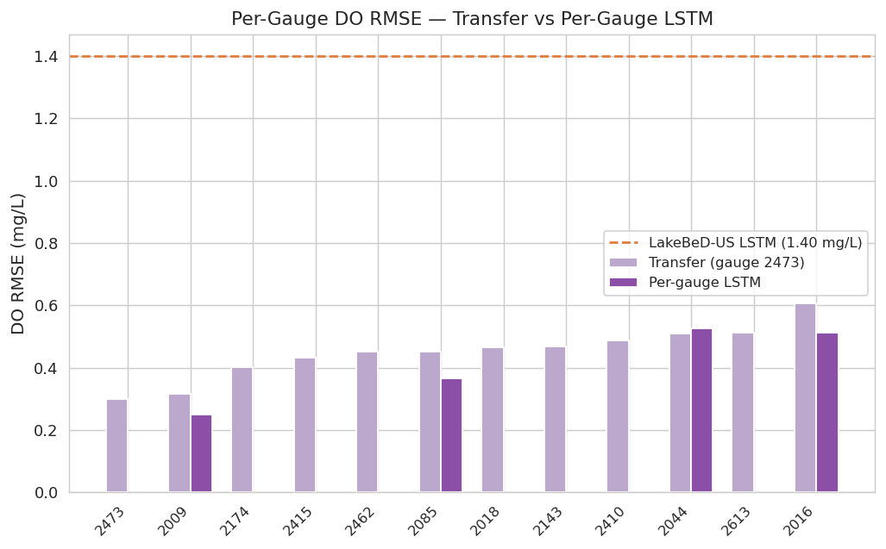
Zero-shot transfer: LSTM beats Ridge where it matters
Strategy | RMSE | NSE
Ridge zero-shot | 0.568 mg/L | 0.628
LSTM zero-shot | 0.464 mg/L | 0.843
LSTM per-gauge | 0.393 mg/L | 0.867
EA-LSTM | 0.420 mg/L | 0.843
18% better
LSTM vs Ridge zero-shot
Wilcoxon p = 0.024 · n = 11 gauges · statistically significant
LOO cross-validation across all 16 DO gauges
110 transfer pairs · mean RMSE: 0.463 mg/L — not a cherry-pick
nb04 · nb16
7

Slide 8
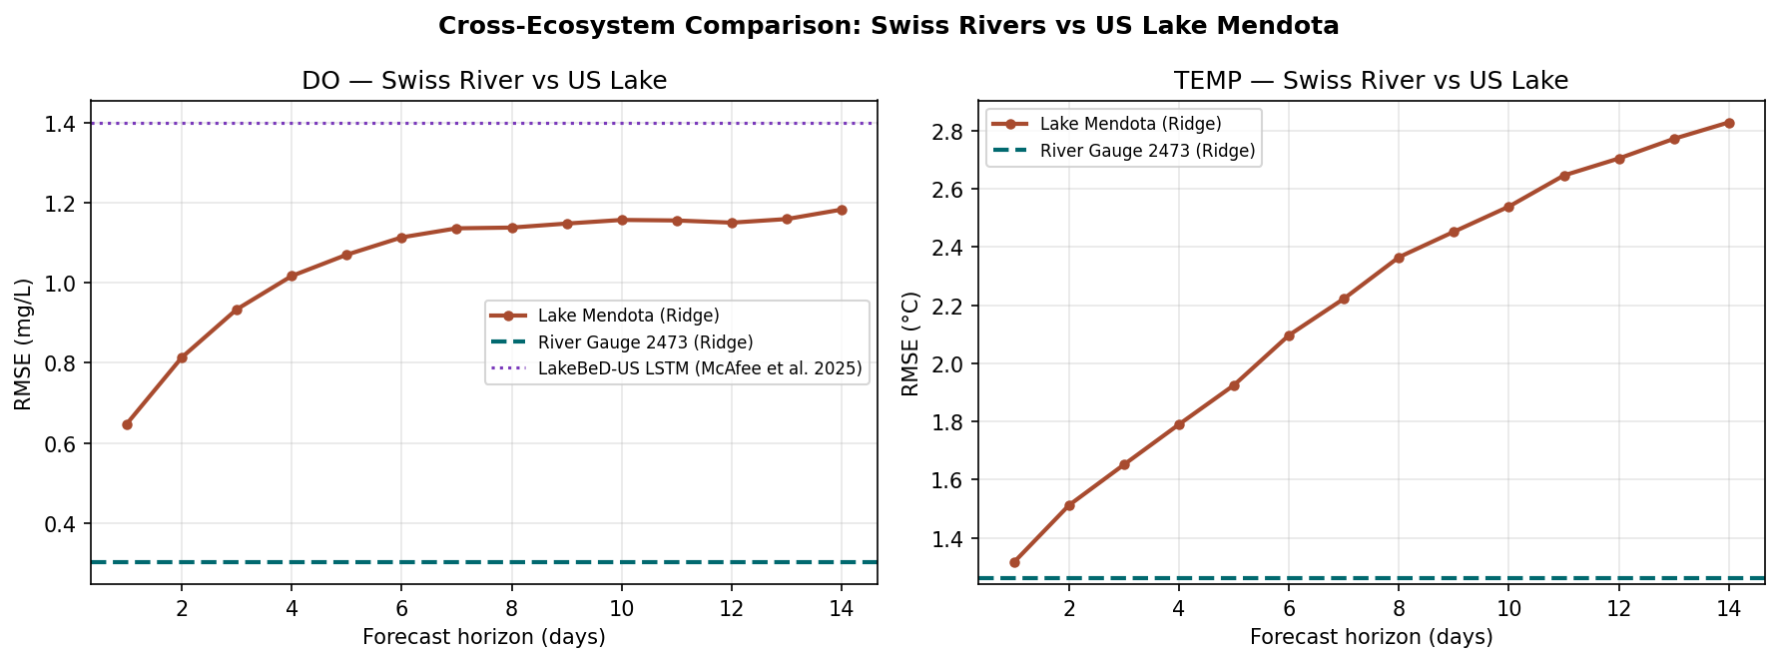
Transfer works — until the physics changes
Swiss Rivers
0.464 mg/L
Same physics · Zero-shot transfer
US Rivers
1.376 mg/L
Similar hydrology · Willamette (OR): 0.996
Swiss Lakes
NSE −6.486
Different physics · Worse than mean predictor
Retrained: 0.768 mg/L
nb06 · nb07 · nb08 · nb10
8

Slide 9
Static catchment attributes improve generalisation
DO Prediction
0.464 → 0.420 mg/L
Improvement: +9%
Temperature
2.597 → 1.721°C
Improvement: +34%
8 Static Features from CAMELS-CH
· log catchment area
· mean elevation
· aridity index
· mean precipitation
· snow fraction
· forest cover %
· cropland %
· urban cover %
Elevation explains the temperature gap — catchment attributes anchor predictions per gauge · Kratzert et al. 2019
Source: CAMELS-CH · Höge et al. 2023, ESSD
nb04 · nb04b | Höge et al. 2023
9

Slide 10
Temperature transfer across 15 gauges
Zero-shot LSTM
2.597°C
RMSE
NSE 0.727
EA-LSTM
1.721°C
RMSE
NSE 0.862
34% improvement — elevation is the dominant static attribute
Notebooks: nb04b · nb04c (EC as precipitation proxy)
nb04b · nb04c
10

Slide 11
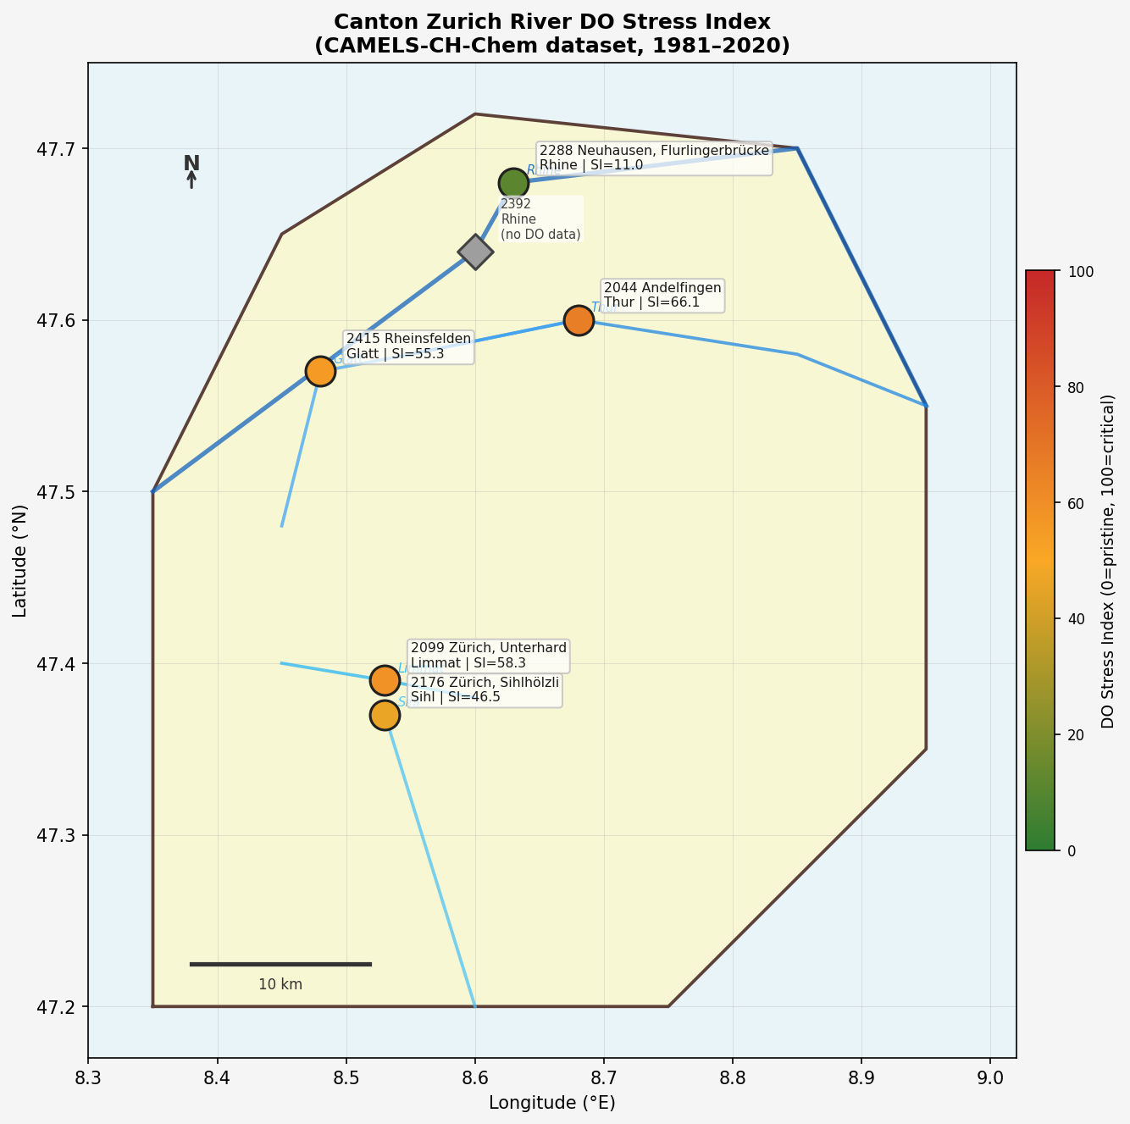
Safe today — but the trend is clear
Current Status
Within safe DO limits
8 mg/L early warning threshold
Early Warning System
Managers get time to act before
the 6 mg/L fish stress threshold
Canton Zurich rivers are currently above the fish stress threshold of 6 mg/L.
Rivers warming year over year — dissolved oxygen declining in step.
The system needs to be built now — not after the first fish kill.
Zhi et al. 2023 — −0.038 mg/L per decade across Central European rivers
nb09
11

Slide 12
Daily AI-assisted development · UBELIX HPC · Eawag
16 notebooks
EDA → Baselines → LSTM
→ Transfer → Validation
→ Ablation → EA-LSTM
RTX 4090
UBELIX HPC cluster
University of Bern
Jobs up to 8 hours
Thiago Nascimento
Eawag, Kastanienbaum
CAMELS-CH-Chem co-author
Detailed technical review
Honest note: Code by AI. Ideas, decisions, and scientific judgement by me.
12

Slide 13
Two equations, three unknowns — and a direction
Key Findings
References
LSTM zero-shot 18% better than Ridge in transfer (0.464 vs. 0.568 mg/L)
EA-LSTM: 34% improvement for temperature (2.597 → 1.721°C)
Swiss Lakes: NSE −6.486 — river model cannot handle stratified physics
Result robust across 110 LOO cross-validation pairs (mean 0.463 mg/L)
Nascimento et al. 2025 — CAMELS-CH-Chem
Höge et al. 2023 — CAMELS-CH base attributes
Zhi et al. 2021 — DO LSTM benchmark
Kratzert et al. 2019 — EA-LSTM for hydrology
Zhi et al. 2023 — Central European deoxygenation
github.com/polar-bear-after-lunch/AareML
13

