Slide 1
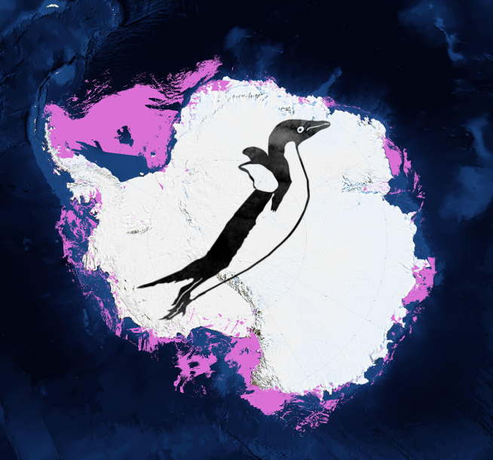
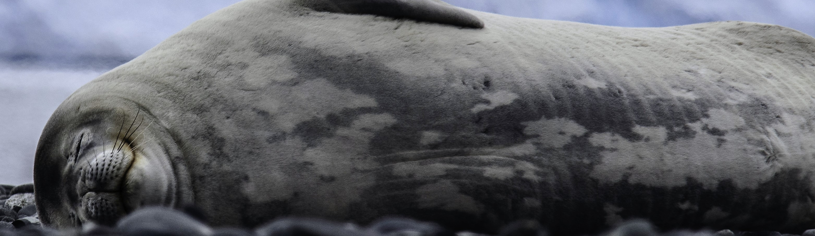
Seal Team 6
http://polar-computing.org

Slide 2
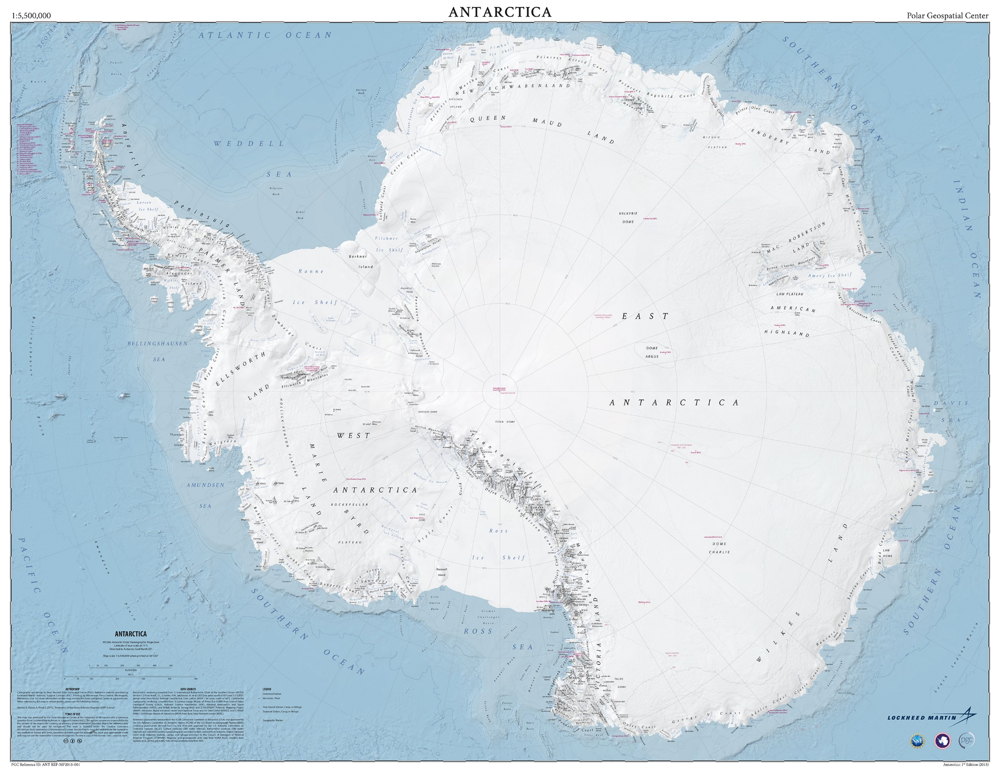
Science Objective
Identify individual Weddell seals
Understand movement over time

Slide 3
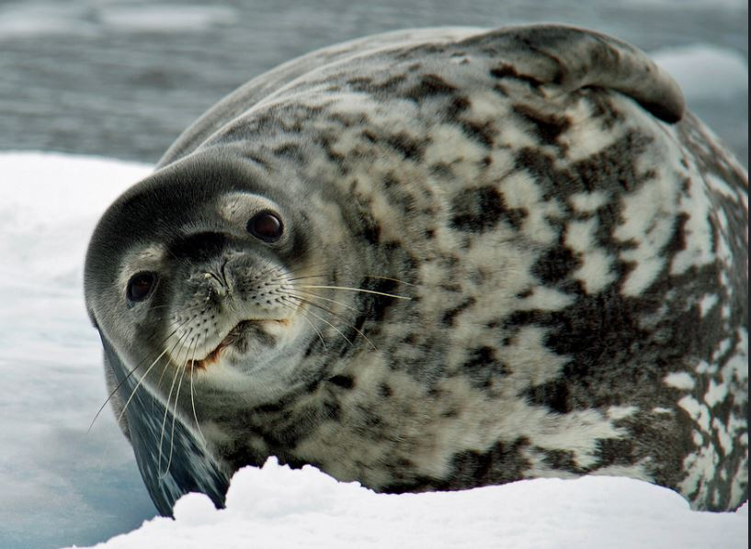
Computational Challenge
Feature detection and extraction
Is this the same?

Slide 4
What did you achieve?

Slide 5
What did you not achieve?

Slide 6
Any highlights? What worked? What didn’t?

Slide 7
Biggest insight/lesson learnt?
By Scientists?
By programmers?

Slide 8
Specific comments to XSEDE
What is a typical job size? (# of processors, wall clock time, memory/processor)
What software do you use?
What are the XSEDE digital services that you will be using to support your research?
Data Transfers such as GridFTP, Globus Online, etc. from where to where?
XSEDE Visualization systems
XSEDE Data Analytics systems
Has XSEDE documentation been helpful?

