Slide 1
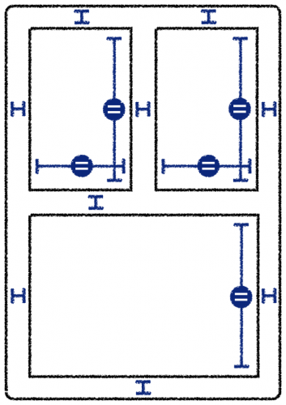
Auto Layout

Slide 2
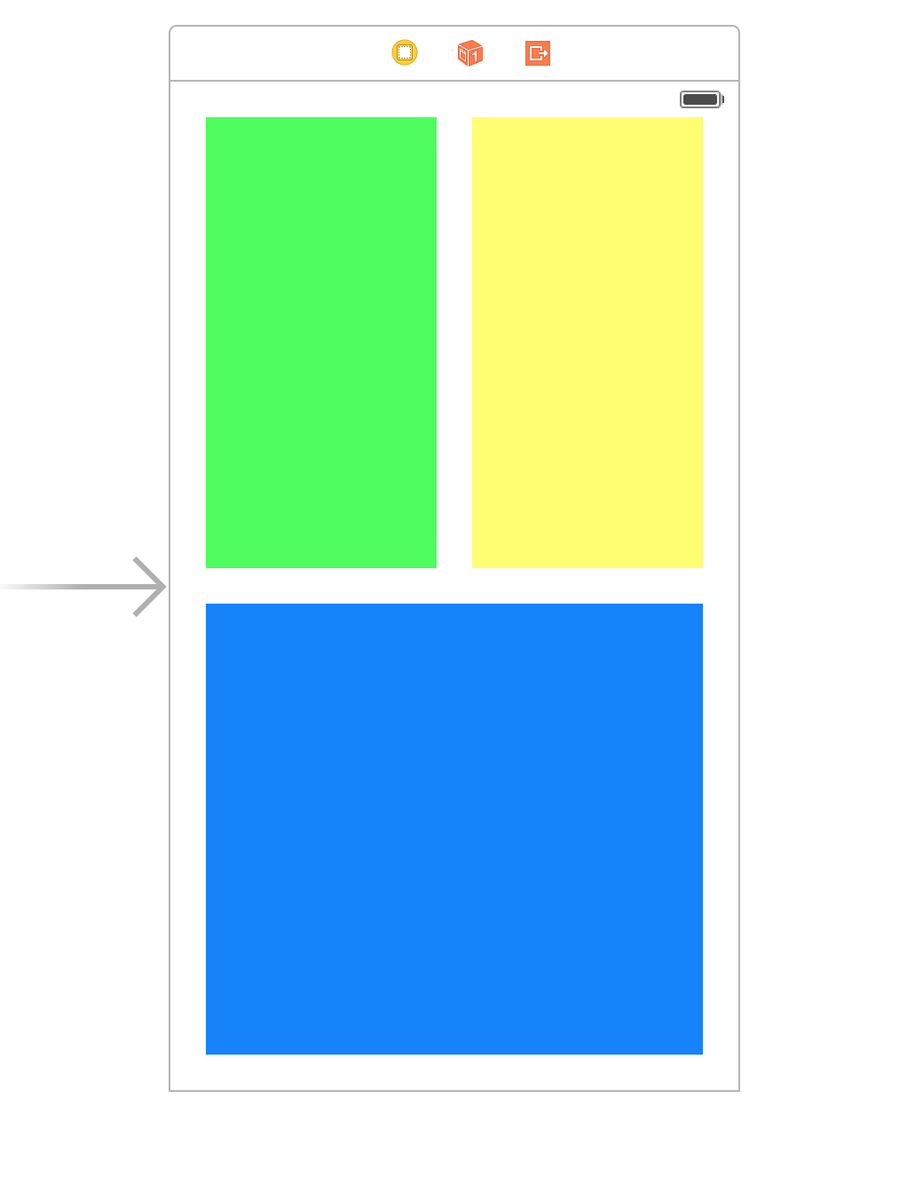

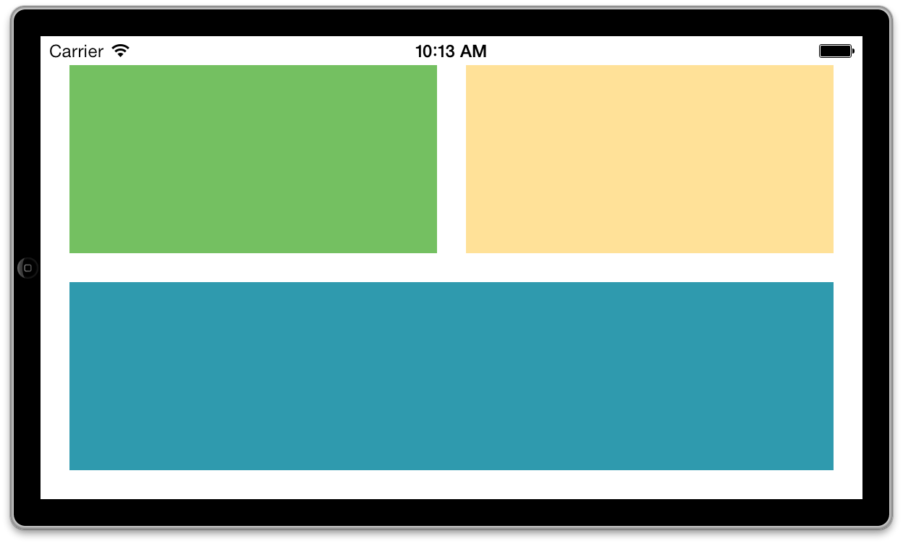
Xib
In stead, you want the app to look like this in landscape.
In landscape, the app doesn’t look quite right.

Slide 3
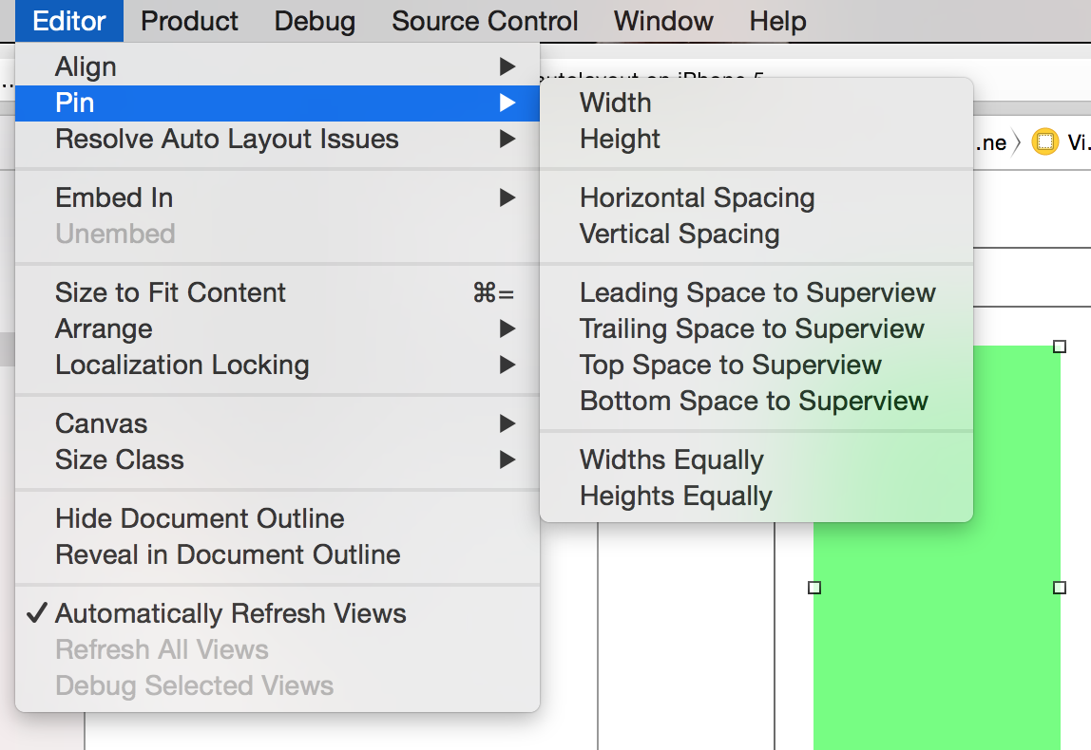
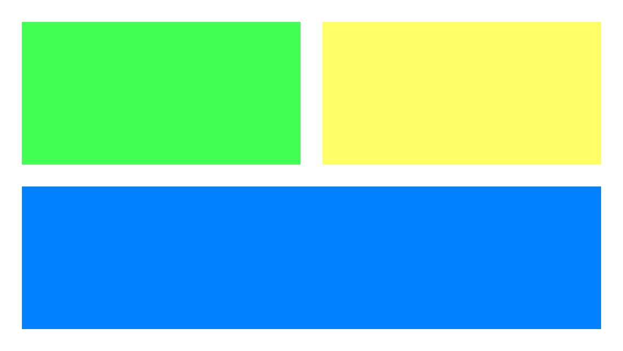
Xib
From Xcode’s Editor menu, select Pin\Widths Equally
Editor\Pin\Horizontal Spacing
For the green view on the top left, choose from the Editor\Pin menu:
Top Space to Superview
Leading Space to Superview
For the yellow view on the right, choose:
Top Space to Superview
Trailing Space to Superview
And for the big blue view at the bottom:
Leading Space to Superview
Trailing Space to Superview
Bottom Space to Superview

Slide 4
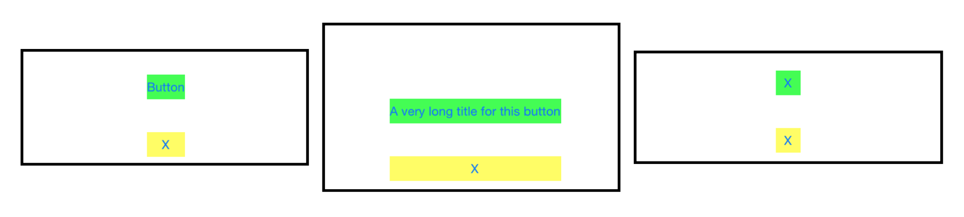
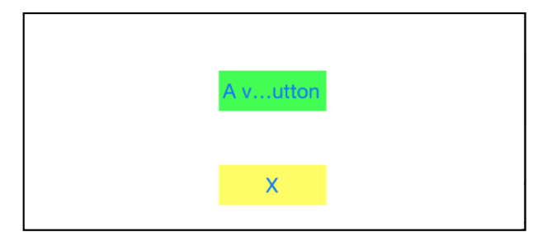
Xib

Slide 5
Masonry
Installation:
Either use the orsome CocoaPods
In your Podfile
pod 'Masonry’
Or import all files in the folder ‘Masonry-master/Masonry’
If you want to use masonry without all those pesky 'mas_' prefixes. Add #define MAS_SHORTHAND to your prefix.pch before importing Masonry
#define MAS_SHORTHAND
Get busy Masoning
#import "Masonry.h"

Slide 6
Masonry
Examples:
UIEdgeInsets padding = UIEdgeInsetsMake(10, 10, 10, 10);
[view1 mas_makeConstraints:^(MASConstraintMaker *make) {
make.top.equalTo(superview.mas_top).with.offset(padding.top); //with is an optional semantic filler
make.left.equalTo(superview.mas_left).with.offset(padding.left);
make.bottom.equalTo(superview.mas_bottom).with.offset(-padding.bottom);
make.right.equalTo(superview.mas_right).with.offset(-padding.right);
}];
Or even shorter
[view1 mas_makeConstraints:^(MASConstraintMaker *make) {
make.edges.equalTo(superview).with. Insets(padding);
}];

Slide 7
Masonry
Example:
1. MASViewAttribute
make.centerX.lessThanOrEqualTo(view2.mas_left);
2. UIView/NSView
if you want view.left to be greater than or equal to label.left :
//these two constraints are exactly the same
make.left.greaterThanOrEqualTo(label);
make.left.greaterThanOrEqualTo(label.mas_left);
3. NSNumber
Auto Layout allows width and height to be set to constant values. if you want to set view to have a minimum and maximum width you could pass a number to the equality blocks:
//width >= 200 && width <= 400
make.width.greaterThanOrEqualTo(@200);
make.width.lessThanOrEqualTo(@400)
4. NSArray
An array of a mixture of any of the previous types
make.height.equalTo(@[view1.mas_height, view2.mas_height]);
make.height.equalTo(@[view1, view2]);
make.left.equalTo(@[view1, @100, view3.right]);
Learn to prioritize
.priority allows you to specify an exact priority
.priorityHigh equivalent to UILayoutPriorityDefaultHigh
.priorityMedium is half way between high and low
.priorityLow equivalent to UILayoutPriorityDefaultLow
Priorities are can be tacked on to the end of a constraint chain like so:
make.left.greaterThanOrEqualTo(label.mas_left).with.priorityLow();
make.top.equalTo(label.mas_top).with.priority(600);

Slide 8
Masonry
Composition, composition, composition
Masonry also gives you a few convenience methods which create multiple constraints at the same time. These are called MASCompositeConstraints
edges
// make top, left, bottom, right equal view2
make.edges.equalTo(view2);
// make top = superview.top + 5, left = superview.left + 10,
// bottom = superview.bottom - 15, right = superview.right - 20
make.edges.equalTo(superview).insets(UIEdgeInsetsMake(5, 10, 15, 20))
size
// make width and height greater than or equal to titleLabel
make.size.greaterThanOrEqualTo(titleLabel)
// make width = superview.width + 100, height = superview.height - 50
make.size.equalTo(superview).sizeOffset(CGSizeMake(100, -50))
center
// make centerX and centerY = button1
make.center.equalTo(button1)
// make centerX = superview.centerX - 5, centerY = superview.centerY + 10
make.center.equalTo(superview).centerOffset(CGPointMake(-5, 10))
You can chain view attributes for increased readability:
// All edges but the top should equal those of the superview
make.left.right.and.bottom.equalTo(superview);
make.top.equalTo(otherView);

Slide 9
Masonry
1. References
You can hold on to a reference of a particular constraint by assigning the result of a constraint make expression to a local variable or a class property. You could also reference multiple constraints by storing them away in an array.
// in public/private interface
@property (nonatomic, strong) MASConstraint *topConstraint;
...
// when making constraints
[view1 mas_makeConstraints:^(MASConstraintMaker *make) {
self.topConstraint = make.top.equalTo(superview.mas_top).with.offset(padding.top);
}];
…
// then later you can call
[self.topConstraint uninstall];
2. mas_updateConstraints
Alternatively if you are only updating the constant value of the constraint you can use the convience method mas_updateConstraints instead of mas_makeConstraints
// this is Apple's recommended place for adding/updating constraints
// this method can get called multiple times in response to setNeedsUpdateConstraints
// which can be called by UIKit internally or in your code if you need to trigger an update to your constraints
- (void)updateConstraints {
[self.growingButton mas_updateConstraints:^(MASConstraintMaker *make) {
make.center.equalTo(self);
make.width.equalTo(@(self.buttonSize.width)).priorityLow(); make.height.equalTo(@(self.buttonSize.height)).priorityLow();
make.width.lessThanOrEqualTo(self);
make.height.lessThanOrEqualTo(self);
}];
[super updateConstraints];
}

Slide 10
Masonry
3. mas_remakeConstraints
mas_updateConstraints is useful for updating a set of constraints, but doing anything beyond updating constant values can get exhausting. That's where mas_remakeConstraints comes in.
mas_remakeConstraints is similar to mas_updateConstraints, but instead of updating constant values, it will remove all of its contraints before installing them again. This lets you provide different constraints without having to keep around references to ones which you want to remove.
- (void)changeButtonPosition {
[self.button mas_remakeConstraints:^(MASConstraintMaker *make) {
make.size.equalTo(self.buttonSize);
if (topLeft) {
make.top.and.left.offset(10);
} else {
make.bottom.and.right.offset(-10);
}
}];
}

Slide 11
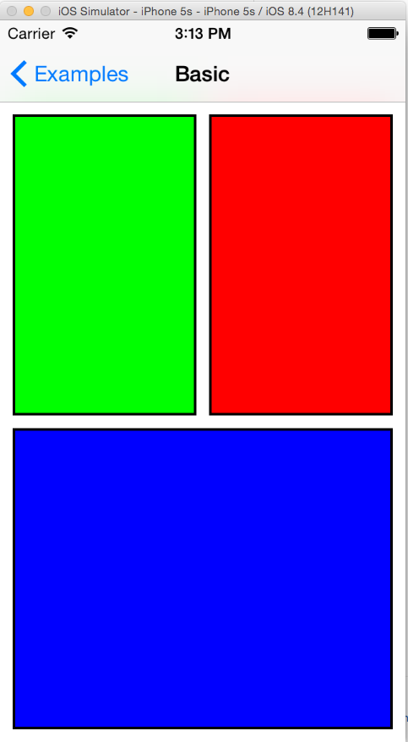
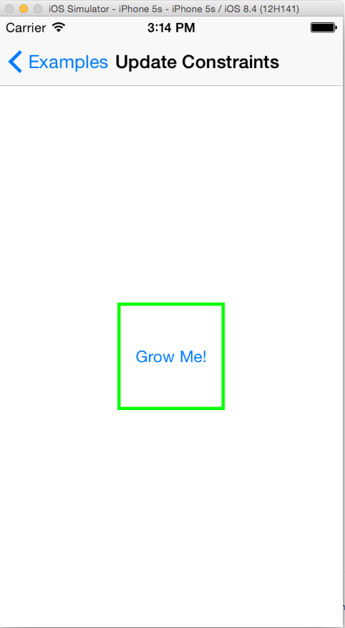
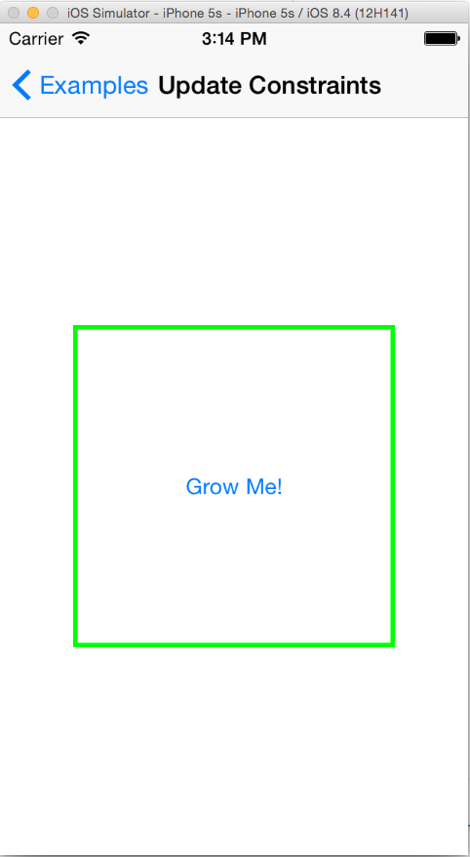
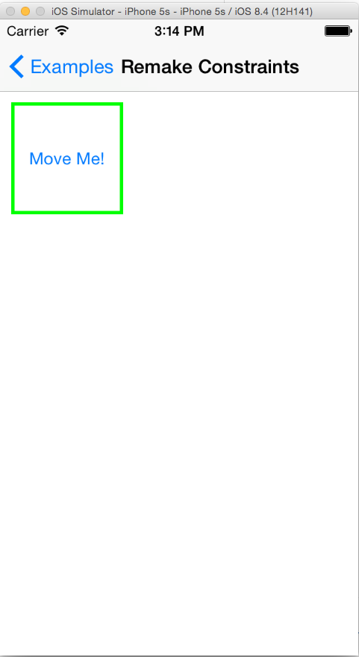
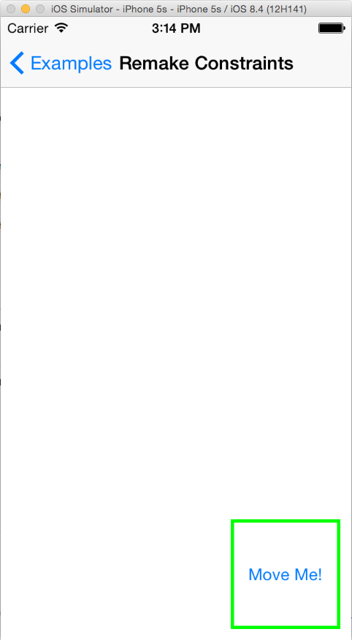
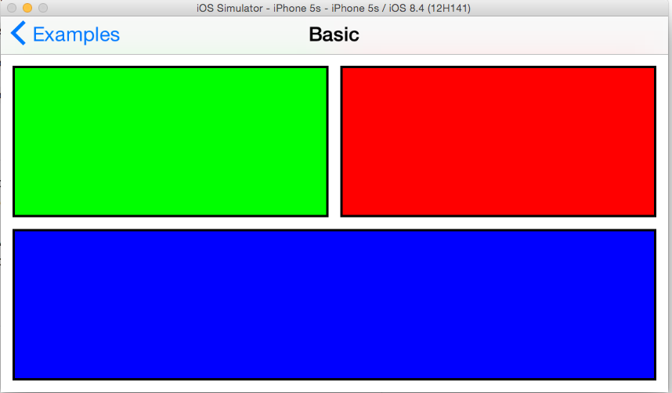
Masonry

Slide 12
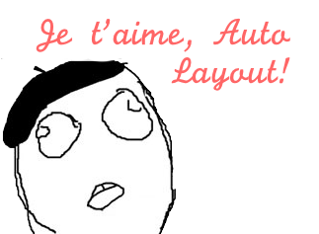
Thanks!

