Slide 1
CAS Applied Data Science University of Bern
Module 6 Deep Learning –
Music vs Speech Classification
Stefano Brandinu & Marc Bratschi
13. März 2023, Bern

Slide 2
Content
Objectives & Data
Data preparation, preprocessing and split
Goal
Model building
Only Convolutional Layers
With Pooling
Final model and evaluation
Conclusion
Jupyter notebook on Github: Link

Slide 3
Objective & Data
Objective
This project tries to implement a deep learning model that classifies audio samples in music or speech.
Data
128 audio files of 30 seconds each
64 speech files
64 music files

Slide 4
Data preparation, preprocessing and split
Split in train and test set
Get directory of each audio file
All audios from a category (i.e. speech or music) are split into a training (80%) and validation (20%) set
Data preprocessing
Load audio files for music and speech datasets separately for training and validation
Applying discrete Fourier Transformation
Transform and cut into smaller slices (79 per audio with overlapping)
Put together samples of speech and music
Add labels
Results in:
Training set: 8’058
Validation set: 2’054

Slide 5
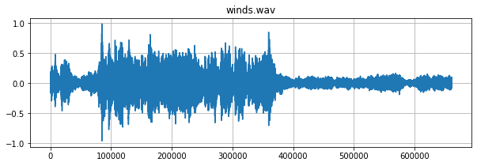
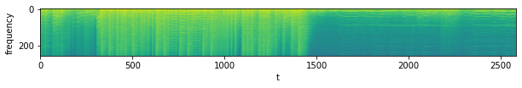
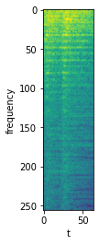
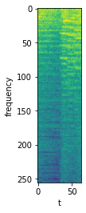
Data preparation, preprocessing and split
Example of the frequence of a music file (winds.wav) including a fourier transformation and the first slice.

Slide 6
Model building
Model architecture
With and without Pooling Layers
Epochs = 30
Batch Size = 10
Testing different activations functions for hidden layers
ReLU and tanh
Chose model based on accuracy
Try different hyperparameters
Stride
Kernels
Test Learnings rates
0.0005
0.001

Slide 7
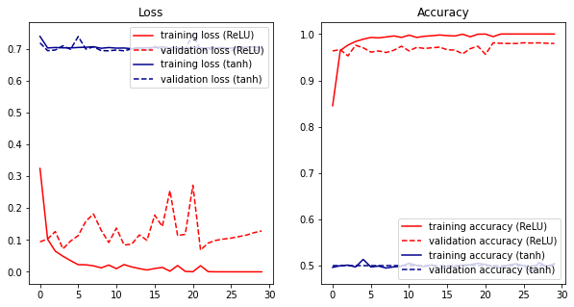
Model building - only Convolutional Layers
tanh activation function does not seem to work
tanh activation function has some drawbacks
One of the main limitations is the “vanishing gradient” problem.
This makes it difficult for the model to learn and converge.

Slide 8
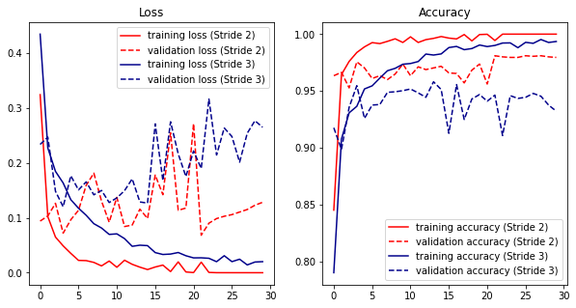
Model building - only Convolutional Layers
Using a smaller stride value will result in a larger output volume which can increase the computational cost of the network.
Using a larger stride can also result in a loss of information as some areas of the input may not be considered in the output.
According to the plot implementing stride 2 leads to lower validation loss and better validation accuracy

Slide 9
Model building - only Convolutional Layers
Findings
tanh activation function does not seem to work
Better implement ReLU activation function
Stride of 2 leads to lower validation loss and better validation accuracy than stride of 3

Slide 10
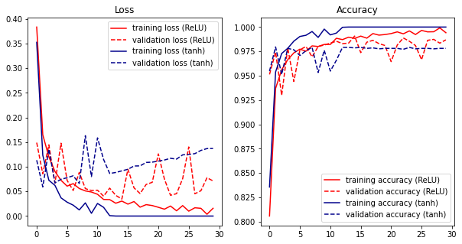
Model building - with Pooling Layers
ReLU activation function shows lower validation loss and better validation accuracy than tanh activation function

Slide 11
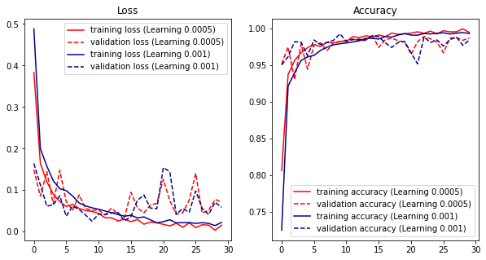
Model building - with Pooling Layers
Testing model 1 with different learnings rates (0.0005 and 0.001)
No visible difference with different learning rates

Slide 12
Model building - with Pooling Layers
Testing different value for kernel size, stride and learning rate does not show strong differences in validation set.
For the final model the following parameters will be implemented:
Activation function ReLU (Rectified Linear Unit)
Padding “same”
Kernel size = 2x2
Strides = 2
Higher strides does not work well with many layers
Learning rate = 0.0005

Slide 13
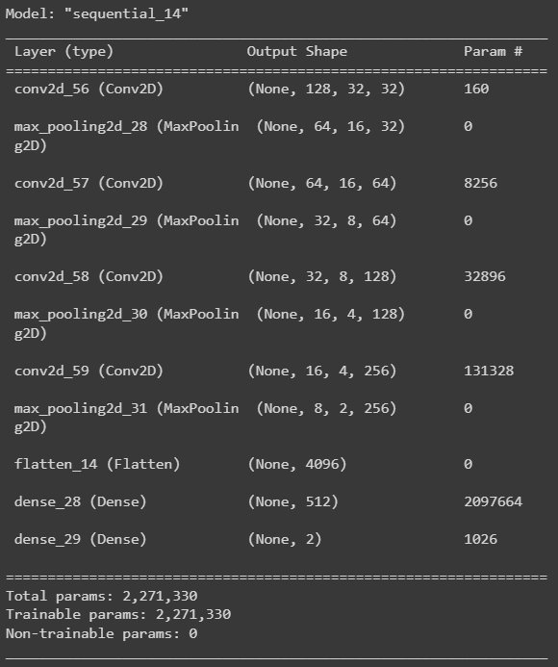
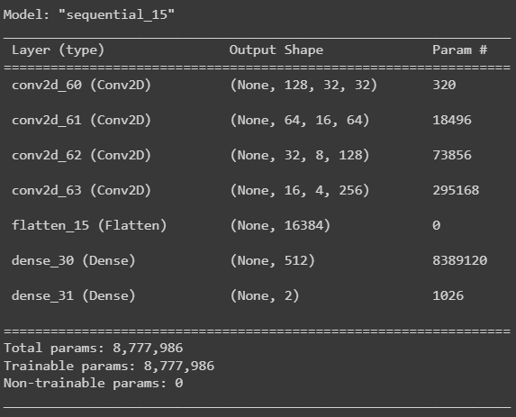
Model Comparison
Model with pooling layer
Model only convolutional layer
Notes:
Less trainable parameters with model with pooling layer

Slide 14
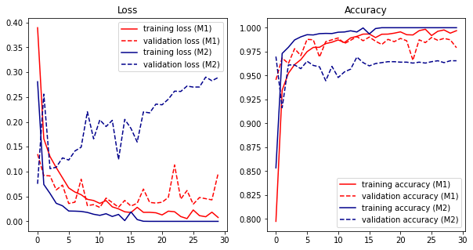
Comparison Model 1 & Model 2
The comparison of the model with pooling layers and the model only with convolutional layers shows lower validation loss and better training accuracy with pooling layer.
Apparently this is mainly due to the pooling layer which improves the performance with less trainable parameters

Slide 15
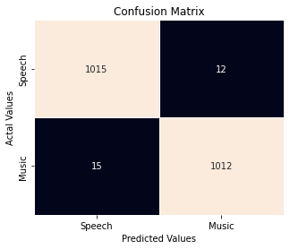
Evaluation - Confusion Matrix
Validation accuracy: 98%
Even distribution of wrong predicted classes

Slide 16
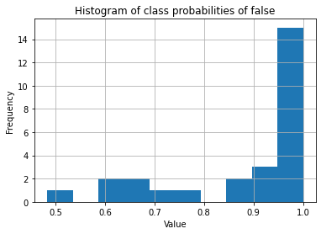
Evaluation - Probabilities and Audio Files
Fairly high probabilities by wrong ones
Remember: 79 slices per audio
Not whole song, only segment is wrongly predicted
Names of wrong predicted audio files
ncherry.wav': 4,
gravity.wav': 8,
voices.wav': 1,
nj105.wav': 2,
dialogue1.wav': 2,
nj105a.wav': 2,
dialogue.wav': 6,
my_voice.wav': 2

Slide 17
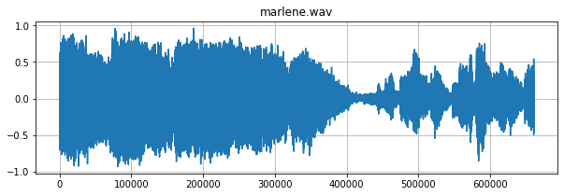
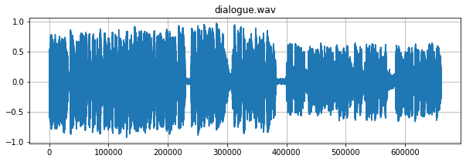
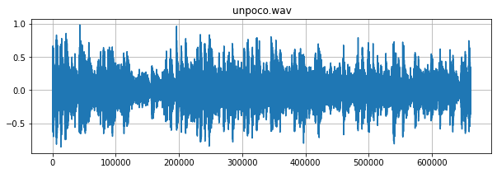
Evaluation - Speech recognized as Music

Slide 18
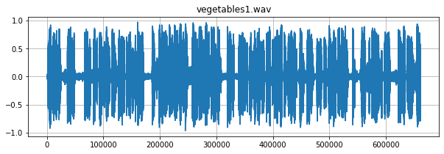
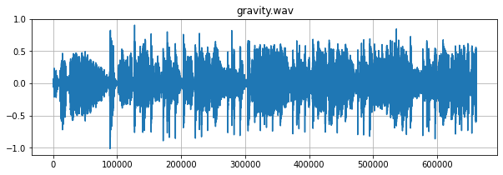
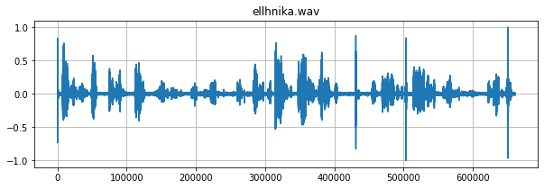
Evaluation - Music recognized as Speech

Slide 19
Conclusion
Model works very good with moderate computational effort
Pooling layers improved the performance with less trainable parameters
Variation of model parameters would be better done by grid search

