Slide 1
CAS Applied Data Science University of Bern
Module 3 Machine Learning –
Winner Prediction of Soccer Games
Stefano Brandinu & Marc Bratschi
12. Dezember 2022, Bern

Slide 2
Content
Introduction & Objectives
Data Description
Descriptive Statistics
Machine Learning Model
Conclusion

Slide 3
Introduction & Objectives
Introduction
Soccer is probably the most popular sport in the world
A large part of the articles and reports in newspapers and television is not only about the football game itself, but also about previews, predictions, analysis, etc.
Many experts and analysts each try to predict the winner of games based on their expertise and data
Objectives
This project tries to implement a machine learning model that predicts the winner

Slide 4
Data Description – Data source
Data Source: https://www.kaggle.com/datasets/hugomathien/soccer
+25,000 matches
+10,000 players
11 European Countries with their lead championship
Seasons 2008 to 2016
Players and Teams' attributes* sourced from EA Sports' FIFA video game series, including the weekly updates
Team line up with squad formation (X, Y coordinates)
Betting odds from up to 10 providers
Detailed match events (goal types, possession, corner, cross, fouls, cards etc…) for +10,000 matches

Slide 5
Data Description – Data cleaning
Subset
Country / Leagues: Italy Serie A & Spain La Liga
Reason for chosen leagues: two differenct leagues with comparable level (belong to the top leagues in Europe) und same amount of teams
Seasons: 2014/2015 – 2015/2016
Reason for chosen seasons: fully available data
Teams / Opponents
Results
Odds of bookmakers
Gained points
Number of observations: 1518
The data is stored in different tables (sqlite links). The tables were linked.
Only information used that was available

Slide 6
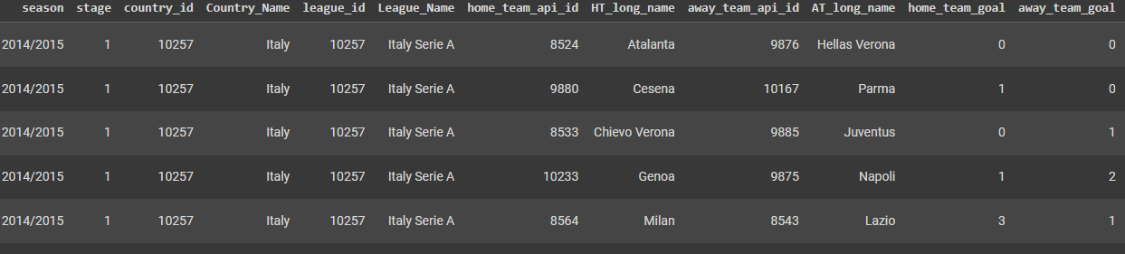
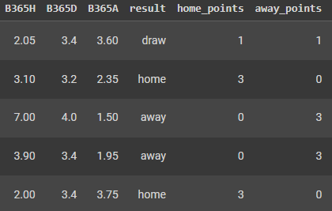
Data Description – Data cleaning
Extension of subset
We extended the data set by additional variables
by calculating the achieved points of the last 3 matches for each team
by calculating rankings after every stage of the season

Slide 7
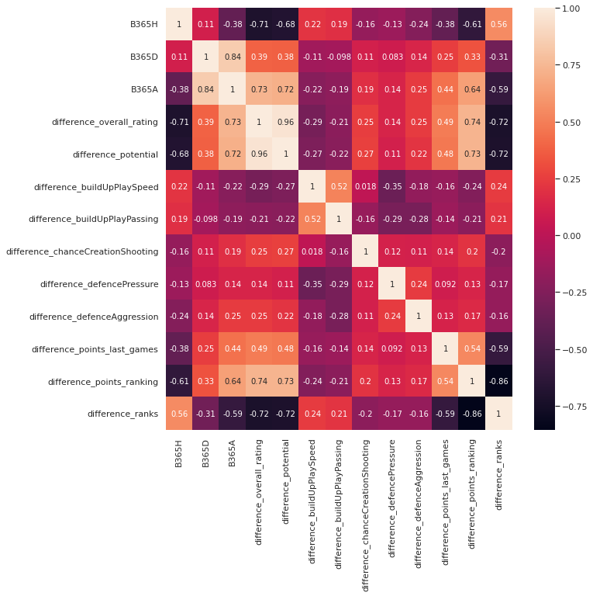
Descriptive Statistics – Correlation Heatmap

Slide 8
Descriptive Statistics – Correlation Heatmap
Strong correlations
Strong correlation between difference_overall_rating and the odds
The more positive the difference of the ratings of the two teams, the lower the odds for the home team and vice versa
The more negative the difference of the ratings the higher the odds for the home team and vice versa
Strong correlation between difference_overall_rating and difference_points_ranking
The higher the difference of the overall ratings of the two teams, the higher the difference in the ranking.

Slide 9
Descriptive Statistics – Correlation Heatmap
Medium correlations
Medium correlation between difference_points_last_games vs. odds
The more points a team has gained in the last games the lower the odds for B365H and vice versa
Medium correlation between difference_points_ranking vs. odds
The bigger the difference in total gained points the lower the odds for B365H and vice versa
Medium correlation between difference_ranks vs. odds
The bigger the difference in the ranking the higher the odds for B365H and vice versa

Slide 10
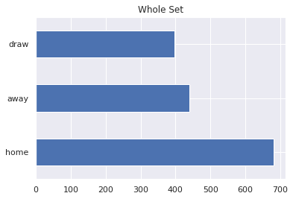
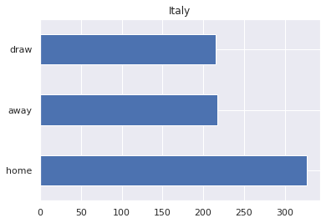
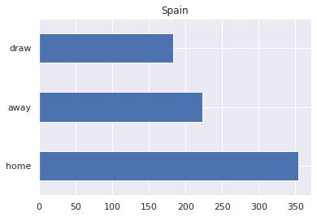
Descriptive Statistics
Plot shows comparison of whole set, Italy and Spain
Mostly home teams wins
There seem to be more draws in Italy than in Spain

Slide 11
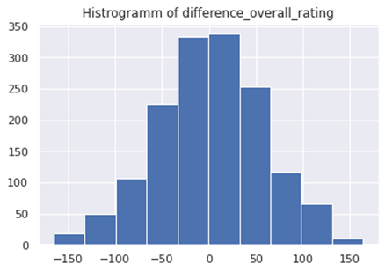
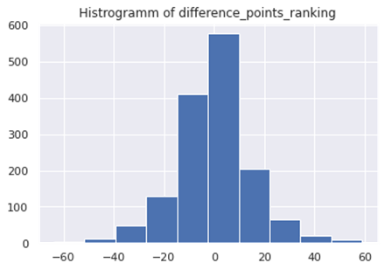
Descriptive Statistics
First histogram shows distribution of the difference between teams with regards to overall rating
Second histogram shows distribution of the difference between teams with regards to ranking points

Slide 12
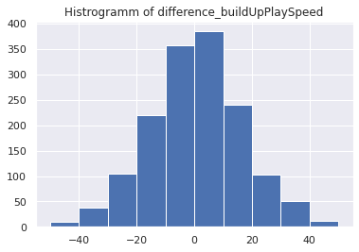
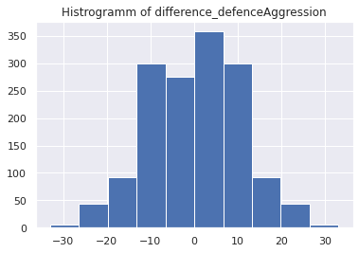
Descriptive Statistics
Distribution of teams with regard to certain abilities like
Play Speed
Defence Aggression

Slide 13
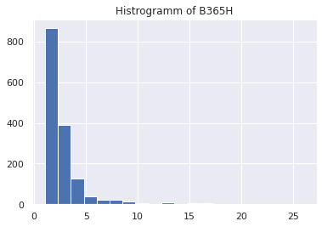
Descriptive Statistics
Distribution of odds for home teams

Slide 14
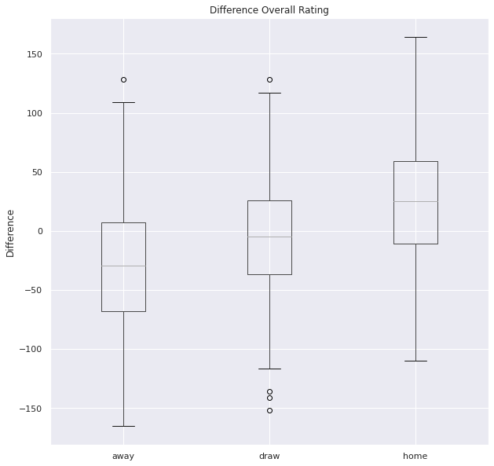
Descriptive Statistics
The more positive the difference in overall rating (for the home team), the more likely it is that the home team will win
Only small overlap between home and away

Slide 15
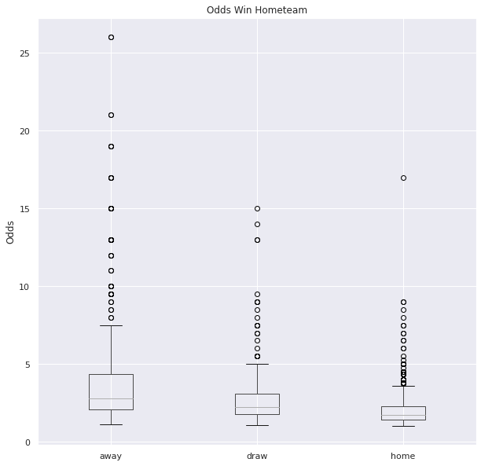
Descriptive Statistics
The lower the odds, the more likely it is that the home team will win
Only small overlap between home and away

Slide 16
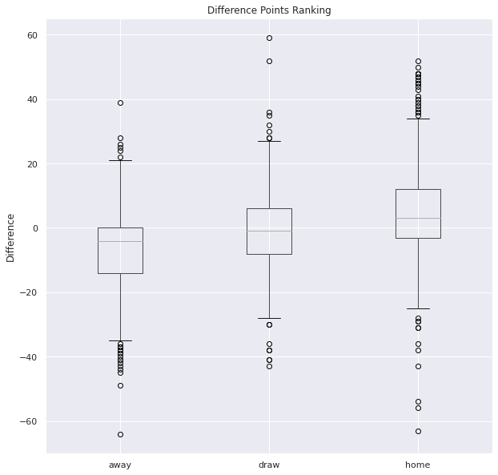
Descriptive Statistics
The more positive the difference (for the home team) with regard to ranking points, the more likely it is that the home team will win.
Only small overlap between home and away

Slide 17
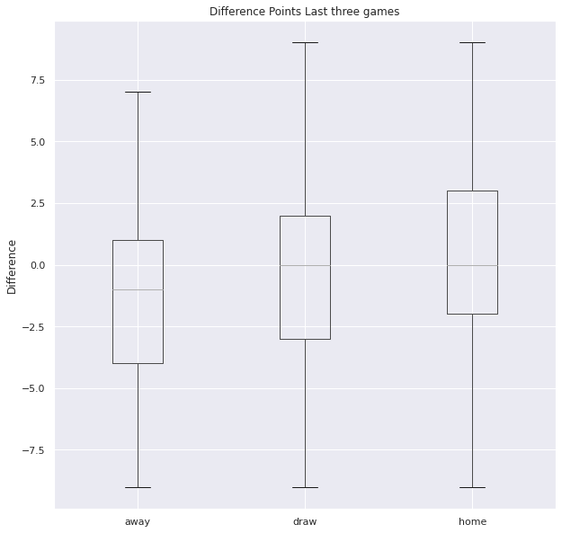
Descriptive Statistics
The more positive the difference (for the home team) of gained points in the last three games, the more likely it is that the home team will win
However, there es quite a big overlap between home and away
Thus, the last three games seem to be less important for the outcome of the next game than other factors.

Slide 18
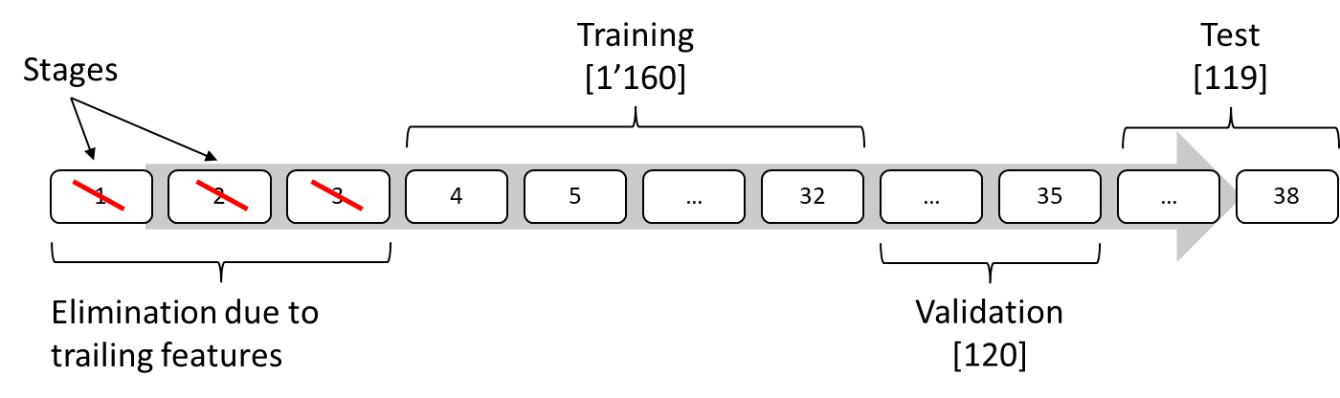
Split Train and Test
No random choice, since there is more information available at the end of the season (favourites rise, motivation, …)
Split as follows for each season:

Slide 19
Machine Learning Model
Multinomial Classification Problem
RandomForest (RF)
Different numbers of estimators [1, 10 , 50, 100]
Different depth levels [2, 4, 6, 8]
Based on the validation set accuracy chose (minor differences):
Number of estimators = 100
Number of depth levels = 4
Logistic Regression (LR)
Eliminate strong correlated features
B356A
difference_overall_rating
Multiclass argument in [‘Multinomial’, ’ovr’]
Based on the validation set accuracy chose (minor differences):
one vs. rest approach

Slide 20
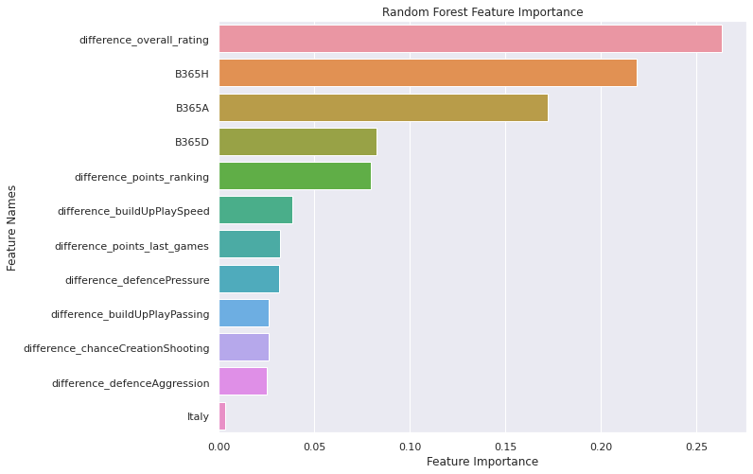
RF: Feature Importance

Slide 21
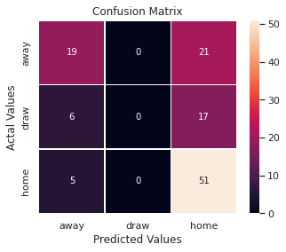
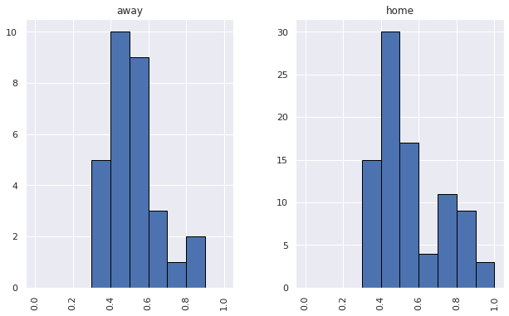
RF: Confusion Matrix
Accuracy Test Set: 0.588
Probabilities which led to the decisions:

Slide 22
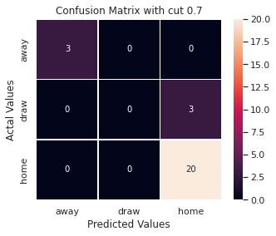
RF: Confusion Matrix with cut threshold
Accuracy Test Set: 0.885
Total of 26 bets
Accuracy increased dramatically
only 3 times 100% loss
Suspicious?

Slide 23
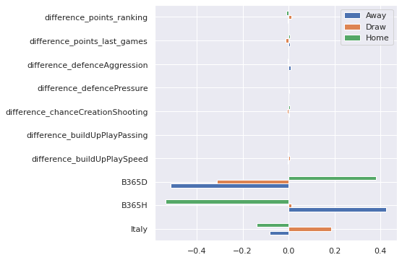
LR: Feature Coefficients
Positive coefficients: increase probability in favour of the positive outcome (Away, …)
Not surprising: odds are a good indicator of the outcome
More draws in Italy than in Spain in the data

Slide 24
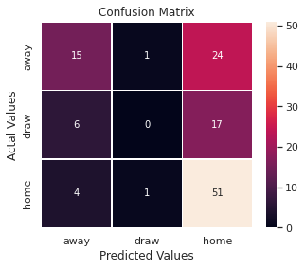
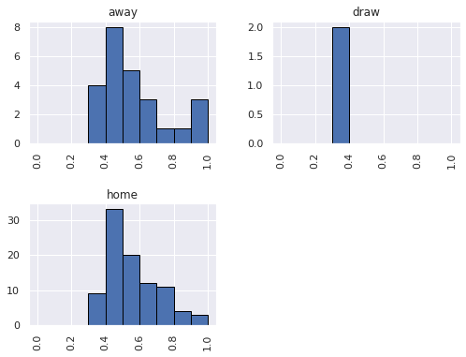
LR: Confusion Matrix
Accuracy Test Set: 0.555
Probabilities which led to the decisions:

Slide 25
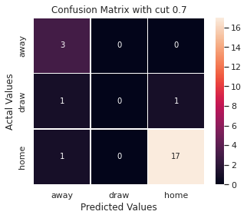
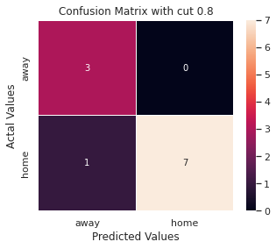
LR: Confusion Matrix with cut threshold
Accuracy Test Set: 0.870
Total 23 bets
Accuracy Test Set: 0.901
Total 11 bets

Slide 26
Conclusion
We fitted a RandomForest and Logistic Regression Model to predict the outcome in soccer matches
Without the threshold we would not use the model
Taking a threshold into account works quite good
Further investigation of the models since the outcome looks suspiciously good
Thing to improve:
The model should be trained on newer data
More data (more seasons, countries)
More investigation on:
Usage of different countries in one model
Usage of earlier seasons for more data

