Slide 1
BIKE RENTAL ANALYSIS CAS APPLIED DATA SCIENCE UNIVERSITY OF BERN – MODUL 2 STATISTICAL INTERFERENCE PROJECT PRESENTATION – 22.09.2022

Slide 2
CONTENT
Data Description
Hypothesis
Descriptive Statistics
Inferential Statistics
Conclusion / Outlook

Slide 3
DATA DESCRIPTION
Daily demand of rented bikes for two years (01.01.2011 - 31.12.2012)
12 different variables (categorical or numerical). Only used a subset of them:
dteday: Date
season: Season to which the day belongs
weekday: Day of the week (Mon, Tue, …)
workday: Indicates whether the day is a workday or not
weathersituation: Classification of the weather situation (clear, clouds/mist, rainy/snowy)
temp: Normalized temperature
windspeed: Normalized winspeed
cnt: Total count of rented bike at the date
Source: https://www.kaggle.com/competitions/bike-sharing-demand/data

Slide 4
HYPOTHESIS
Hypothesis 1: On average there are more rentals on workdays than on non-workdays.
Hypothesis 2: The number of daily rented bikes differ for different weather situations.
Hypothesis 3.1: The number of daily rented bikes differ among the seasons.
Hypothesis 3.2: If there is a difference, there are on average more daily rentals in Spring than in Fall.
Regression: Check the influence of Temperature, Wind Speed and the Weather Situation on the daily demand.

Slide 5
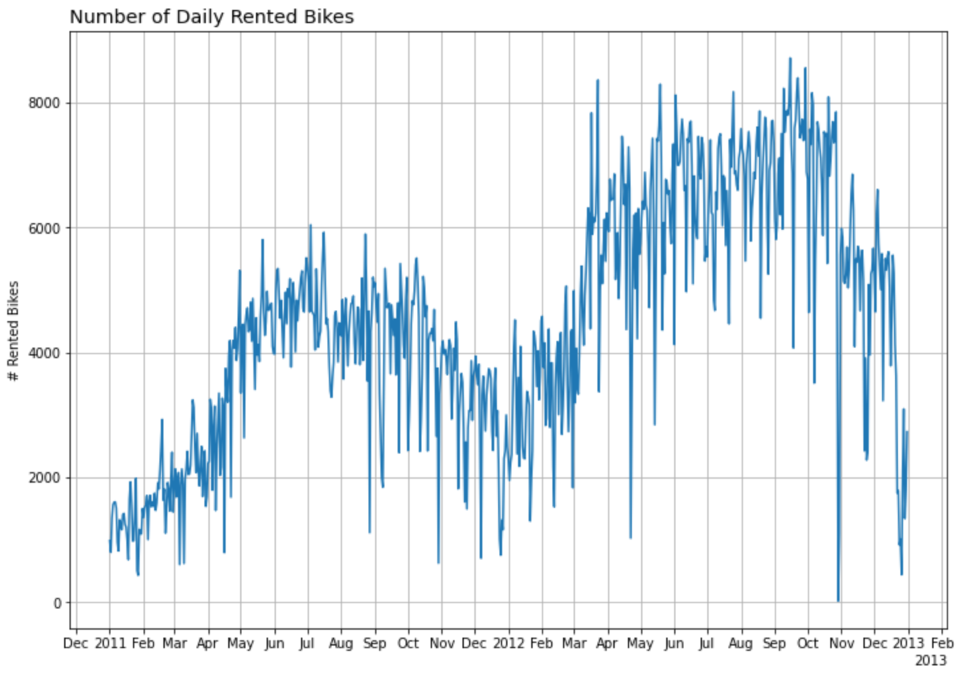
DESCRIPTIVE STATISTICS
Plot of daily bike rentals over the observation period
A simple plot of the time series gives a overview of the number of daily bike rentals over the observation period.
More bikes seem to be rented in warmer seasons.

Slide 6
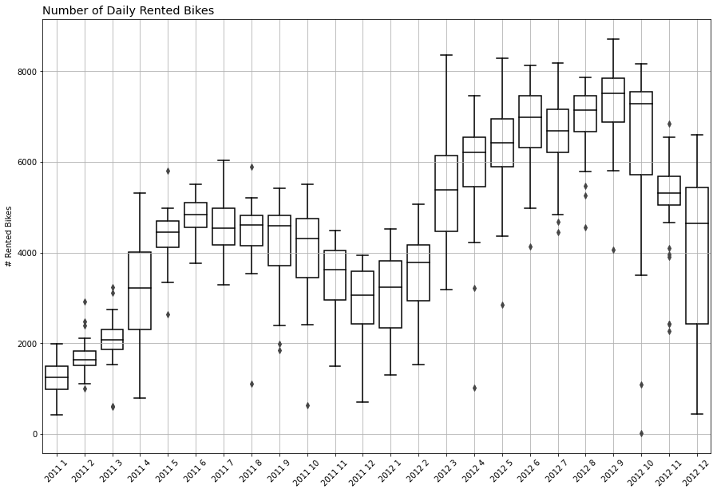
DESCRIPTIVE STATISTICS
Boxplot of daily bike rentals over the observation period
The boxplots represent the variety of daily bike demand per month
December 2012 seems to be a statistical outlier
Most months have similar dispersions around the mean

Slide 7
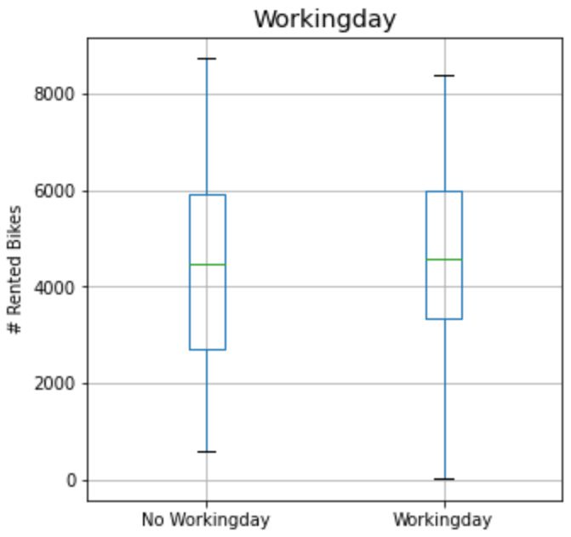
DESCRIPTIVE STATISTICS
Boxplot workingday vs. non-workingdays
This boxplot gives an impression of the variance of daily bike rentals between workingdays and non-workingdays.
There seems to be no big difference between workingdays and non-workingdays.

Slide 8
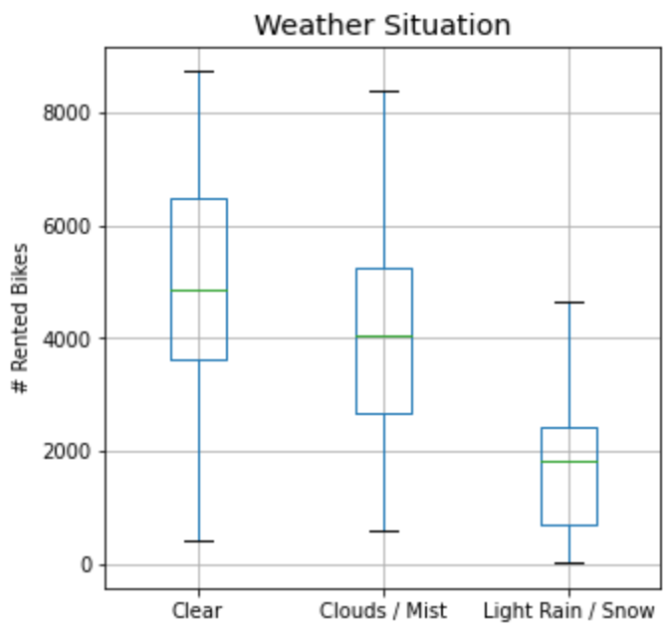
DESCRIPTIVE STATISTICS
Boxplot Weather situation
This boxplot gives an impression of the variance of daily bike rentals depending on the weather situation.
There seems to be a lower demand of bike rentals when weather conditions are worse.

Slide 9
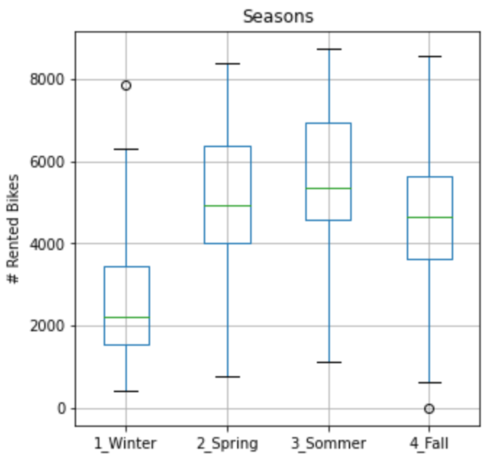
DESCRIPTIVE STATISTICS
Boxplot seasons
This boxplot gives an impression of the variance of daily bike rentals depending on the seasons.
There seems to be a lower number of daily bike rentals in winter.

Slide 10
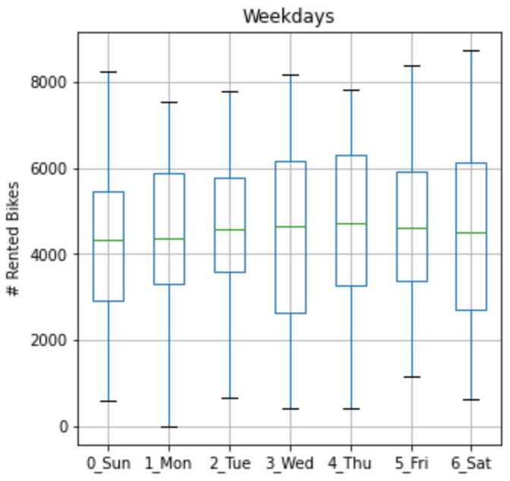
DESCRIPTIVE STATISTICS
Boxplot weekdays
This boxplot gives an impression of the variance of daily bike rentals depending on the weekday.
There seems to be no variance in the number of daily bike rentals depending on the weekday.

Slide 11
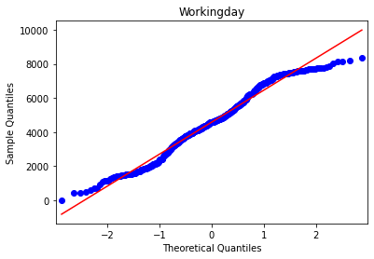
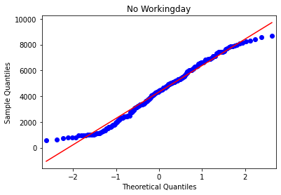
INFERENTIAL STATISTICS
Hypothesis 1: On average there are more rentals on workdays than on non-workdays

Slide 12
INFERENTIAL STATISTICS
Hypothesis 1: On average there are more rentals than on workdays than on non workdays
Since the data is not normally distributed and unpaired, we use the one-sided Mann-Whitney U Test.
p-Value: 0.059 > 0.05
We cannot reject the Null-Hypothesis.
There is no significant higher demand on workingdays than on non-workingdays.
 | Workingday | Non-workingday
D’Agostino-Pearson | 0.000 | 0.000
Shapiro | 0.000 | 0.000
Smirnov | 0.000 | 0.000

Slide 13
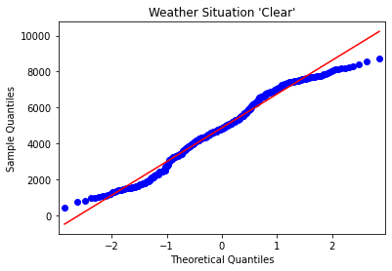
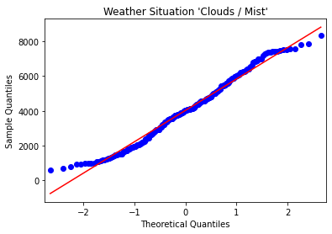
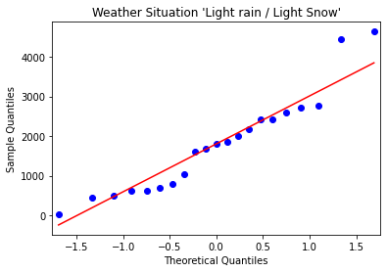
INFERENTIAL STATISTICS
Hypothesis 2: The number of daily rented bikes differ for different weather situations

Slide 14
INFERENTIAL STATISTICS
Hypothesis 2: The number of daily rented bikes differ for different weather situations
 | Clear | Clouds / Mist | Light rain / lignt snow
D’Agostino-Pearson | 0.000 | 0.002 | 0.210
Shapiro | 0.000 | 0.001 | 0.092
Smirnov | 0.000 | 0.000 | 0.000
Since the data is not normally distributed and unpaired, we use the Kruskal-Wallis-test.
p-Value: 0.000 < 0.05
With 95% certainty we reject the Null-Hypothesis.
At least one weather situation differs in the number of daily rentals.
Thus the number of daily rented bikes depends on the weather situation.

Slide 15
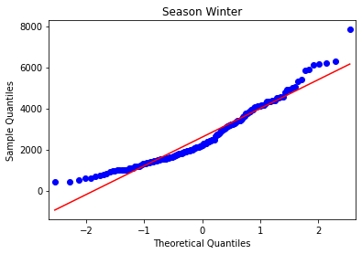
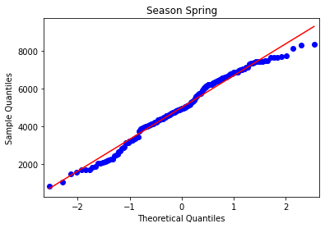
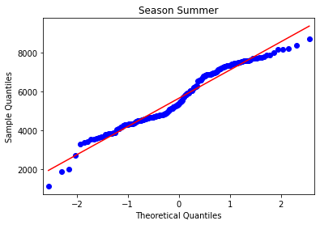
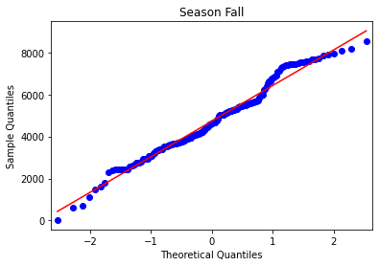
INFERENTIAL STATISTICS
Hypothesis 3.1 / 3.2: The number of daily rented bikes differ among the seasons

Slide 16
INFERENTIAL STATISTICS
Hypothesis 3.1: The number of daily rented bikes differ among the seasons.
 | Winter | Spring | Summer | Fall
D’Agostino-Pearson | 0.000 | 0.028 | 0.100 | 0.691
Shapiro | 0.000 | 0.008 | 0.000 | 0.018
Smirnov | 0.000 | 0.000 | 0.000 | 0.000
Since the data is not normally distributed and unpaired, we use the Kruskal-Wallis-test.
p-Value: 0.000 < 0.05
With 95% certainty we reject the Null-Hypothesis.
At least one season differ in the number of daily rentals.

Slide 17
INFERENTIAL STATISTICS
Hypothesis 3.2: If there is a difference, there are on average more daily rentals in Spring than in Fall
 | Spring | Fall
D’Agostino-Pearson | 0.028 | 0.691
Shapiro | 0.008 | 0.018
Smirnov | 0.000 | 0.000
Since the data is not normally distributed and unpaired, we use the one-sided Mann-Whitney U test.
p-Value: 0.045 < 0.05
With 95% certainty we reject the Null-Hypothesis.
Spring has (weak) significant higher daily rentals than Fall

Slide 18
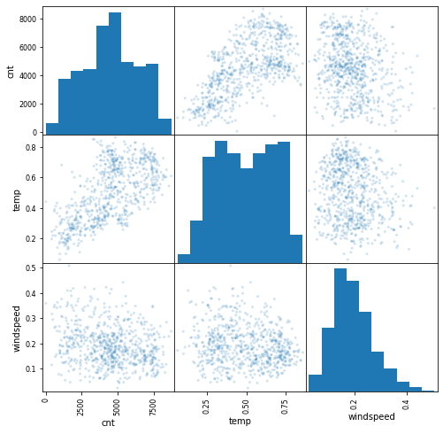
INFERENTIAL STATISTICS
Regression: Check the influence of temeprature, wind speed and the weather situation on the daily demand
 | rented bikes (cnt) | temperature | windspeed
rented bikes (cnt) | 1.000
temperature | 0.627 | 1.000
windspeed | -0.235 | -0.158 | 1.000
Quite strong correlation between rented bikes and temperature
Rest is negligible
rented bikes is not normally distributed, so cautious with results of regression
Notes:
Check the influence of Temperature, Wind Speed and the Weather Situation on the daily demand.

Slide 19
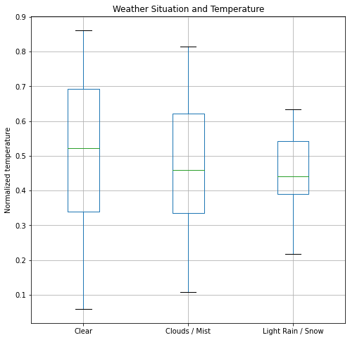
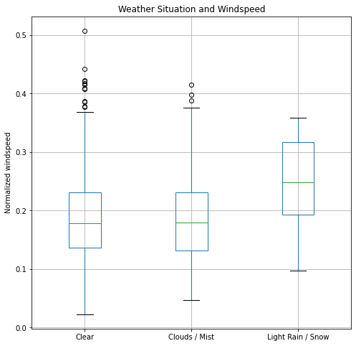
INFERENTIAL STATISTICS
Regression: Check the influence of temeprature, wind speed and the weather situation on the daily demand

Slide 20
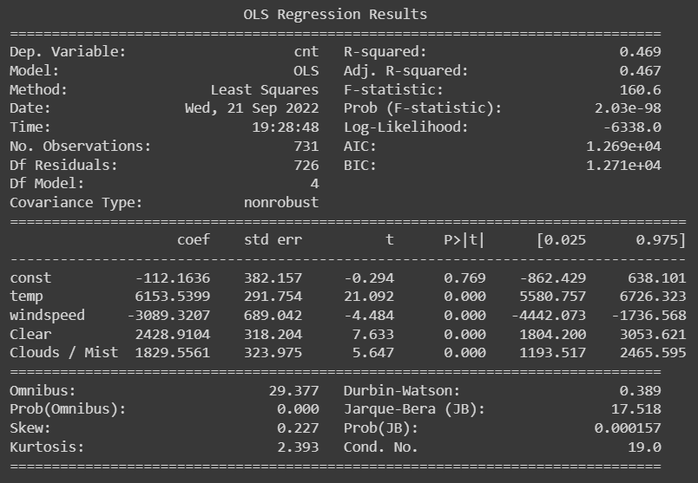
INFERENTIAL STATISTICS
Regression: Check the influence of temeprature, wind speed and the weather situation on the daily demand
46.7% of the variance of the target (number of rented bikes) can be explained with this simple model
This is quite high
Temperature alone explains 39% (simpel test with only temperature)
Temperature has an influence on demand (not quite surprising)

Slide 21
CONCLUSION / OUTLOOK
The hypothesis about the higher demand on working days and non-working days couldn’t be confirmed
The hypothesis about differences in demand between different weather situations and the different season could be confirmed
Furthermore there is more demand in Spring than in Fall
The temperature seems to explain a lot of the variance in demand
A more sophisticated model with more variables and interactions could be applied to investigate the factors which influence the demand the most
Check the use of a time series model
Many variables seem to be correlated (e.g. higher / lower temperature in certain seasons)

