Slide 1
Java Mobicents based diameter tester

Slide 2
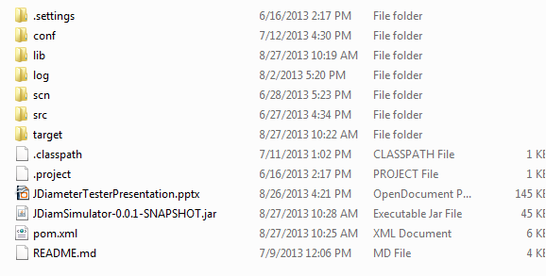
Downloading project
Build it: Prerequisite tools: maven and git.
git clone https://exropo@bitbucket.org/emblacom/diameter-tester.git
mvn install
Read README.md
lib directory will contain dependant jar’s
Run application java –jar JDiamSimulator-0.0.1-SNAPSHOT.jar - c <diameter-stack-config.xml> -a key=value <scenario_file_path.scn>

Slide 3
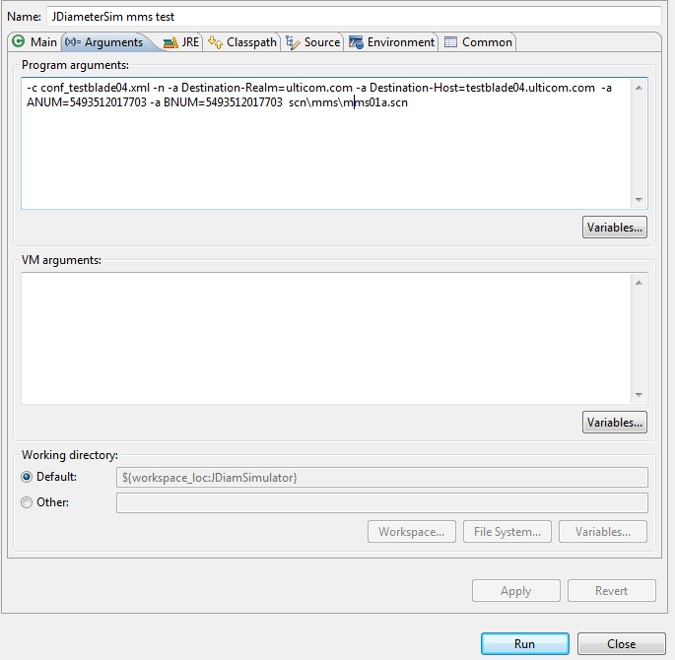
Option: execute within Eclipse
Example how to call tester from within Eclipse :
- Create Run Configuration
- Specify class to call: pl.p4.diameter.client.jDiamClient
- Specify program arguments -c <mobicents config.xml> // use different file for each environment -a // replacement parameters. Number of parameters has been recognized like Origin-Host, Destination-Host, ANUM and BNUM

Slide 4
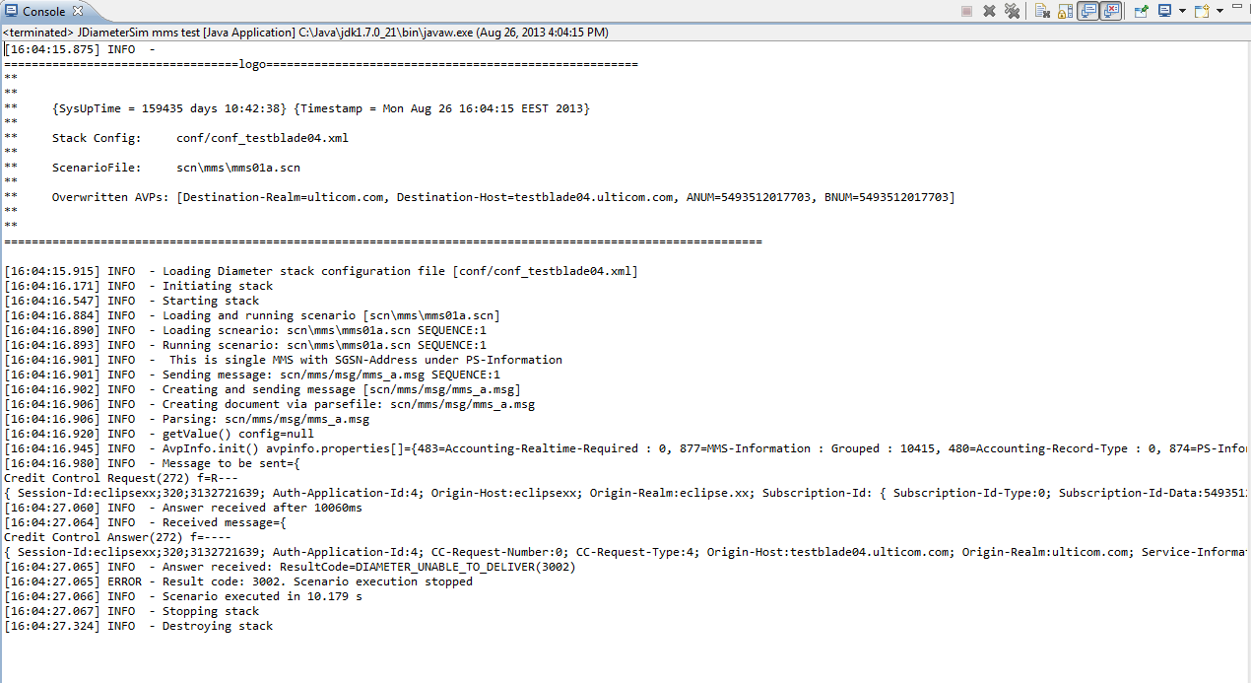
Output example
This output shows :
- Which scenario has been used e.g. Scn\mms\mms01a.scn
- Which mobicents config has been used e.g. Conf_testblade04.xml
- diameter message has been sent – in single line all avp’s are show
- diameter message received (again all avps present) plus text formated diameter result code. Complete log is collected at log directory

