Slide 1
“
LEGO: Efficiently Generate Optimized LLMs through Low-Rank Decomposition and Assembly
”
Pingwei Sun
2023.12
BDT Program
HKUST
Notes:
Good afternoon and I will start the presentation of my independent project. The project focus on the study of LLM compression and finally we propose a method called LEGO to generate optimized LLMs through low-rank decomposition and assembly.

Slide 2
CONTENTS
PART 01.
PART 03.
Survey on model compression
LEGO: A compression method based on LoRA weighted SVD
PART 02.
PART 04.
Preliminary study of low-rank features in LLMs
Experiments and future work
Notes:
Here is the outline and let’s go to the first part

Slide 3
PART 01.
Survey on model compression

Slide 4

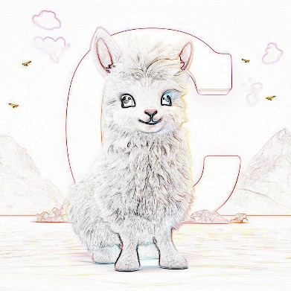





CPU设计
Survey
Quantization
Predominant Strategies
Quantization: fp32 -> fp16、int8、int4…
UP: sparse computing, support from framework and hardware.
SP: simplify the model’s structure (layers, heads, hidden size).
Knowledge Distillation: transfer knowledge to smaller LLMs.
Low-rank Approximation: decompose a large matrix into the multiplication of two small ones.
How to retain more knowledge in the weight matrix (pic):
llama, “C”, clouds, mountains
Unstructured Pruning
512
Structured Pruning
&
Knowledge Distillation
1024
Low-rank Approximation
Notes:
Due to the demand for accelerating LLM, there has been many research and opensource projects in the field of compression.
Here are several predominant approaches. The pictures on the right side illustrate those methods from the view of image compression.
For an example, quantization is to reduce the bits, UP to convert the model to a sparse one just remaining the crucial params, SP and KD try to achieve a model of smaller scale and Low-rank approximation utilize multiplication of two smaller matrices to represent the original one.

Slide 5
CPU设计
Survey
Methods | Quantization (compatible with others) |  | Knowledge Distillation | Pruning |  | Low-rank Approximation
 | PTQ | Data Aware Quantization | KD | Structured | Unstructured | Features are low-rank
Paper | GPTQ [1] (ICLR2023) | AWQ [2] (MIT, SJTU, THU) | MINILLM [3] (CoAI, THU) | LLMPruner [4] (NUS, Neurips2023) | SparseGPT [5] (ICML2023) | LoRD [6] (UdeM, Nolano AI)
Compress ratio | 87.5% (fp32->int4) | 90%+ (fp32->fp16/int3) | 50% | 20% | 50~60% | 20%
Speedup | 3.2x (compared with fp16) | 3x (compared with fp16) | ~2x | NA | 1.67x | NA
Performance | Little influence, can be ignored. | Nearly the same as fp16 on PPL | 2~3 points drop of feedback from GPT4 | 10% drop on zero-shot | Little drop on some few-shot tasks | Less than 1% drop
Note | Widely used in industry | Work with the provided framework |  | Inexpertly obtain increase on some tasks |  | Reproducing NJU’s work in AAAI 2023 on LLMs
[1] GPTQ: Accurate Post-Training Quantization for Generative Pre-trained Transformers
[2] AWQ: Activation-aware Weight Quantization for LLM Compression and Acceleration
[3] Knowledge Distillation of Large Language Models
[4] LLM-Pruner: On the Structural Pruning of Large Language Models
[5] SparseGPT: Massive Language Models Can Be Accurately Pruned in One-Shot
[6] LORD: Low Rank Decomposition Of Monolingual Code LLMs For One-Shot Compression
Notes:
Here are some latest methods in each category along with their pros and cons.
The quantization methods are now most popular in industry because they are easy to practice and can achieve great performance. However, supports from framework and hardware are necessary to make the best speedup.
Other methods like KD and UP are also useful and can be combined with quantization.
While there is still not impressive work on low-rank approximation, the LoRD listed is only a reproduction of NJU’s work on Code LLMs.

Slide 6
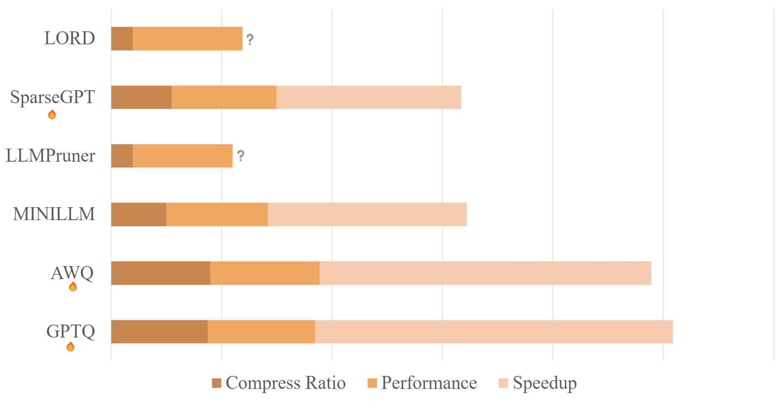
CPU设计
Survey
Comparison
A rough comparison of compression methods, with accurate compression ratios. The benchmarks across different methods are not entirely consistent. Some methods do not report speedup in their papers and stay closed source.
Notes:
From this figure, you can directly compare those methods.

Slide 7
Preliminary study of low-rank features in LLMs
PART 02.
Notes:
The second part is our preliminary study on low-rank features in LLM.

Slide 8
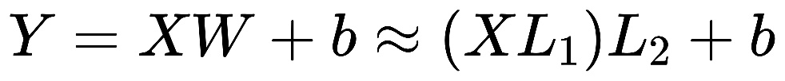

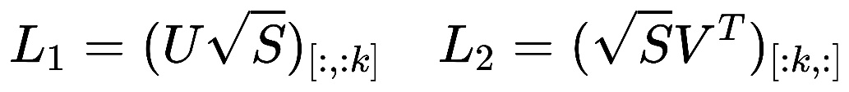
Low-rank
in LLM
WHY
Reduce the error produced during low-rank approximation
Decompose into matrices and singular values
Select first k singular values
Rebuild small matrices
A SVD friendly matrix:
Most singular values are 0 or
Distribution of singular values is centralized
Notes:
The reason why we expect matrices to be low-ranked is because the algorithm as shown on the right side.
A large matrix is first decomposed into U, V and diagonal matrix S of singular values.
Then we select the first k values to rebuild it as two small matrix L1 and L2.
To achieve less error when ignoring the later ones, singular values are expected to be 0 or distribute centrally, which can be called SVD friendly.

Slide 9
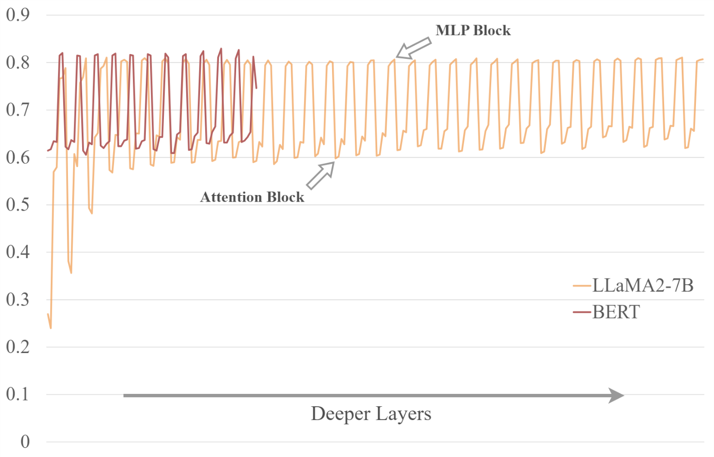
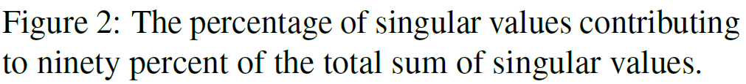
Low-rank
in LLM
Our experiments
Weight matrix:
Taking more than half singular values to make up 90% of the sum of singular value.
Not SVD friendly
Notes:
To explore the potential of SVD on LLMs, we firstly conducted experiments on weight matrices.
From the picture we can see that, only the attention blocks in the starting layers possess low-rank features.
Furthermore, most matrix takes more than half of singular values to make up 90% of the total sum, indicating that LLMs are not SVD friendly like what BERT shows in the previous research.

Slide 10
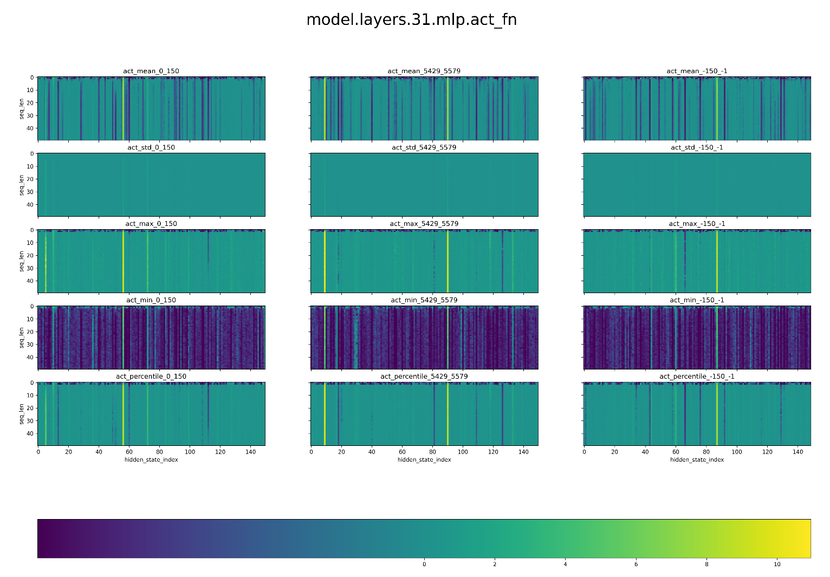
Low-rank
in LLM
Our experiments
Weight matrix:
Taking more than half singular values to make up 90% of the sum of singular value.
Not SVD friendly
Output features:
Exists low-rank features
LoRD a recent work have used it on Code LLM
Notes:
The paper from NJU in AAAI2023 proposed that transformers’ output features after activate function are low-rank.
So, then we profile the hidden states and indeed observe this in LLMs.
The LoRD published on arxiv in Oct has already utilized it on Code LLMs and to avoid similarity, we will not consider it for now.

Slide 11
Low-rank
in LLM
Domain Specific Parameters
Updating of parameters is low-rank during finetuning
LoRA
QLoRA, LQ-LoRA (quantization + LoRA)
Notes:
Besides those mentioned above, it is commonly agreed that updates during finetuning are low-rank. And that is why LoRA and its variants work.

Slide 12
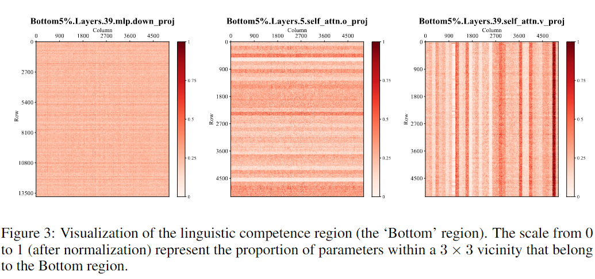
Low-rank
in LLM
Domain Specific Parameters
Updating of parameters is low-rank during finetuning
LoRA
QLoRA, LQ-LoRA (quantization + LoRA)
Core Region Parameters
There exists core linguistic region
After finetuning on several languages some parameters remain stable.
Model’s performance is sensitive to them.
Their distribution lies in rows or columns.
Unveiling A Core Linguistic Region in Large Language Models (FDU, 23 Oct)
Notes:
A recent work from FDU unveils that those parameters which remain stable during finetuning on several domains are also crucial for models’ performance and called them core linguistic region.
It is exciting that their distribution is SVD friendly.

Slide 13
LEGO: A compression method based on LoRA weighted SVD
PART 03.
Notes:
After the preliminary study, we are now able to give a solution

Slide 14
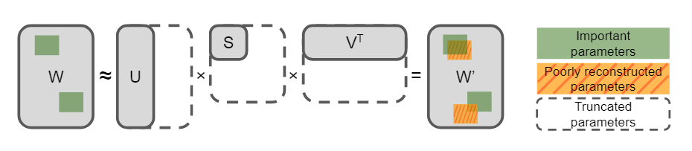
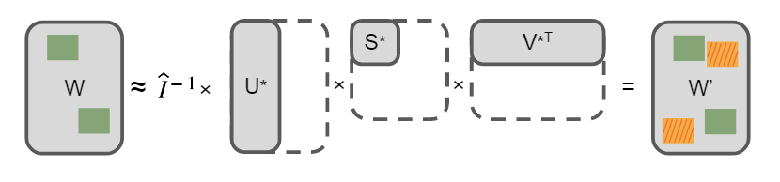
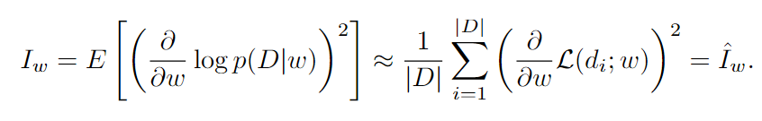
Weighted SVD
CPU设计
Information from Gradient
Improve the accurate by fisher information in FWSVD.
Align the objective of compression with the model’s task, instead of minimizing reconstruction error (F- norm).
Obtain SVD friendly matrix by assigning weights.
Vanilla SVD
Fisher-Weighted SVD
Language model compression with weighted low-rank factorization (ICLR 2022)
Numerical Optimizations for Weighted Low-rank Estimation on Language Model (ACL 2022)
Notes:
Since the parameter matrix itself is not low-ranked, we can obtain one by assigning weights for elements.
The FWSVD as the SOTA in PLMs compression uses fisher information, gradient during finetuning as the weight to improve the model’s post-compression performance.

Slide 15
Weighted SVD
CPU设计
Information from Gradient
Improve the accurate by fisher information in FWSVD.
Align the objective of compression with the model’s task, instead of minimizing reconstruction error (F- norm).
Obtain SVD friendly matrix by assigning weights.
Vanilla SVD
Limitations
Computationally expansive
Forward + backward: 7B model->60GB+ memory footprint
Fp32 is necessary for gradient storage
Important parameters may be miss-weighted for their relatively stable gradients
Fisher-Weighted SVD
Language model compression with weighted low-rank factorization (ICLR 2022)
Numerical Optimizations for Weighted Low-rank Estimation on Language Model (ACL 2022)
Notes:
But it is difficult to be transferred to LLMs for the demanding computational resource.
Besides, since LLMs are well pretrained, the core region params may be miss-weighted for their small gradients during the finetuning stage.

Slide 16
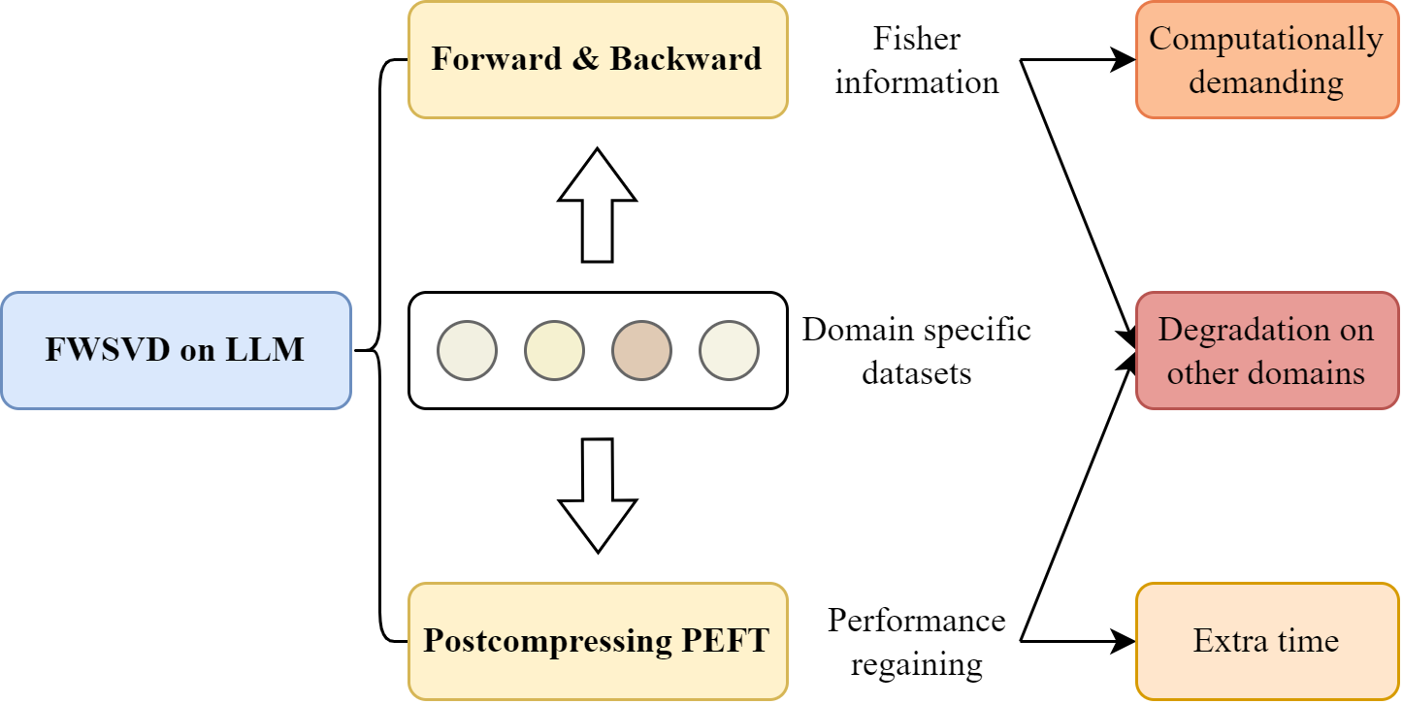
CPU设计
Motivation
Compression based on SVD
FWSVD
Preliminary study: competitive with structure pruning on language modeling
Compatible with quantization
To be improved:
Computationally demanding
Need peft for calibration
Language model compression with weighted low-rank factorization (ICLR 2022)
Numerical Optimizations for Weighted Low-rank Estimation on Language Model (ACL 2022)

Slide 17
CPU设计
Two Direction
LoRA Weighted SVD
Degradation on other domains
Retuning-free base model with competitive LM ability
Memory footprint
Utilize LoRA to avoid computing full params’ gradient, saving 25% GPU mem
QLoRA is also compatible
Further improvement
Layer-wise compressing strategy
Kernel for efficient SVDLinear OP

Slide 18
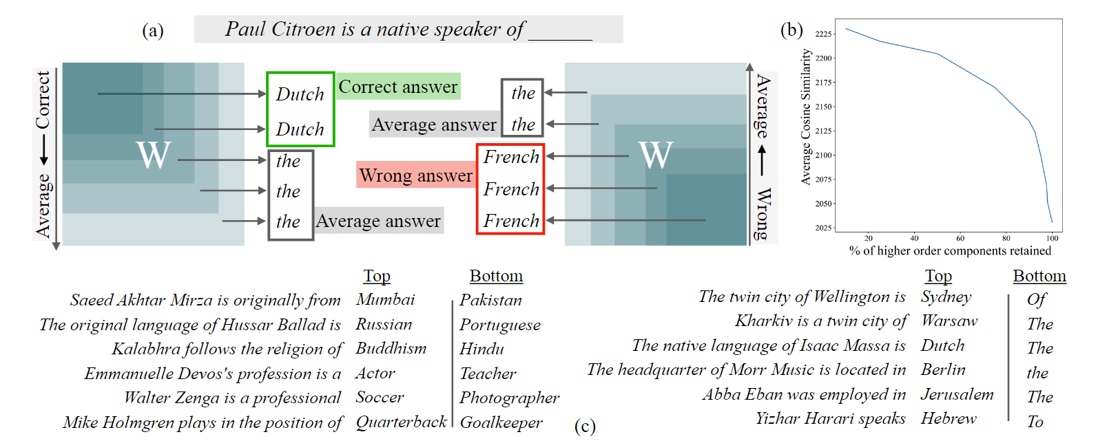
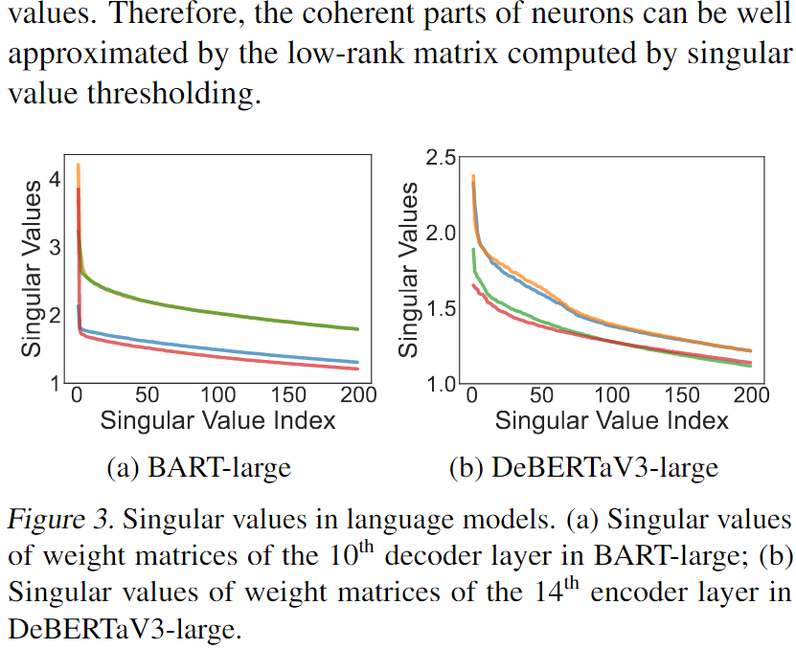
CPU设计
Two Direction
Theoretical Research
Current trend: low-rank + quant/sparse
LQ-LoRA: low-bit weights + LoRA
LoSparse: SP weight matrix + LoRA
Layer-Selective Rank Reduction: components with lower singular values may introduce “noise”
Topic:
Low order/coherent parts的作用
LQ-LORA (MIT)
LoSparse (ICML 2023)
Layer-Selective Rank Reduction (MIT)

Slide 19
LEGO
Fine-grained Importance Evaluation
FWSVD: larger gradient on downstream dataset -> to be remained
But we need a general base model
Directly multiplying importance with weights leads to re-finetuning
CLR: elements with less variants during multi-domain finetuning are important
Core language region -> general ability of language modeling
Notes:
Briefly speaking, FWSVD try to preserve domain specific params while CLR stresses elements with less variants are important.
To achieve a LLM with general Language modeling ability and being compatible with domain specific jobs, we proposed a weighting strategy with infor from LoRAs.

Slide 20
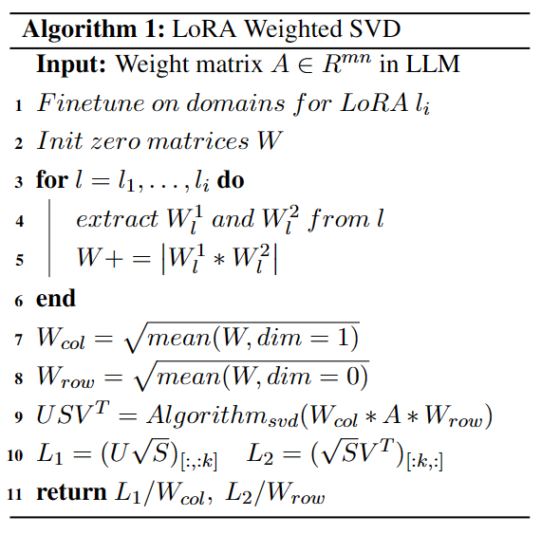
LEGO
Fine-grained Importance Evaluation
FWSVD: larger gradient on downstream dataset -> to be remained
But we need a general base model
Directly multiplying importance with weights leads to re-finetuning
CLR: elements with less variants during multi-domain finetuning are important
Core language region -> general ability of language modeling
Notes:
The Algorithm is shown on the right

Slide 21
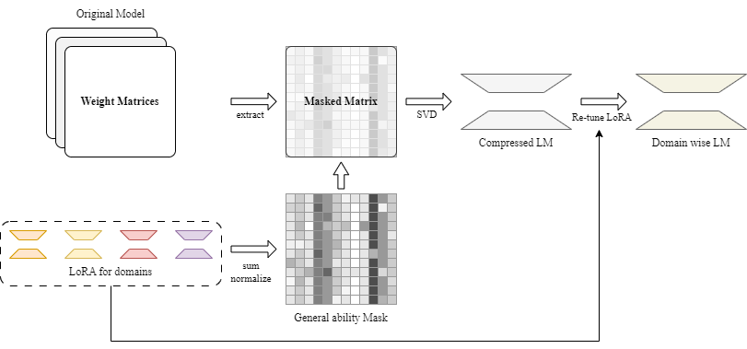
LEGO
Fine-grained Importance Evaluation
FWSVD: larger gradient on downstream dataset -> to be remained
But we need a general base model
Directly multiplying importance with weights leads to re-finetuning
CLR: elements with less variants during multi-domain finetuning are important
Core language region -> general ability of language modeling
Notes:
As illustrated in the chart, the LoRA modules are rebuilt and sum together. Pramas with less variants will be paid more attention to during SVD, and after compression the domain specific LoRA can be reused for calibration to improve the model’s performance.

Slide 22
PART 04.
Experiments and future work
Notes:
Lastly is the experiments and our future work.

Slide 23
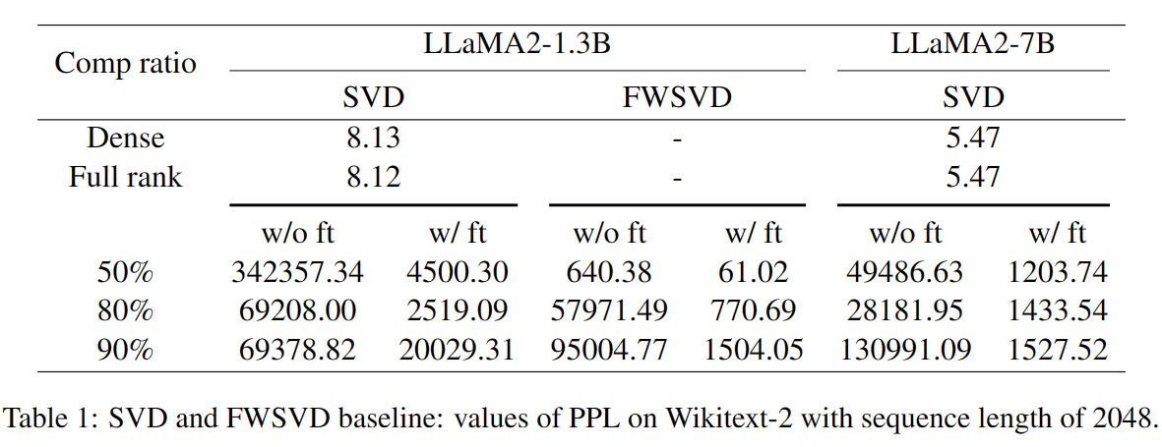
Baseline
LLaMA2
Wikitext: PPL
Sequence length = 2048
torch.svd_lowrank
Fp16 inference
Notes:
Here is the baseline for LEGO. The Full rank items are used to validate the implementation works well.
We reproduce FWSVD(without official opensource) and the vanilla SVD and test the model on wikitext2 with metric of ppl.
It is evident that vanilla SVD cannot preserve the information inside the matrix and there is even no relationship between comp ratio and performance.
While FWSVD achieve a promising result at 50% compression ratio, but there is still a gap between its performance when compressing domain specific BERT.
I think the degradation may be caused by errors of those core region params.

Slide 24
Future Work
Experiments
Performance of LEGO
Core functions have been finished, working on the test and benchmark now.
Evaluate both base model and domain specific models with LoRA.
Comparisons between other methods
GPTQ, AWQ, QLoRA, LQ-LoRA …
Compress ratio, Performance, Speedup
Ablation experiment to verify the contribution of LoRA weighted SVD.
Further Improvement
Efficient integration of LoRA module and the compressed model.
Combination with quantization methods.
Notes:
Because of the busy final week, further experiments are not conducted yet.
I am now working on the test code, and I believe they will start in a few weeks.
Besides the evaluation of LEGO, I will also compare it with methods mentioned in the survey in the aspects of compress ratio and speedup and conduct ablation study to validate LoRA weighted SVD.
For practical purpose, we may provide functions to integrate the LoRA with the stem model and consider to combine it with quantization.

Slide 25
“
Q&A
”
Thanks for your time

