Slide 1

Project Title –Seasonal Agriculture Performance Analysis
Student Name: Abhilash Polavarapu
College Name- Vasireddy Venkatadri Institute of Technology
AICTE STU ID : STU6a69f9059da2f1785329925

Slide 2

PROBLEM STATEMENT
Agricultural activities are influenced by seasonal variations in environmental conditions, farming practices, resource availability and market conditions. As a result, agricultural performance may differ from one season to another.
However, raw agricultural data does not clearly explain how agricultural performance changes across seasons or what patterns can be observed in different seasonal conditions.
The problem is to analyze the given agricultural dataset and investigate seasonal differences in agricultural performance by identifying meaningful patterns, trends, relationships and variations within the available data.

Slide 3
Project Description
The project will address the analysis of agricultural data to support decision-making on different seasons, geography, and agricultural conditions.
The work will focus on researching farming practices, environmental characteristics, resource consumption, crop yields, and financial performance.
The project will include data preparation steps to ensure that the information is properly structured. In addition, the work will address the analysis of seasonal trends and patterns, evaluate the performance of agriculture in different seasons, and identify relationships between environmental conditions and agricultural practices.
Statistical and visual data presentation methods will be applied to explore the data and provide evidence for agricultural decision-making.

Slide 4

WHO ARE THE END USERS?
Farmers – To gain insights on seasonal performances and trends.
Agricultural Planners – To plan and forecast seasonal agricultural activities effectively.
Agricultural Stakeholders – To compare performance and consumptions of resources during different seasons
Researchers – To establish scientific relations between environmental factors and agricultural performances.
Students & Data Analysts – To explore and analyze agricultural data in depth.

Slide 5

Technology Used
Python – Data analysis and processing
Pandas – Data cleaning and manipulation
NumPy – Numerical analysis
Matplotlib / Seaborn – Data visualization
Jupyter Notebook – Development and documentation of the analysis
Statistical Analysis Techniques – Identifying trends, relationships, and variations

Slide 6
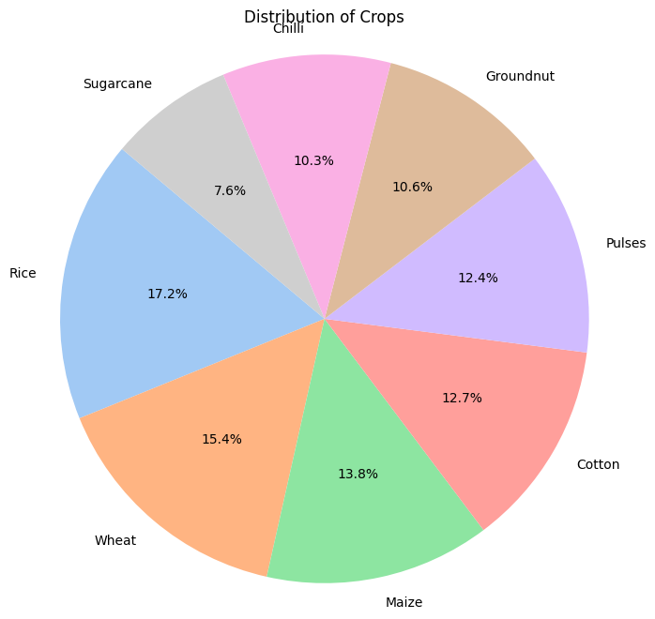
RESULTS
By this chart,
it is evident that the distribution of the crop is taking place according to the availability of crops to till. According to the Chart,
Rice holds the highest crop distribution, with a share of 17.2%. Wheat accounts for 15.4% of the total crop distribution.
Cotton and Pulses comprise 12.7% and 12.4%, respectively. The groundnut has 10.6%, while Chilli has 10.3% of the total crop distribution.
Sugarcane, on the other hand, has the lowest percentage of total crop distribution, which is 7.6%.

Slide 7
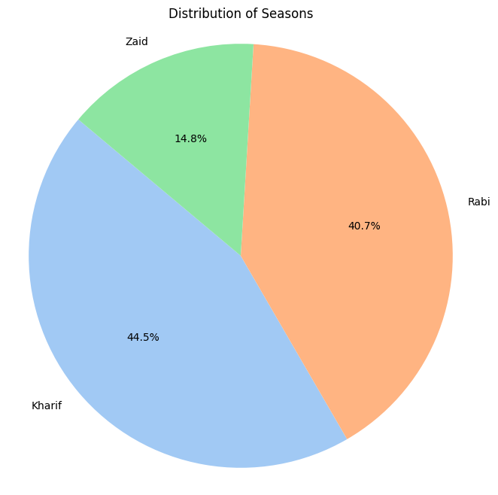
RESULTS
By this Chart,
Kharif season has the highest percentage in distribution, which is 44.5%.
Rabi season has the next level of distribution, which is 40.7%. Zaid season has the lowest percentage in the distribution, which is 14.8%.
From this chart, it can be observed that approximately 85.2% lies between Kharif and Rabi, and the remaining amount is covered by Zaid season.
So that, it can be concluded the majority of the data is occupied by the first two seasons, while the last one has a significant amount of contribution.

Slide 8
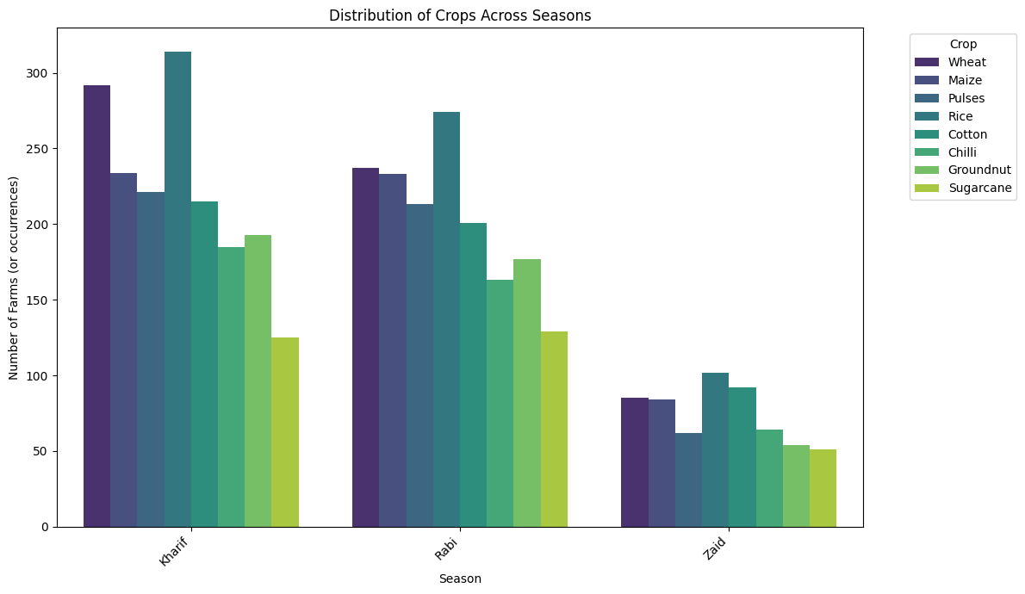
RESULTS
Based on this chart,
Rice possesses the highest number of occurrences in farms from all seasons with the maximum occurring in Kharif (~315).
Meanwhile, wheat has the second-highest occurrences of cultivation for Kharif (~292) and Rabi (~237) but drops considerably in Zaid (~85).
Maize has a similar pattern to that of wheat, only with a lower count of occurrences, and sugarcane records the lowest number of any crop’s occurrences for both Kharif and Rabi with a comparatively low count for Zaid as well.
Overall, it is seen that the occurrences of cultivation for Kharif and Rabi are substantially higher than those of Zaid for most crops.

Slide 9
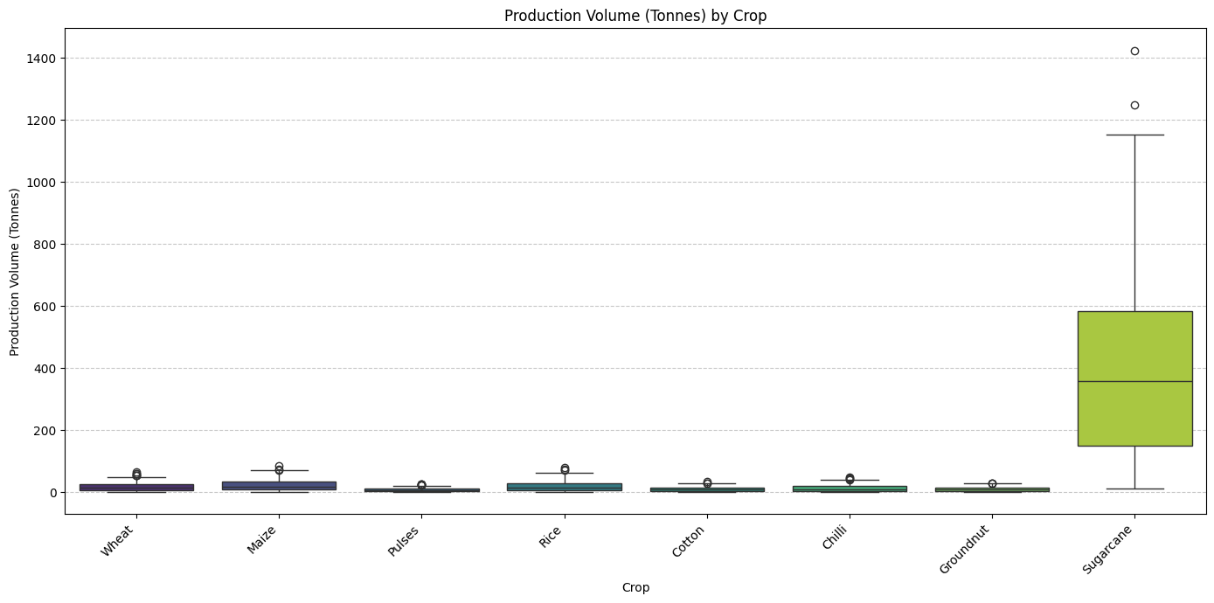
RESULTS
From this chart,
Sugarcane has the largest production volume and variability among other crops.
There is a significant number of high-value outliers for this crop, which are in the range of above 1,200 tonnes and approximately 1,400 tonnes.
Wheat, Maize, and Rice appear to have a moderate production volume, with a few outliers.
Pulses, Cotton, Chilli, and Groundnut account for a lower production volume, and they seem to be relatively consistent. Thus, it is possible to conclude that the chart above demonstrates that for Sugarcane, production volumes are much higher, on average, than for other types of crops, and there is a higher variability of these volumes.

Slide 10
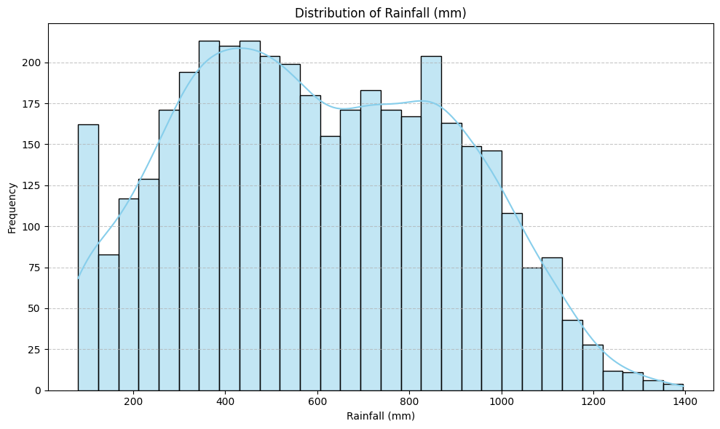
RESULTS
By this chart,
The values of rainfall are distributed roughly between 100 mm and 1,400 mm.
The highest concentration of rainfall is between 350-500 mm. There is a second concentration of rainfall between 700-900 mm.
Further, it decreases and becomes lower than 1,000 mm Thus,that over 1,000 mm it is a rarity to see a high amount of rainfall. As a result, it is not so common to observe rainfall over 1,200 mm, but it is more common to observe medium rainfall compared to high.
It helps for cropping irrigation.

Slide 11
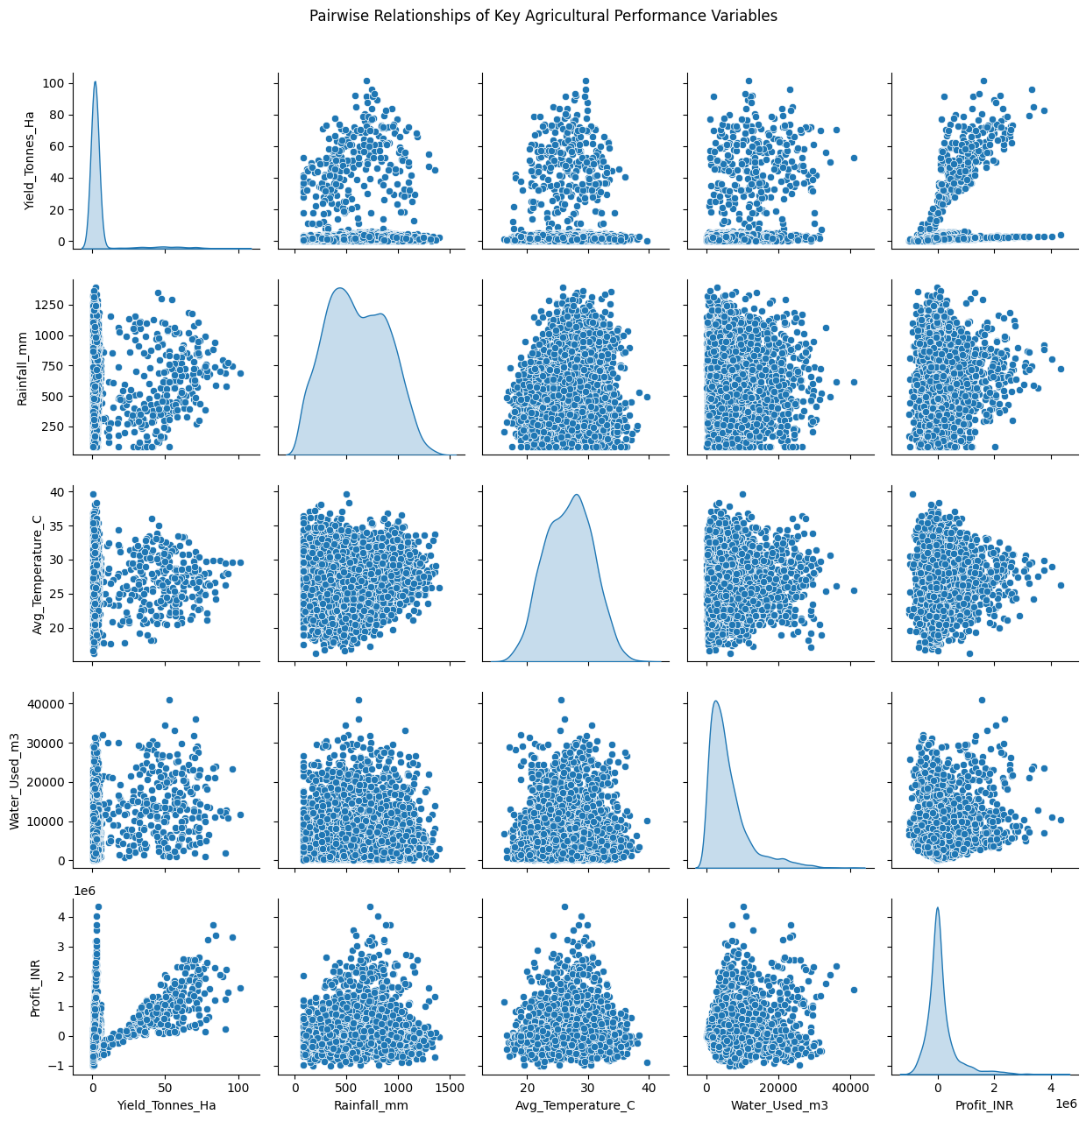
RESULTS
By this chart,
Yield and Profit have a clear positive relationship, as higher yield leads to higher profit. Yield also has a positive relationship with Rainfall, although the data points are widely scattered, implying that rainfall has little impact on the yield.
Temperature, on the other hand, has a weak relationship with both Yield and Profit, as there are data points at all levels of temperature.
Finally, Water usage also has a wide range, with no obvious relationship to yield. The diagonal panels provide distributional summaries for each variable, while the scatter plots display the relationships between the variables.
In general, this chart suggests that yield is an important factor in determining agricultural profit, while other variables have more mixed relationships.

Slide 12
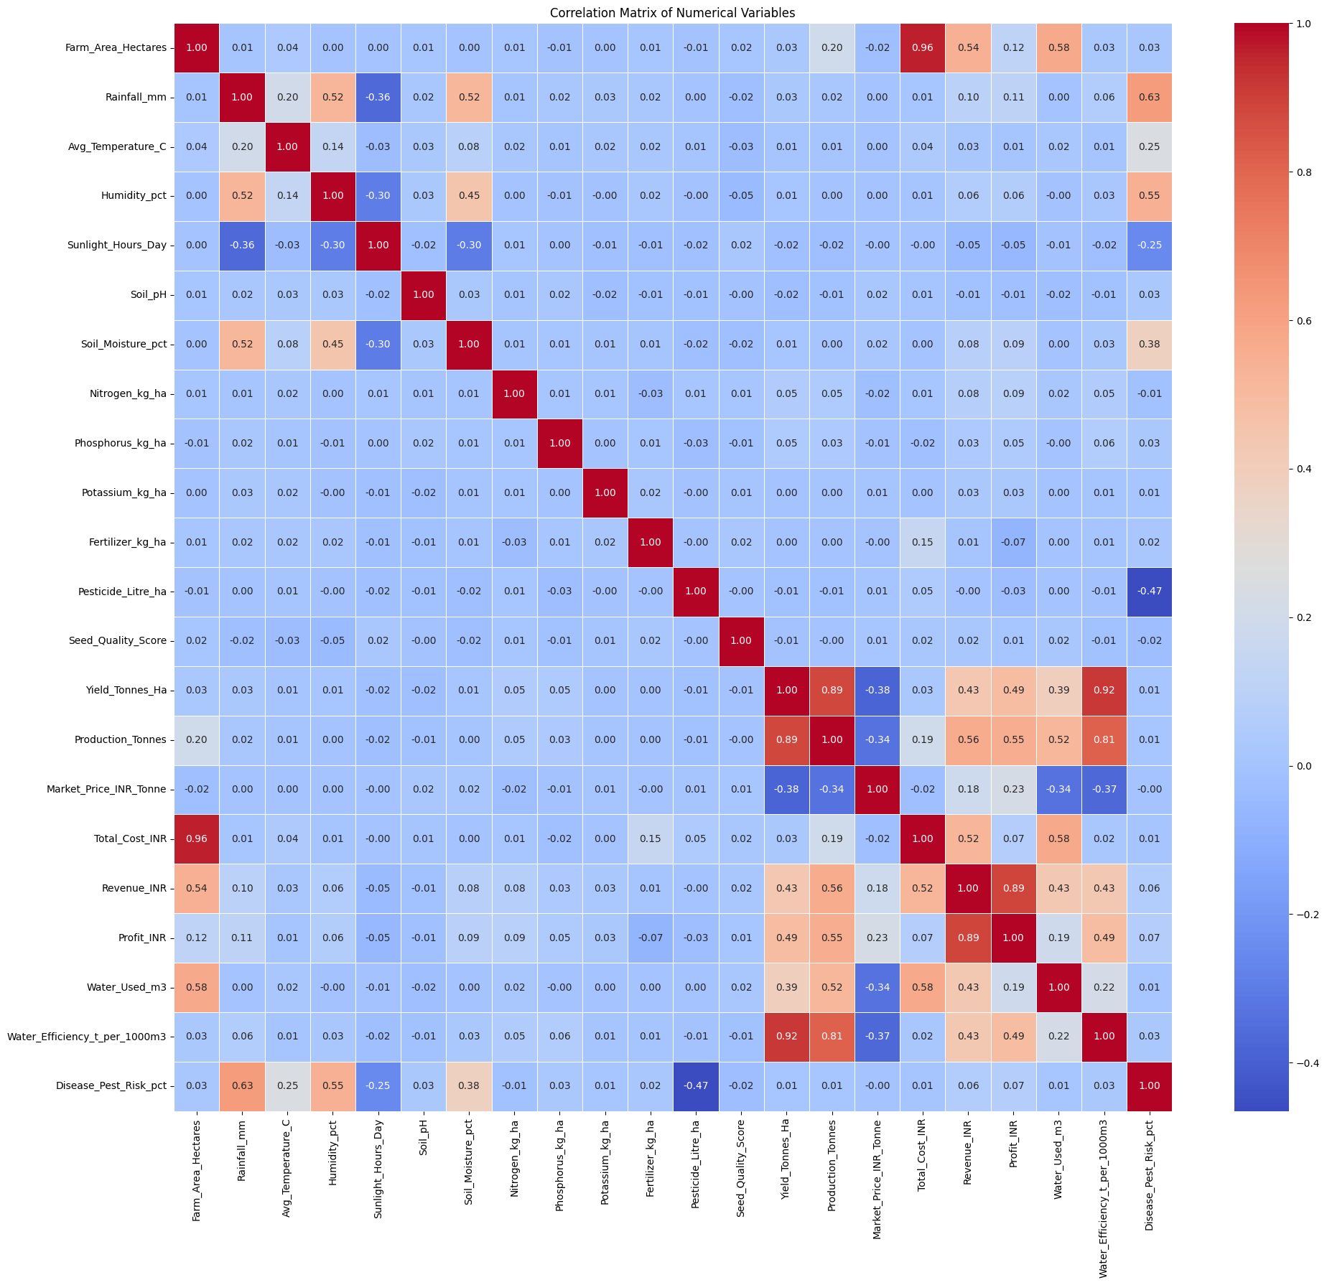
RESULTS

Slide 13
Future scope
Develop predictive models to forecast agricultural performance for upcoming seasons.
Integrate real-time weather and environmental data for more accurate analysis.
Extend the analysis to more regions, crops, and agricultural categories.
Build interactive dashboards to help users monitor seasonal agricultural trends.
Analyze market and economic factors to understand their impact on agricultural outcomes.
Use advanced machine learning techniques to identify complex patterns and relationships.
Provide data-driven recommendations to support better seasonal agricultural planning.

Slide 14
GitHub Link
Seasonal Agriculture Performance Analysis

Slide 15
VOIS Course completion certificate - Course name- Data Visualization

Slide 16
Thank you
.
.

