Slide 1
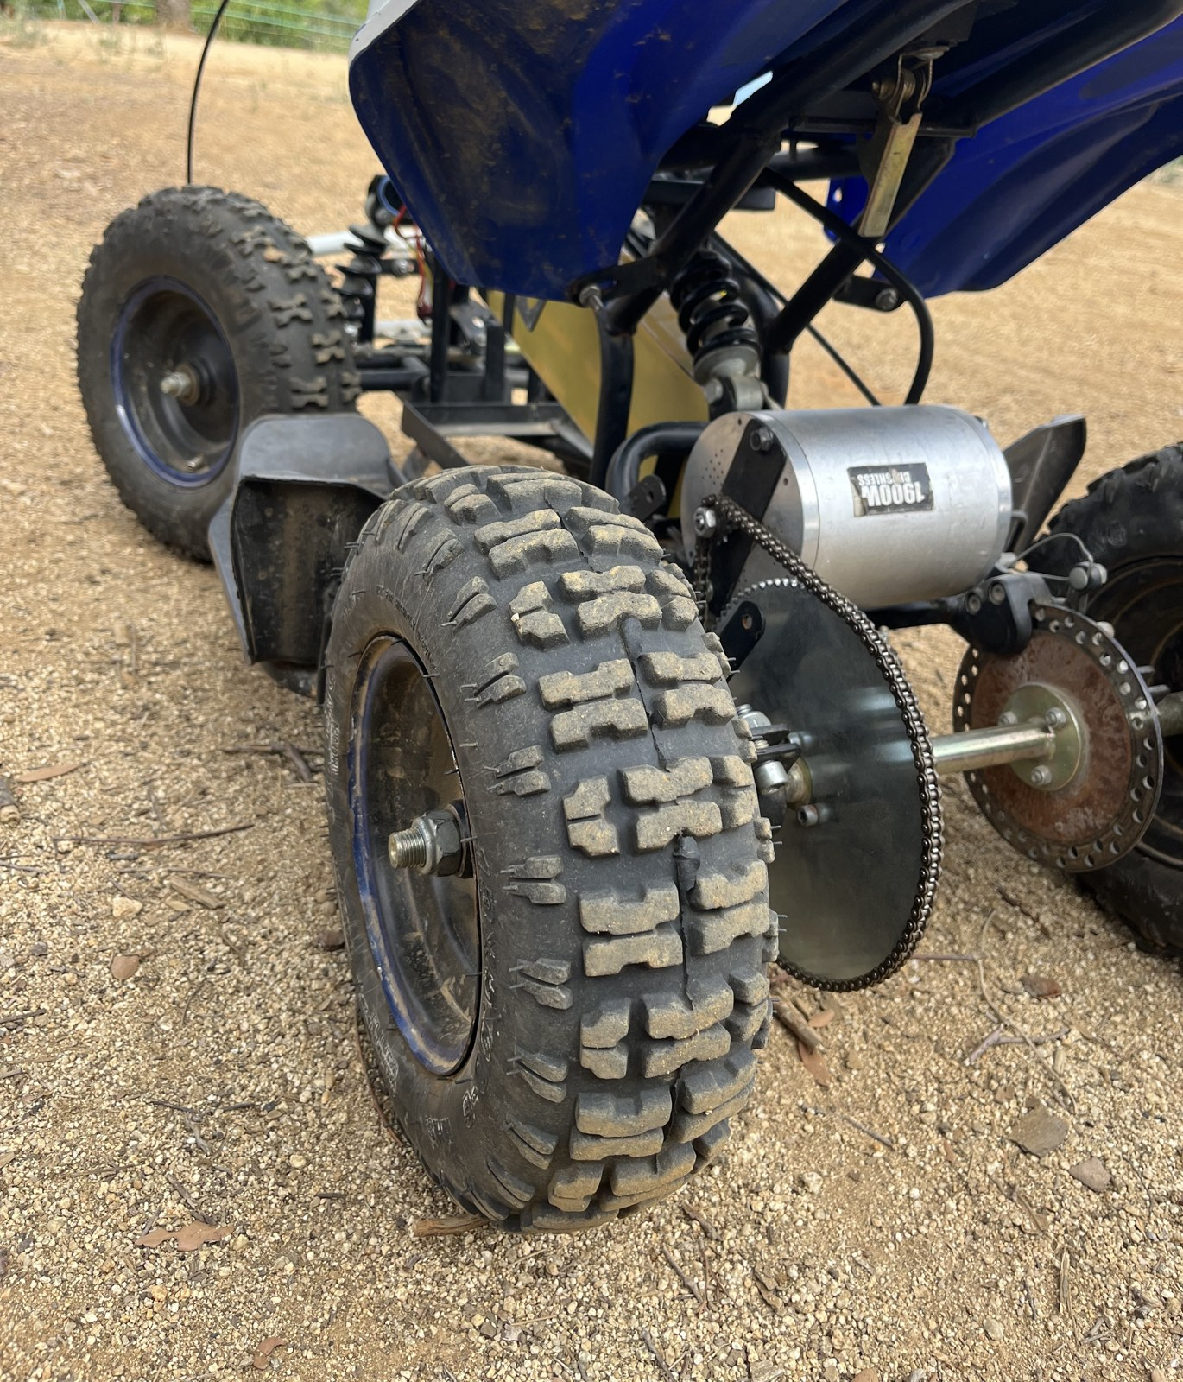

LONGITUDINAL
MODEL
Level 1 of the digital twin — built before the vehicle could be measured
C01 REVIEW
POL CRUAÑAS · 9 OCTOBER 2026

Slide 2
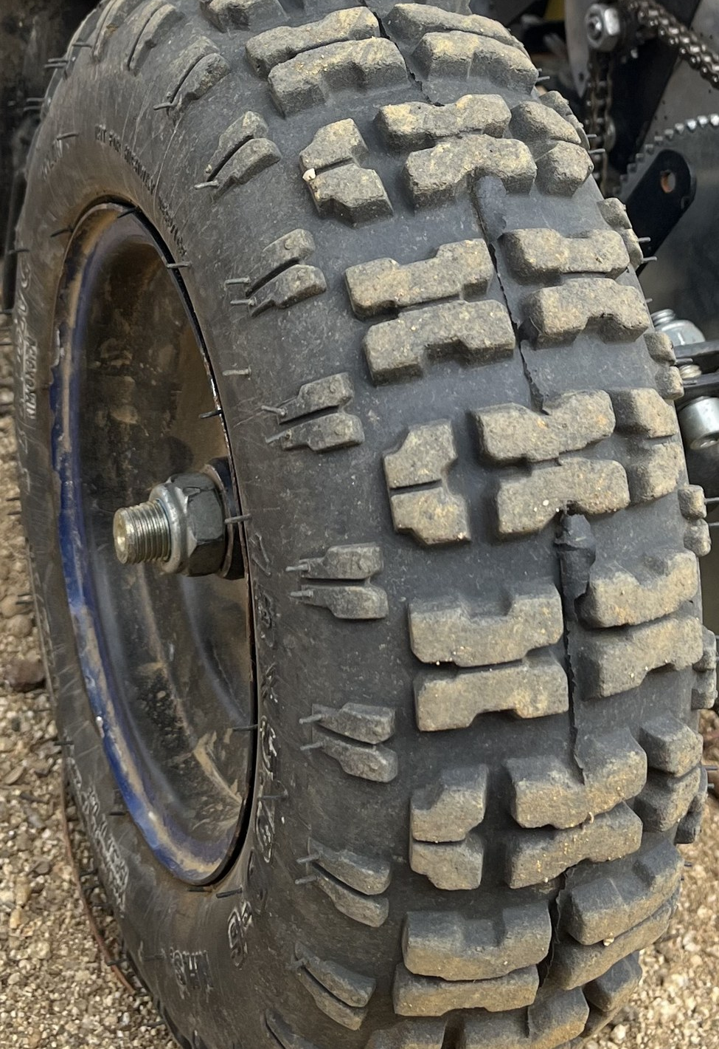
Why a model before the data
The coast-down could not run: both tyres punctured, and the logger's ESP32 was lost to a ground loop.
C01 PLAN · SEPTEMBER
measure
→
fit
→
model
DONE · AFTER THE PIVOT
model
→
predict + freeze
→
measure → C02
Written down first, so the test can prove it wrong.
OFF-ROAD EV PLATFORM · C01 review · October 2026
02
Notes:
PREGUNTA PROBABLE: ¿Por qué no esperaste a tener neumáticos? ¿Calibrar y validar: qué diferencia hay?

Slide 3
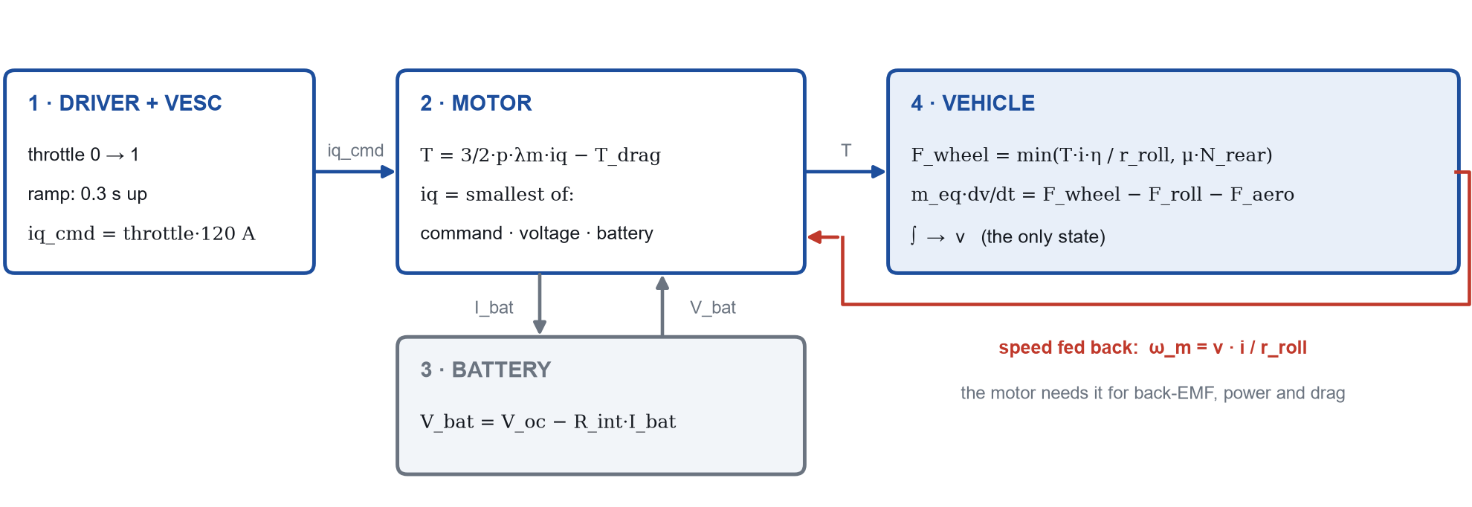
The model: four blocks, one state
SANITY CHECK · MOTOR ONLY, WHEELS IN THE AIR
5448 rpm
5480 rpm
−0.6 %
model, wheels in the air, 52.77 V
measured, C00 no-load (16 440 ERPM ÷ 3)
λm + voltage ceiling + drag — not the vehicle
OFF-ROAD EV PLATFORM · C01 review · October 2026
03
Notes:
PREGUNTA PROBABLE: ¿Por qué un solo integrador? ¿Qué valida el −0,6 % y qué NO valida?

Slide 4
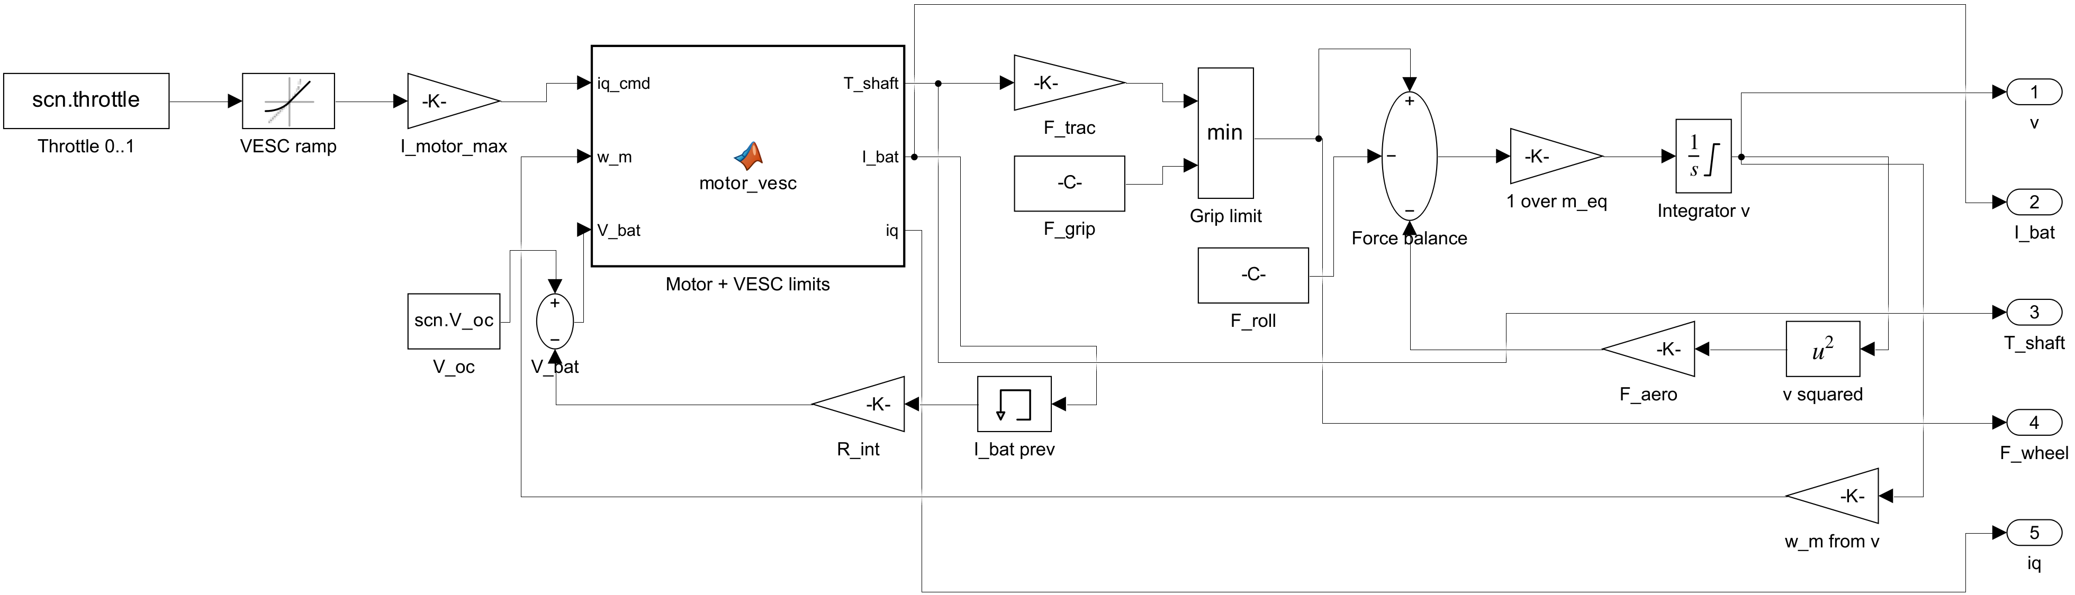
The same model in Simulink (L1)
Built by script (build_longitudinal_L1.m): every block and wire is text in Git. L2 = same physics in 4 subsystems, identical output.
OFF-ROAD EV PLATFORM · C01 review · October 2026
04
Notes:
PREGUNTA PROBABLE: ¿Qué hace el bloque MATLAB? ¿Para qué es el Memory en I_bat?

Slide 5
The force balance, with numbers
m_eq · dv/dt = F_wheel − F_roll − F_aero
TERM
LAW
VALUE
INPUTS
F_wheel
T · i · η / r_roll
≤ 463 N
i = 8.36 · η = 0.95 · r = 0.155 m
F_roll
Crr · m · g
32 N
Crr = 0.030 · m = 110 kg
F_aero
½ · ρ · CdA · v²
25 N at 30 km/h
CdA = 0.60 m² · ρ = 1.20 kg/m³
grip
μ · N_rear
421 N
μ = 0.60 (dirt) · rear share 0.65
m_eq
m + J_wheels/r² + J_rotor·i²/r²
114.5 kg
110 + 4 wheels (ASSUMED) + 0.45 rotor (MEASURED)
At top speed, rolling and aero are about equal. Below it, rolling resistance dominates.
OFF-ROAD EV PLATFORM · C01 review · October 2026
05
Notes:
PREGUNTA PROBABLE: ¿Por qué la rodadura es constante y la aero crece con v²? ¿Por qué m_eq no es solo la masa?

Slide 6
Where every number comes from
MEASURED
VESC ESTIMATE
CONFIG
ASSUMED
pole pairs
phase resistance
motor current
rolling radius
3
Hall count
28 mΩ
detection, 3 runs
120 A
typed in VESC
0.155 m
13 in, −6 % squash
flux linkage λm
inductance
battery current
Crr
16.9 mWb
scope, 3 methods
106 µH
detection, 3 runs
40 A
= BMS rating
0.030
soft knobby tyre
rotor drag
max duty
CdA
63 mN·m
spin-down, + viscous
0.95
typed in VESC
0.60 m²
upright rider
masses
throttle ramp
grip μ
38 + 72 kg
scale
0.3 s
typed in VESC
0.60
dirt, no tyre data
gear
chain η
92/11
teeth counted
0.95
roller chain
pack R_int
0.10 Ω
no datasheet
Every ASSUMED value carries a range. The sensitivity sweep runs over exactly those ranges.
OFF-ROAD EV PLATFORM · C01 review · October 2026
06
Notes:
PREGUNTA PROBABLE: De los ASSUMED, ¿cuál te preocupa más? ¿De dónde sale μ = 0,60?

Slide 7
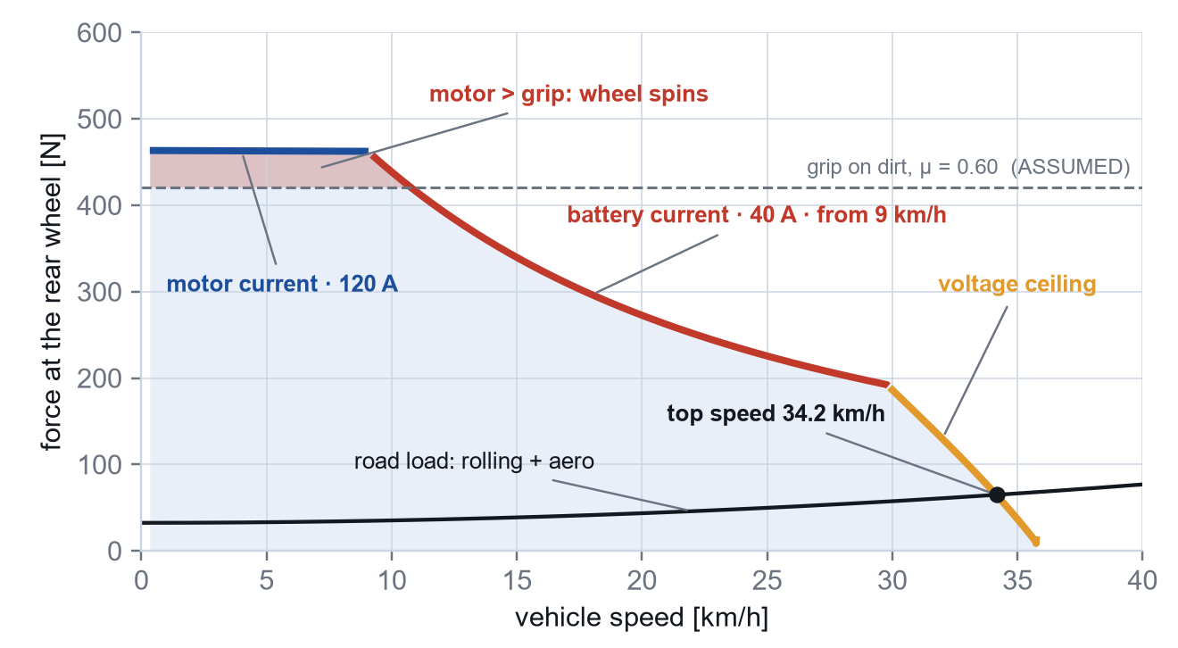
Where the limits are
MOTOR CURRENT
iq ≤ 120 A
T = 3/2·p·λm·iq = 9.1 N·m
BATTERY CURRENT
I_bat ≤ 40 A
≈ 1.8 kW, from 9 km/h
VOLTAGE
|v| ≤ 0.95 · V_bat / √3
C00 check: 28.9 V reached
On dirt the tyre limits the launch (421 N < 463 N). From 9 km/h: the battery. At the top: voltage.
OFF-ROAD EV PLATFORM · C01 review · October 2026
07
Notes:
PREGUNTA PROBABLE: ¿Qué pasa desde 9 km/h? ¿Por qué se desploma cerca de 35 km/h? Si patina, ¿el modelo lo ve?

Slide 8
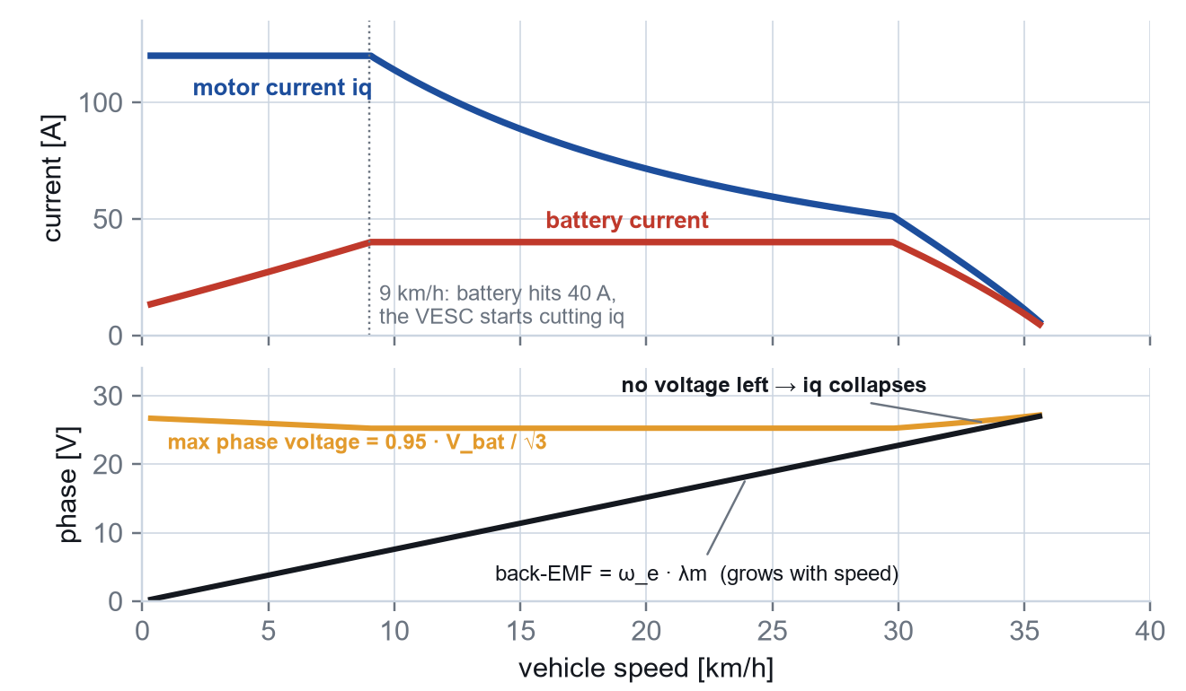
Motor current is not battery current
POWER IS CONSERVED
V_bat · I_bat ≈ 3/2 · v_q · iq. Low speed → low motor voltage → 120 A of motor is little battery current.
FROM 9 KM/H
The battery reaches 40 A. The VESC cuts iq so it stays there: constant power.
NEAR THE TOP
The back-EMF reaches the voltage the inverter can make. No voltage left to push current: iq collapses.
OFF-ROAD EV PLATFORM · C01 review · October 2026
08
Notes:
PREGUNTA PROBABLE: ¿Por qué la corriente de batería es menor que la de motor a baja velocidad?

Slide 9
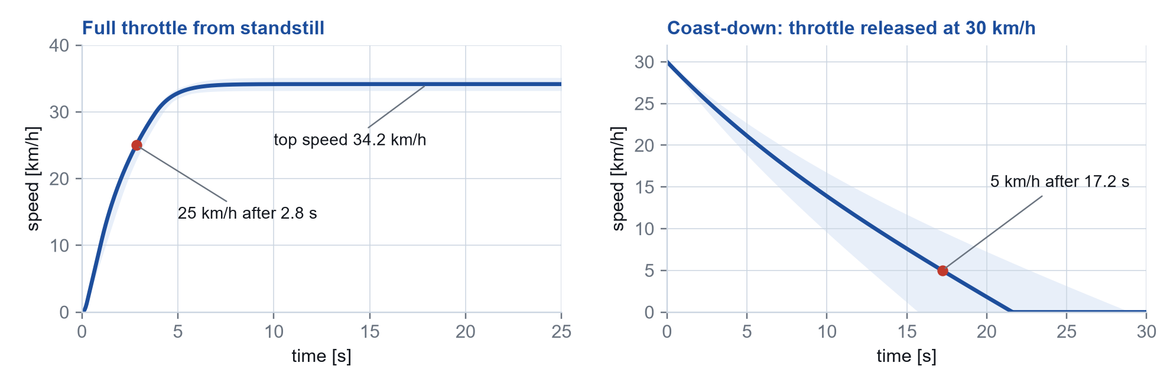
Predictions, frozen before the test
34.2 ± 1.2 km/h
2.8 ± 0.5 s
17.2 ± 5.6 s
9.0 ± 0.6 km/h
top speed, at 50 V
0 → 25 km/h, full throttle
coast-down 30 → 5 km/h
where the 40 A limit starts
Two simulated manoeuvres. Shaded: every parameter at the ends of its range, one at a time.
OFF-ROAD EV PLATFORM · C01 review · October 2026
09
Notes:
PREGUNTA PROBABLE: ¿Cómo sale la banda ±? ¿Son simulaciones o cuentas a mano?

Slide 10
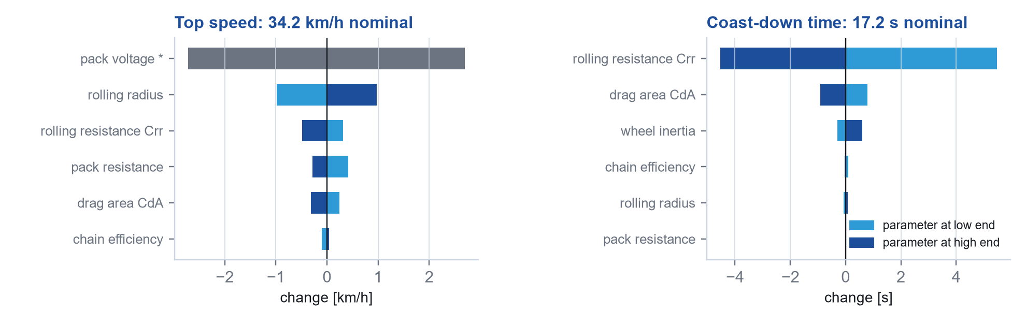
What moves the predictions
TOP SPEED
0 → 25 KM/H
COAST-DOWN
Pack voltage moves it 31–37 km/h. Measure V_bat first.
Grip μ is 60 % of the spread. On dirt the tyre, not the motor.
Crr is 96 % of the spread. The first thing to measure.
* pack voltage is a test condition, not an unknown — it is measured, so it stays out of the band.
OFF-ROAD EV PLATFORM · C01 review · October 2026
10
Notes:
PREGUNTA PROBABLE: ¿Por qué la tensión del pack no entra en la banda? ¿Por qué μ manda en el 0→25?

Slide 11
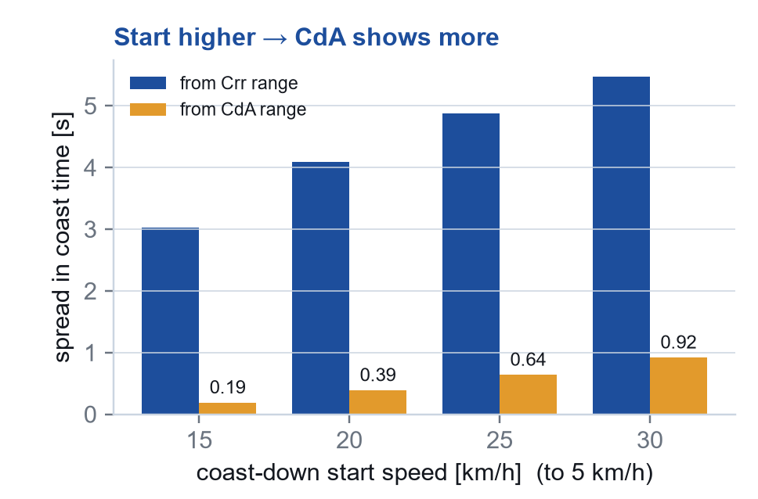
Designing the tests
RUN 1 · FULL THROTTLE, 0 → TOP SPEED
Checks: top speed · 0 → 25 km/h · battery limit at 9 km/h
GPS + VESC log · V_bat before
tyres
logger
RUN 2 · COAST-DOWN, 30 → 5 KM/H
Checks: coast time. Then fits Crr (CdA only weakly)
VESC log: speed vs time
tyres
logger
Start the coast-down as high as the quad reaches: CdA shows 5× more at 30 than at 15 km/h — still small next to Crr.
Every run in both directions: slope and wind cancel in the average.
OFF-ROAD EV PLATFORM · C01 review · October 2026
11
Notes:
PREGUNTA PROBABLE: ¿Por qué desde 30 y no desde 15 km/h? ¿Por qué ida y vuelta?

Slide 12
What is in the model, and what is next
Level 1 answers “how fast, how quick”. It cannot answer “how much does it slip”.
IN NOW · LEVEL 1
NEXT · TYRES + LEVEL 2
C02 · MOTOR + INVERTER
— force balance + grip cap
— new tyres → check predictions
— dq machine: Clarke, Park
— 3 limits on iq
— load transfer (needs h_cg)
— current loop
— rotor drag
— launch-control hook
— inverter losses
— throttle ramp
— tyre pressure → Crr
— temperature
— pack R_int sag
2027
traction control
launch control
MPC
For you: 120 A motor and 40 A battery were typed in. How would you derive them?
OFF-ROAD EV PLATFORM · C01 review · October 2026
12
Notes:
PREGUNTA PROBABLE: G10: tu regla dice 'no saltar niveles'. ¿Por qué motor + inversor sin validar el vehículo?

