Slide 1
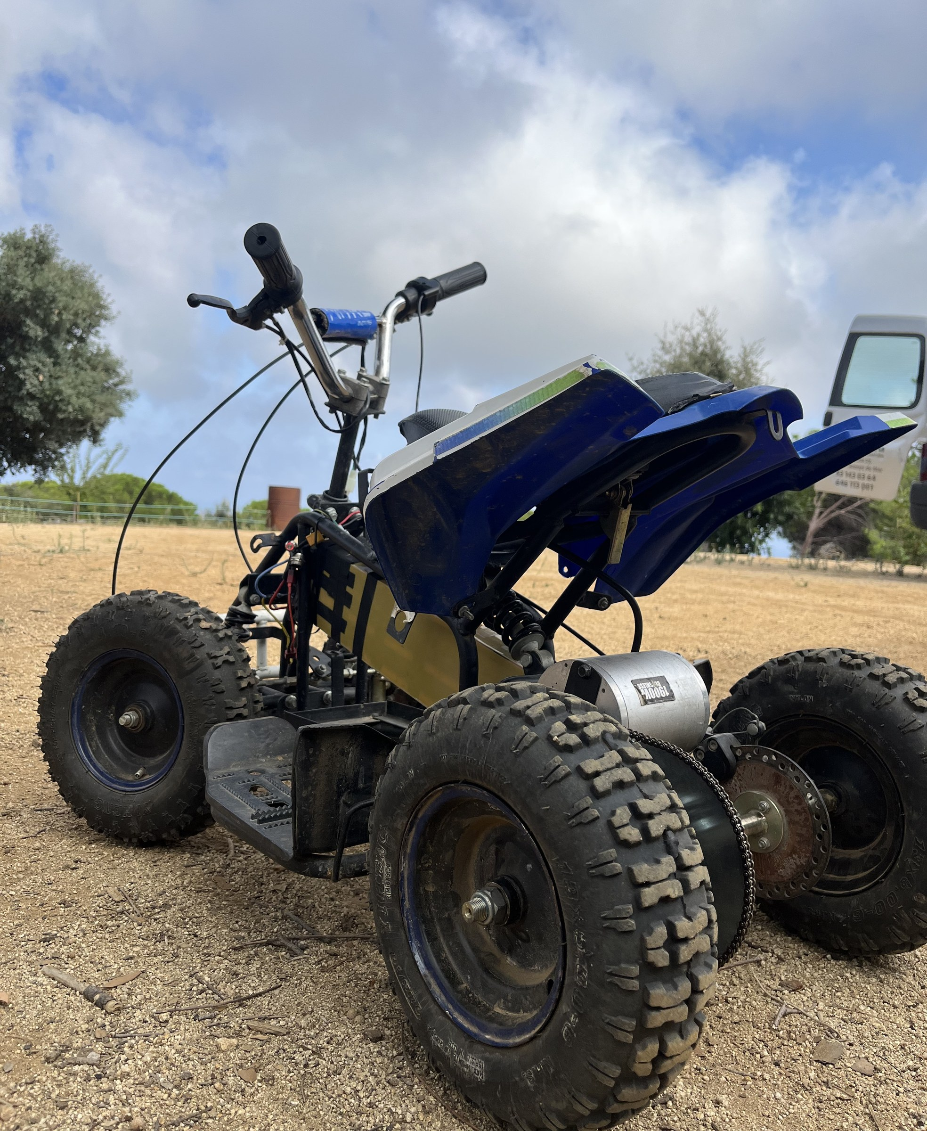

OFF-ROAD
EV PLATFORM
Powertrain modelling, control and validation on a real vehicle
KICKOFF REVIEW
POL CRUAÑAS · SEPTEMBER 2026

Slide 2

What this project is
An electric mini-quad, used as a bench for power electronics, machines and control. The hardware is finished — the work is modelling it and controlling it.
THE PLANT
THE DIGITAL TWIN
THE ENGINE
The vehicle.
It exists and it runs.
A Simulink model,
parameterised from measurements.
A two-week cycle,
closed by a review with you.
WHAT ALREADY TRANSFERS
WHAT DOES NOT
— Test benches and measurement campaigns
— Torque and efficiency maps
— Correlating a model against real hardware
— Power electronics
— Electric machines in the rotating dq frame
— Embedded control and software architecture
OFF-ROAD EV PLATFORM · Kickoff review · September 2026
02

Slide 3
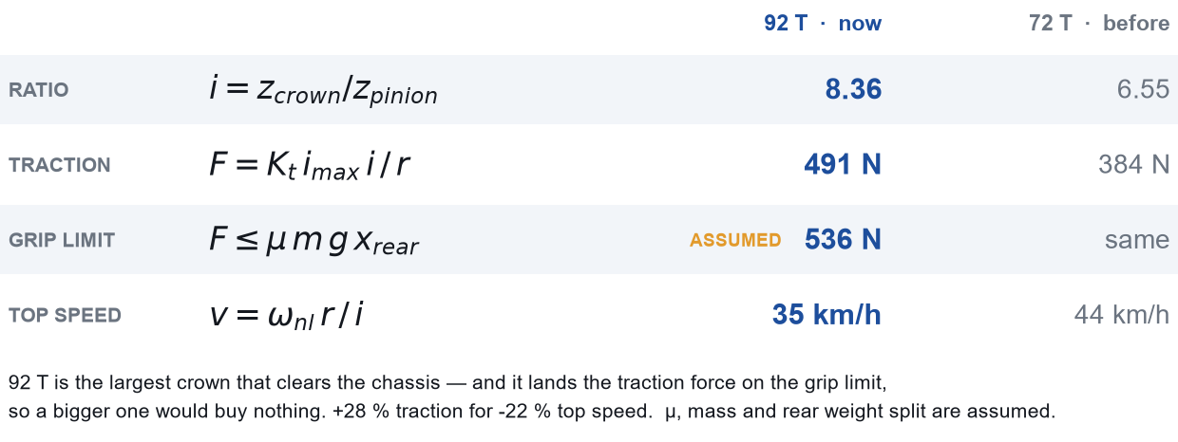
The vehicle
Nitro Motors mini-quad: 36 V lead-acid → 48 V lithium.
Mass, with driver
Wheels
≈ 112 kg
13 × 5.00-6 · r ≈ 0.155 m loaded
Final drive
Battery
chain 25H · 11T / 92T = 8.36:1
13S5P Li-ion · 48.1 V · ~13 Ah
Motor
Peak wheel torque
48 V PMSM · ~1.9 kW · 3 pp
76 N·m at 120 A
WHY 92 TEETH
OFF-ROAD EV PLATFORM · Kickoff review · September 2026
03

Slide 4
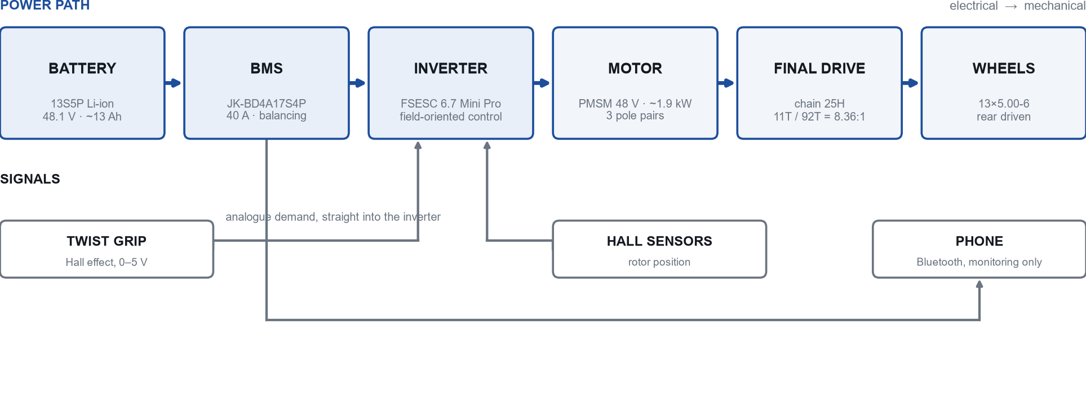
System architecture — as it is today
The twist grip drives the inverter directly. Nothing sits between the driver and the torque, and nothing records what happens under load.
OFF-ROAD EV PLATFORM · Kickoff review · September 2026
04

Slide 5
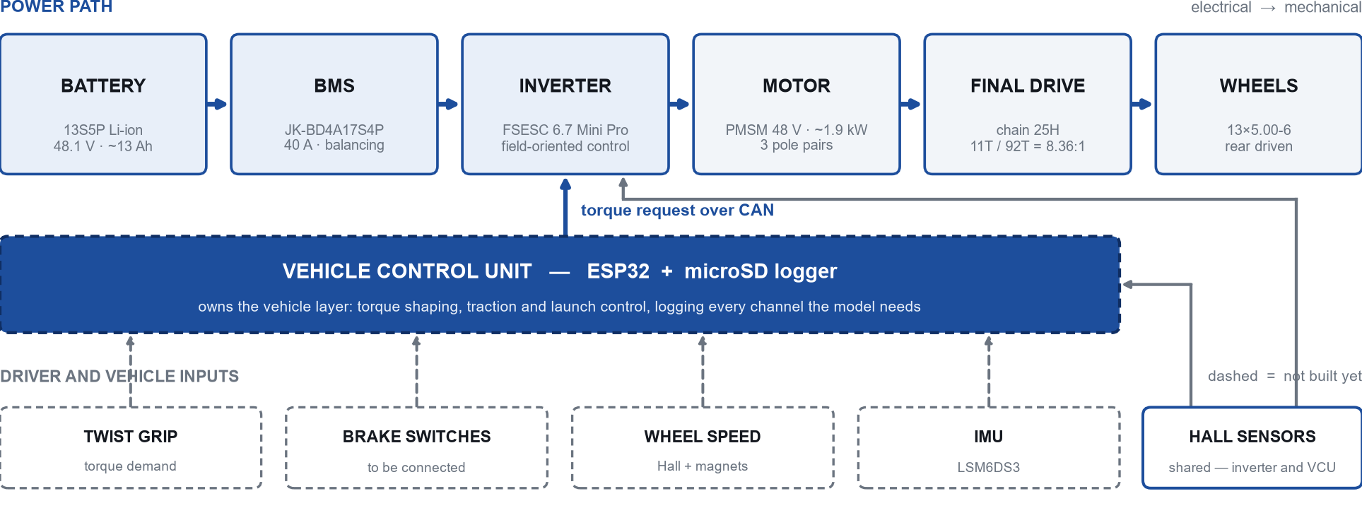
System architecture — where it is going
A vehicle control unit takes the driver inputs — brakes included — and sends a torque request over CAN.
OFF-ROAD EV PLATFORM · Kickoff review · September 2026
05

Slide 6
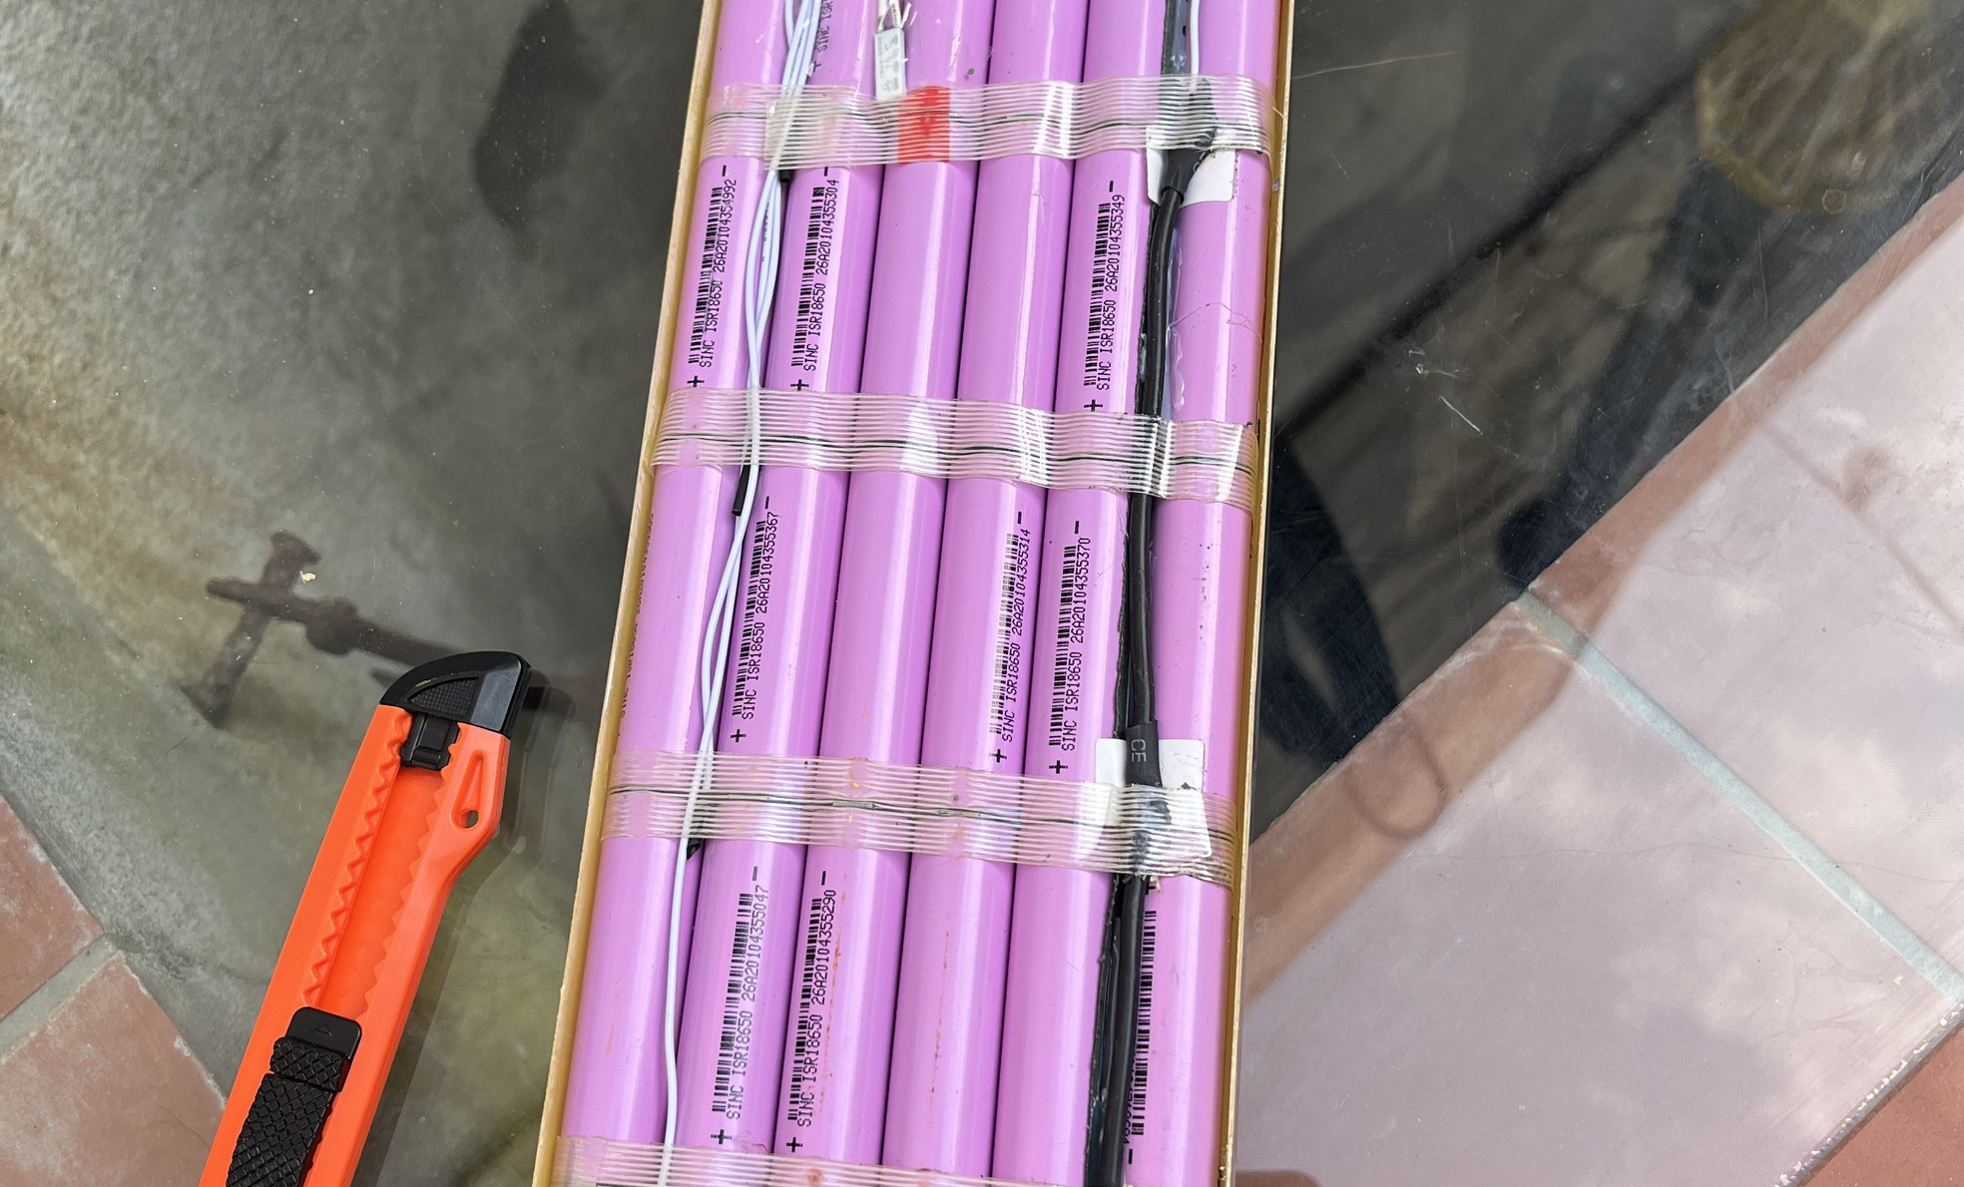
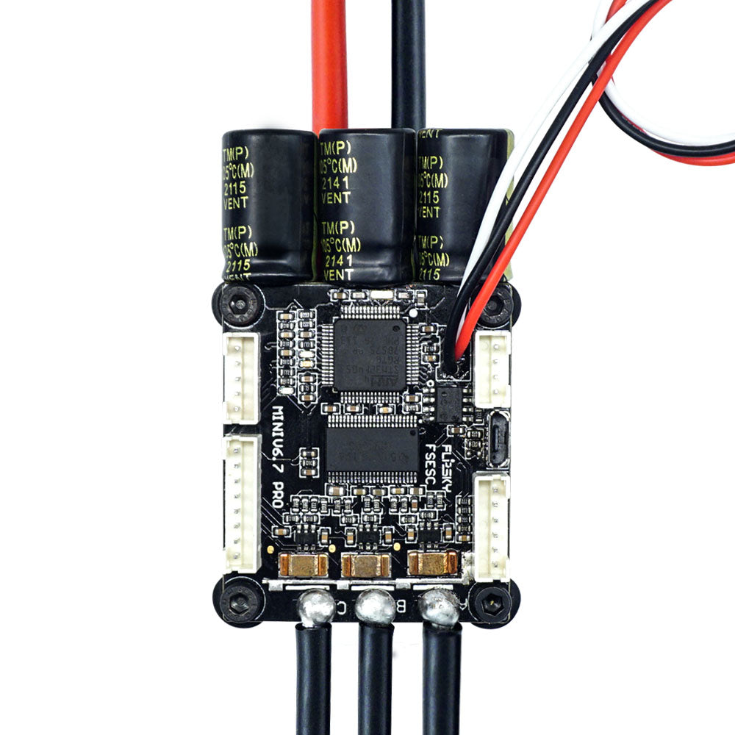
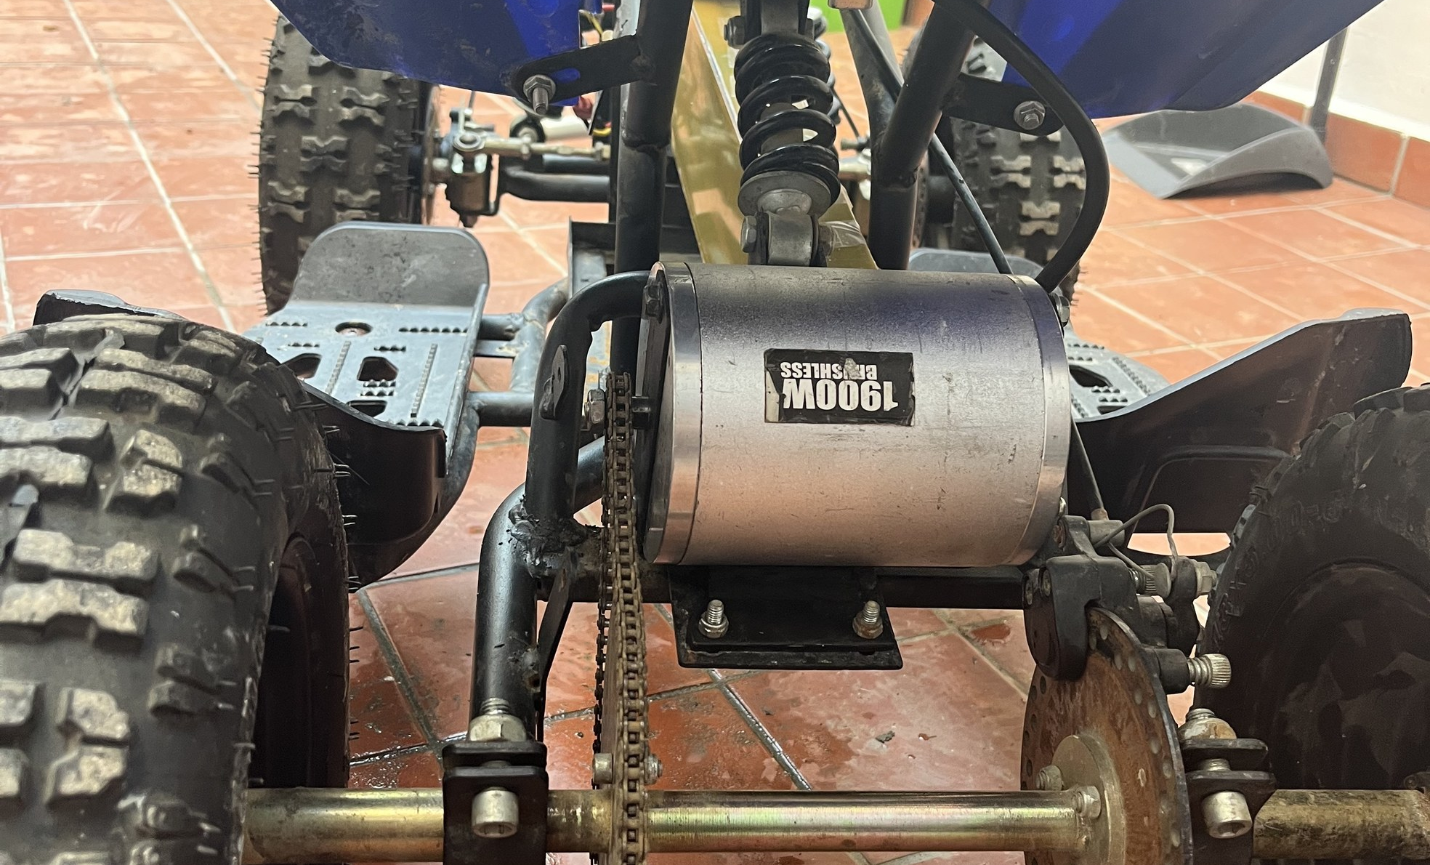
The powertrain, component by component
BATTERY
INVERTER
MOTOR
— 13S5P Li-ion · 65 cells
— 48.1 V · ~13 Ah
— JK smart BMS · 40 A
— Flipsky FSESC 6.7 Mini Pro
— 70 A cont. · 200 A peak
— FOC · 30 kHz · CAN
— 48 V PMSM · ~1.9 kW
— 3 pole pairs · Hall
— Urban Fox scooter donor
WHY THIS ONE
WHY THIS ONE
WHY THIS ONE
Configurable and observable: every cell voltage readable from the phone while the vehicle runs.
Open source. I can read the firmware line that computes the torque, and export the whole configuration to XML — which is what parameterises the model.
Came with the donor, and is not confirmed on paper. It is the component the whole model hangs on, so it had to be measured.
OFF-ROAD EV PLATFORM · Kickoff review · September 2026
06

Slide 7
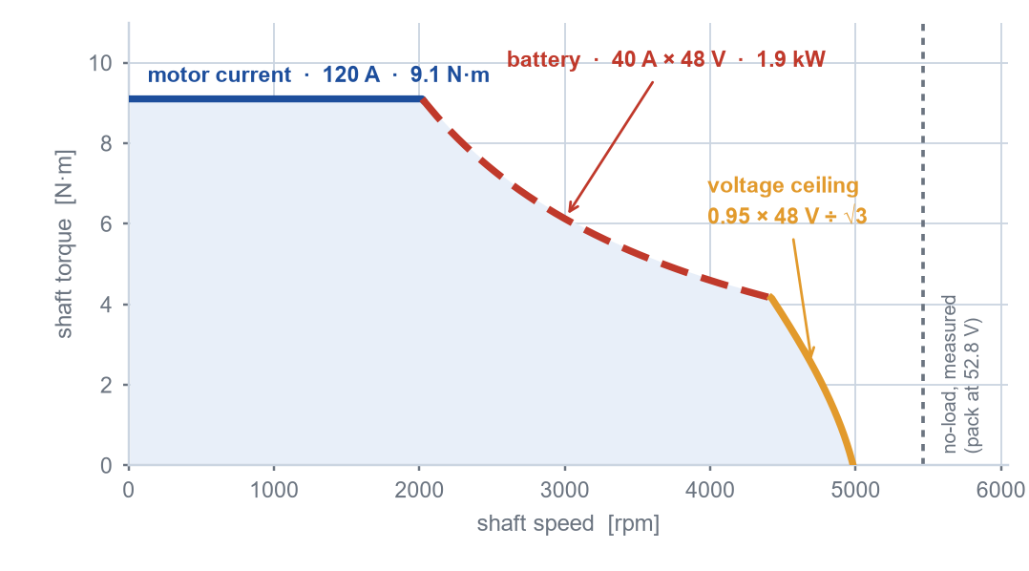
Where the limits actually are
BATTERY
40 A → 1.9 kW
this is the ceiling
MOTOR
120 A → 9.1 N·m
no thermal protection
VOLTAGE
0.95 × 48 V
sets top speed
WHAT THAT MEANS FOR THE MODEL
The inverter, 70 A continuous, never shapes this curve — it limits how long the flat part can be held. The battery gets only what it takes to set the ceiling: no thermal model, not this year.
OFF-ROAD EV PLATFORM · Kickoff review · September 2026
07

Slide 8
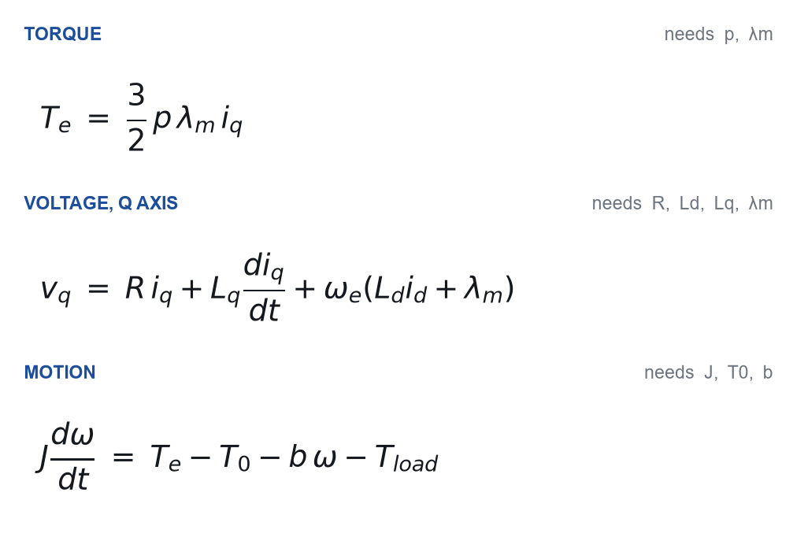
What the model needs, and where it comes from
MEASURED ON THIS VEHICLE
p
3
Hall pulse count
λm
16.86 mWb
back-EMF, scope
Kt
0.0758 N·m/A
derived from p and λm
R
28.0 mΩ
inverter detection
Ld / Lq
99 / 113 µH
inverter detection
J
1.56·10⁻⁴ kg·m²
spin-down
T₀ / b
63 mN·m / 139 µN·m·s/rad
spin-down
Three equations. Every symbol in them is a number someone has to go and measure.
None of this came from a datasheet. The datasheet was wrong.
OFF-ROAD EV PLATFORM · Kickoff review · September 2026
08

Slide 9
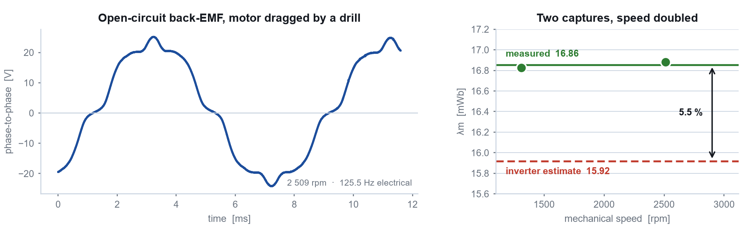
How the machine was measured
POLE PAIRS
FLUX LINKAGE
INERTIA AND DRAG
Counted the Hall pulses over one turn of the sprocket: 25 against 25.1 predicted for p = 3, and 33.5 for p = 4.
Motor off the inverter, dragged by a drill, scope across two phases. Two speeds agree to 0.17 %.
Three spin-downs anchored on the steady no-load point: J = 1.56·10⁻⁴ kg·m², plus dry and viscous friction.
Next: a coast-down on the vehicle — rolling resistance, drag and vehicle inertia in one test. That is what the straight-line model needs.
OFF-ROAD EV PLATFORM · Kickoff review · September 2026
09

Slide 10
How I learn, and what I refuse to delegate
DERIVE IT
COPY IT
LET THE AI FILE IT
A dragged-in FOC block gives a quad that works and an engineer who learned nothing.
No first principles there, and no shame about it. The budget for deriving goes where the learning is.
Never the reasoning. An agent that hands me a conclusion I should have reached has negative value.
Clarke and Park
build systems
notes and plots
the current loop
protocols
traceability
vehicle dynamics
drivers
formatting
file formats
my own slips
One Git repository holds the measurements, the decisions and the reasons behind them. Nothing important lives only in my head.
OFF-ROAD EV PLATFORM · Kickoff review · September 2026
10

Slide 11
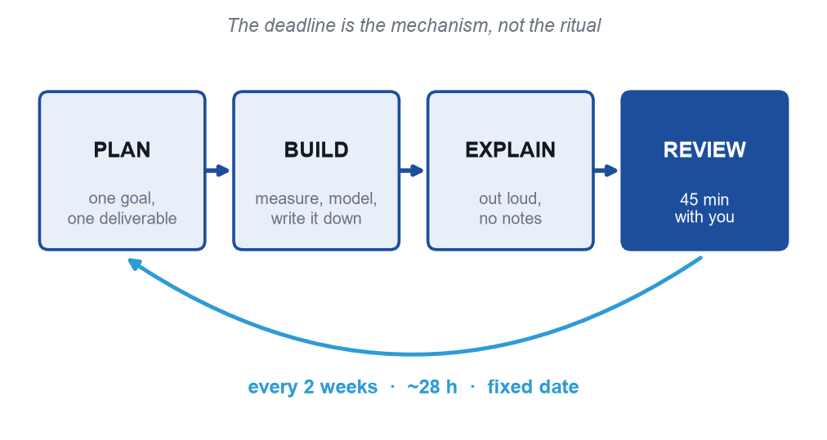
How the work is organised
THE 45 MINUTES WITH YOU
5 min
What I said I would do
15 min
What I did, with data
10 min
What I do not understand
10 min
Does the reasoning hold?
5 min
Goal of the next cycle
The middle twenty minutes are the point. A review where I only show what worked wastes two doctorates.
If I cannot explain it out loud without notes, the cycle is not finished.
OFF-ROAD EV PLATFORM · Kickoff review · September 2026
11

Slide 12
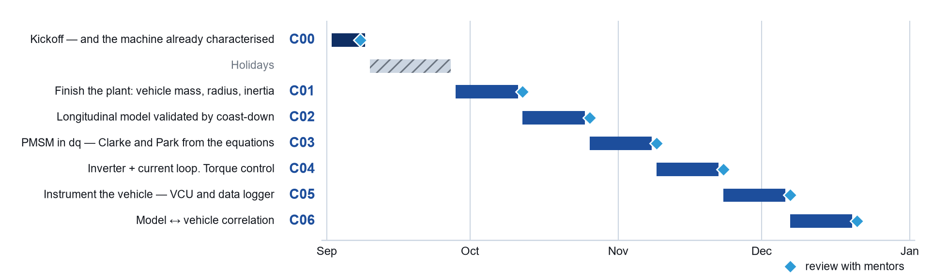
The plan to December
AFTER C06 · 2027
Control on the ESP32 · Traction and launch control · MPC on a validated model
End of 2026: a model validated against the real vehicle.
The machine came in ahead of plan, so C01 moves on to the vehicle.
OFF-ROAD EV PLATFORM · Kickoff review · September 2026
12

Slide 13
What I need from you
Three things. They are worth more to me than technical answers.
01
Hold me to a date
Without an external deadline I postpone indefinitely. The date being fixed is the mechanism — the meeting itself is secondary.
02
Attack the reasoning, not the result
Do not ask whether the number is right. Ask why I chose that method, and what would have to be true for it to be wrong.
03
Tell me when I explain badly
If an explanation does not land, that is usually not a language problem. It is me not having understood it.
What I am not asking for: that you validate field-oriented control or electric-machine theory. That gap I close elsewhere — you are not being examined on a domain that is not yours.
OFF-ROAD EV PLATFORM · Kickoff review · September 2026
13

Slide 14
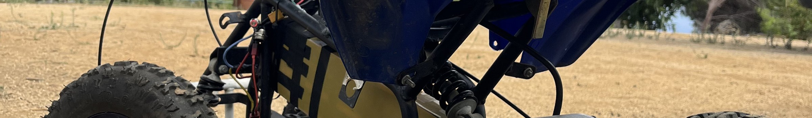
What I am asking for today
12 Oct
Every 2 weeks
3 of 3
First full review
Cadence
Machine parameters measured
C01 — closing the vehicle side
Monday, 45 minutes, six reviews to December
pole pairs · flux linkage · inertia
Confirm the slot, and I will put all six review dates in the calendar before I leave.
OFF-ROAD EV PLATFORM · Kickoff review · September 2026
14

