Slide 1
OpenNeuro: An open archive for analysis and sharing of BRAIN Initiative data
Russ Poldrack

Slide 2
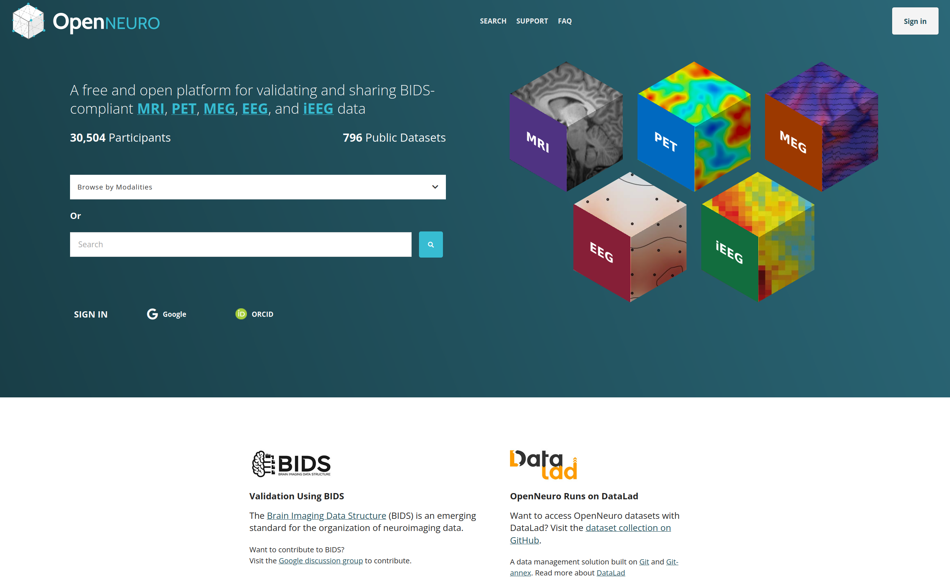

Slide 3
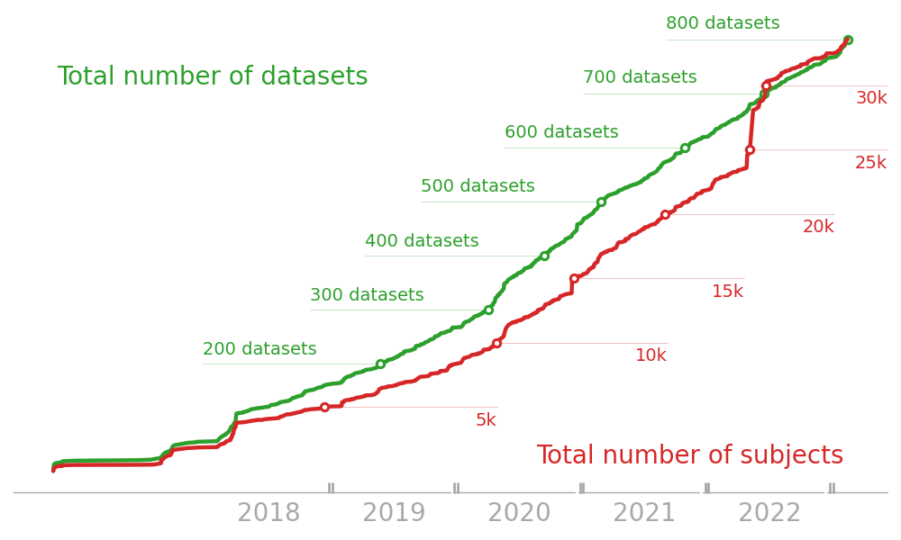

Slide 4
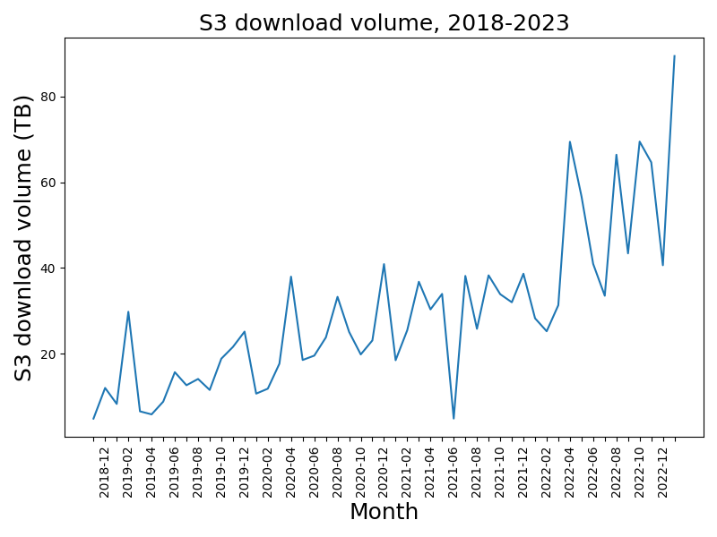

Slide 5
New developments
Renewal grant approved for funding (2023-2028)
Migration from AWS to GCP
Improved performance, easier scaling, and lower cost per dataset
Open datasets still shared via AWS Public Datasets
Improved performance for large datasets (now handling 2TB+)
Published data retention/admin policies for reference in Data Sharing Plans
Links to NEMAR for supported datasets
Initial support for ORCID integration
Support for fNIRS upload
Schema-based validation for BIDS
OpenNeuro data ingestion relies upon JavaScript BIDS validator
Original validator built the standard structure directly into the validator code
Made addition of new data types quite laborious
JavaScript expertise is relatively rare in our community
Work began in 2021 on defining the standard separately using a schema that
Three sprints to date involving the OpenNeuro team, NIMH Data Science and Sharing team, and others
Goals of the schema-based validator effort
Authoritative, machine-readable descriptions of BIDS concepts
Reduce need for proliferation of implementations, such as the PyBIDS configuration object
Enforce consistency in specification by generating text and tables from schema
Unify terms reused in multiple locations in the specification
Reduce burden of writing BEPs by eliminating the requirement for validator coding
Consequence: Whether a rule can be encoded in the schema or will need custom code / schema expansion is now an informal review criterion.

Slide 6
What is the schema?
A hierarchy of YAML documents in the specification repository, under src/schema.
Three major divisions:
Objects (objects.*)
Definitions of BIDS concepts like entities and terms like sidecar values
Rules (rules.*)
Validatable rules, such as entity ordering or permissible/required sidecar values
Meta-schema (meta.*)
Defines a “context” object to which rules can be applied
Potentially expanded to any definitions or rules related to the schema itself

Slide 7
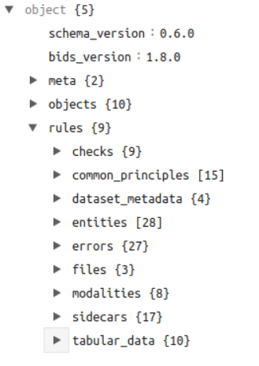

Slide 8
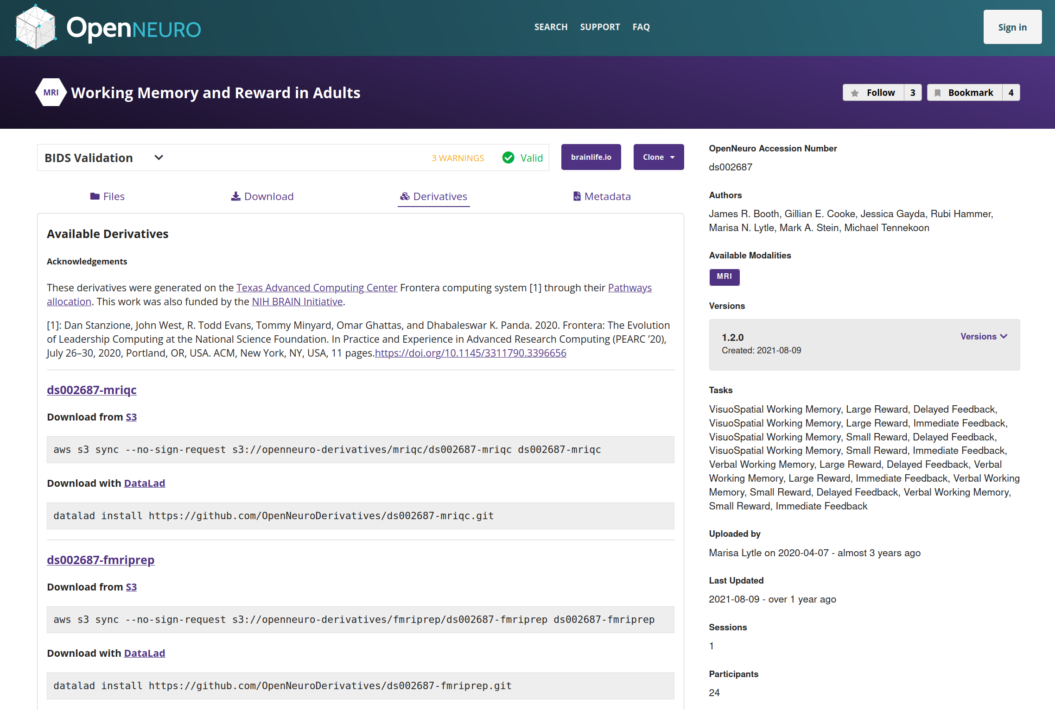
Integrating the schema-based validator into OpenNeuro
Completed
Schema based validation can be run server side by OpenNeuro’s dataset worker
Remaining
Integration for client side (prior to upload) usage
Port OpenNeuro CLI to new JavaScript runtime (Deno) to support calling the schema validator
UI to control use of schema validator during upload
Support for dual validation with existing and schema validators
Decisions
How do we handle cases when one validator passes and the other fails (for early users)?
Sharing of derivative datasets
Derivative data (e.g. preprocessed MRI data) are now supported through the BIDS-Derivatives extension (developed under BRAIN R24MH114705)
One major motivation for the schema-based validator was to support the validation of derivative datasets
In advance of this, we have been developing support for sharing of derivative datasets within OpenNeuro

Slide 9
Preprocessing/QC of OpenNeuro fMRI datasets

Slide 10
All human fMRI datasets from OpenNeuro are being run through MRIQC and fMRIPrep
Via a Pathways allocation on the TACC Frontera supercomputer
To date:
229/430 datasets successfully run with MRIQC
65/430 successfully preprocessed with fMRIPrep
Derivatives openly available via S3 or Datalad

Slide 11
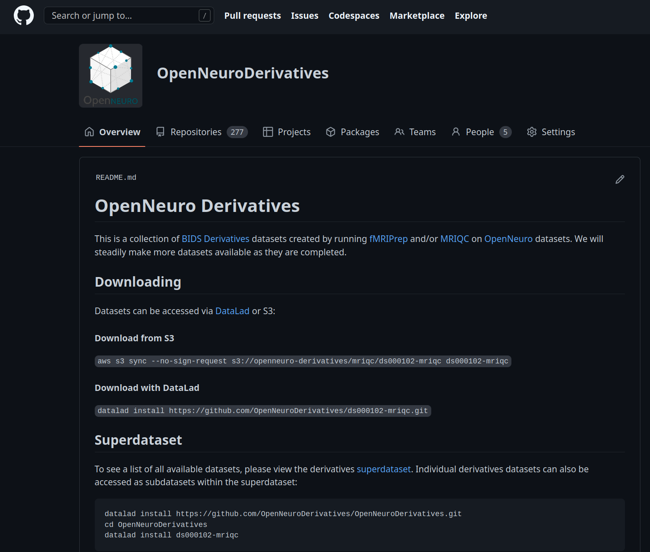

Slide 12
https://github.com/OpenNeuroDerivatives
Alignment with new NIH Data Sharing Policy
“we highlight the importance of researchers considering whether, in choosing where and how to make their data available (if not already specified by an FOA or funding NIH ICO expectation), access to scientific data derived from humans should be controlled, even if de-identified and lacking explicit limitations on subsequent use…SACHRP identified concerns regarding re-identification of otherwise de-identified data, and indeed technological advances and increasing interoperability among data resources, while providing opportunities for new analyses, present identifiability concerns that are widely acknowledged.”
Final NIH Policy for Data Management and Sharing (https://grants.nih.gov/grants/guide/notice-files/NOT-OD-21-013.html)
Potential solution
We are considering adding a click-through agreement for all users requiring agreement to not attempt reidentification
This would cause friction because automated download would require an API key for each user
vs. unauthenticated downloads from S3/datalad at present
Neuroethics supplement

Slide 13
A neuroethics supplement has supported Dr. Annie Jwa, a legal scholar with expertise in neuroethics
Jwa & Poldrack (2022, Journal of Law and the Biosciences) argued for development of regulatory protections against misuse of neuroscience data
“Neuroscience Information Non-discrimination Act”
With funding from Stanford HAI, we are working with Sanmi Koyejo to examine potential for adversarial perturbations of structural MRI data to disable reidentification attempts

Slide 14
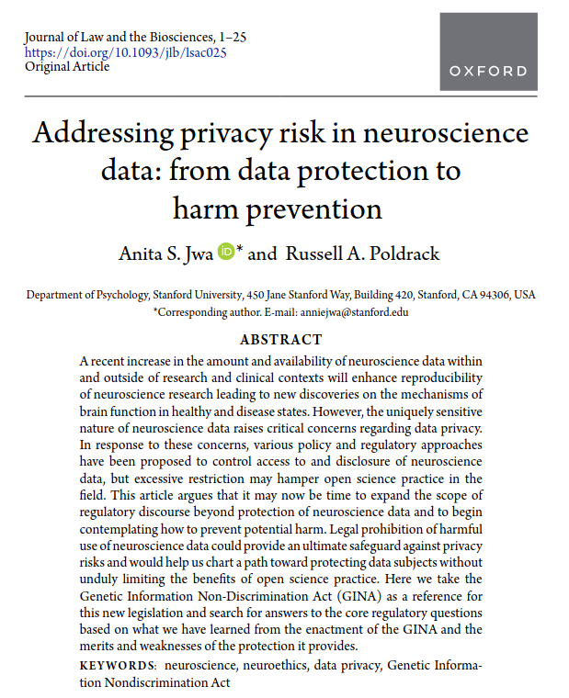

Slide 16
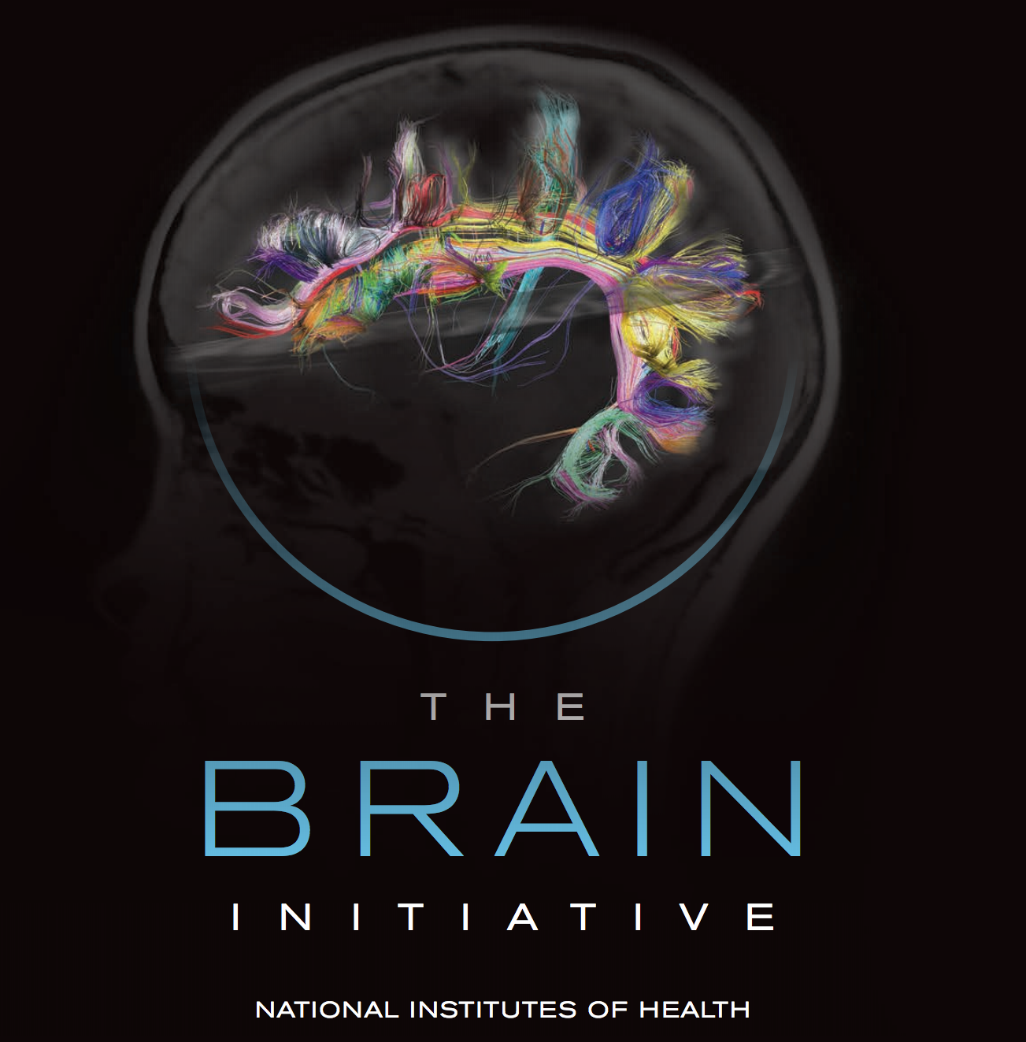
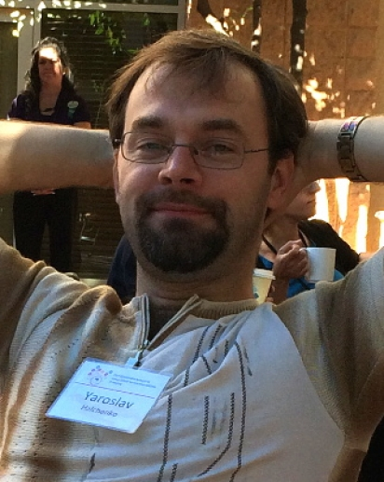

The Poldrack Lab
Funding
OpenNeuro Team
Collaborators

