Slide 1
Deep RStudio
Managing scripts at multiple scales
With Rstudio IDE
By Elie Arnaud
Collaboration Fest – 6th/7th/8th November 2019
Station de Biologie Marine de Concarneau

Slide 2
Prerequisites
Knowing how to write a R script

Slide 3
Program
Fun little things offered in Rstudio
Managing different R files properly
How to use the git interface
Speed up R work with RStudio

Slide 4
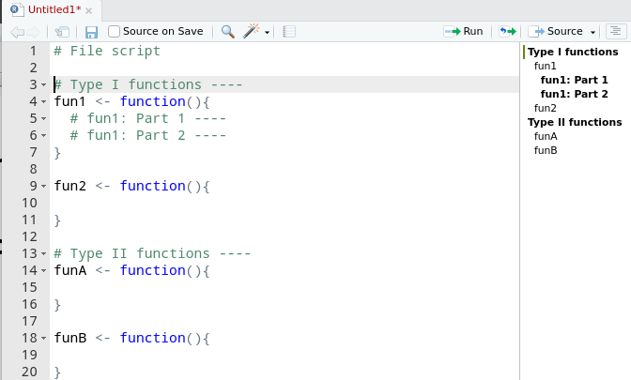
Fun little things
Pressing alt in code editor brush-selects code
Show file outline
Use the margin
History/environment
View() and
ViewerPane
Package management

Slide 5
Managing different R files
1st step: create a .Rproj file (except for utility scripts to reuse, and still: package is appreciable)
2nd : add the R files (R, Rmd, R Shiny, LaTeX…)
3rd : many buttons appear ! Check for them all, it is more than useful

Slide 6
Rstudio git interface
Point about Git / Github, why it is necessary
Where is it located in Rstudio? (need a .git file)
All main functions supported in user-friendly way
“staging” of commits
Files difference
Shell access

Slide 7
Speed up your work
Loooots of shortcuts !
Many ways to debug
Cheatsheet
Rstudio pro (! require real needs for a great team)

