Slide 1
Introduction to Machine Learning
Indraneel Pole M.Eng. – IT Senior Software Engineer, daenet GmbH

Slide 2
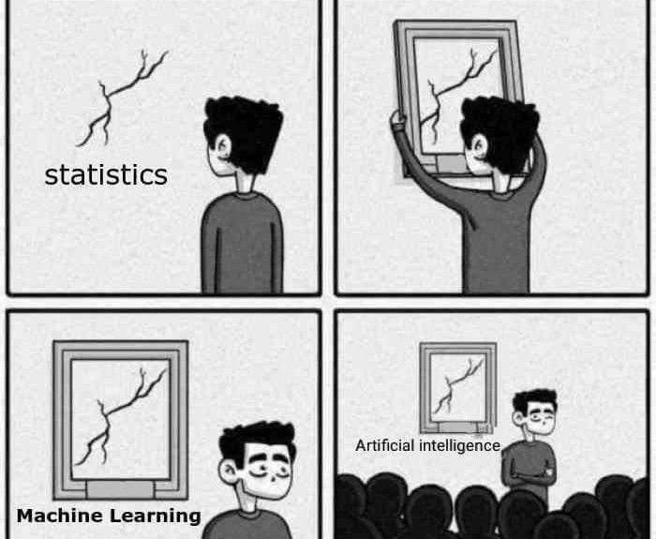

Slide 3






Was ist Maschinelles Lernen?
Machine Learning findet Muster in Daten
Wettervorhersage
Notes:
https://www.coursera.org/learn/machine-learning Temperatur, Feuchtigkeit, Luftdruck,

Slide 4
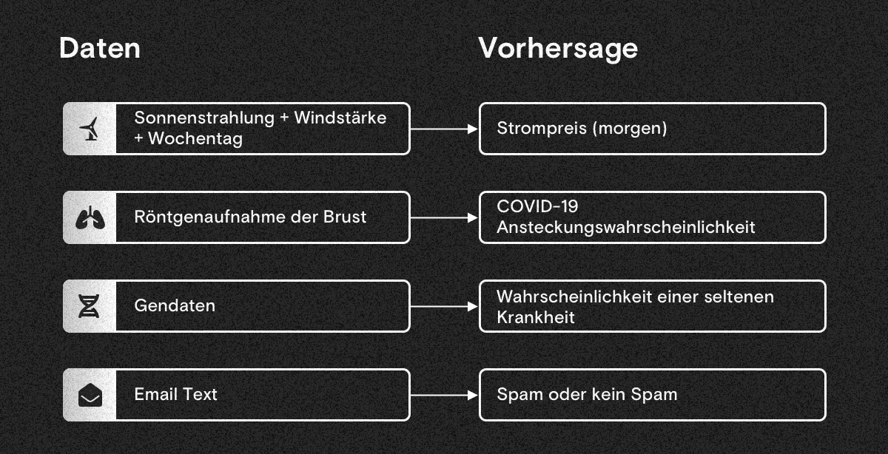

Slide 5


Slide 6



Was ist Maschinelles Lernen?
Arthur Samuel (1959). Machine Learning: Field of study that gives computers the ability to learn without being explicitly programmed.
Rules
Data
Result
Data
Result
Rules
Traditional Programming
Machine Learning
Notes:
Forschungsgebiet, das gibt Computern die Fähigkeit zu lernen, ohne explizit programmiert zu werden. Rules – Regeln; Data – Daten; Result – Ergebnis;

Slide 7
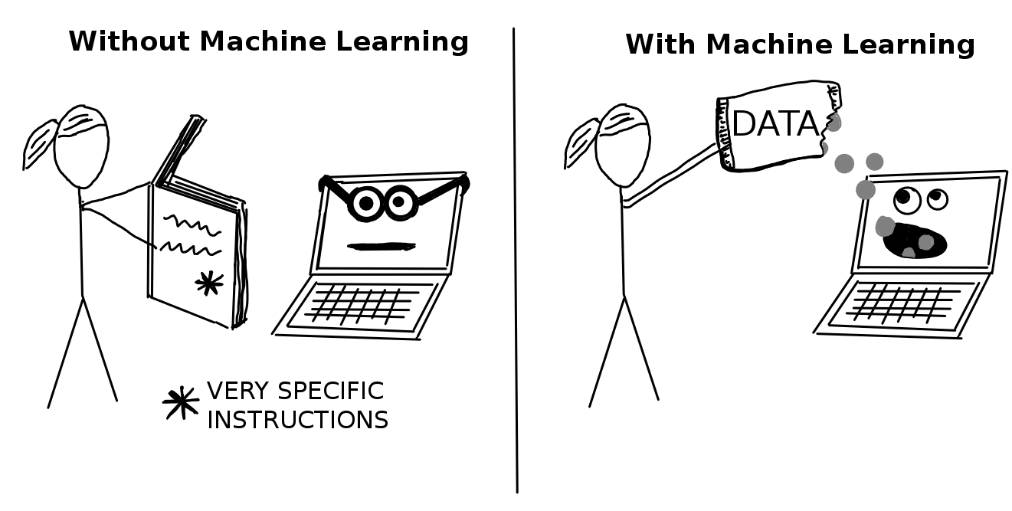
Notes:
Beim Einsatz "normaler" Software geben wir dem Computer vor, was er tun soll. Bei Machine Learning erklären wir dem Computer, wie er etwas anhand entsprechender Daten selbst herausfindet.

Slide 8













Train Machine Learning Algorithm
Trained Model
Training Dataset
Machine Learning Algorithm
Test Input
Notes:
Train - trainieren

Slide 9
Wie lernen Machine Learning Algorithmen?
In Machine Learning unterscheidet man hauptsächlich (aber nicht ausschließlich) zwischen zwei große Arten an Lernproblemen: Supervised (überwachtes) und Unsupervised Learning (unüberwachtes)
Supervised Learning
Unsupervised Learning
Notes:
In Supervised Learning (in Deutsch Überwachtes Lernen genannt) haben wir Daten vorliegen, die quasi schon ein "Label" enthalten. In anderen Worten, jeder Datenpunkt in der vorhandenen Datenmenge besteht aus Eingabe- und Ausgabewerten (Input & Output) Bei Unsupervised Learning (in Deutsch Unüberwachtes Lernen) handelt es sich um das allgemeine Verstehen der vorliegenden Daten. Was wir als "Knowledge Discovery" bezeichnen ist letzendlich das Entdecken von versteckten Strukturen in den Daten. Im Gegensatz zu Supervised Learning haben wir hier dann mit Daten zu tun, die nicht markiert oder durch Labels gekennzeichnet sind.

Slide 10
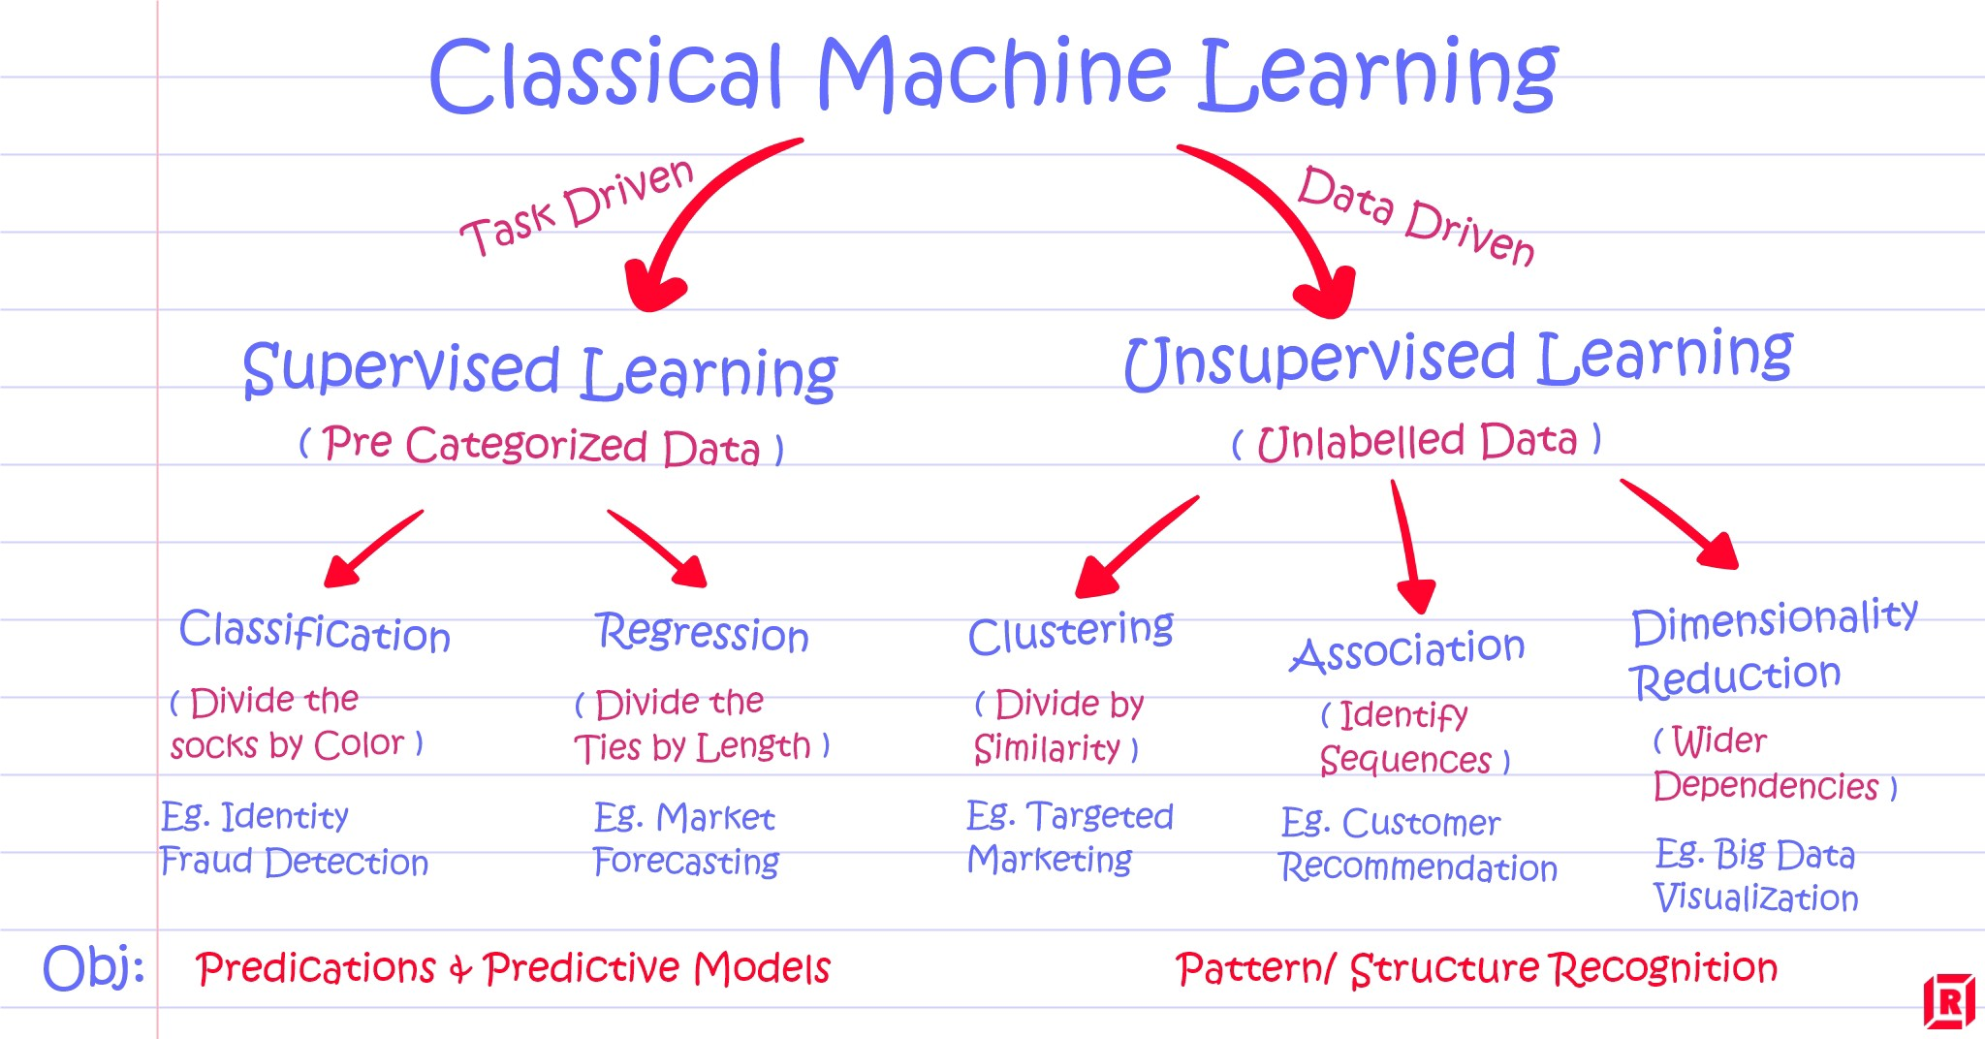
Source: https://www.r-craft.org/r-news/supervised-vs-unsupervised-learning-explained/

Slide 11
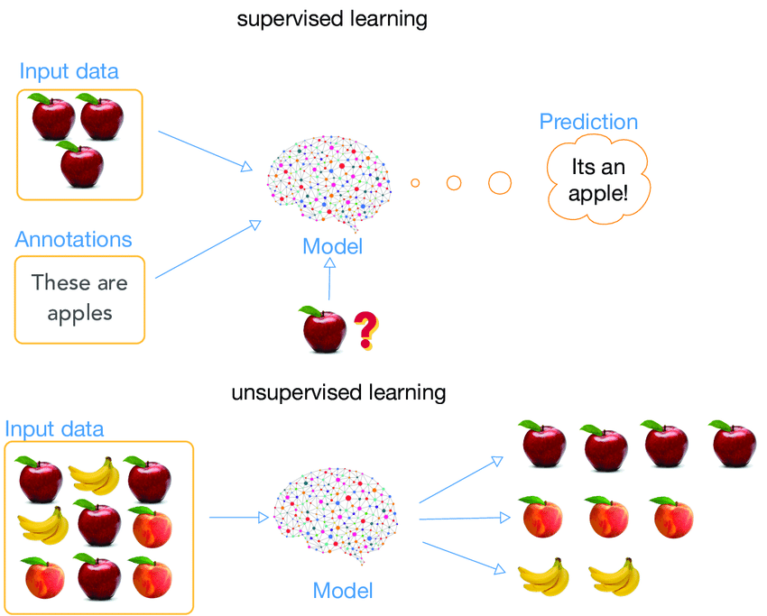
Supervised Learning
In Supervised Learning (in Deutsch Überwachtes Lernen genannt) haben wir Daten vorliegen, die quasi schon ein "Label" enthalten. In anderen Worten, jeder Datenpunkt in der vorhandenen Datenmenge besteht aus Eingabe- und Ausgabewerten (Input & Output)

Slide 12
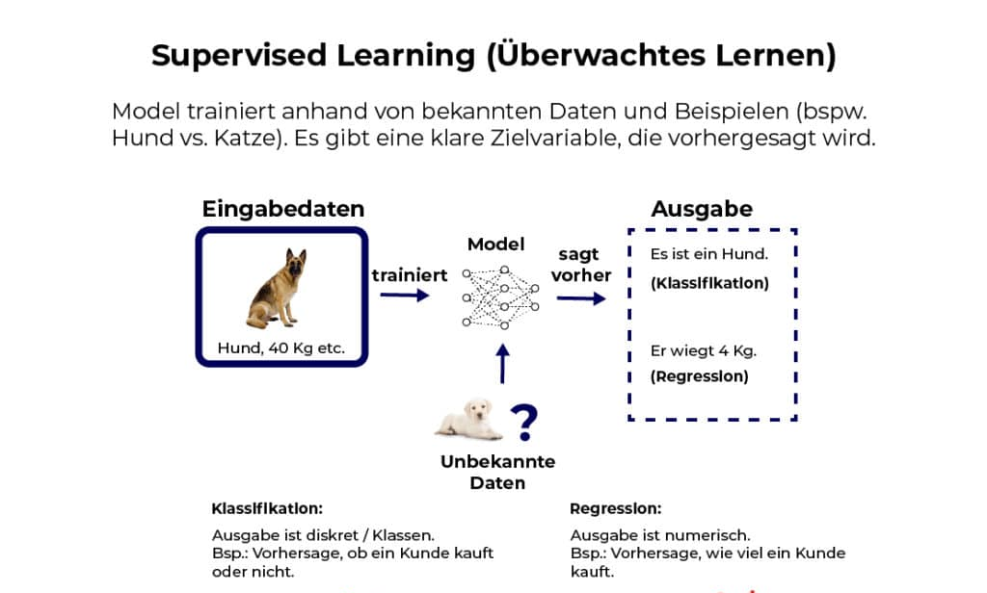
Source: https://datasolut.com/wiki/supervised-learning/

Slide 13
Types of Supervised Learning
Classification
Image Classification
Object Detection
Fraud Detection
Regression
Risk Assessment
Score Predictions

Slide 14

Classification
Klassifizierung ist der Prozess der Vorhersage der Klasse von gegebenen Datenpunkten.
Klassen werden manchmal auch als Labels oder Kategorien bezeichnet.
Image Source: https://towardsdatascience.com/machine-learning-classifiers-a5cc4e1b0623

Slide 15
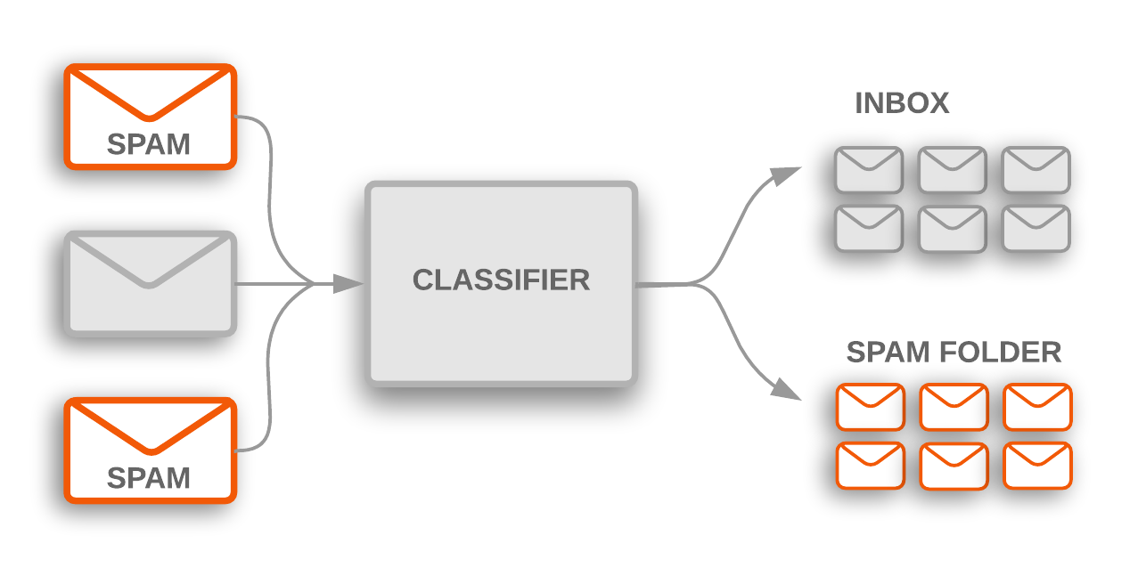
Spam Detection

Slide 16
Classification Types
Lazy Learners
Im Gegensatz zum eager learning findet dabei die Modellbildung nicht während oder nach dem Trainieren statt, sondern erst zur Zeit der Anfrage.
Eager Learners
Im Gegensatz zum lazy learning findet dabei die Modellbildung offline einmalig auf Basis der Trainingsdaten statt, und nicht online zur Zeit der Anfrage
Notes:
The primary motivation for employing lazy learning, as in the K-nearest neighbors algorithm, used by online recommendation systems ("people who viewed/purchased/listened to this movie/item/tune also ...") is that the data set is continuously updated with new entries (e.g., new items for sale at Amazon, new movies to view at Netflix, new clips at YouTube, new music at Spotify or Pandora). Because of the continuous update, the "training data" would be rendered obsolete in a relatively short time especially in areas like books and movies, where new best-sellers or hit movies/music are published/released continuously. Therefore, one cannot really talk of a "training phase". The main advantage gained in employing an eager learning method, such as an artificial neural network, is that the target function will be approximated globally during training, thus requiring much less space than using a lazy learning system. Eager learning systems also deal much better with noise in the training data. Eager learning is an example of offline learning, in which post-training queries to the system have no effect on the system itself, and thus the same query to the system will always produce the same result.

Slide 17
Classification Algorithms
K-Nearest Neighbors
Decision Tree
Support Vector Machines
Naive Bayes
Logistic Regression

Slide 18
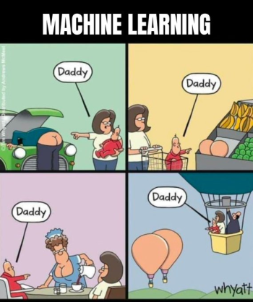
Classification
Image Source: Reddit

Slide 19
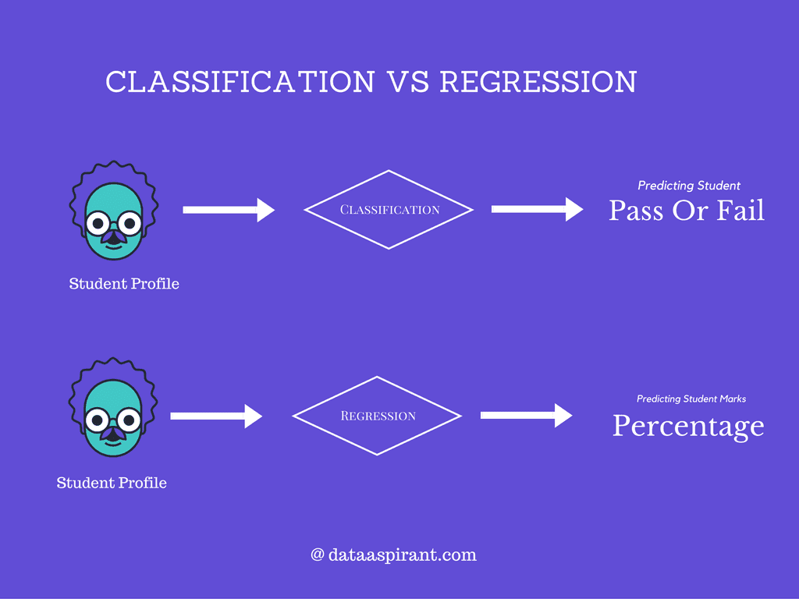
Regression
Image Source: https://builtin.com/data-science/regression-machine-learning
Notes:
Regression analysis is a fundamental concept in the field of machine learning. It falls under supervised learning wherein the algorithm is trained with both input features and output labels. It helps in establishing a relationship among the variables by estimating how one variable affects the other.

Slide 20
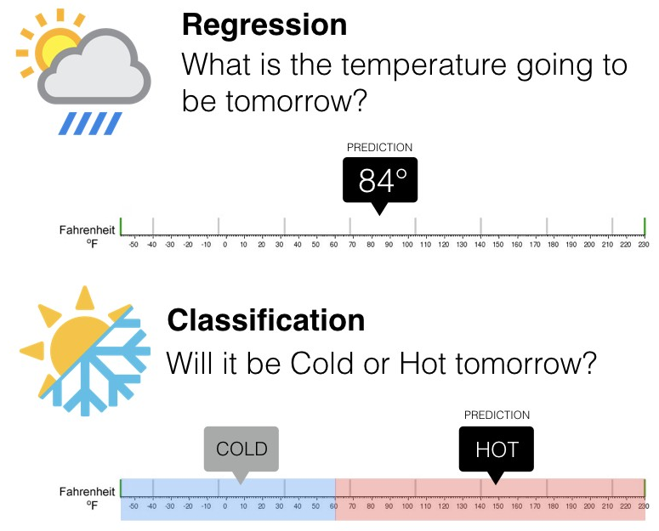
Image Source: https://www.springboard.com/blog/ai-machine-learning/regression-vs-classification/

Slide 21
Regression Algorithms
Linear Regression
Polynomial Regression
Support Vector Machines
Decision Trees
Random Forest
Lasso
Logistic Regression

Slide 22
Unsupervised Learning
Unüberwachtes Lernen (unsupervised learning) bezeichnet maschinelles Lernen ohne im Voraus bekannte Zielwerte sowie ohne Belohnung durch die Umwelt
Die (Lern-)Maschine versucht, in den Eingabedaten Muster zu erkennen, die vom strukturlosen Rauschen abweichen
Notes:
Unsupervised learning is a type of machine learning in which the algorithm is not provided with any pre-assigned labels or scores for the training data.^{[1][2]} As a result, unsupervised learning algorithms must first self-discover any naturally occurring patterns in that training data set.

Slide 23
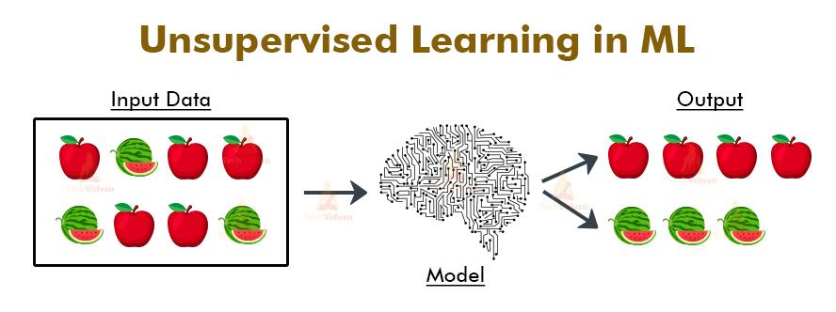
Unsupervised Learning
Wenn maschinelles Lernen ein Kind wäre, das Fahrradfahren lernt, dann wäre überwachtes Lernen ein Elternteil, das hinter dem Fahrrad herläuft und es aufrecht hält. Unüberwachtes Lernen ist, wenn man dem Kind das Fahrrad übergibt, ihm auf den Kopf klopft und "viel Glück" sagt.
Image Source: https://techvidvan.com/tutorials/unsupervised-learning/
Notes:
If machine learning was a child learning to ride a bike, supervised learning is the parent running behind the bike holding it upright. Unsupervised learning is handing over the bike, patting the child on the head, and saying ‘good luck’.
To understand unsupervised learning, we have to understand supervised learning. If a computer was learning to identify fruit in a supervised learning setting, it would be given example images of fruit that were labelled. This is called input data. For instance, the labels would say that bananas are long, curved and yellow, apples are round and red, while an orange is spherical, waxy-looking and orange. After enough time, the machine should be able to confidently identify which fruit is which, based on those descriptors. If presented with an apple, for instance, it would be able to confidently say it’s not orange coloured, therefore it’s not an orange, but also that it’s not yellow and long, therefore it’s not a banana. It’s round and red, so it’s an apple.
In contrast, unsupervised learning is when there is no categorization or labelling of the data at all. The machine will have no idea about the concept of fruit, so it cannot label the objects. However, it can group them together according to their colors, sizes, shapes and differences. The machine groups things together according to similarities, finding hidden structures and patterns in unlabelled data. There is no right or wrong way, and no teacher. There are no outcomes, just a pure analysis of the data.

Slide 24

Unsupervised Learning Algorithms
K-means clustering
Hierarchal clustering
Anomaly Detection
Neural Networks

Slide 25
http://www.r2d3.us/visual-intro-to-machine-learning-part-1/

