Slide 1
SALES DATA
ANALYSIS DASHBOARD
Internship Mini-Project
Python • Pandas • NumPy • Matplotlib • Power BI
Data cleaning → Analysis → Visualization → Business insights
01

Slide 2
Project Overview
From raw sales data to a business-focused dashboard
Analyzed a Superstore sales dataset to understand business performance.
Prepared and validated data using a Python-based workflow.
Compared sales trends across time, regions, categories, and products.
Built a Power BI dashboard to present key metrics in one place.
02

Slide 3
Project Objectives
Questions the analysis aims to answer
01
Prepare data
02
Measure performance
Inspect and clean data before analysis.
Summarize sales, profit, orders, and units.
03
Compare segments
04
Communicate insights
Find leading regions, categories, and products.
Use charts and KPIs to support decisions.
03

Slide 4
Dataset at a Glance
Superstore sales dataset used in the analysis
RECORDS
COLUMNS
CUSTOMERS
PRODUCTS
10,194
21
804
1,862
Key fields
Orders and shipping dates
Customer and geographic details
Product category and sub-category
Sales, quantity, discount, and profit
04

Slide 5
Tools and Technologies
Each tool supports a stage of the workflow
Python
Core scripting and workflow
Pandas / NumPy
Data cleaning and manipulation
Matplotlib
Exploratory charts
Power BI
KPI cards and dashboard visuals
Git / GitHub
Version control and project sharing
05

Slide 6
Methodology
A repeatable data-analysis pipeline
01
02
03
04
05
Inspect
→
Clean
→
Analyze
→
Visualize
→
Interpret
Shape, columns, types, missing values
Text, dates, numeric fields, duplicates
KPIs and segment-level summaries
Python charts and Power BI visuals
Insights, caveats, recommendations
06

Slide 7
Key Performance Indicators
Summary values calculated from the supplied dataset
TOTAL SALES
TOTAL PROFIT
TOTAL ORDERS
$2.33M
$292.30K
5,111
Exact: $2,326,534.35
Exact: $292,296.81
Distinct order IDs
UNITS SOLD
PROFIT MARGIN
38,654
~12.6%
Total quantity
Profit ÷ sales
Also identified 804 customers and 1,862 unique products.
07

Slide 8
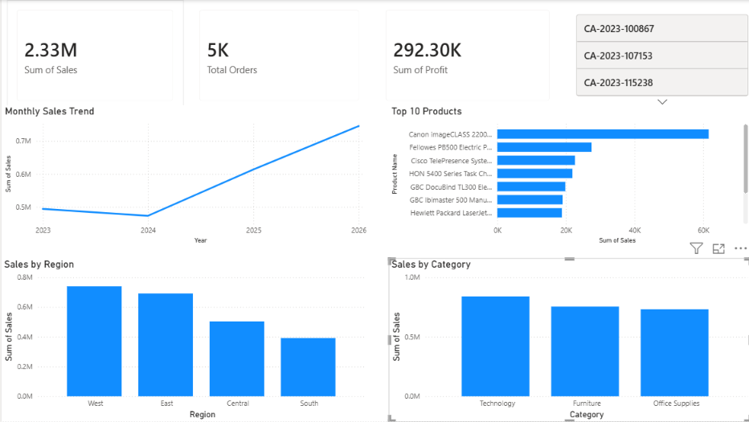
Power BI Dashboard
08

Slide 9
Key Business Insights
Highlights from regional, category, and product analysis
WEST REGION
TECHNOLOGY
$739,813.61
$839,893.28
Highest regional sales in the analysis.
Leading category by sales.
TOP PRODUCT
OVERALL MARGIN
$61,599.82
~12.6%
Canon imageCLASS 2200 Advanced Copier.
Review margin by product and segment.
09

Slide 10
Recommendations and Data Caveat
Use the results to guide follow-up analysis
Investigate the factors behind strong sales in the West and East regions.
Compare profit margins by product and category, not revenue alone.
Use top-product performance to inform inventory and promotion reviews.
Validate records dated after October 13, 2026 before drawing time-based or seasonal conclusions.
Data-quality note: the supplied dataset includes future-dated November and December 2026 entries.
10

Slide 11
Conclusion
What the project demonstrates
Built an end-to-end workflow from data inspection and cleaning to analysis.
Summarized core business KPIs and compared sales performance across segments.
Created visual outputs in Python and a consolidated Power BI dashboard.
The analysis provides a foundation for deeper profitability and trend investigations.
11

Slide 12
THANK YOU
Sales Data Analysis Dashboard
Questions & Discussion
12

