Slide 1

Automated Program Verification
and Synthesis
Cristina David
cristina.david@cs.ox.ac.uk
Lucas Cordeiro
lucas.cordeiro@cs.ox.ac.uk

Slide 2
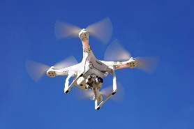
Control Software in Unmanned Aerial Vehicle
Obstacle
4
Obstacle 1
Obstacle
3
Obstacle 2
Goal
What is the shortest trajectory considering the obstacles, dynamics, non-holonomic constraints?
Flight Planning
UAV
Position References
Attitude Digital Controller
Attitude System
Attitude and Position System
Attitude and Position Controllers
u(t)
A/D
r(t)
Angles References

Slide 3
Synthesizing Control Software in UAVs
Input specification
initial example
of a candidate
solution
candidate
solution
Synthesize
Verify
INPUTS
counter-
example
synthesis failed
verification successful

