Slide 1

Automated Program Verification
and Synthesis
Cristina David
cristina.david@cs.ox.ac.uk
Lucas Cordeiro
lucas.cordeiro@cs.ox.ac.uk

Slide 2
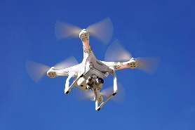
Control Software in Unmanned Aerial Vehicle
Obstacle
4
Obstacle 1
Obstacle
3
Obstacle 2
Goal
What is the shortest trajectory considering the obstacles, dynamics, non-holonomic constraints?
Flight Planning
UAV
Position References
Attitude Digital Controller
Attitude System
Attitude and Position System
Attitude and Position Controllers
u(t)
A/D
r(t)
Angles References

Slide 3




Synthesizing Control Software in UAVs
CEGIS automates the design of digital controllers that are correct-by-construction
$$\left(1\right) C\left(z\right)=\frac{0.026}{z+1.002}$$
Input specification
$$\left(2\right)C\left(z\right)=\frac{12.402z^{2}−11.439z+0.596}{4.003z^{2}−0.287z+0.015}$$
$$C\left(z\right)=\frac{a_{2}z^{2}+a_{1}z+a_{0}}{b_{2}z^{2}+b_{1}z+b_{0}}$$
$$\left(3\right)C\left(z\right)=\frac{11.305z^{2}+5.864z+4.901}{1.097z^{2}+0.063z+0.128}$$
initial example
of a candidate
solution
candidate
solution
Synthesize
Verify
INPUTS
finite-precision arithmetic and related rounding errors
counter-
example
synthesis failed
verification successful

