Slide 1
Exercise 1: Information Coding & Data Structures
Exercise 1 for the lecture ‘Foundations of Data Science’
Prof. Dr. Karsten Donnay, Assistant: Philipp Kling
15.6.2020
Foundations of Data Science, Exercise 1
Page <number>

Slide 2
This session covers
General data science process
Introduction to git
Introduction to our working case
Data import in R
15.6.2020
Foundations of Data Science, Exercise 1
Page <number>

Slide 3
Data science process

Slide 4
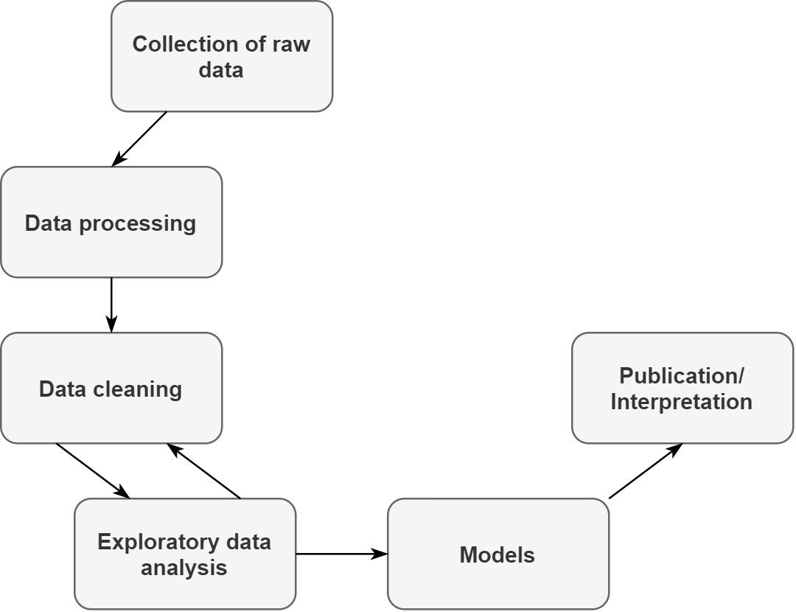
Data science process
“Make sense of new and/or large data and communicate insight”
Access innovative and large data resources.
Process data to make it machine readable.
Use statistical methods or machine learning to detect structure in the data.
Provide meaningful insights.
15.6.2020
Foundations of Data Science, Exercise 1
Page <number>

Slide 5
Data science process
What is good science?
peer review, transparency and replicability (Apart from other criteria)
Karl Popper (1934): “non-reproducible single occurrences are of no significance to science”.
Emphasizes the need for publication of employed methods, documentation of the data collection and cleaning process, and the provision of datasets.
15.6.2020
Foundations of Data Science, Exercise 1
Page <number>

Slide 6
Data science process
Why is reproducibility in data science difficult?
Available resources (e.g. computing power, storage)
Data on the Internet often in flux (e.g. websites change, Tweets get deleted…)
Permission to use data (e.g. Facebook data)
Git is one way to improve on one part of the reproducibility crisis: make method transparent and easily accessible.
15.6.2020
Foundations of Data Science, Exercise 1
Page <number>

Slide 7
Introduction to git

Slide 8

Git (Version control)
The ‘Dropbox’ for programming
Documents the different stages (versions) of files
Makes it easy to track changes and restore previous versions.
Enables controlled collaborations with others
Eases the publication of work and increases transparency
15.6.2020
Foundations of Data Science, Exercise 1
Page <number>

Slide 9
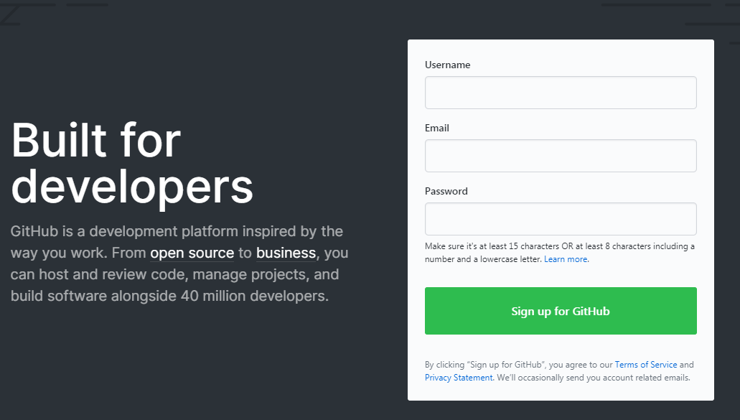
Popular platform: Github (alternatively: bitbucket)
Go to https://github.com/
Select your role (student) and the purpose of usage and confirm the email.
Create your first repository
e.g. github.com/philippklinguzh/datascience
Download and install git
Use notepad++ to edit (https://notepad-plus-plus.org/downloads)
Enable 3rd party software
OpenSSL library
Checkout Windows-style
Use MinTTY
Enable file system caching and enable Git credential manager
15.6.2020
Foundations of Data Science, Exercise 1
Page <number>

Slide 10
Version control with git
Two possibilities:
download existing data from a repository
Initialize repository from data from your computer
Let’s add some data to your repository
Create a folder where you want to have your repository saved (C:\Philipp\Documents\git)
Open git bash/console
Navigate to the folder
cd C:/Philipp/Documents/git
(make sure to change the \ to /)
15.6.2020
Foundations of Data Science, Exercise 1
Page <number>

Slide 11
Version control with git
git clone https://github.com/username/name_of_repository.git
Create a file in a folder of your choice (test.txt)
Store your account information
git config –-global user.email “YOUR GITHUB EMAIL”
git config –-global user.name “YOUR GITHUB NAME”
Check the status of all files in this repository
git status
Add the file to the current list of files to be committed and check status again
git add test.txt
git status
15.6.2020
Foundations of Data Science, Exercise 1
Page <number>

Slide 12
Version control with git
Commit your changes and add a message/description to the commit
git commit -m "Initial upload"
Upload (“push”) your local changes to the repository
git push
Inspect your changes by visiting your repository in the web browser
Open your test.txt file and insert some text, then save it
Check the status of all files in this repository again. You should see now that test.txt has changed.
Repeat the previous steps
git add test.txt
git commit –m “Added some text to the test.txt”
git push
15.6.2020
Foundations of Data Science, Exercise 1
Page <number>

Slide 13
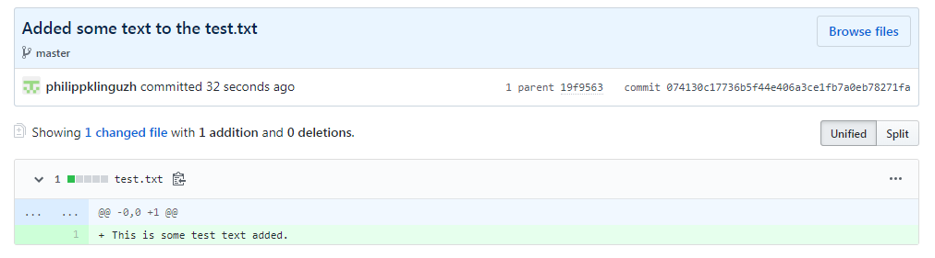
Version control with git
15.6.2020
Foundations of Data Science, Exercise 1
Page <number>

Slide 14
Version control with GitHub
You can apply for educational discount (GitHub Pro for free):
https://education.github.com/
15.6.2020
Foundations of Data Science, Exercise 1
Page <number>

Slide 15
Introduction to our working case

Slide 16
Introduction to our working case
While we talk about the case, you may already install the required packages for today’s exercise.
git clone https://github.com/css-zurich/fds-2020-exercise.git
15.6.2020
Foundations of Data Science, Exercise 1
Page <number>

Slide 17


Introduction to our working case
Hypothetical use case: How do characteristics of news articles relate to reactions on social media?
Our two examples: The Guardian for news and Twitter for social media data
15.6.2020
Foundations of Data Science, Exercise 1
Page <number>

Slide 18
Introduction to our working case
Goal: combine news data with social media data
There are already established packages in R that retrieve data from these platforms. However, we will use these platforms to build some applications from scratch and demonstrate core concepts of data science using R.
Keep in mind: before starting to build your own application, do some research on existing work. Often there are already established ways that work efficiently.
After the five exercises you will be able to…
…manage and process data efficiently.
…manipulate text into formats that you can work with.
…read data from websites into R.
…retrieve data from application programming interfaces (APIs)
15.6.2020
Foundations of Data Science, Exercise 1
Page <number>

Slide 19
Introduction to our working case
Why use the Internet to collect data?
Has a plethora of useful data sources:
Government publishes data (e.g. speeches, voting…)
Social media data to analyze human communication
News data for public discourse and attention to events
User interactions with e.g. products (Amazon reviews), Films (IMDB)…
Why is this relevant?
Re-evaluation of existing research with new data
Enables entirely new research questions
Cost and time efficient
Theoretically easily reproducible
15.6.2020
Foundations of Data Science, Exercise 1
Page <number>

Slide 20
Introduction to our working case
Why use the R?
Free and open source
Excels in data visualization and application of statistical methods
Also: can be used to collect data on the Internet
Beginner friendly for people with no programming background
Can be used at every stage of our workflow (no need to switch programs)!
15.6.2020
Foundations of Data Science, Exercise 1
Page <number>

Slide 21
Data import in R

Slide 22
Data import in R
You can save R objects (e.g. a dataframe) in in .Rda-files
You use “load()” to import an .Rda file into R.
Most datasets will not be prepared for R (e.g. .csv-files, Excel files, etc.) and we will learn in the next exercise more about the ways to recognize data formats and how to import them.
15.6.2020
Foundations of Data Science, Exercise 1
Page <number>

Slide 23
Outlook
There are many packages suitable to load specific types of data into R:
jsonlite: for JSON data
xml2: for XML data
readr: for Text data
haven: for SPSS, SAS, Stata files
readxl: for Microsoft excel files (.xls or .xlsx)
DBI: for connections to data bases
httr: to retrieve data from APIs
rvest: to retrieve data from websites/html
15.6.2020
Foundations of Data Science, Exercise 1
Page <number>

