Slide 1
UK Gender Pay
Gap
By Polianna Moraes

Slide 2
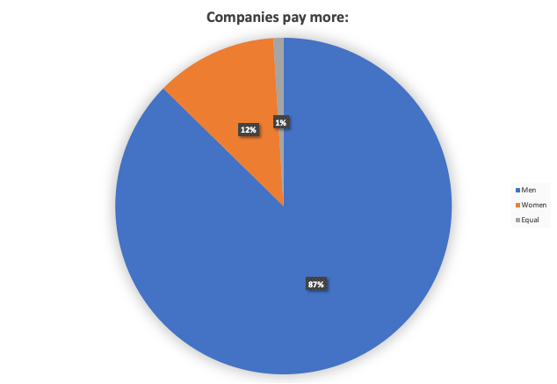
From the 1074 companies, 8885 pay more to men (87%)
and just 99 (1%) pay equally

Slide 3
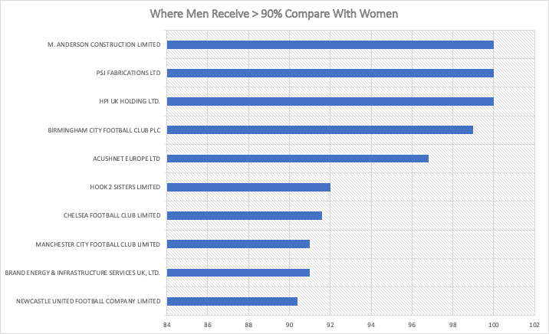
40% companies are Football Clubs

Slide 4
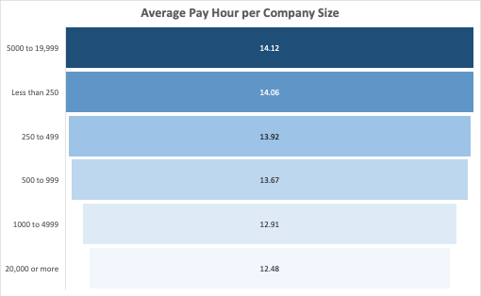
Some hypotheses, like company size, didn't affect the average pay per hour

Slide 5
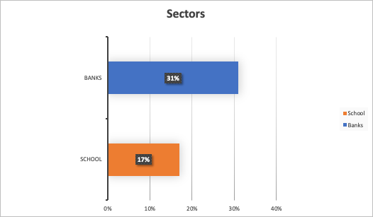
We can see the difference in sector that is predominant male (bank) versus female (school)

Slide 6
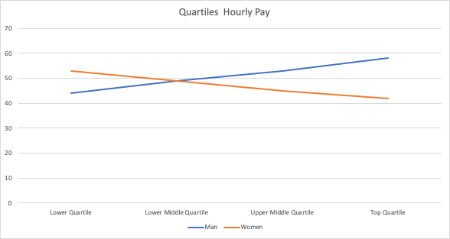
There were more women receiving in the lowest quartile and more men receiving in the top quartile

Slide 7
Considerations
The dataset could have more meaning information instead calculations, like sectors, city and the mean salarial for company (women receiving 184% more than man in some companies is not necessarily being well pay compare with the men that receive 100% in the other edge).
The data is submitted by company and they can post wrong data and it is not revised, making unclear for, example, some zero values.
Some assumptions, like Region (London or outside) and Company Size didn't could be proved because is not affecting the average paid hourly.
Making the steps clear (using visual guide, video explaining how to calculate each values, instead text) can help companies improve they data and give more accuracy.
We didn't use the quartiles reference, but when we look at the average per quartile, distributed by gender, we can see that the women receive better on lower quartile but decrease the pay when goes to the top quartile (where is the highest average pay) as show the line trend on last slide.

