Slide 1

Airline Passenger Satisfaction
Poli Ghosh

Slide 2
Outline (ML flow)
Future plan
Business problem
Tune Model
Problem formulation
Yes
Meets business goal?
Collect and label data
EDA
Feature engineering
Select and train model
Evaluate
No
Feature augmentation

Slide 3


Business Problem
Airline revenue depends heavily on frequent passengers. For the airline companies, it has become increasingly difficult to retain loyal passengers.
An airline company wants to identify the customer satisfaction level based on their rating on various aspects of airline experience so that it can try to improve the satisfaction level of a passenger to retain him for long term retention.
Problem Statement
“To develop a classification model
to identify the satisfaction level of a passenger”

Slide 4
Data Collection & Labeling
Customer satisfaction scores are obtained from ~130,000 airline passengers, including additional information about each passenger, their flight, and type of travel, as well as their evaluation of different factors like cleanliness, comfort, service, and overall experience.
The data is obtained from mavenanalytics.io which represents airline satisfaction data consisting of 129,880 observations and 24 attributes.
The attribute ‘satisfaction’ which is our dependent variable represents the overall satisfaction level with the airline with value Satisfied / Neutral or unsatisfied.

Slide 5
Field | Description
ID | Unique passenger identifier
Gender | Gender of the passenger (Female/Male)
Age | Age of the passenger
Customer Type | Type of airline customer (First-time/Returning)
Type of Travel | Purpose of the flight (Business/Personal)
Class | Travel class in the airplane for the passenger seat
Flight Distance | Flight distance in miles
Departure Delay | Flight departure delay in minutes
Arrival Delay | Flight arrival delay in minutes
Departure and Arrival Time Convenience | Satisfaction level with the convenience of the flight departure and arrival times from 1 (lowest) to 5 (highest) - 0 means "not applicable"
Ease of Online Booking | Satisfaction level with the online booking experience from 1 (lowest) to 5 (highest) - 0 means "not applicable"
Check-in Service | Satisfaction level with the check-in service from 1 (lowest) to 5 (highest) - 0 means "not applicable"
Online Boarding | Satisfaction level with the online boarding experience from 1 (lowest) to 5 (highest) - 0 means "not applicable"
Gate Location | Satisfaction level with the gate location in the airport from 1 (lowest) to 5 (highest) - 0 means "not applicable"
On-board Service | Satisfaction level with the on-boarding service in the airport from 1 (lowest) to 5 (highest) - 0 means "not applicable"
Seat Comfort | Satisfaction level with the comfort of the airplane seat from 1 (lowest) to 5 (highest) - 0 means "not applicable"
Leg Room Service | Satisfaction level with the leg room of the airplane seat from 1 (lowest) to 5 (highest) - 0 means "not applicable"
Cleanliness | Satisfaction level with the cleanliness of the airplane from 1 (lowest) to 5 (highest) - 0 means "not applicable"
Food and Drink | Satisfaction level with the food and drinks on the airplane from 1 (lowest) to 5 (highest) - 0 means "not applicable"
In-flight Service | Satisfaction level with the in-flight service from 1 (lowest) to 5 (highest) - 0 means "not applicable"
In-flight Wifi Service | Satisfaction level with the in-flight Wifi service from 1 (lowest) to 5 (highest) - 0 means "not applicable"
In-flight Entertainment | Satisfaction level with the in-flight entertainment from 1 (lowest) to 5 (highest) - 0 means "not applicable"
Baggage Handling | Satisfaction level with the baggage handling from the airline from 1 (lowest) to 5 (highest) - 0 means "not applicable"
Satisfaction | Overall satisfaction level with the airline (Satisfied/Neutral or unsatisfied)

Slide 6
Data processing
Duplicate instances: No duplicate instances of observations has been found in the data.
Missing Values: Observed that the variable "Arrival Delay" has missing values. To mitigate the missing values (NA’s) we imputed the missing value with the mean of the variable. (mean ~ median in this case.)

Slide 7
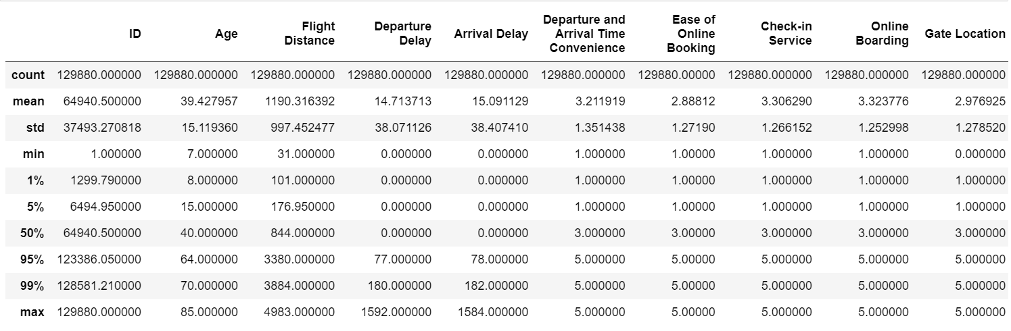
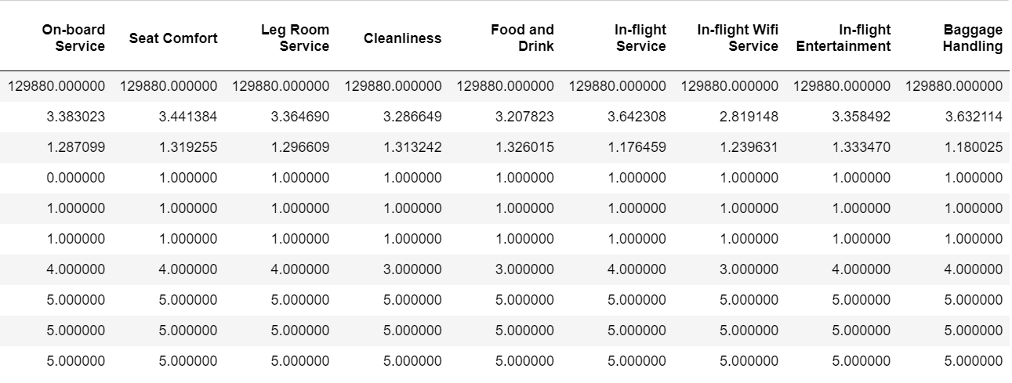
EDA: Summary Statistics

Slide 8
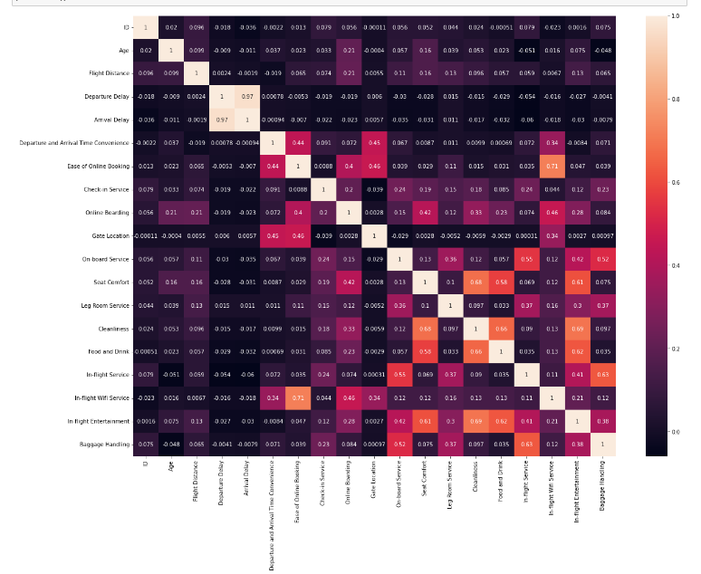
Data Visualization
Heat Map
Heat Maps are ideal to understand the correlation between variables.

Slide 9
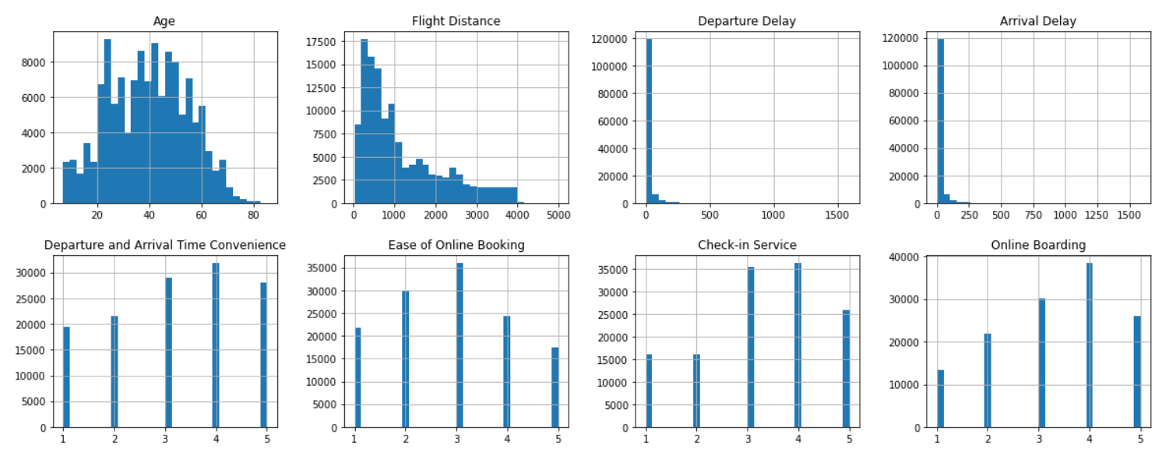
Data Visualization cont’d

Slide 10
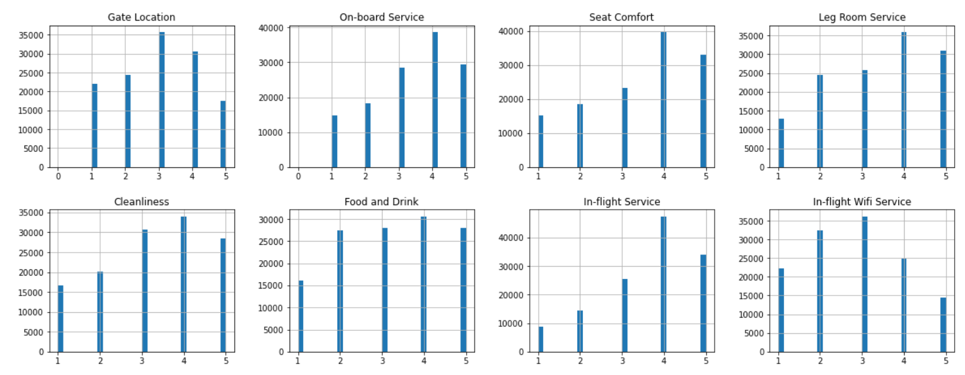
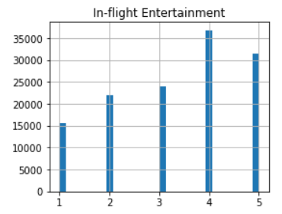
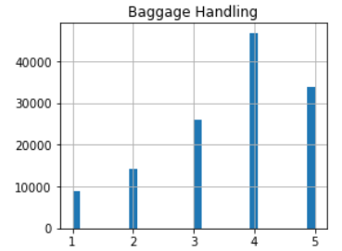

Slide 11
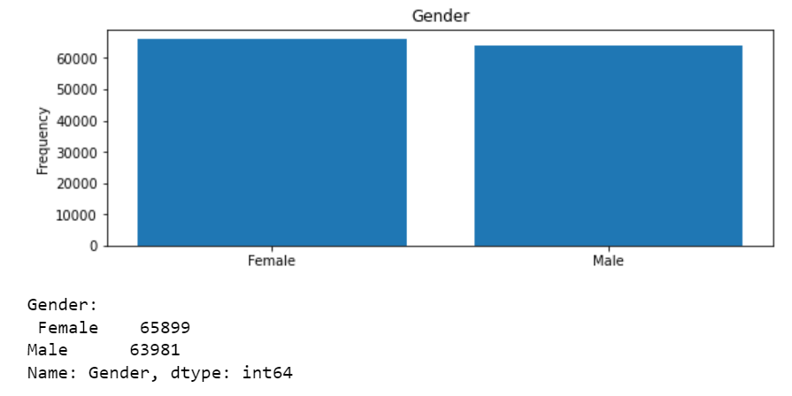
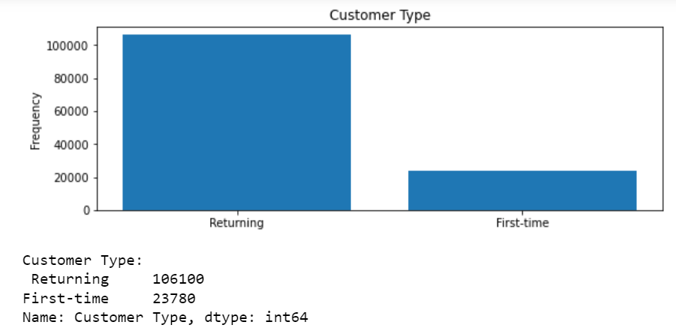
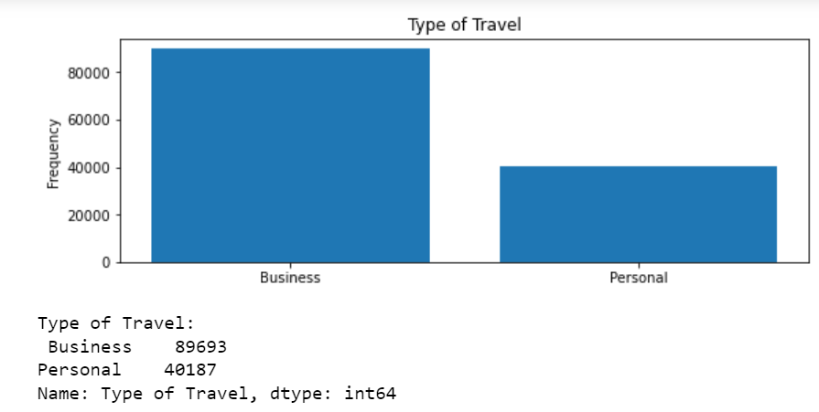
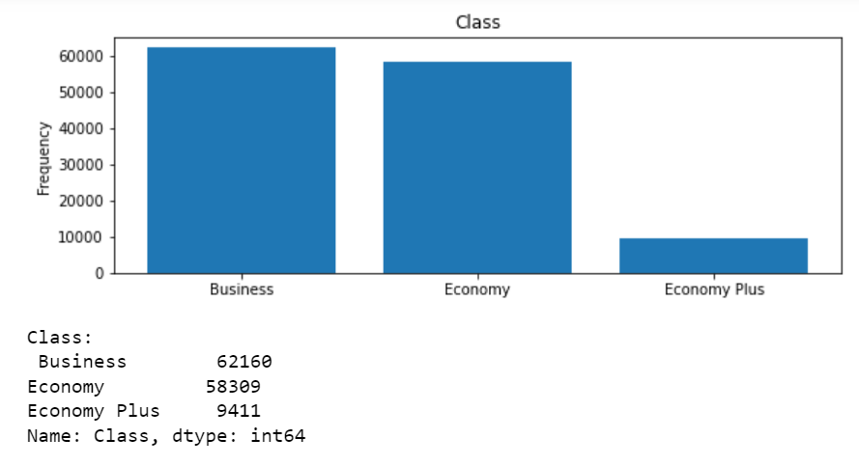

Slide 12
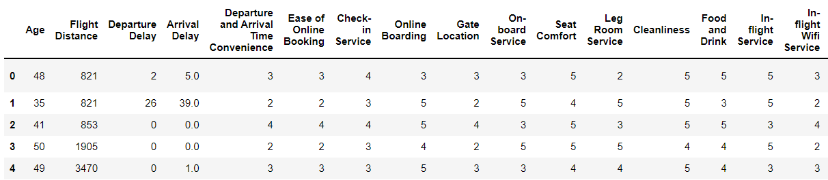
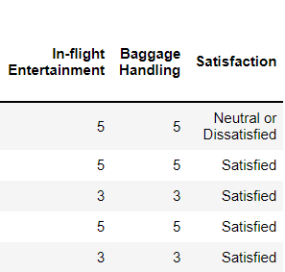
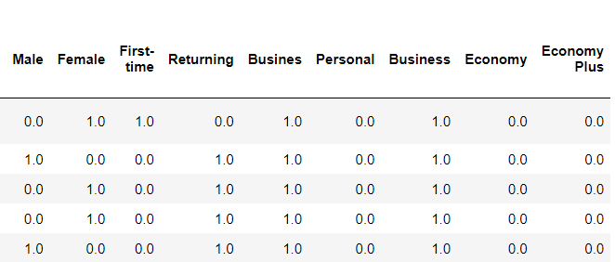
Feature Engineering
One Hot Encoding

Slide 13
Data Modelling
We build models to predict the satisfaction level of the customer based on the independent variable of our dataset. This will help the airline company to understand the satisfaction level of its customers and hence take necessary actions, in order to improve customer satisfaction.
Here we build 4 models to predict the satisfaction level, namely
Logistic Regression
Decision Tree
Ensemble Method
Random Forest

Slide 14
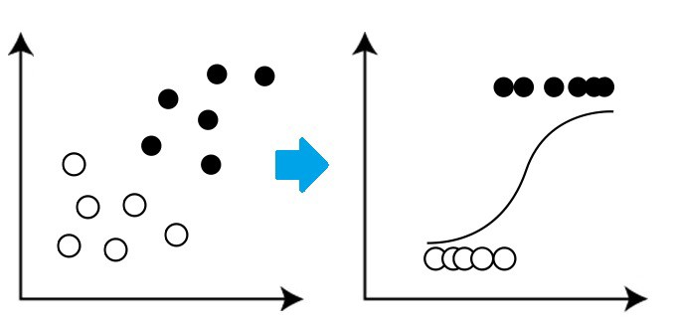
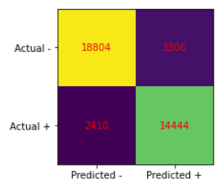
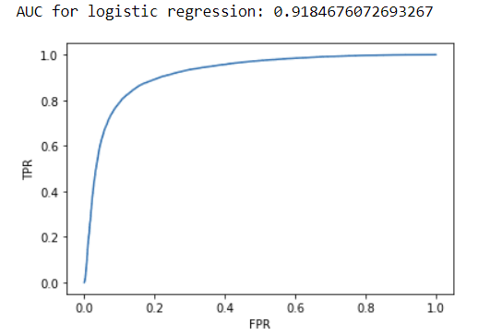
Logistic Regression
Confusion Matrix
1) Test Accuracy = 0.8533004824966636
2) Train Accuracy = 0.854426063619165
3) Precision Score = 0.8137464788732395
4) Recall score: 0.8570072386377121
5) Accuracy score: 0.8533004824966636
6) F1 score: 0.8348167841867993

Slide 15
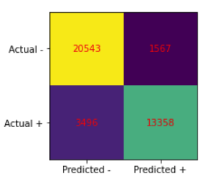
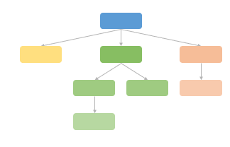
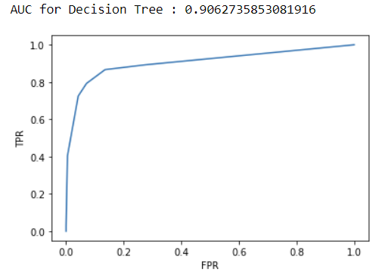
Decision Tree
Test Accuracy = 0.9281387947849297
Train Accuracy = 1.0
Addressed Overfitting by using
Grid search Cross Validation method.
1) Test Accuracy = 0.870059542141464
2) Train Accuracy = 0.8714197720973206
3) Precision Score = 0.8950083752093803
4) Recall score: 0.7925714963806811
5) Accuracy score: 0.870059542141464
6) F1 score: 0.8406809528304856
Confusion Matrix

Slide 16
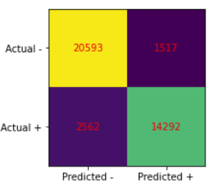
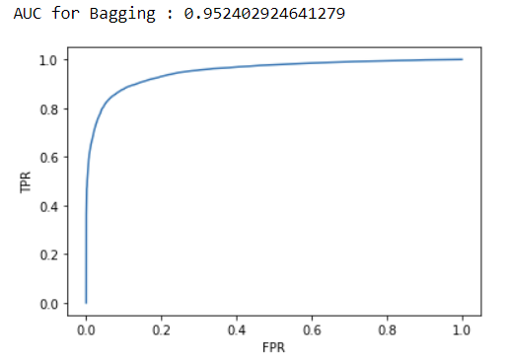
Ensemble Method (Decision Tree with Bagging)
1) Test Accuracy = 0.8953136228313315
2) Train Accuracy = 0.8967838444278234
3) Precision Score = 0.9040420013916124
4) Recall score: 0.8479886080455679
5) Accuracy score: 0.8953136228313315
6) F1 score: 0.875118635765239

Slide 17
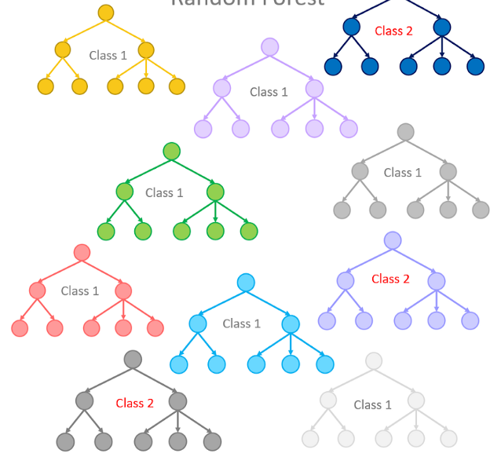
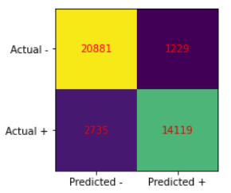
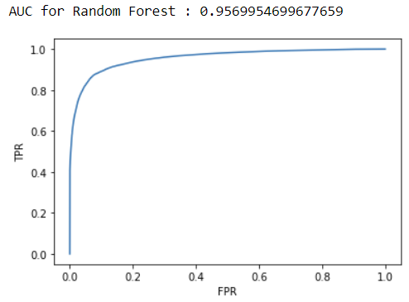
Random Forest
1) Test Accuracy = 0.898265065188379
2) Train Accuracy = 0.8991266663733556
3) Precision Score = 0.9199244201198853
4) Recall score: 0.8377239824374035
5) Accuracy score: 0.898265065188379
6) F1 score: 0.8769020557729332
7) AUC score: 0.9569954699677659

Slide 18
Model Evaluation
Based on AUC-ROC and Accuracy, we chose Random Forest model.

Slide 19
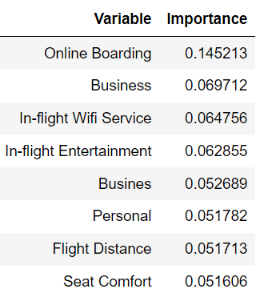
Conclusion & Future plan
Based on the Random Forest model, these are the top ten variables of importance.
By focusing on these variables, and taking appropriate measures, the airline may enhance customer satisfaction and there by retain repetitive passengers!

Slide 20

Thank you!

