Slide 1
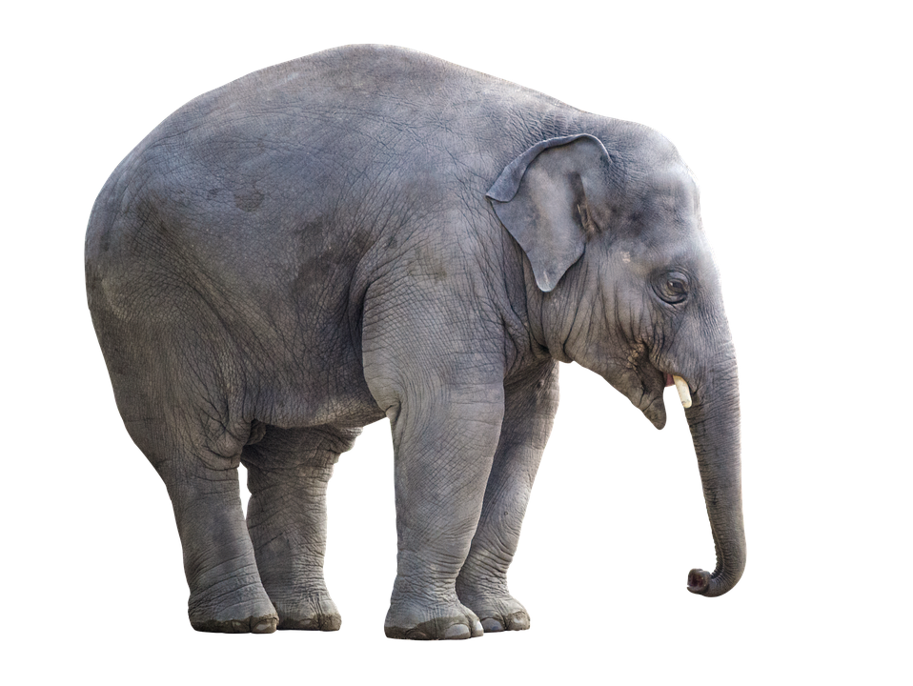
DISCOVERY
INDIA
INDIA

