Slide 1

Generative Audio via Interaction with Ambient
CMLS Final Project 2024/25

Slide 2





What is GAIA?
GAIA (Generative Audio via Interaction with Ambient) is an ambient generative system that transforms real-time enviromental conditions and user interaction into immersive audiovisual experience.

Slide 3




What is GAIA?
It captures ambient data – temperature, light and humidity – using Arduino-based sensors.

Slide 4

What is GAIA?
It converts them with algorithmic composition to produce evolving, meditative ambient music, visually enhanced by a responsive particle system.

Slide 5
Projectual philosophy
‘’Wow, se metto la mano sul sensore le palline cambiano.’’
– Andrea Crisafulli, has problems keeping up his focus. –
‘’Ho provato con VCable, Jack e ReaRouter, ma non funziona niente.’’
– Giacomo De Toni, lost his faith in audio softwares. –
‘’Ma non possiamo mandare tutto tramite OSC?’’
– Filippo Longhi, still does not know how OSC works. –
‘’Ragazzi, ho fixato e pushato tutto JUCE.’’
– Marco Porcella, he didn’t fix anything. –

Slide 6








Workflow
OSC
OSC

Slide 7
Arduino
Data collection – OSC protocol transmission

Slide 8




Data collection
Arduino reads temperature and humidity (DHT22) and ambient light (LDR).

Slide 9



Musical Timing
Arduino generates musical rhythm impulses: steady pulses define the bar, while random accents create spontaneous melodic gestures.

Slide 10

Data transmission
Sensor and timing data are formatted and transmitted via Open Sound Control (OSC) over Wi-Fi to SuperCollider and Processing.

Slide 11
SuperCollider
Sound generation

Slide 12




Variables initialization
SuperCollider first needs to set the audio engine, the OSC ports, and the global parameters.

Slide 13


Data reception
In order to work, it listens for incoming values from Arduino. It continuously receives: temperature, humidity, light and timing cues.

Slide 14

Synth definition
It defines a SynthDef that merges bass, chords, and melody each shaped by light, humidity, and temperature to form a living, ambient texture.

Slide 15

Alternative execution
GAIA can also run in a simulation mode: random data replaces real sensor input.

Slide 16
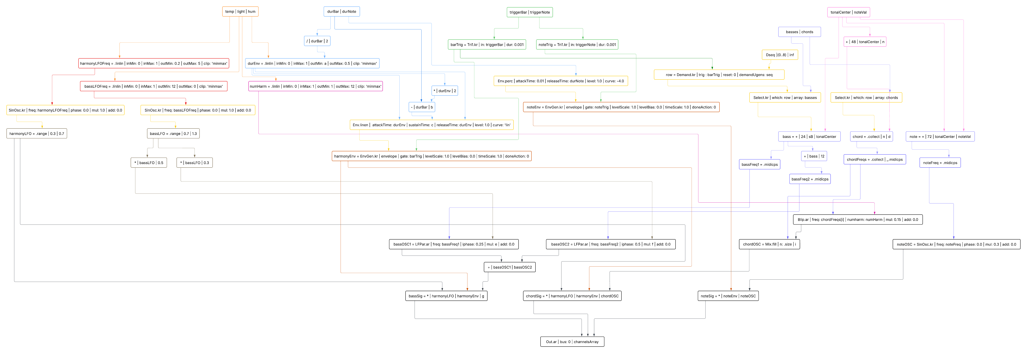
UGen graphs

Slide 17
Reaper
DAW

Slide 18



Input signal format
Reaper receives three stereo audio signals from SuperCollider: bass, chords, and notes. Each is routed to a separate track for dedicated processing.

Slide 19


Plugin execution
Each JUCE plugin lets the user shape the sound with distortion, delay, and reverb, all adjustable in real time through a simple interface.

Slide 20

Output
The three processed signals are mixed in Reaper’s master track.

Slide 21
JUCE
User interaction – Signal manipulation

Slide 22



Input signal reception
The JUCE plugin receives the stereo signal.

Slide 23

User interaction via GUI
The user interacts with a GUI with different handles.
Each of them allows to vary a parameter of a specific effect.

Slide 24

Signal manipulation: Reverb
Reverb is implemented with the integrated JUCE class. Users can control various parameters shaping how “distant” or “surrounding” the sound feels.

Slide 25
Signal manipulation: Distortion
Distortion multiplies and clips the signal, adding harmonic richness and texture. A drive control sets the saturation, with a dry/wet blend to keep it smooth or aggressive.

Slide 26
Signal manipulation: Delay
The delay effect creates echo-like repetitions, adding rhythm and depth to the sound. Users can adjust the delay time and balance between original and repeated signals.

Slide 27
Processing
Visual generation

Slide 28


OSC receiver
As Supercollider also Processing receives real-time data from Arduino via OSC.

Slide 29

Particle system
The particle system translates sensor values into motion and color. Light affects hue, humidity controls density, and temperature influences movement and speed.

Slide 30
Thanks for your attention
Andrea Crisafulli, Giacomo De Toni, Filippo Longhi, Marco Porcella

Slide 31

Live Demo
Let’s hope everything works

