Slide 1

BIAGIO NELLO SPAZIO SOGADADO Space Flanger
Flanger floating in space made by the following group of space travelers:
Sebastian Gafencu
Olivia Basedova
Giorgio Magliocco
Arthur Soltanpourkhazaei
DADO Barbieri

Slide 2



General idea
We have decided to implement a flanger plugin and to connect its parameters to the fate and the emotional state of our friend Biagio, floating alone in the vasteness of the interstellar space.

Slide 3

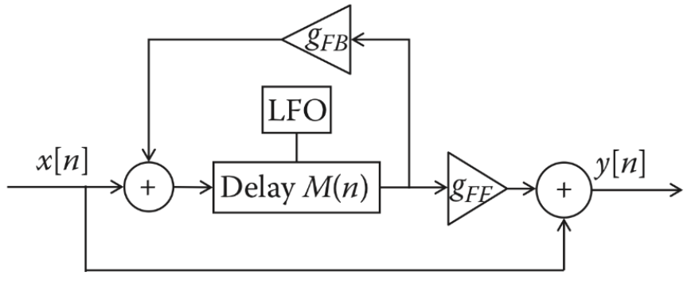
FLANGER EFFECT

Slide 4
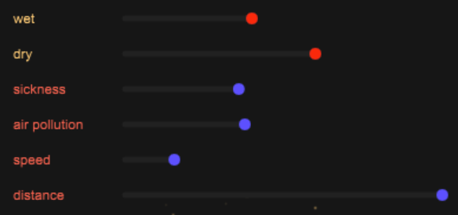
Parameters
In the flanger we have created, the typical implemented parameters have been renamed partially for artistical purposes and are listed below:
-Dry (amout of original signal in the output)
-Wet (amount of processed signal in the output)
-Sickness (the amount of delay)
-Air Pollution (feedback gain)
-Speed (the frequency of the LFO)
-Distance (the amplitude of the LFO)

Slide 5






GUI
Class used for the graphic interface:
-juce::Label
-juce::Slider
-juce::Slider::Listener
-juce::Image
-juce::imageCache

Slide 6
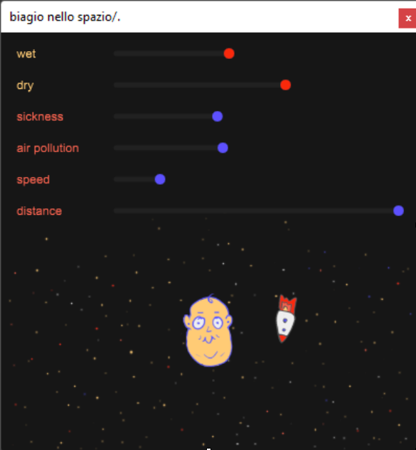

The animated graphic part with Biagio and his spaceship has been implemented by drawing the background, the character, and the ship on an external graphics editor. The images have been introduced in the cache in Projucer and loaded in the code through the class juce::imageCache.

Slide 7
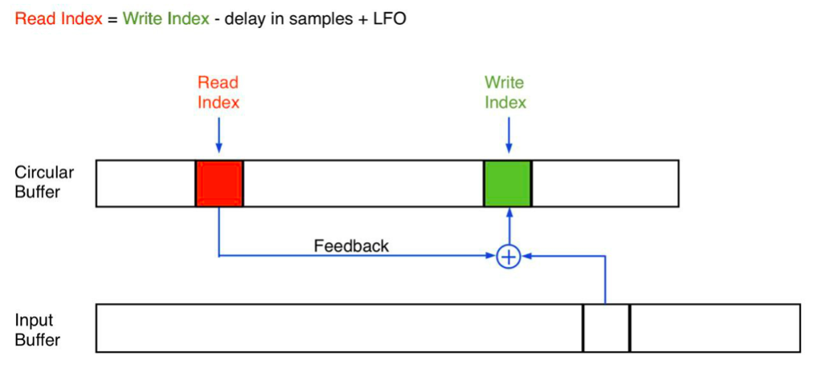
Processor

Slide 8
The future of Biagio:
LONELINESS: Biagio is single – find him a companion to implement stereo flanging
POVERTY: Biagio is unemployed – widen the range of the parameters to get also delay and chorus effects for the price of one plugin.
MONOTONY: Biagio has a repetitive life – new waveforms for the LFO, also would be interesting to have continuous noise generator (to model the iconic finger-on-tape flanging).

Slide 9
Demo Video

