Slide 1
SOGADADO PRESENTS The Multi-sound synthesizer
Designed and created as a response to HW1, by:
Sebastian Gafencu
Olivia Besedova
Giorgio Magliocco
Arthur Soltanpourkhazaei
DADO Barbieri

Slide 2
Components
This application was developed using supercollider and is comprised of 3 parts:
1. The sound design part
2. The Interface
3. The Midi Connections.

Slide 3
Sound Design
This part includes 6 type of sounds each using different methods of synthesis
1. Ditzy
2. Yogababa
3. Stupidbass
4. Sogarmonies
5. Velocityequalsoctave
6. Bolzen

Slide 4
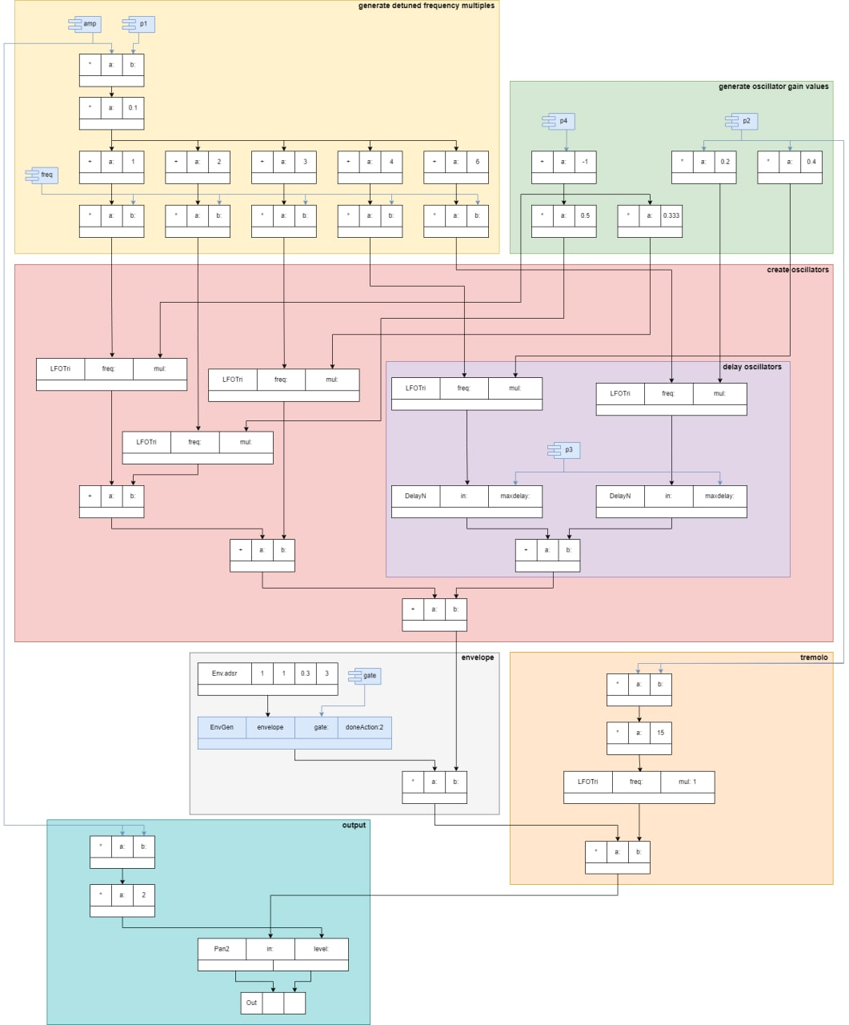

Slide 5
Interface
The interface was developed was developed using standard SuperCollider GUI library.
It consists of:
1. Title
2. Two drop boxes
3. Four knobs

Slide 6
Midi Connect
Since this application can utilize both a real or virtual Midi Keyboard, inevitably it needed a section defining the protocol it uses to connect those devices to our application.

Slide 7
Demo Video
Click To Play

