Slide 1

Titolo presentazione sottotitolo
Interaction Design: NOTANHARP
Computer Music Languages and Systems
Milano, XX mese 20XX
Group ID: NaN

Slide 2
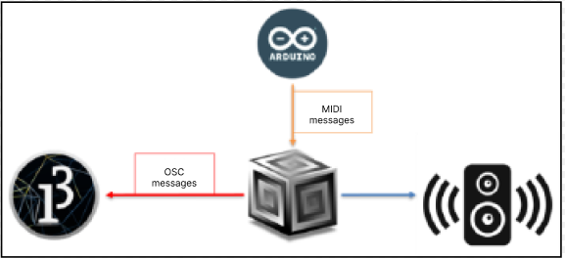
Objectives and Approach
Designing a complete music system capable of capturing gestural information.
Developing a computer music unit for emulating the harp sound with responsive features to MIDI messages.
Structuring a visual interface, resembling the strings of a harp.

Slide 3
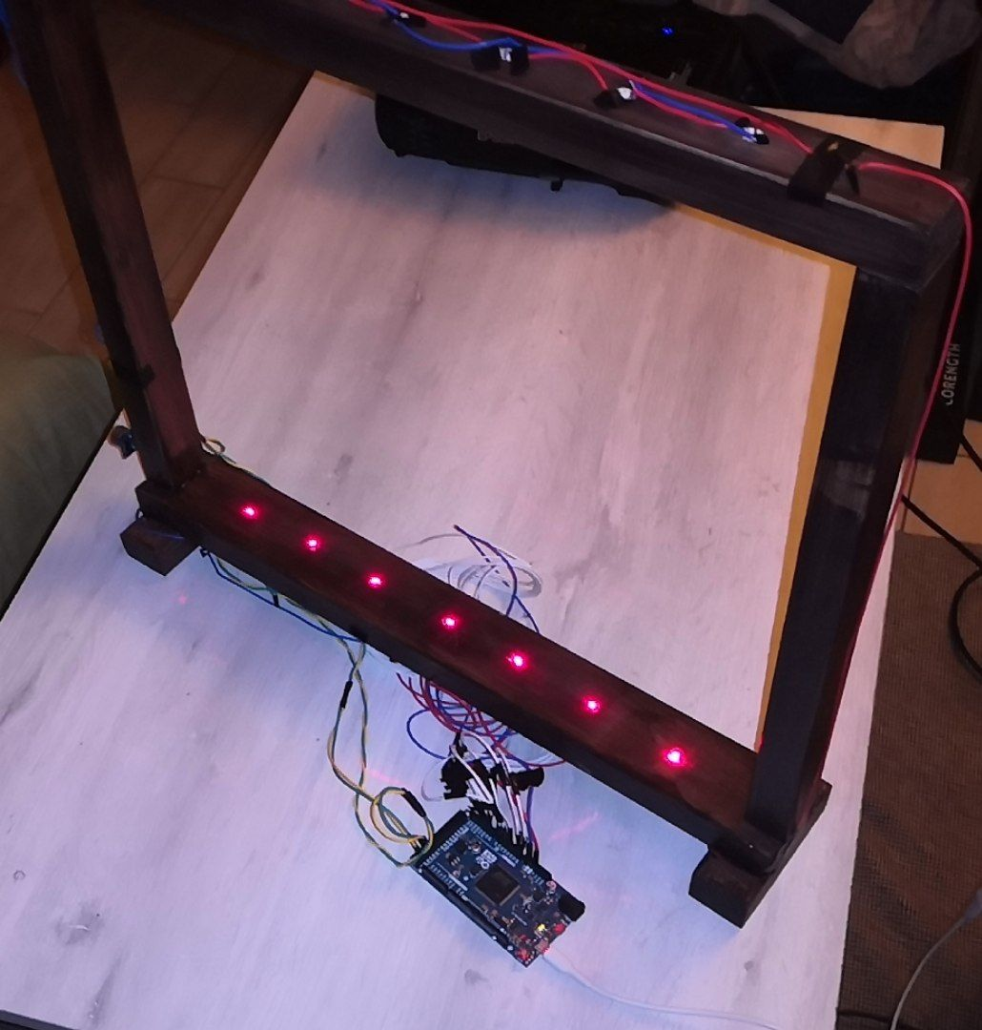
Arduino
Notes triggered by a voltage drop on the photoresistor when the laser beam is interrupted.
The two proximity sensors modulate pitch and tremolo respectively, based on the distance of the hand.
All messages sent by Arduino use MIDI protocol, based on the MIDI-USB library.

Slide 4
SuperCollider
The synthesized sound emulates that of a plucked harp.
MIDI messages are interpreted using a MIDI-def.
NoteOn/Off
Frequency
Pitch Bend
Frequency ratio
Synth
Control Change
Frequency LFO

Slide 5
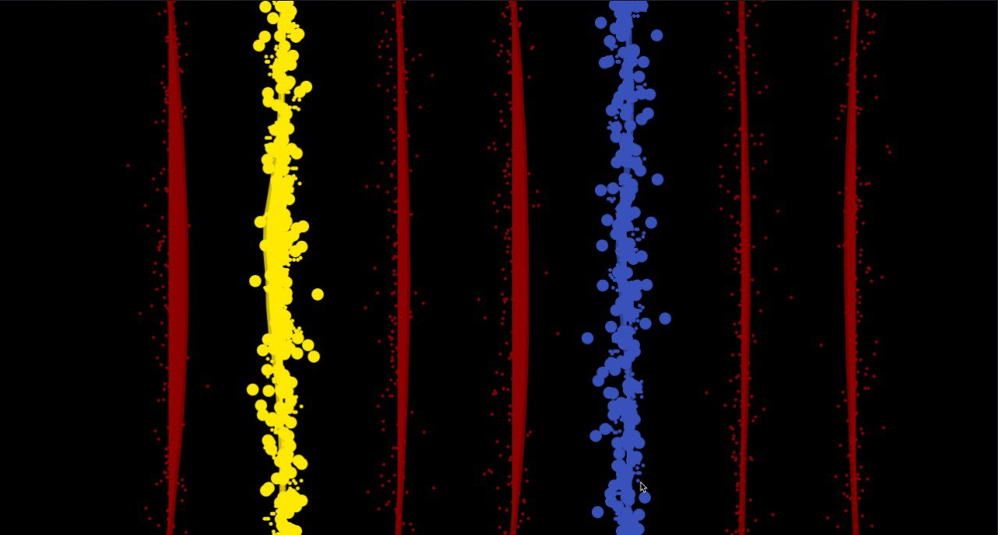
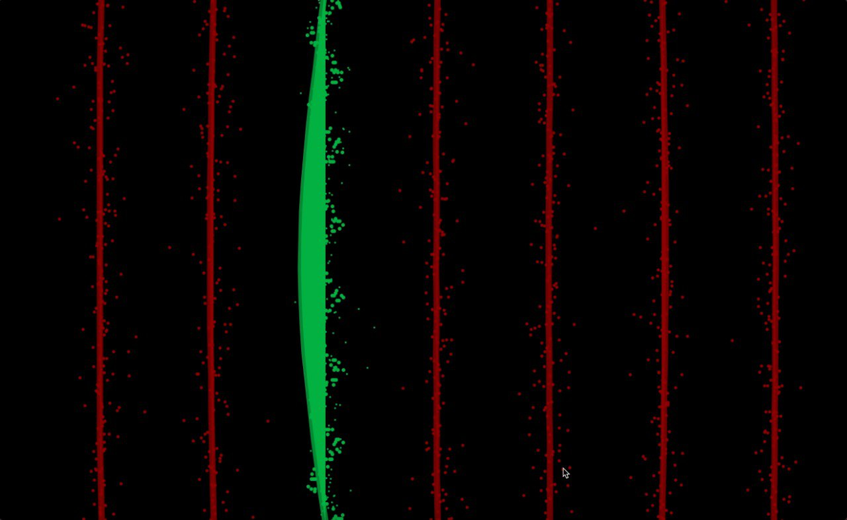
Processing
Vibration of the strings simulated and projected onto the harp to make them visible.
Pitch modulation causes the color of the strings to change.
Tremolo modulation causes the size of the dots orbiting around the strings to change.

Slide 6
Results
The final product is a system in which the hardware, the sound synthesis and the visual feedback interact with each other in a functional and smooth way

