Slide 1

Titolo presentazione sottotitolo
Distortion: DISTORCOLOR
Computer Music Languages and Systems - Assignment 5
Milano, XX mese 20XX
Group ID: NaN

Slide 2
Problem Description and objectives
Challenges:
Define the qualitative characteristics of distorted sound
Develop a plug-in that outputs a distorted signal according to certain parameters
Define a processing method for the acquisition of a sound signal
Implement a graphical interface
PROBLEM
It has to sound as valve amplifier distortion

Slide 3
Approach
PRE - WORK
Comprehensive understanding of the distortion effect and its identity.
WAVESHAPING
Trade-off (sound complexity / computational cost)
Various processing functions.
GUI
Inspired by the retro sound obtained.

Slide 4
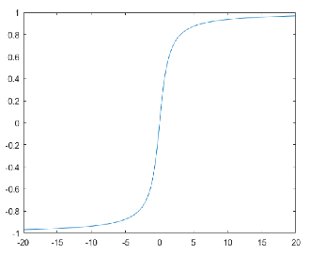
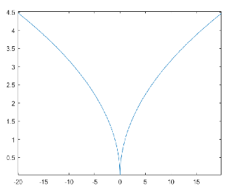
Implementation
SOFT-CLIP
Arctg function used
Odd function
More natural sounding distortion
HARD-CLIP
Sqrt function used
Even function
Fuzzy type of distortion

Slide 5
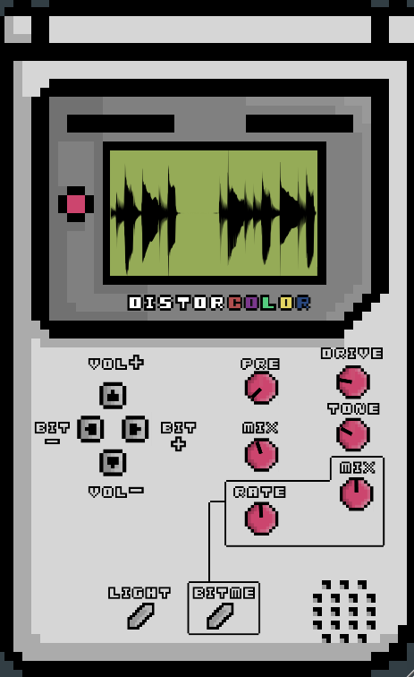
Implementation (BitCrusher)
Bitcrusher is a low-resolution digital distortion effect;
It allows to emulate the sound of early digital audio devices;
It includes both the bit reduction and the sample rate reduction;
The dynamic range of the signal decreases when the bitrate is reduced
Bitme button (Rate and mix), bit+ and bit- buttons;
Bit+/Bit- buttons
BITME button

Slide 6
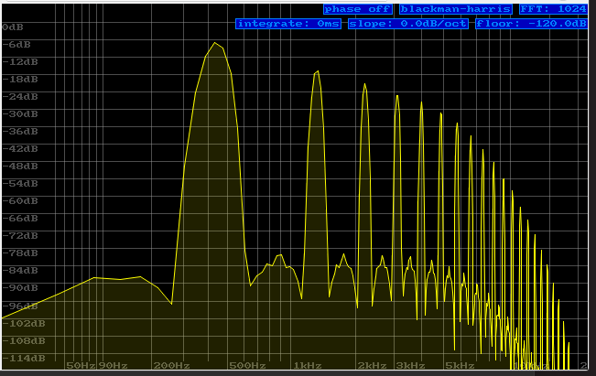
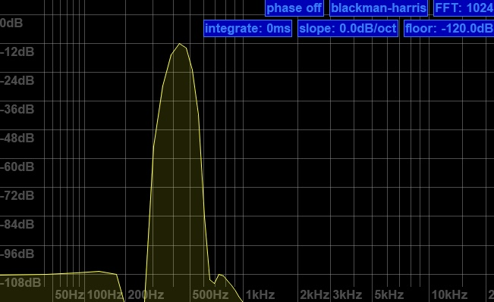
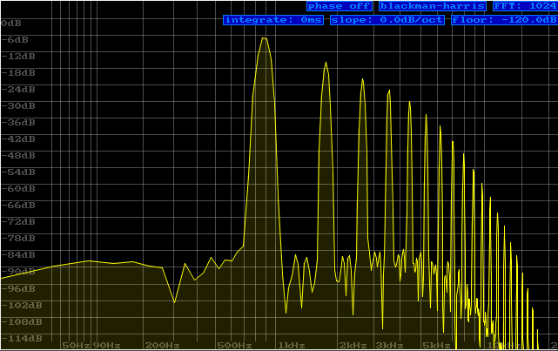
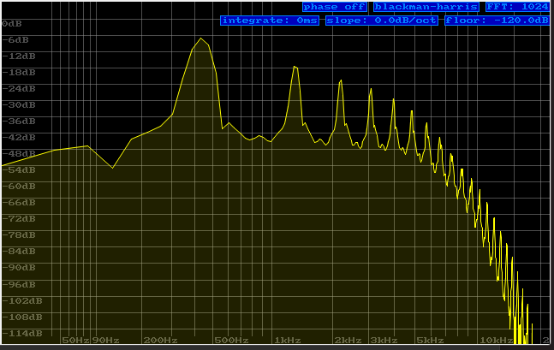
Results
Hard distortion
Light distortion
Input signal
Light+Bitcrusher

